Slide 1


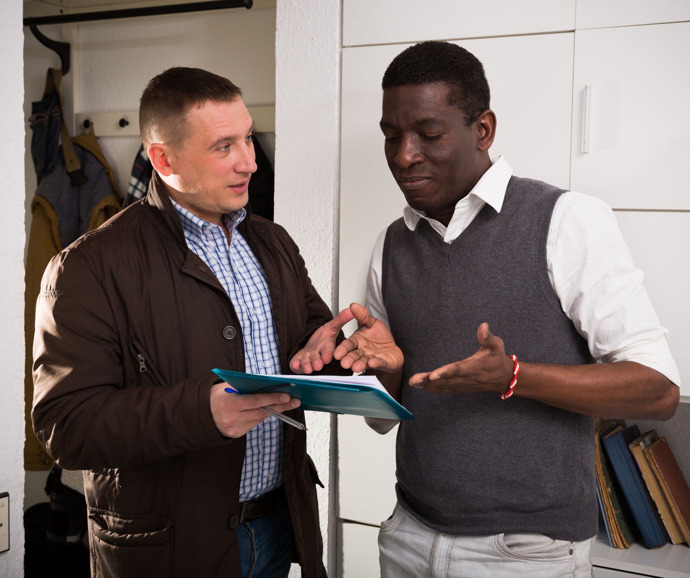




An introduction to R in NISRA
Coffee and Coding
Trusted statistics and research for a better society

Slide 2

Housekeeping
Toilets
90 minute session
10 minute comfort break
Tea/Coffee/Water

Slide 3
Overview of sessions
This introductory set of sessions is delivered in 2 parts (A and B)
It is assumed you have attended Part A when attending Part B
If you missed Part A, it is advised that you wait until the next month for a spot on that session, before booking into Part B
Outside of the above, this is a course designed for absolute beginners in R
In Part A we cover:
Data Types
Data Structures
R Packages
Data Processing
In Part B we cover:
Data Summarisation
Else/if & Case when logic
Dataset joins
Pivoting data
Charts

Slide 4
Name
Work area
Experience with R

Slide 5
Why R?
Free and Open Source
Large support community
Highly flexible and extensible
NISRA direction is to use R as a default – consistency across agency and cost savings
Not just a pure statistics software
Everything you would expect from a stats package
Great chart and mapping options
Digital document creation (HTML/PDF etc.)
Analysis that is transparent, easy to share and with high levels of reproducibility

Slide 6
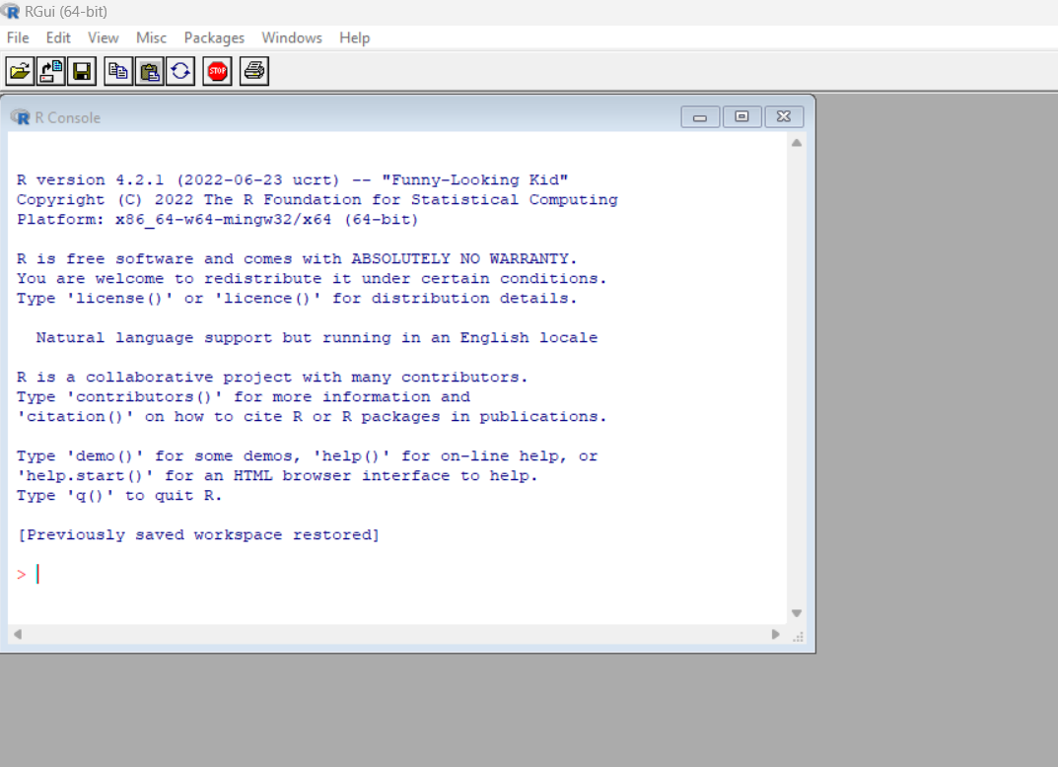
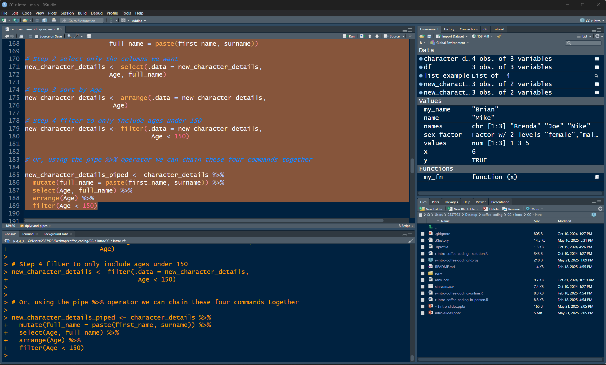
R vs R Studio
R is a software with different versions available e.g. v4.2.1, v4.4.0
Rstudio is a development environment (IDE) that is made for R
RGui (Standard R)
RStudio

Slide 7
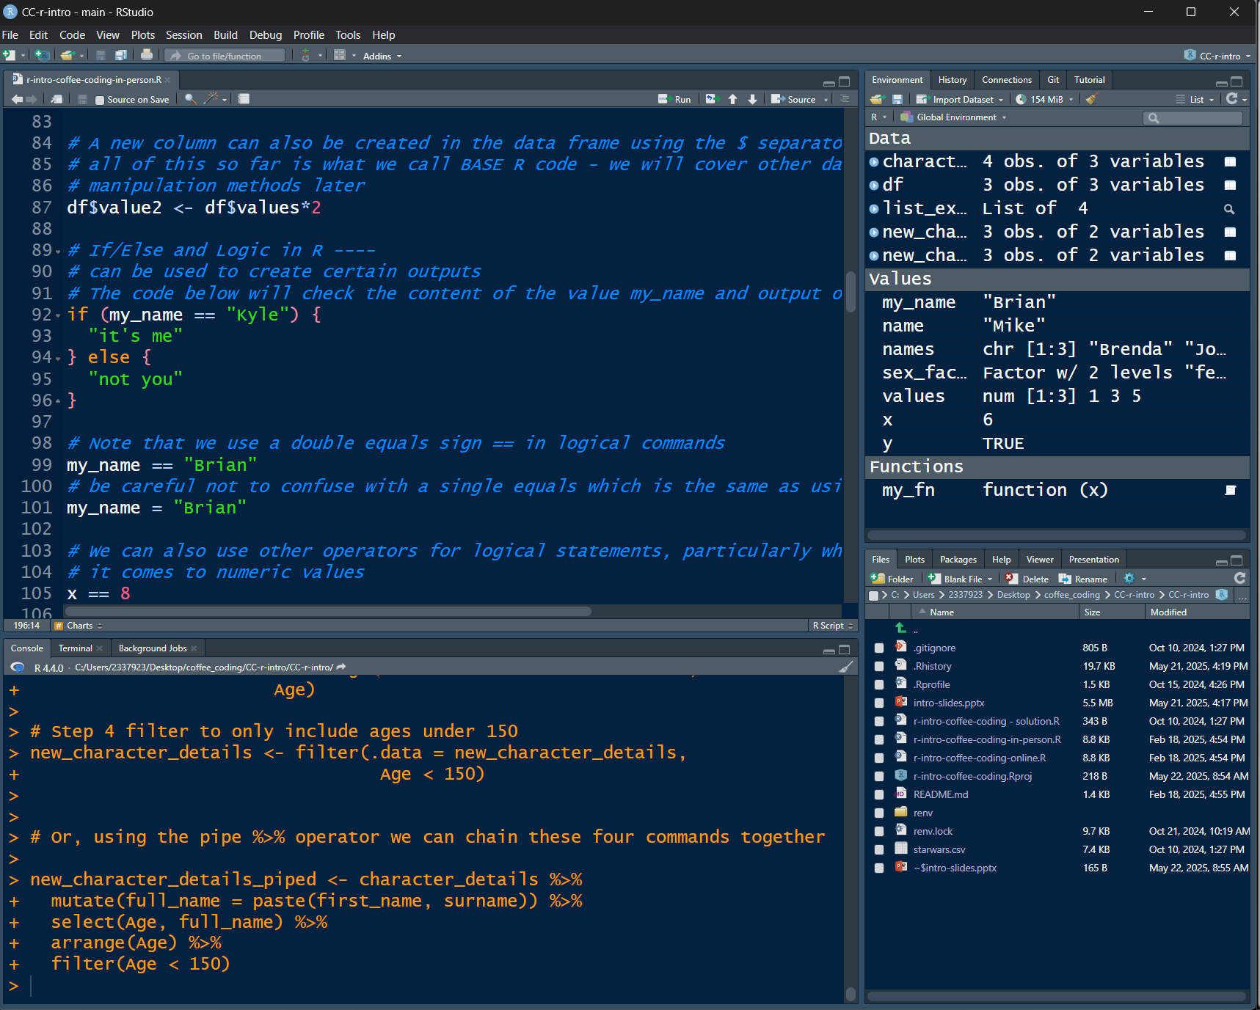
R Studio Overview
Scripting Pane
Console

Slide 8
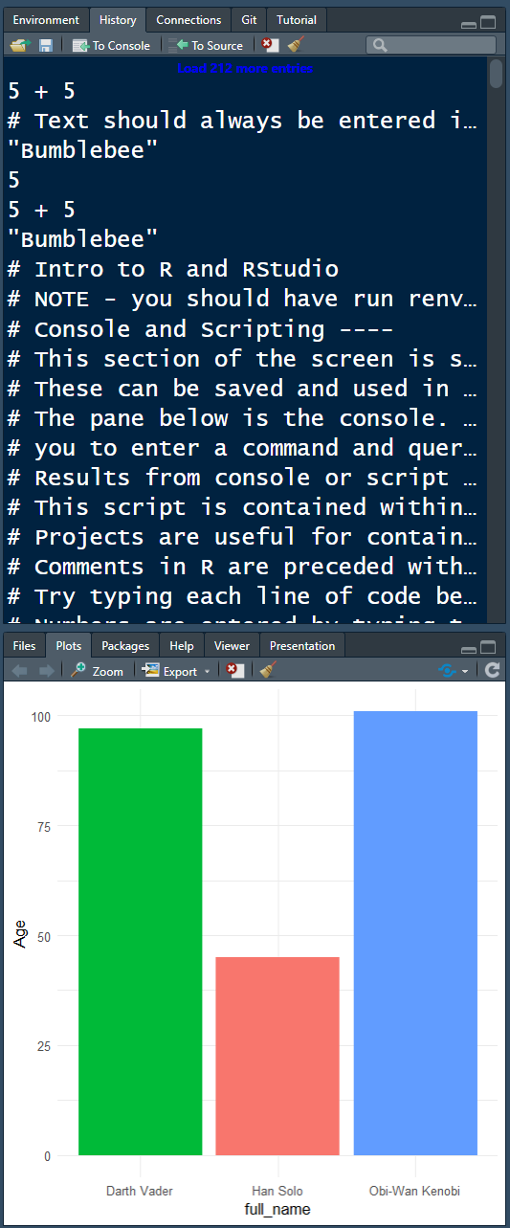
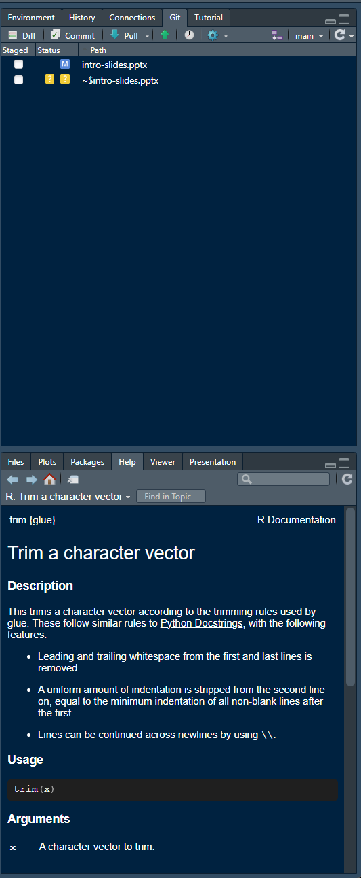
R Studio Overview 2
History
Git integration
Plots/Viewer
R Help

Slide 9
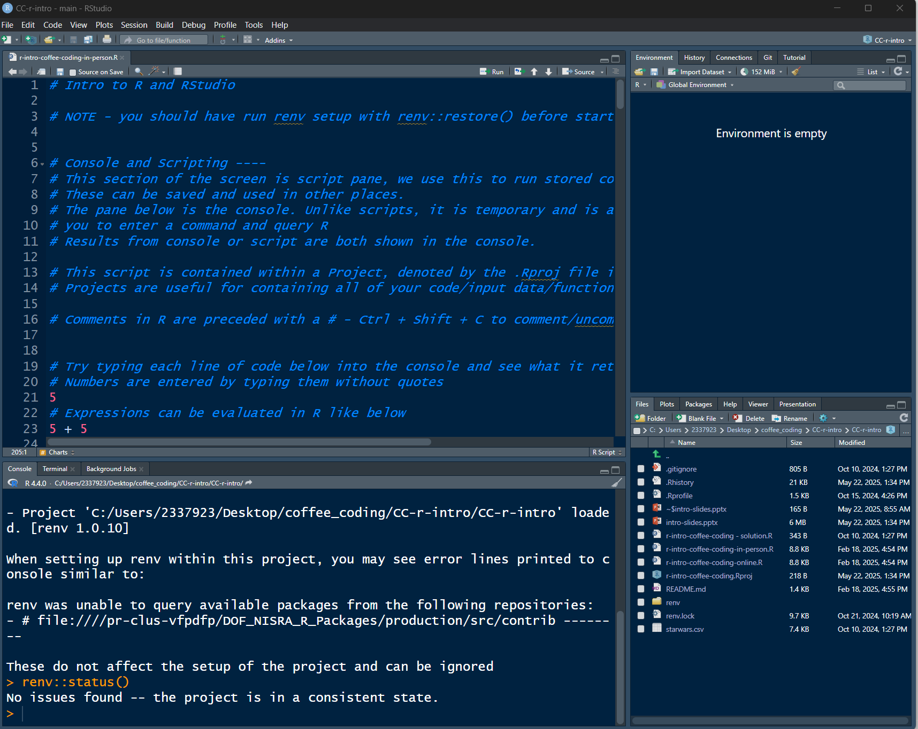
Workshop
Open ‘r-intro-coffee-coding.Rproj’ from downloaded and unzipped folder
You will know you are in the correct project if you see CC-r-intro in the very top right
Check the project package status by going to the Console and typing “renv::status()” and hitting Enter. You should see the message “No issues found -- the project is in a consistent state.”
If an alternative message presents asking you to install packages, instead type “renv::restore()” and hit Enter. Enter “Y” when prompted. Once complete you can try “renv::status()” again.
Once that is complete, open “r-intro-coffee-coding-session-a.R” from the Files tab. Your screen should look similar to what is on screen.

Slide 10
Future Developments
Online Training Links on TM-DOF-NISRATEAM - Staff Training
RAP Pages on TM-DOF-NISRATEAM – RAP
RAP Training Pathways
There are a selection of previous Coffee and Coding session recordings available on TM-DOF-NISRATEAM - TechLab
Development of Tidyverse understanding
Use of Rmarkdown/Quarto to create HTML outputs
Tech Lab RAP Skeleton
Tech Lab RAP Skeleton Lite
Coffee and Coding sessions on Intro to RMarkdown in NISRA, RAP Skeleton and RAP Skeleton Lite are available
Git and Github for code versioning – coffee and coding sessions available
R forum – contact BSDB for access (Kim Jordan or Laura McIlwee)

Slide 11
Feedback
Short 2 question survey – all feedback welcome to help improve this course
https://dttselfserve.nidirect.gov.uk/NISRA/rateit#/Coffee_and_Coding_sessions

