Slide 1

NEXT-GENERATION PLATFORM
BioSync
Smart Automation & Analytics Platform
BIOSYNC is a purpose-built institutional automation platform that bridges the gap between biometric device data and actionable administrative intelligence.
Built for the real-world demands of educational institutions, BIOSYNC handles everything from raw data ingestion to structured reporting, automated communication, and cloud-backed archival — all without manual intervention.
Notes:
1

Slide 2
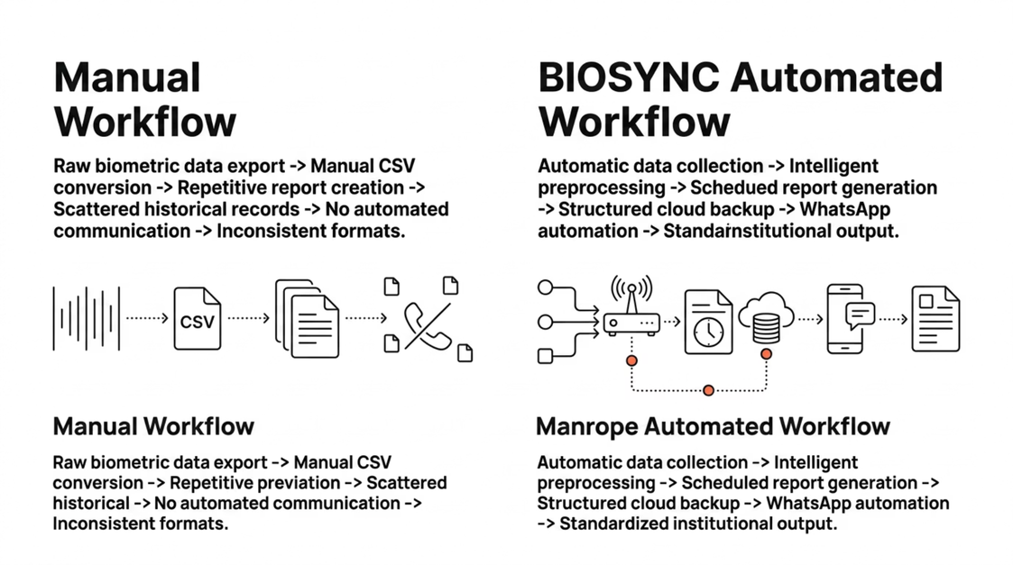
THE PROBLEM
The Institutional Attendance Gap
Across educational institutions, attendance management remains one of the most operationally expensive and manually intensive workflows. Biometric devices capture data reliably — but that data rarely translates directly into usable administrative output. The gap between a biometric log and a decision-ready report is filled with repetitive manual effort, inconsistent processes, and institutional risk.
Manual Attendance Workflow
Intelligent Automated Workflow
Raw logs exported manually from biometric device
Faculty spend hours converting CSV data into structured formats
Daily, weekly, and monthly reports created from scratch each cycle
Historical data scattered across files, emails, and local drives
No automated alerts or stakeholder communication
Inconsistent reporting formats across departments
High risk of human error in data transcription
Administrative decisions made without timely attendance intelligence
BIOSYNC automatically collects and preprocesses biometric device data
Attendance computed, validated, and structured without manual effort
Reports generated on schedule — daily, weekly, or on demand
Historical data preserved in organized, searchable backup systems
Automated WhatsApp delivery to the right stakeholders
Standardized, consistent reporting across all departments
Built-in deduplication and data normalization
Real-time dashboards and cloud-synced records for instant access
Notes:
2

Slide 3
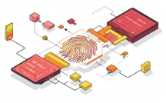
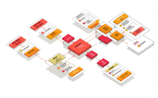
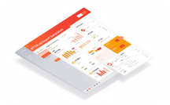
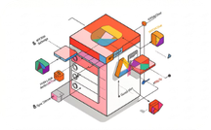
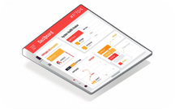

THE SOLUTION
BIOSYNC: An End-to-End Institutional Automation Platform
BIOSYNC is not a feature add-on or a reporting plugin. It is a complete operational pipeline — purpose-engineered to handle every stage of institutional attendance management, from the moment a biometric device records a fingerprint to the moment a structured report reaches the right stakeholder's WhatsApp. Every module is integrated, every data handoff is automated, and every output is institution-ready.
Biometric Data Collection
Intelligent Preprocessing
Structured Report Generation
BIOSYNC connects directly to biometric devices and automatically retrieves attendance logs — eliminating manual export cycles and ensuring no data is missed between collection windows.
Raw logs are cleaned, deduplicated, and normalized automatically. Dates are standardized, anomalies are flagged, and only validated records proceed to attendance computation.
Department-wise, class-wise, student-wise, and date-range reports are generated automatically on schedule or on demand — in consistent, professional formats ready for distribution.
Cloud Sync & Archival
Monitoring & Resilience
Automated Communication
All processed data is backed up locally and synchronized to Google Drive, ensuring institutional records are preserved, organized, and retrievable for audits and reviews.
BIOSYNC operates unattended with built-in watchdog monitoring, crash recovery, network interruption handling, and session continuity designed for real world institutional stability.
Reports are delivered automatically via WhatsApp to the appropriate faculty groups, administrators, or parents — with intelligent message formatting and duplicate suppression.
Notes:
3

Slide 4
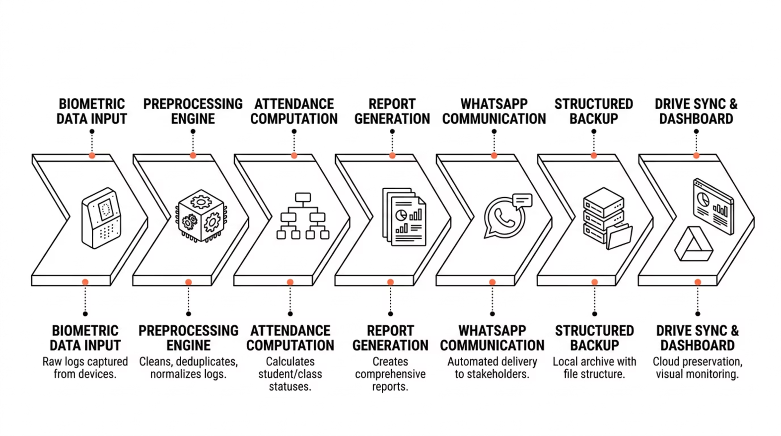
END-TO-END WORKFLOW
From Biometric Device to Institutional Output
Automated Data Flow
BIOSYNC polls the biometric device at configured intervals, retrieves new attendance records, and immediately begins the preprocessing cycle. There is no waiting for a staff member to export a CSV file — data moves from device to processed output entirely through the platform's automated pipeline.
BIOSYNC's operational pipeline is designed as a seamless, automated flow — from the moment a biometric device captures an attendance event to the moment a structured report is delivered to stakeholders and archived in the cloud. Every step is handled programmatically, with no manual handoffs required during normal operation. The diagram below illustrates the complete data journey through the platform.
Each stage in the pipeline has built-in validation. If data fails a check — for example, a malformed timestamp or a duplicate entry it is flagged and handled according to configured rules, ensuring that only clean, reliable records reach the reporting layer.
Output Delivery
Once reports are generated, BIOSYNC automatically routes them through the communication layer. WhatsApp messages are formatted, addressed to the correct group or contact, and sent without manual intervention. Simultaneously, every report and its underlying data are backed up locally and synchronized to Google Drive for long-term institutional preservation.
The entire pipeline — from data capture to cloud sync — operates on schedule or on trigger, making BIOSYNC suitable for unattended, production-grade institutional deployment.
Notes:
4

Slide 5
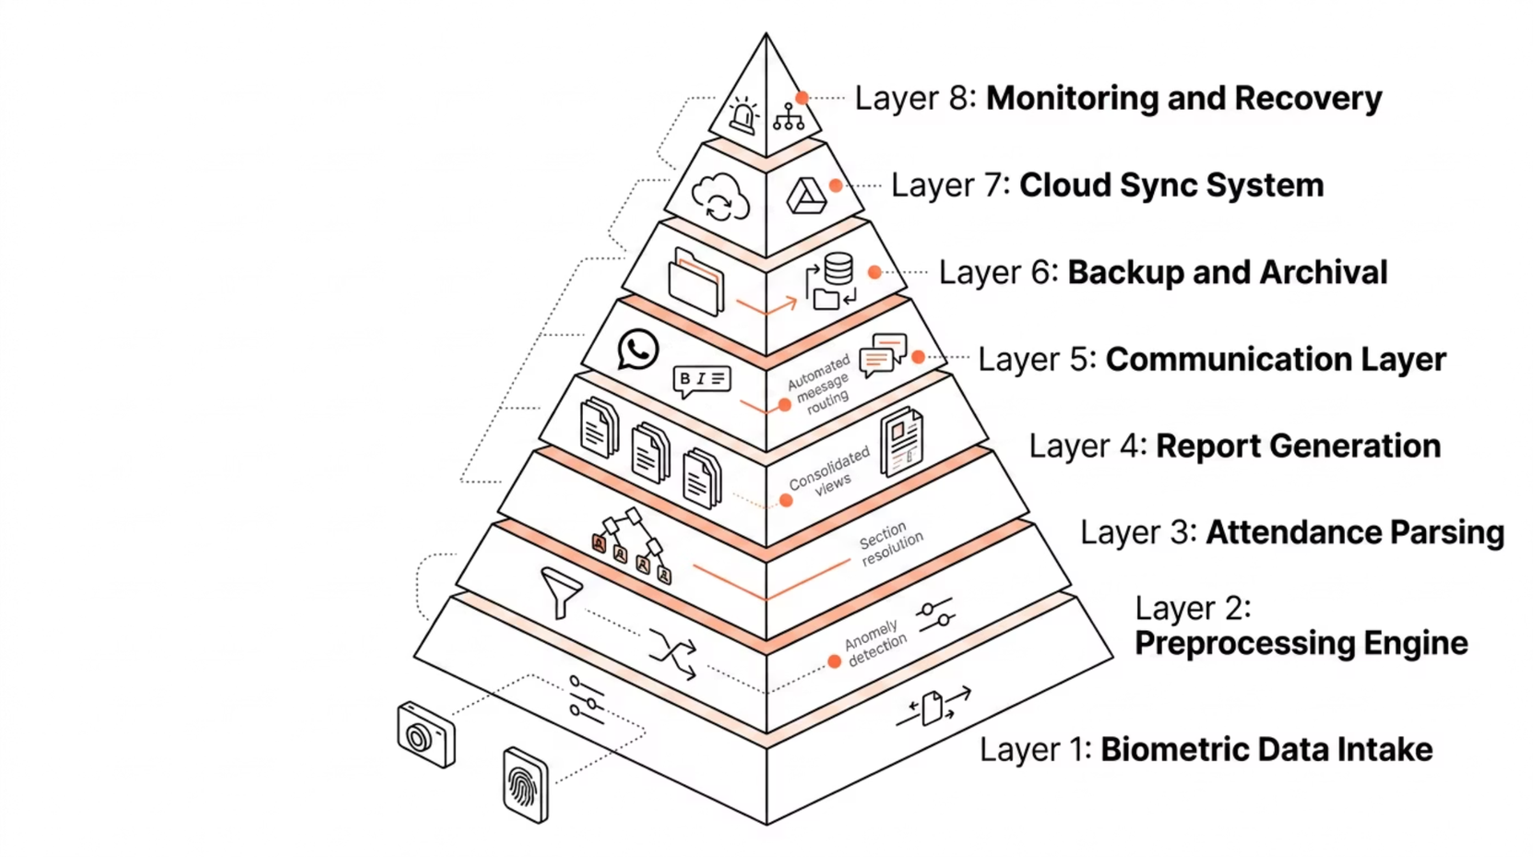
SYSTEM ARCHITECTURE
BIOSYNC Platform Architecture
Modularity & Maintainability
BIOSYNC is engineered as a modular, layered platform — each component has a clearly defined responsibility, communicates through structured interfaces, and can be maintained or extended independently. This architecture ensures that the platform remains stable under load, resilient to failures, and adaptable to evolving institutional requirements. The diagram below presents the full system architecture with all integrated modules and their relationships.
Each architectural layer operates as an independent module with a well-defined interface. The preprocessing engine does not depend on the communication layer the report generator does not depend on cloud sync. This separation means that individual modules can be updated, debugged, or replaced without affecting the stability of the entire platform — a critical requirement for institutions that cannot afford system-wide downtime during maintenance.
Reliability by Design
The monitoring and recovery subsystem sits as a supervisory layer across all other modules. It continuously checks the health of each component, detects stalls or crashes, and initiates recovery procedures automatically. Combined with the backup and archival system, this ensures that BIOSYNC can operate unattended for extended periods while maintaining data integrity and operational continuity — even in the event of network interruptions or unexpected system behavior.
Notes:
5

Slide 6
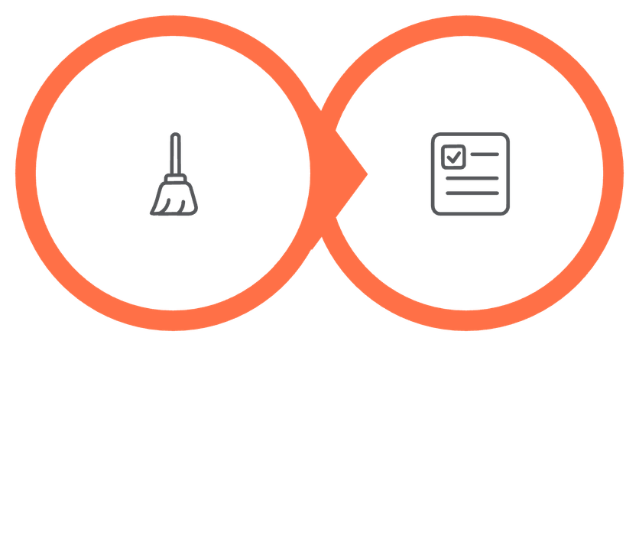
DATA INTELLIGENCE
The Intelligence Layer: From Raw Data to Report-Ready Records
The true value of BIOSYNC lies not in collecting biometric data, but in transforming it. Raw attendance logs from a biometric device are often inconsistent duplicate entries, malformed timestamps, missing department mappings, and unnormalized date formats are common. BIOSYNC's two-stage intelligence layer addresses this directly, converting unreliable raw input into structured, validated, analysis-ready institutional records.
Preprocessing
Attendance
Notes:
6

Slide 7
REPORTING ENGINE
Reporting Depth: Far Beyond Basic Attendance
BIOSYNC's reporting engine is one of its most powerful differentiators. Where most attendance tools produce a single flat export, BIOSYNC generates a comprehensive library of structured reports — covering every dimension an institution needs for administration, auditing, parent communication, and strategic planning. Reports are generated automatically on schedule or on demand, in consistent professional formats.
Department-Wise Reports
Complete attendance summaries for each academic department — including total students, present counts, absence rates, and department level trends across any date range.
Class & Section Reports
Granular attendance breakdowns by class and section, enabling faculty and coordinators to identify patterns at the group level without
manual data filtering.
Individual Student Reports
Full attendance history for any single student — including daily status, monthly percentages, and trend indicators — useful for counseling, parent meetings, and academic review.
Daily, Weekly & Monthly Reports
Scheduled reports generated automatically for each time period — delivered to stakeholders without manual triggering, ensuring consistent institutional visibility.
Custom Date-Range Reports
On-demand reports for any arbitrary date range — essential for audits, attendance verification requests, and administrative reviews outside standard reporting cycles.
Historical Retrieval Reports
Access to preserved attendance records from previous terms and academic years — surfaced efficiently from structured backups for longitudinal analysis and compliance.
All report types can be generated automatically on schedule or triggered manually through the dashboard. Reports are formatted consistently and delivered through the WhatsApp communication layer or accessed directly via the monitoring interface.
Notes:
7

Slide 8

HISTORICAL ANALYSIS
Range Reporting & Historical Attendance Intelligence
Historical Data Preservation
One of BIOSYNC's most practically valuable capabilities is its ability to retrieve, analyze, and report on attendance data across any custom date range — including historical periods that extend well beyond the current academic term. This is not a simple data dump; it is structured, meaningful institutional intelligence that supports audits, student reviews, trend analysis, and administrative evaluation.
BIOSYNC does not overwrite or discard historical attendance data. Every processed record is preserved in structured local backups with organized file naming and folder hierarchies. These backups are then synchronized to Google Drive, creating a redundant, cloud-backed archive that is both secure and efficiently retrievable.
When a historical report is requested, BIOSYNC surfaces the relevant data from backup storage, recomputes aggregated metrics if required, and delivers a report with the same professional formatting as a current-period report. There is no degradation in quality or completeness for historical outputs.
Specify Range
Recompute Attendance
Admin sets custom date range
Recalculate and validate records
Custom Date-Range Retrieval
This capability is particularly valuable for:
BIOSYNC allows administrators to specify any start and end date and instantly generate a complete attendance report for that period. The system queries its structured backup archives, recomputes attendance percentages if needed, and produces a formatted output — whether the range covers a single week or an entire academic year.
Query Archives
Audit compliance — producing verified attendance records for regulatory or accreditation reviews
Student attendance verification — responding to parent or student queries with precise, documented data
Trend analysis — identifying attendance patterns across semesters to inform institutional policy
Administrative evaluation — comparing department-level attendance performance over time
Deliver Report
BIOSYNC searches local backups
Formatted report sent to stakeholder
Notes:
8

Slide 9
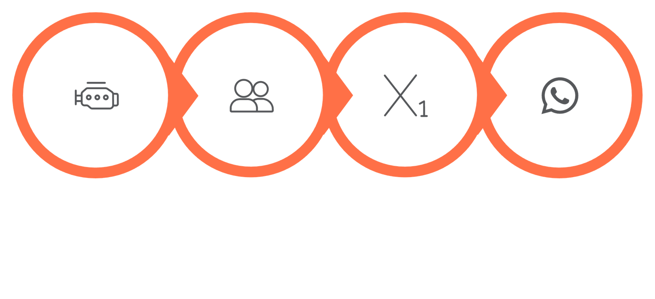
COMMUNICATION LAYER
WhatsApp Automation: Bridging Backend Intelligence and Institutional Communication
BIOSYNC's WhatsApp automation engine transforms attendance intelligence into real-time institutional communication. Rather than requiring staff to manually copy, format, and send reports, BIOSYNC automatically generates structured messages, selects the appropriate recipient group or contact, and delivers attendance outputs through WhatsApp — the communication channel most widely used across educational institutions.
Report Generated
Target Selected
Message Optimized
Delivered via WhatsApp
Notes:
9

Slide 10
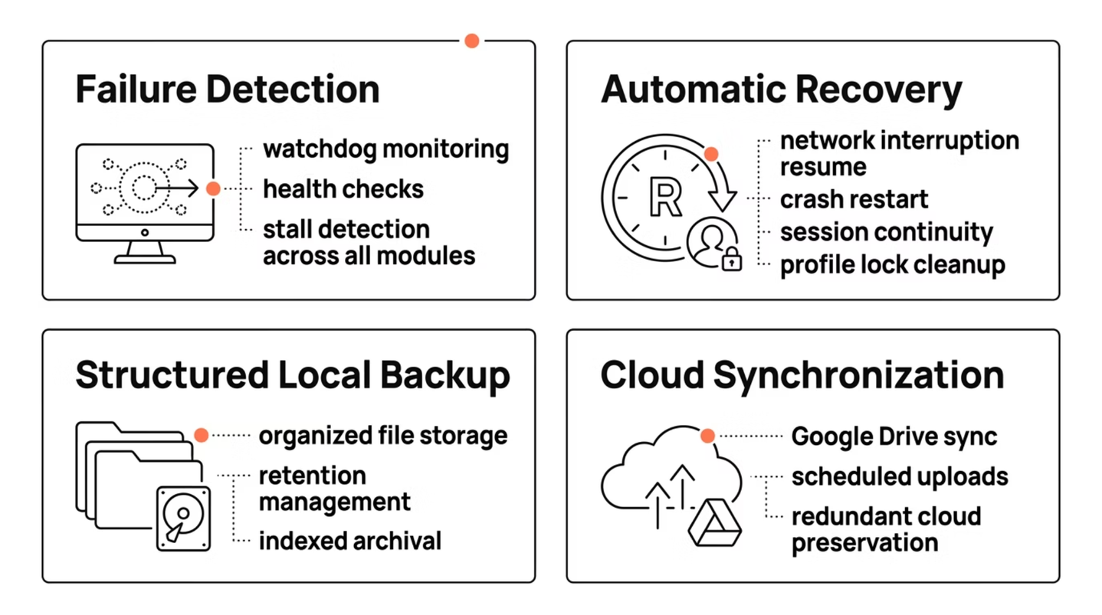
OPERATIONAL RELIABILITY
Resilience Features
Built for Unattended Operation: Resilience, Backup & Cloud Sync
Watchdog Monitoring: Continuous health checks across all platform modules
Crash Handling: Automatic restart and state recovery after unexpected termination
Network Recovery: Resume-after-downtime behavior when connectivity is restored
Scheduled Restart Logic: Periodic self-restart to clear accumulated state and maintain stability
Session Continuity: Preserves operation state across restart cycles
Profile Lock Cleanup: Automatically resolves locked biometric device sessions
BIOSYNC is engineered not only to automate attendance workflows, but to operate reliably over extended periods without manual supervision. Educational institutions cannot depend on a system that requires constant monitoring BIOSYNC is built with a comprehensive resilience layer that handles network interruptions, unexpected crashes, session conflicts, and downtime recovery automatically.
Backup & Cloud Sync
BIOSYNC maintains structured local backups of all processed attendance data, organized by date, department, and report type. These backups are indexed and retrievable, ensuring that historical data can be surfaced efficiently for audits or administrative reviews.
Simultaneously, BIOSYNC synchronizes all backup data to Google Drive on a configured schedule. This creates a redundant, cloud-backed archive that protects institutional records against local hardware failure. The Google Drive folder structure mirrors the local backup organization, making cloud retrieval straightforward for authorized administrators.
Together, the resilience layer and the backup system ensure that BIOSYNC operates as a dependable institutional utility — not a tool that requires daily attention, but a platform that works silently and consistently in the background.
BIOSYNC is designed not only to automate attendance — but to operate reliably over time, without manual intervention, in real-world institutional environments.
Notes:
10

Slide 11
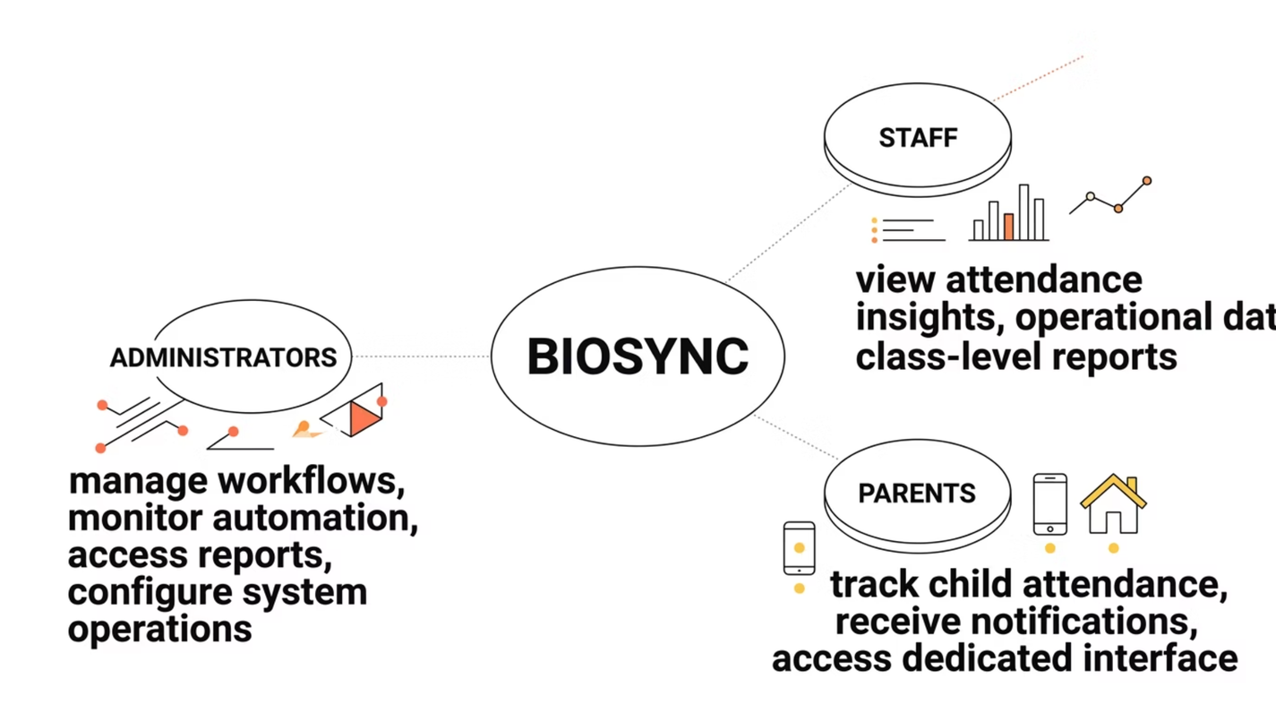
UNIFIED ACCESS LAYER
The BIOSYNC Dashboard Ecosystem
BIOSYNC's centralized dashboard environment provides role-based access for administrators, staff, and parents — increasing visibility, transparency, and control across the institution.
Administrator Access
Full system oversight — manage workflows, monitor automation, configure operations, and access institutional reports from a single command center.
Staff & Faculty Access
Targeted attendance insights and operational data for day-to-day academic management — class-level reports, anomaly flags, and workflow status.
Parent Access
Dedicated interface for tracking their child's attendance, receiving automated notifications, and maintaining awareness of academic participation.
Notes:
11

Slide 12
ENGINEERING ARCHITECTURE
The Technical Foundation of BIOSYNC
BIOSYNC combines file processing, attendance intelligence, browser automation, report generation, dashboard interaction, and synchronization logic into one cohesive engineering system — built for reliability, scalability, and institutional-grade performance.
Core Technology Stack
System Capability Layers
Python
Pandas & OpenPyXL
Data Ingestion
Attendance Intelligence
Core language powering all automation logic, data processing, and system integration.
Advanced data manipulation and Excel-based report generation with precision formatting.
Raw biometric device data is ingested, validated, and preprocessed automatically.
Business rules and logic transform raw timestamps into meaningful attendance records.
Selenium
FastAPI & Google Drive API
Report Generation
Dashboard Sync
Browser automation for seamless dashboard interaction and data synchronization.
Structured reports are produced with institutional formatting and historical context.
Processed data is synchronized to stakeholder dashboards via automated workflows.
RESTful API layer and cloud storage integration for real-time data exchange.
JSON Configuration & Threaded Workers
Flexible system configuration and parallel processing for high-throughput automation.
Notes:
12

Slide 13
INSTITUTIONAL VALUE
Measurable Impact Across Every Stakeholder
BIOSYNC creates structural operational improvements across the institution — reducing manual workload, accelerating report generation, minimizing errors, and strengthening attendance visibility for every stakeholder group.
Before BIOSYNC
After BIOSYNC
Manual Data Entry
Automated Processing
Instant Reports
Staff manually compile attendance from raw device logs — a time-consuming, error-prone process.
Biometric device data flows automatically through intelligent preprocessing and report generation.
Structured reports generated in minutes with historical context and formatting.
Delayed Reporting
Reports take hours or days to produce, limiting timely decision-making.
Unified Communication
Automated notifications and parent dashboards create seamless institutional communication.
Fragmented Communication
No automated alerts or parent-facing visibility into attendance patterns.
Administrators
Faculty & Staff
Full operational control with automated workflows, system monitoring, and institutional reporting.
Real-time attendance insights and class-level data without manual compilation.
Parents
Institutional Workflow
Dedicated interface for tracking their child's attendance and receiving automated notifications.
Structured access and automated processes that strengthen the entire operational framework.
Notes:
13

Slide 14
FUTURE ROADMAP
Scalability & the Future of BIOSYNC
BIOSYNC is a scalable platform with a strong roadmap — designed to grow alongside institutional needs, expand in capability, and integrate with the broader educational technology ecosystem.
Phase 1 — Access Control
1
Role-based access control with granular permissions for administrators, staff, and parents.
2
Phase 2 — Automated Attendance Alerts
Enable intelligent alerts for low attendance, repeated absences, and threshold-based
Phase 3 — ERP Integration
3
Integration with ERP and student information systems for unified institutional data management.
4
Phase 4 — AI Prediction
AI-driven attendance trend prediction and early warning systems for proactive intervention.
Phase 5 — Mobile Application
5
Role-based mobile access for attendance tracking, alerts, and reports.
Platform Philosophy
Key Growth Vectors
BIOSYNC is not a fixed, one-time project. It is a living platform architected to evolve, expand, and adapt as institutional requirements grow in complexity and scale.
Multi-campus deployment — scalable architecture supporting distributed institutional networks
API-first design — seamless integration with third-party educational platforms
Configurable intelligence — attendance rules and thresholds tailored per institution
Cloud-native readiness — infrastructure prepared for enterprise-grade cloud hosting
Notes:
14

Slide 15
SUMMARY & CLOSING
BIOSYNC — An Institution-Ready Automation Platform
BIOSYNC is not merely an attendance project. It is a smart institutional automation platform that combines biometric attendance integration, data preprocessing, attendance intelligence, advanced reporting, historical analysis, communication automation, dashboard-based stakeholder access, backup reliability, and scalable architecture.
Biometric Integration
Intelligent Processing
Direct integration with biometric devices for automated, tamper-proof attendance capture.
Data preprocessing and attendance intelligence transform raw timestamps into meaningful records.
Advanced Reporting
Stakeholder Dashboards
Structured reports with historical context, generated automatically with institutional formatting.
Role-based access for administrators, staff, and parents — unified visibility across the institution.
Backup Reliability
Scalable Architecture
Redundant data systems and automated backups ensure institutional records are always protected.
Built to grow — from single-campus deployment to multi-institution enterprise networks.
"BIOSYNC transforms attendance from a routine record into an intelligent, accessible, and institution-ready operational system."
Thank You !!!
We appreciate your time and attention.
BIOSYNC is ready to redefine how your institution manages attendance with precision, automation, and institutional intelligence.
Notes:
15

