Slide 1
CAPGEMINI AGENTAI BUILDATHON · ROUND 1
Automated Knowledge Base Agent
AI-powered knowledge discovery from scattered documents — transforming organizational knowledge into trusted, searchable, and structured answers.
Team: SuperVerse · Niswanth T · NareshKumar J · NithishSarwin M · VictorVengatesh M · Bharath B
Roles: Agent Architect · Backend & RAG Developer · UI/UX Developer · Evaluation & Compliance Lead
Niswanth T– B.E Artificial Intelligence and Machine Learning, 3rd Year
NareshKumar J – B.E Artificial Intelligence and Machine Learning, 3rd Year
NithishSarwin M– B.E Artificial Intelligence and Machine Learning, 3rd Year
VictorVengatesh M – B.E Artificial Intelligence and Machine Learning, 3rd Year
Bharath B– B.E Artificial Intelligence and Machine Learning, 3rd Year

Slide 2
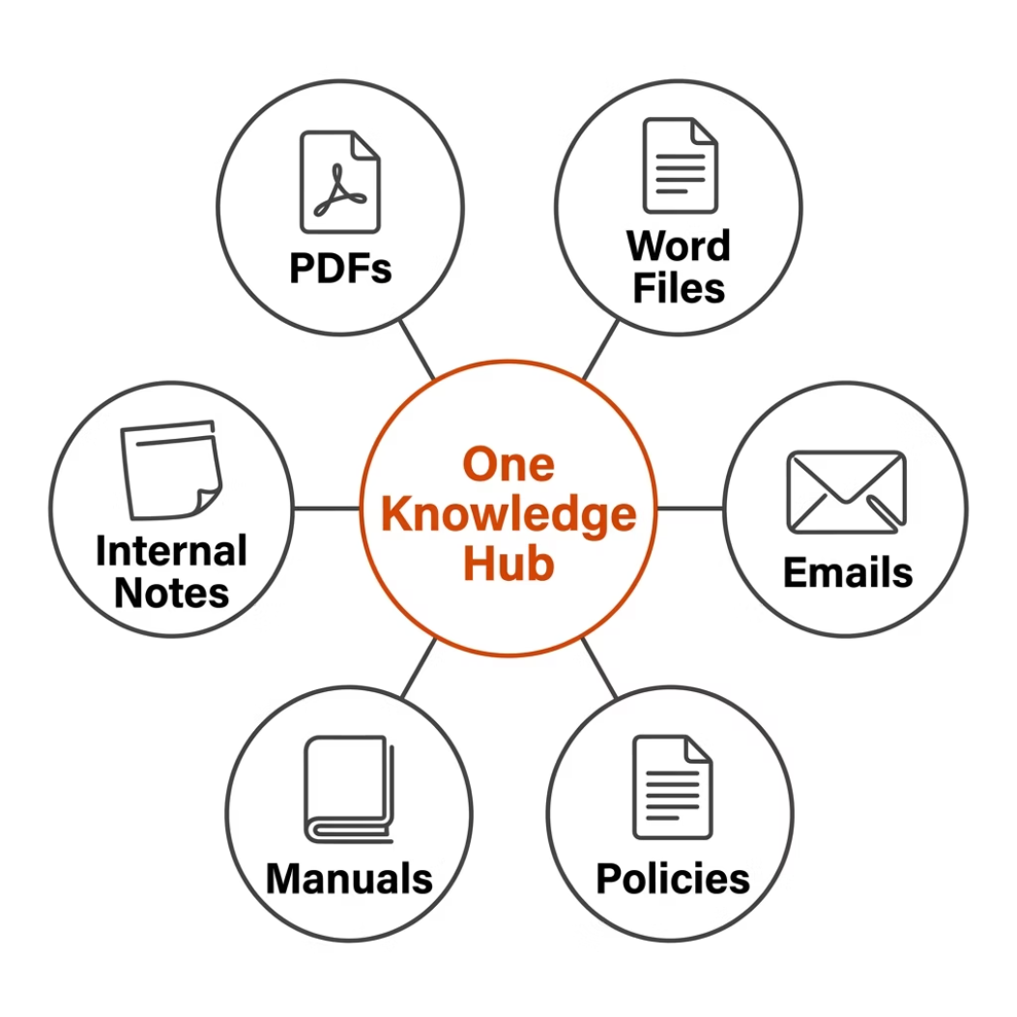


BUSINESS CHALLENGE
The Knowledge Chaos Problem
Organizations store knowledge across PDFs, Word files, policies, manuals, and emails. Employees repeatedly ask the same questions because information is hard to find, outdated, or unstructured.
Scattered Documents
Repeated Questions
Time Lost Searching
Knowledge buried across teams and folders
Same queries asked again and again
Hours wasted finding basic answers
Inconsistent Responses
Hard to Maintain
Outdated or conflicting information
No process for updating new documents
Business Impact: Lower productivity, slower onboarding, support overload, and reduced trust in internal knowledge systems.

Slide 3
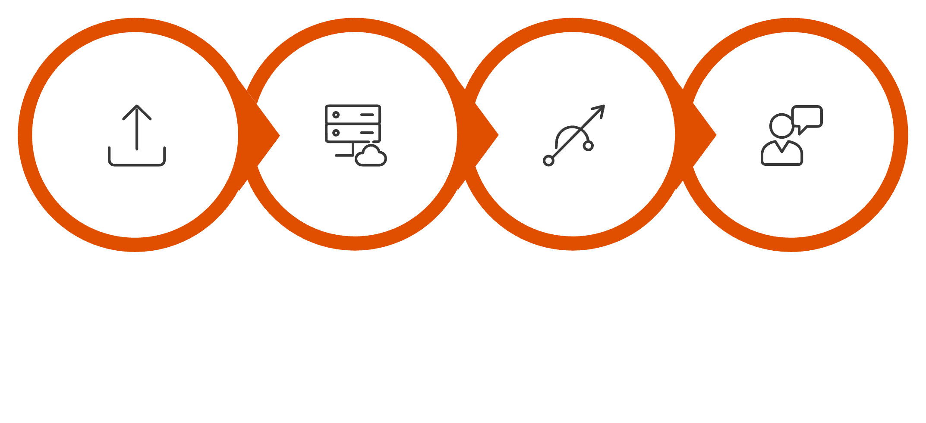
PROPOSED SOLUTION
AI Knowledge Base Agent
An automated agent that ingests documents, extracts key information, and delivers structured FAQs, auto-tags, summaries, and grounded answers with citations.
Ingest
Process
Store
Deliver
From raw documents to structured, citable knowledge — in a single automated pipeline.
Core Capabilities
Tech Stack
Multi-format ingestion: PDF, DOCX, TXT
Chunking, embeddings & vector search
Auto-generated FAQs & taxonomy tags
RAG-based Q&A with citations
Admin workflow for new documents
LLM: Azure OpenAI / OpenAI
Backend: Python FastAPI
RAG: FAISS / Chroma vector store
UI: Streamlit / React
Observability: Logging + OpenTelemetry

Slide 4

INNOVATION STORY
From Static Documents to Living Knowledge
This is not just a chatbot — it's a self-maintaining knowledge system that continuously converts new documents into structured, trusted, and searchable assets.
Generate & Improve
Create initial outputs and iteratively refine for quality.
Ask & Retrieve
Inquire and gather relevant information from data sources.
A closed-loop system where every answer is grounded, every document is indexed, and every update flows automatically into the knowledge base.
What Makes It Different
Example in Action
Grounded answers with exact document references
Automatic FAQ & taxonomy generation
Semantic search beyond keywords
Confidence scoring to reduce hallucination
Human review workflow for low-confidence answers
Maintenance pipeline for new or updated documents
User asks: "What is the leave approval process?"
Agent returns:
Direct answer
Exact source quote
Document reference
Related FAQ links

Slide 5
EXECUTION PLAN
Build Plan & Success Metrics
Phase 1
Phase 3
Phase 5
Ingest sample documents & parse content
Build RAG Q&A agent with citations
Add UI, evaluation tests & logging
Phase 2
Phase 4
Phase 6
Generate embeddings & store in vector DB
Generate FAQs, tags & summaries
Maintenance workflow for new documents
Success Metrics
"Our solution turns organizational documents into a living, trusted, and searchable knowledge base that saves time, improves consistency, and scales with the business."
Information extraction accuracy
Quality of generated FAQs & tags
Citation correctness
Search relevance score
Response latency
Ease of adding new documents

