Slide 1
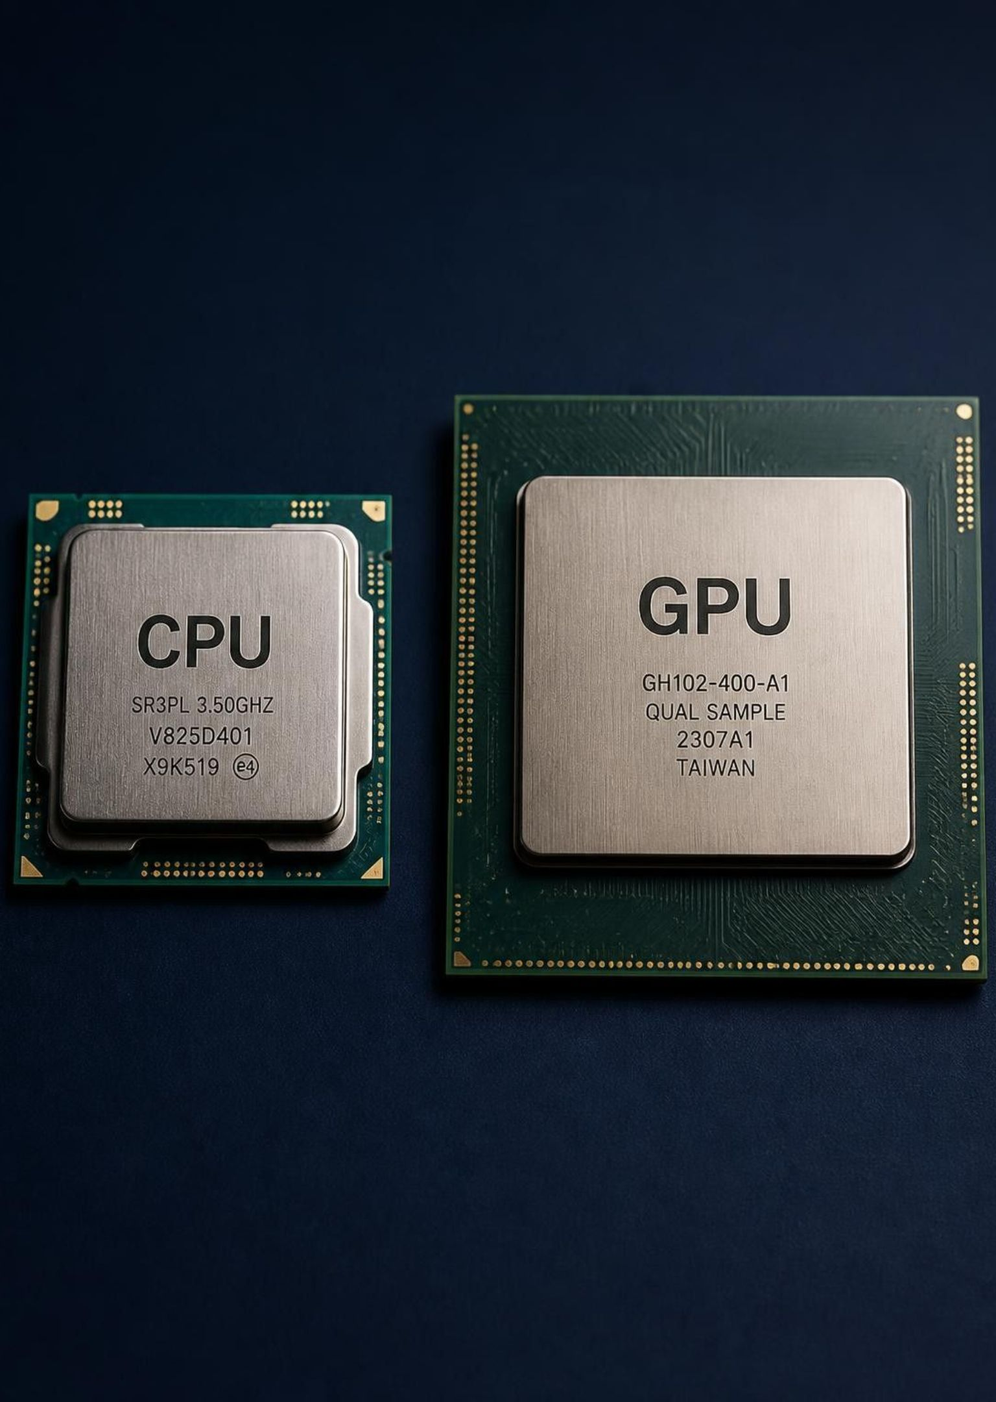

Faculty of Computing
University of Sri Jayewardenepura
Conway's Game of Life: CPU vs GPU
Sequential CPU vs. Parallel CUDA GPU Implementation
CCS3032 - High-Performance Computing
B.Comp (Hons.) in Computer Science
Y.R. Nisal Sanjaya | Index - FC221050 | Reg – FC116340
M.D.S.H.Edirisinghe | Index - FC221012 | Reg - FC115262

Slide 2
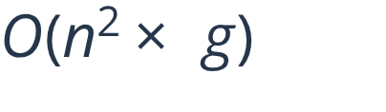
01 · Problem & objectives
Every cell updates from its 8 neighbours in each generation
Compare one-thread CPU execution with one-thread-per-cell CUDA execution
2048 × 2048 grid × 100 generations = work
Keep the seed, density, rules, and final state identical
2

Slide 3
02 · Experimental setup
Grid: 2048 × 2048 = 4,194,304 cells
Initial state: about 30% alive = 1,259,237 cells
CPU: Intel Xeon @ 2.00 GHz · 4 logical CPUs · 1 thread
GPU: Tesla T4 · compute capability 7.5 · 40 multiprocessors · CUDA 12.8
1 warm-up run, then 5 timed runs; mean and range
3

Slide 4
03 · CPU implementation
C with 2D arrays · gcc -O2 -falign-loops=64 · noinline step function, restrict pointers
01
02
03
Two buffers are swapped after each generation
Wrap-around neighbours preserve the toroidal grid
Nested loops update one cell after another
Execution model: sequential · one thread · no device transfer
4

Slide 5
03 · CPU implementation
C with 2D arrays · gcc -O2 -falign-loops=64 · noinline step function, restrict pointers
01
02
03
Two buffers are swapped after each generation
Wrap-around neighbours preserve the toroidal grid
Nested loops update one cell after another
Execution model: sequential · one thread · no device transfer
5

Slide 6
03 · CPU implementation
C with 2D arrays · gcc -O2 -falign-loops=64 · noinline step function, restrict pointers
01
02
03
Two buffers are swapped after each generation
Wrap-around neighbours preserve the toroidal grid
Nested loops update one cell after another
Execution model: sequential · one thread · no device transfer
6

Slide 7
04 · CUDA implementation
One GPU thread per cell
Naive kernel reads global memory; tiled kernel stages an 18 × 18 tile in shared memory
16 × 16 blocks = 256 threads; 128 × 128 blocks
4,194,304 threads cover the full grid
The grid stays on the GPU for all 100 generations
7

Slide 8
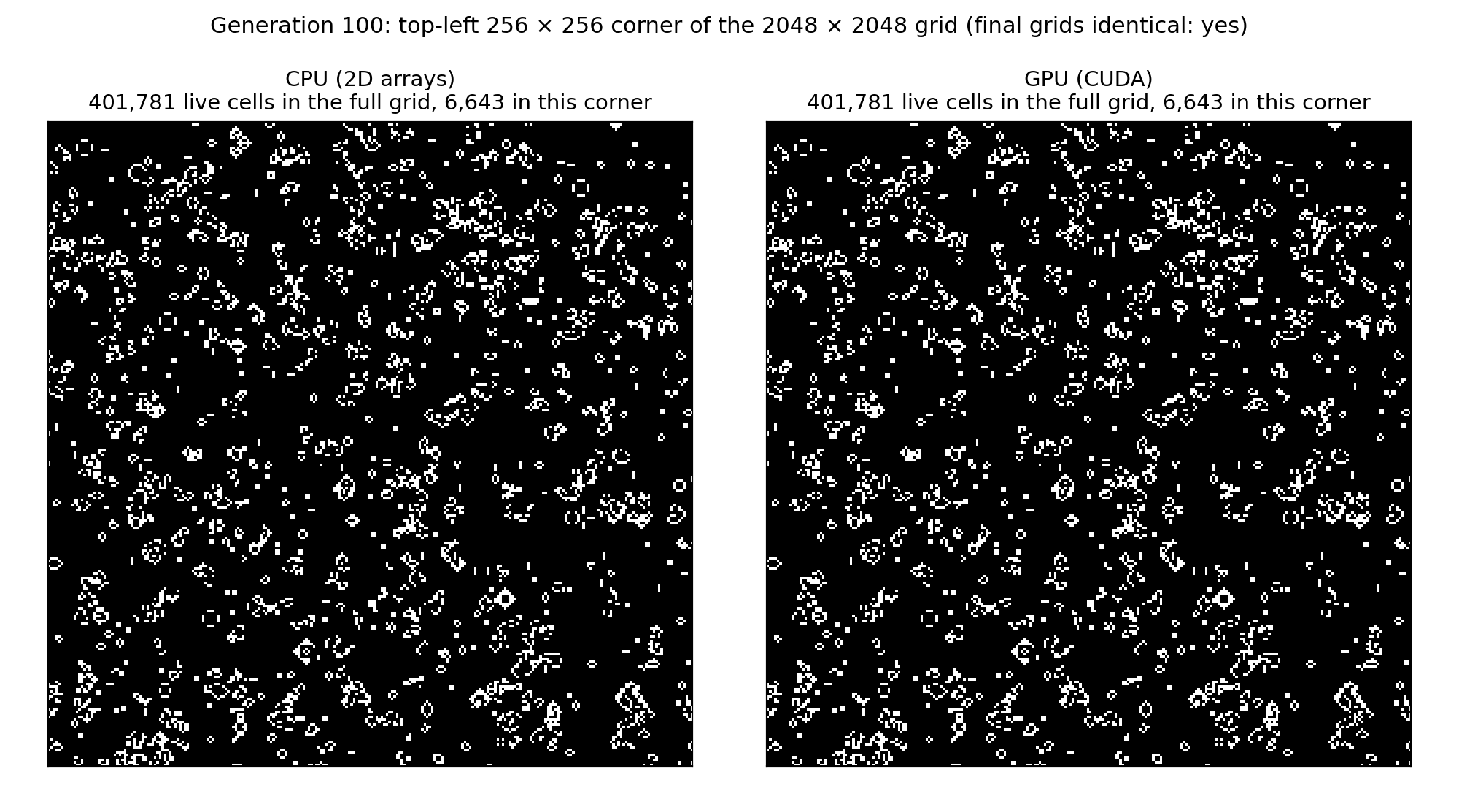
05 · Correctness first
401,781 live cells after 100 generations on both
0 cells differ
Identical SHA-256 hash
51 of 51 animation frames identical byte for byte
Same simulation. Different execution model.
8

Slide 9
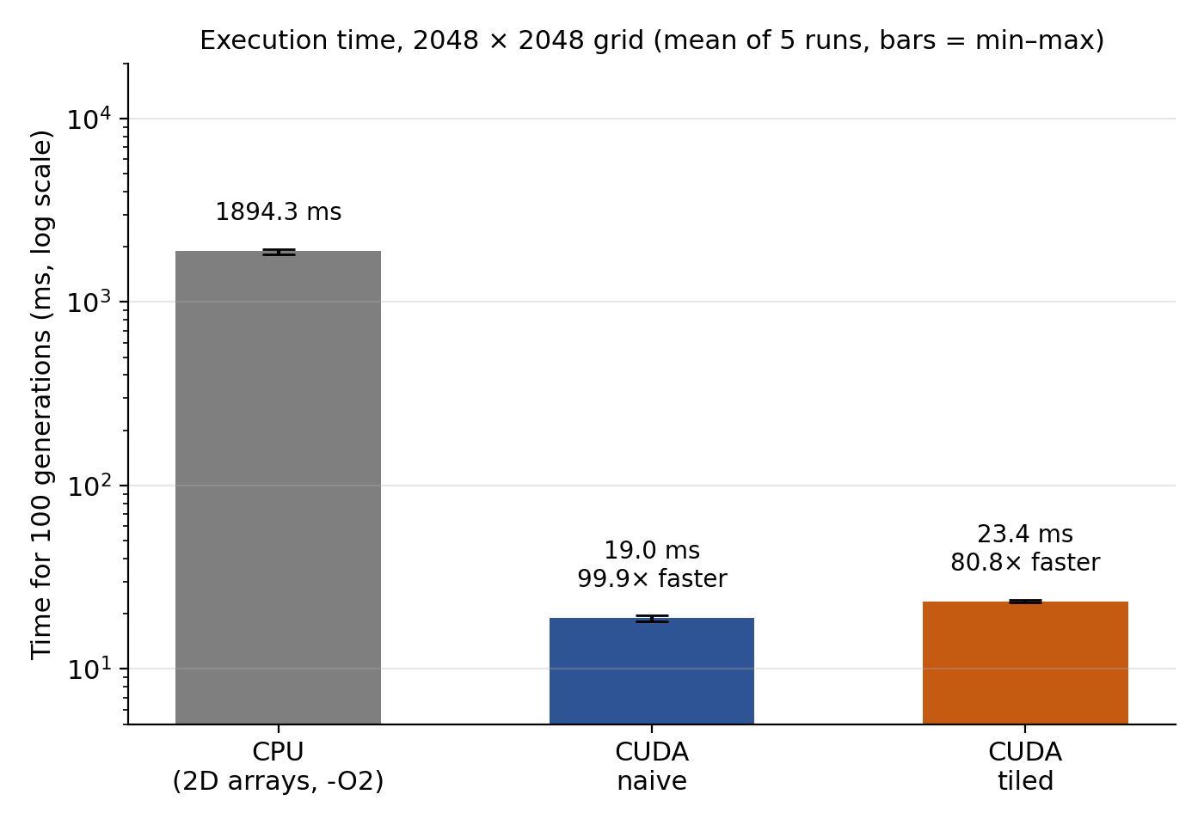
06 · The result: 99.9× faster on the kernel
99.9× kernel speedup ·
80.1× including copies
Version | Kernel (ms) | Total (ms) | Speedup
CPU | 1894.3 | 1894.3 | 1.0×
CUDA naive | 18.971 | 23.642 | 99.9× / 80.1×
CUDA tiled | 23.437 | 28.155 | 80.8× / 67.3×
Kernel = the 100 kernel launches only. Total = kernel + copy to GPU + copy back. Mean of 5 timed runs after 1 warm-up (CPU range 1826.6-1940.0 ms).
9

Slide 10
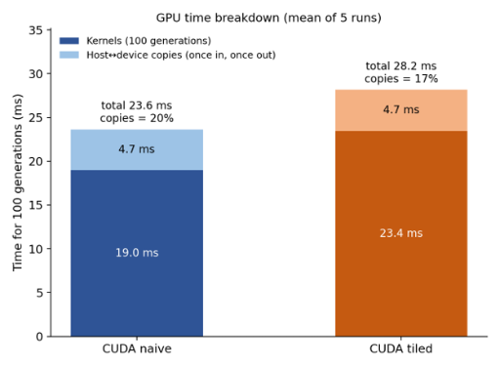
07 · Where the GPU time goes
Copying to and from the GPU takes about 4.7 ms
Copies are 20% of naive total time and 17% of tiled total time
They are paid once for all 100 generations
Keeping the grid on the GPU avoids copying every generation
10

Slide 11
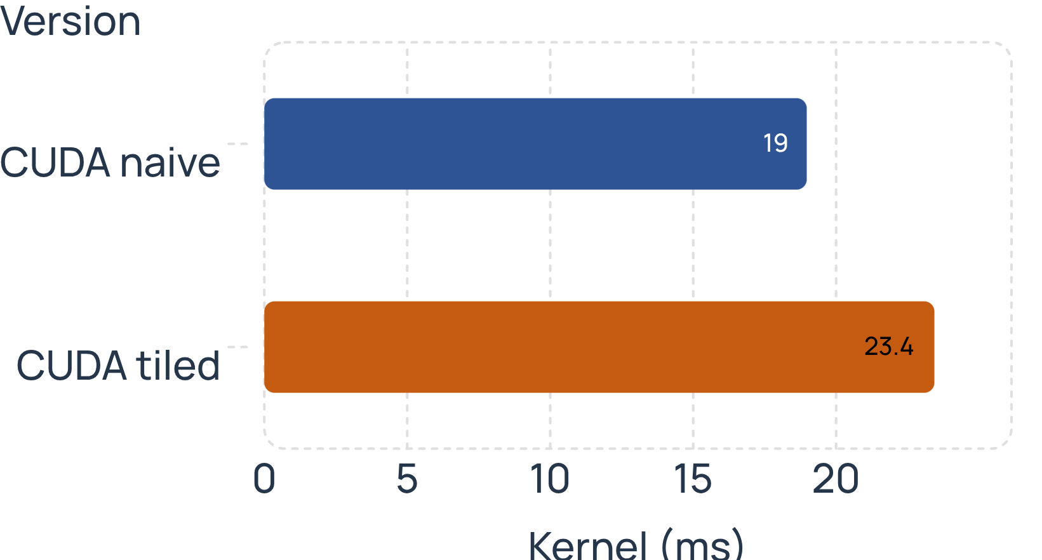
08 · The optimisation surprise
Tiled kernel: 23.437 ms · naive kernel: 18.971 ms
Tiling is 23.5% slower on average, and slower in all 5 runs (22% to 26% per run)
Likely reason: the T4's L1/L2 caches already serve most repeated neighbour reads
Halo loading (integer division and modulo), a synchronisation barrier, and extra shared-memory accesses add overhead
Always measure an optimisation
11

Slide 12
09 · Why only 14% of peak bandwidth?
≈ 839 MB
≈ 44 GB/s
≈ 14%
moved over 100 generations
(minimum: 1 read + 1 write of the 8.4 MB grid per generation)
effective on the naive kernel
(46 GB/s in the fastest run)
of the T4’s ≈ 320 GB/s peak
(manufacturer figure)
Not memory-bandwidth bound. Each thread does 9 one-byte loads, a store and index arithmetic, so instructions per cell are the likelier limit. This is why bit-packing is the next step.
12

Slide 13
10 · CPU vs GPU: technical comparison
CPU | GPU
Execution model: Sequential, one thread, nested loops | Execution model: Data-parallel SIMT, one thread per cell
Parallelism: None | Parallelism: 4,194,304 threads in 16,384 blocks, warps of 32
Memory: Registers + L1/L2/L3 caches, automatic | Memory: Registers, programmer-managed shared memory, L1/L2, global memory
Data layout: 2D array cur[r][c] | Data layout: Flat 1D array in[r*N + c]
Memory access: Sequential along rows, prefetcher helps | Memory access: Coalesced across a warp
Synchronisation: None needed | Synchronisation: Block barrier in tiled kernel; kernel launch between generations
Data movement: None | Data movement: One copy in, one copy out, buffers swapped on device
Development effort: Low, easy to debug | Development effort: Higher: kernels, memory management, error checks
Portability: Any CPU + C compiler | Portability: Needs NVIDIA GPU + CUDA toolkit
13

Slide 14
11 · Conclusion & next steps
Thread-per-cell parallelism, coalesced reads and device-resident data explain the gain
Naive kernel reaches only about 14% of peak bandwidth, so the next gains are likely to come from fewer instructions per cell
Naive CUDA: about 100× kernel speedup and 80× end to end
Shared-memory tiling did not help on this T4
Limits: single-threaded CPU baseline; one Kaggle session
Next: bit-packing, multi-threaded CPU baseline, larger grids
14

