Slide 1

PREDICTING SHARED BIKE RENTALS
Project By:
Nitansh Gupta
NXG180004

Slide 2
Index
Abstract
Approach
About Data
Data Distribution and Box plots
Time Trends
Seasonal trends
Model Results
Conclusion

Slide 3
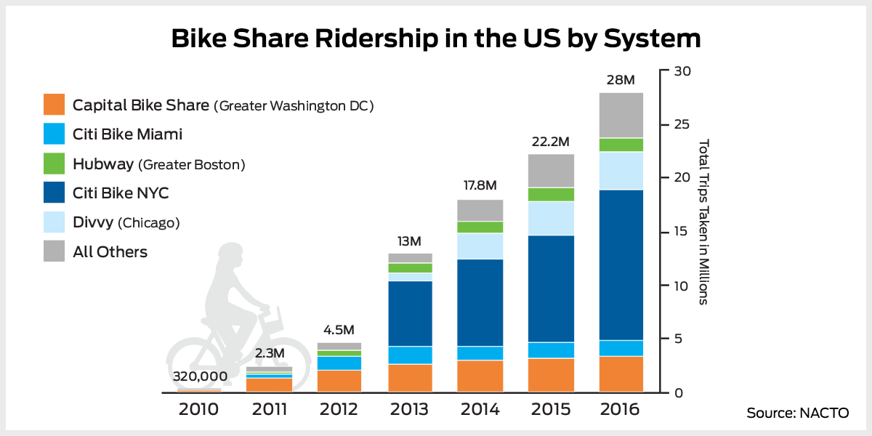
Abstract
Climate change and pollution has been very big concern all over the globe. While the list of factors causing
this change is huge, ever increasing presence of motor vehicles has persisted as one of the major demonic
source of the air pollution. While electric vehicles are pitch for a lucrative potential solution, their reach and
and quality is still not at par. Within the list of high potential solutions, Bike Sharing has appeared as one of the
most successful alternative, having shown success in many parts of the world already. While even the less
developed nations across Asia, and Europe have implemented the bike sharing model with much established
infrastructure, US still has a lot more potential untapped.
This could be because of many basic reasons like availability, ease-of-use, quality of bikes and related services,
mindset of the populace, promotional activities etc. Being at a nascent stage, these variables affecting the
adoption of bike sharing ecosystem can not be quantified. So if one wants to enquire and predict the use of the
shared bikes, macro factors, like weather and event types could be used most effectively to initiate this
developmental phase.
Bike share is growing at an astounding clip across the U.S., with over 88 million trips made on a bike share bike in the U.S. since 2010. In 2016 alone, riders took over 28 million trips

Slide 4
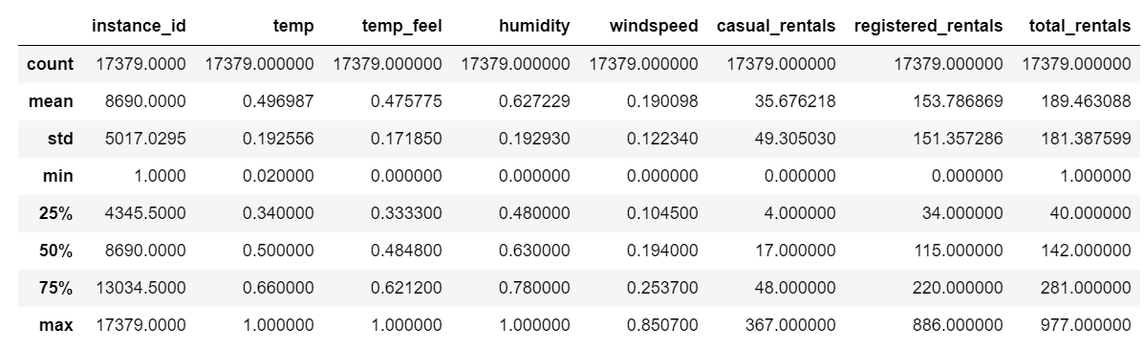
Approach
We got the data of 2 years of shared bike rentals through rentals company named CAPITAL BIKESHARE, which is metro DC’s bikeshare service, with 4,300 bikes and 500+ station across 7 jurisdictions. The bikes renters are of two types: Registered – renters who have taken periodic rental subscriptions and hence have more re-occurring use. Casual renters on the other hand are the once a while users who rent out on one time payment basis. These casual and registered rentals are mapped against the macro factors like temperature, humidity, windspeed , working-day/holiday(flags) etc. We not only looked at the trends but also evaluated various supervised learning models to predict each kind of rentals. In the process, we executed data cleaning, EDA, feature engineering, model execution and evaluation.
About Data
Source: https://archive.ics.uci.edu/ml/datasets/Bike+Sharing+Dataset
Contributor: Capital BikeShare, Washington DC
Shape: 17,389 x 17
Hourly rentals for the metro DC area over span of two years
The Temperature, Humidity,and Windspeed are provided after normalization
Index
Categorical Variables
1: Clear, Few clouds, Partly cloudy, Partly cloudy
2: Mist + Cloudy, Mist + Broken clouds, Mist + Few clouds, Mist
3: Light Snow, Light Rain + Thunderstorm + Scattered clouds, Light Rain + Scattered clouds
4: Heavy Rain + Ice Pallets + Thunderstorm + Mist, Snow + Fog
Instance_id
season
Weather
rental_date
Is_holiday
Target Variable
weather_condition
Total_rentals
month
year
Continuous Variables
hour
temp
is_workingday
temp_feel
weekday
humidity
1:winter
2:spring
3:summer
4:fall
windspeed
season
casual_rental
registered_rentals

Slide 5
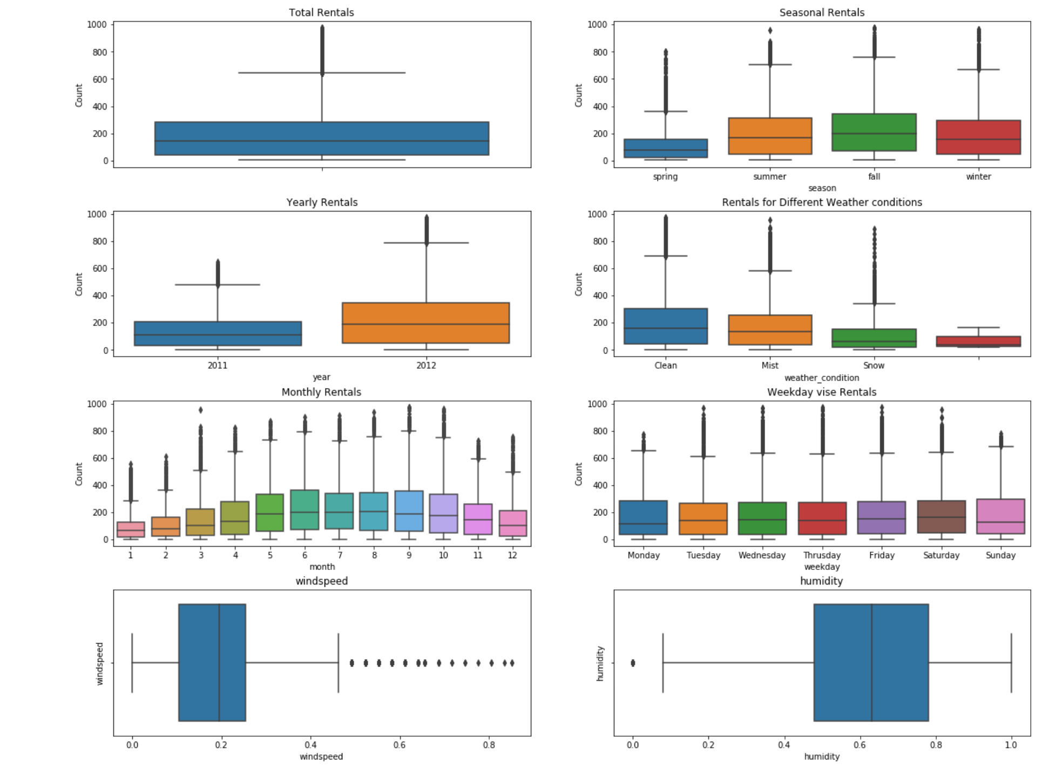
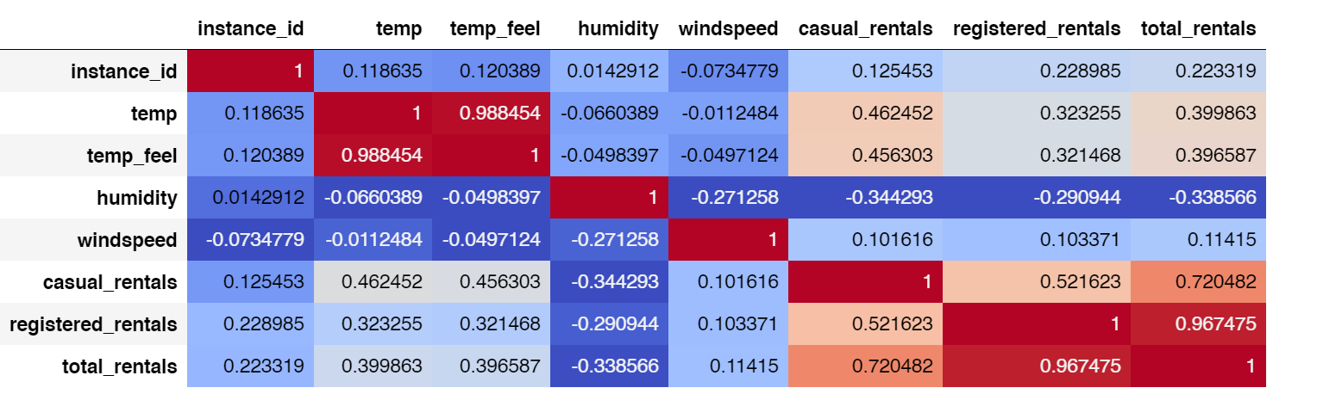
Data Distribution
Correlations

Slide 6
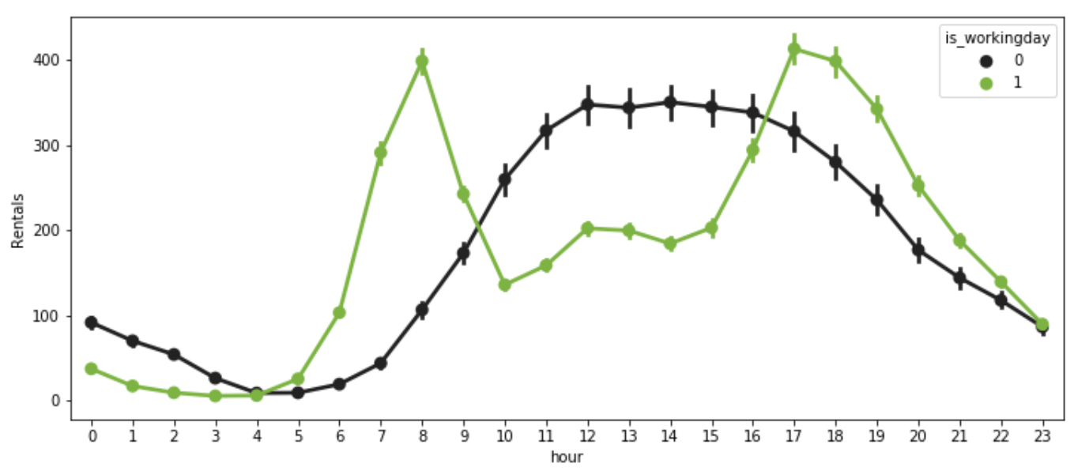
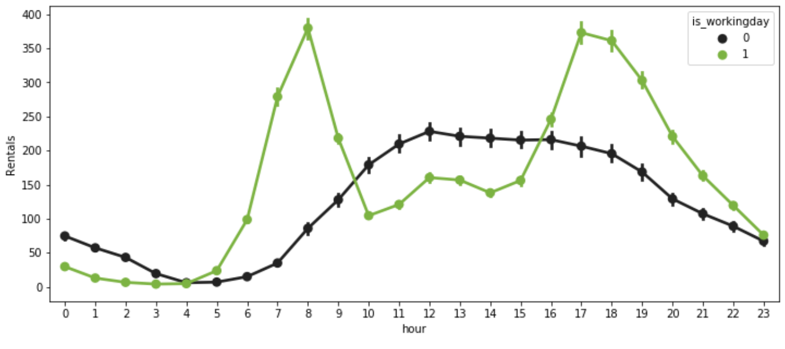
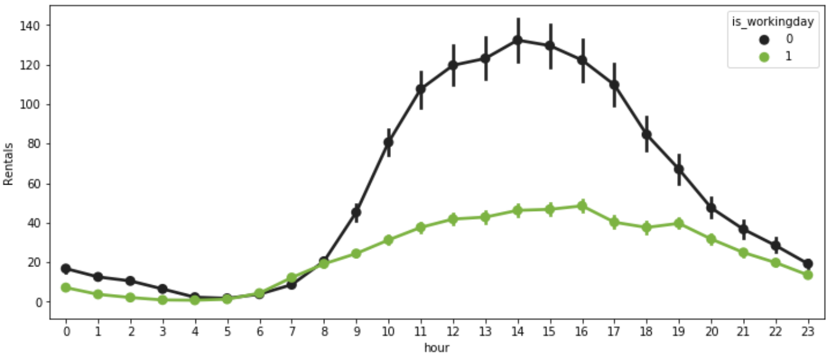
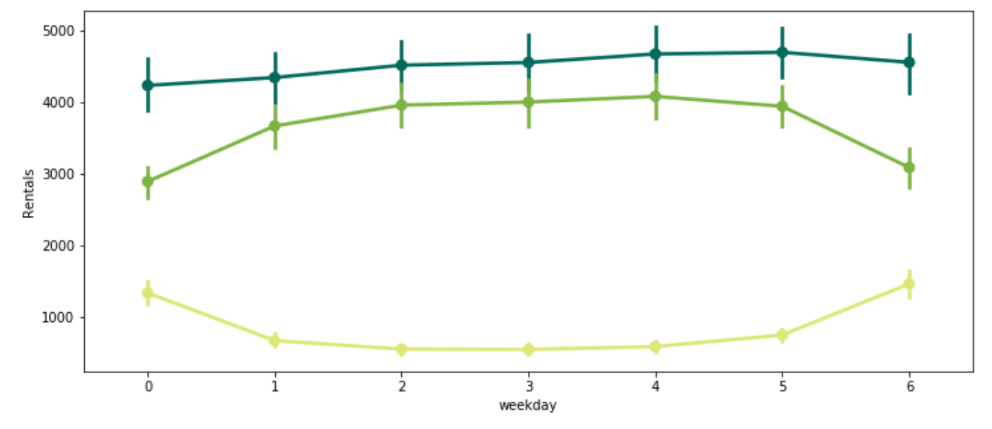
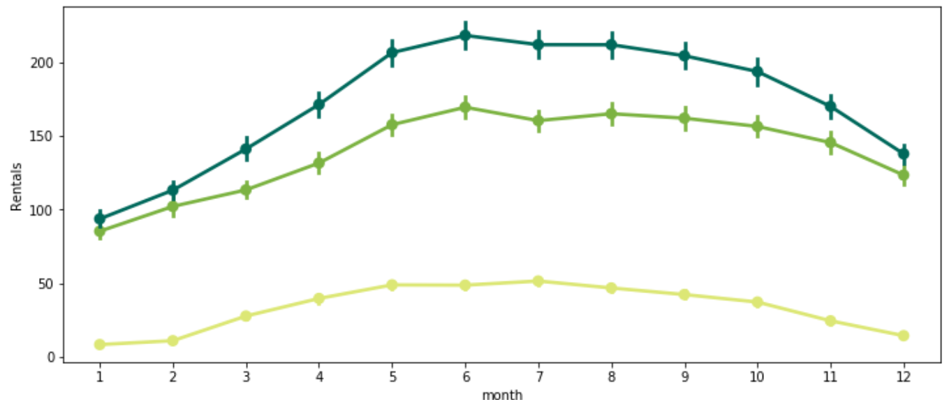
Time Trends
Total Rentals Hourly Trends
When looking at hourly average of rentals, the casual renters have similar pattern, on working and non working days. Where as for registered rentals the peaks can be seen at the office start and end timings
Registered Rentals Hourly Trends
Casual Rentals Hourly Trends
Rentals Trends by Day of Week
Casual rentals and registered rentals show mirror image trends when their average day of week counts are compared. One must place 80% of campaigns for registered renters during the mid of week
Rentals Trend by Month
There is a slight dip from June to July for registered rentals, where as there is negligible uplift for casual rentals. We can guess that the increasing temperature during those months might cause the same
--Total_Rentals --Registered_Rentals --Casual_Rentals

Slide 7
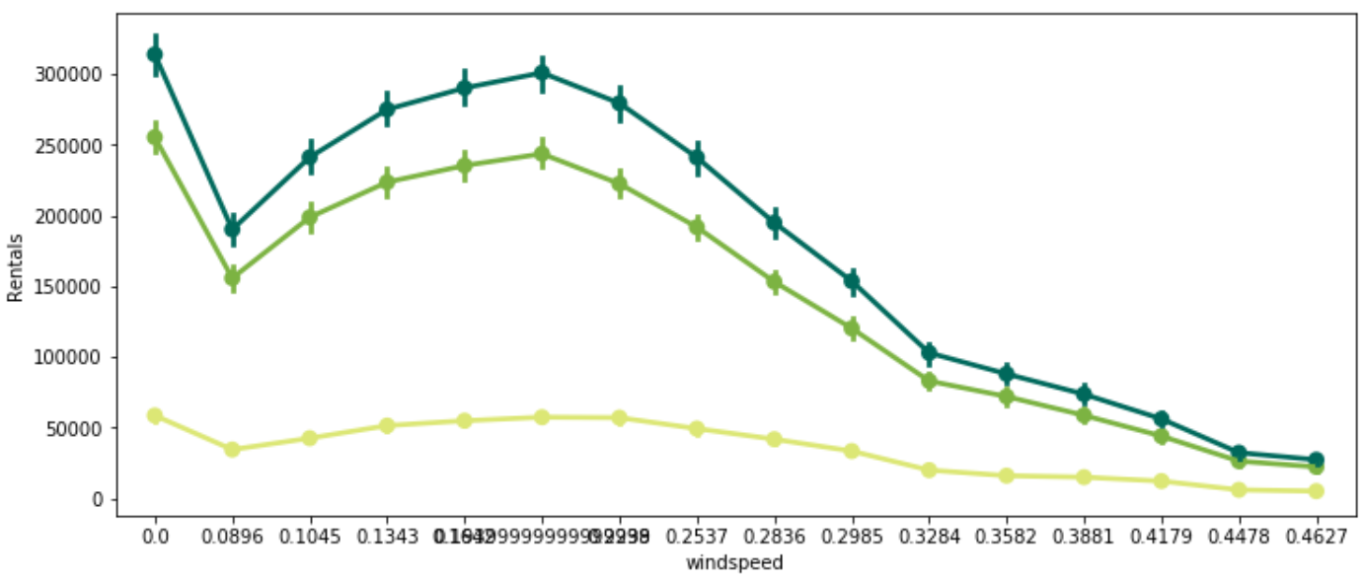
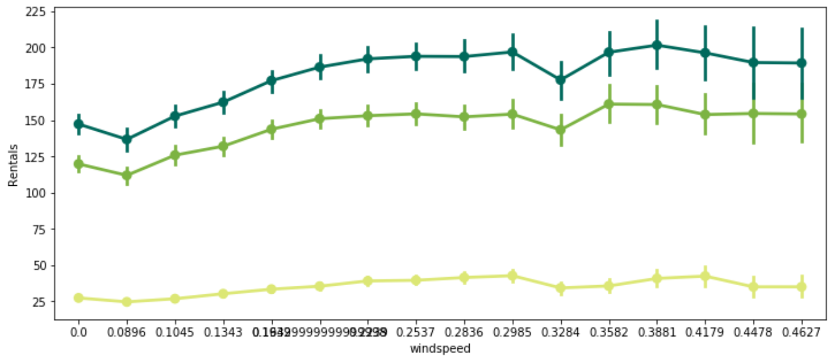
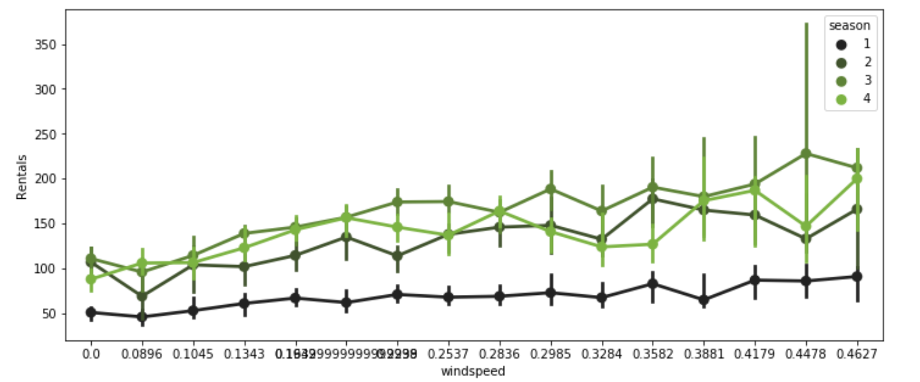
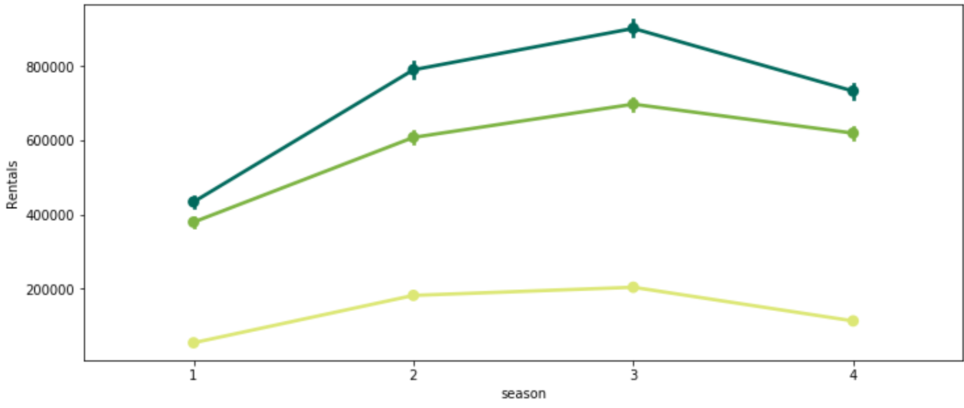
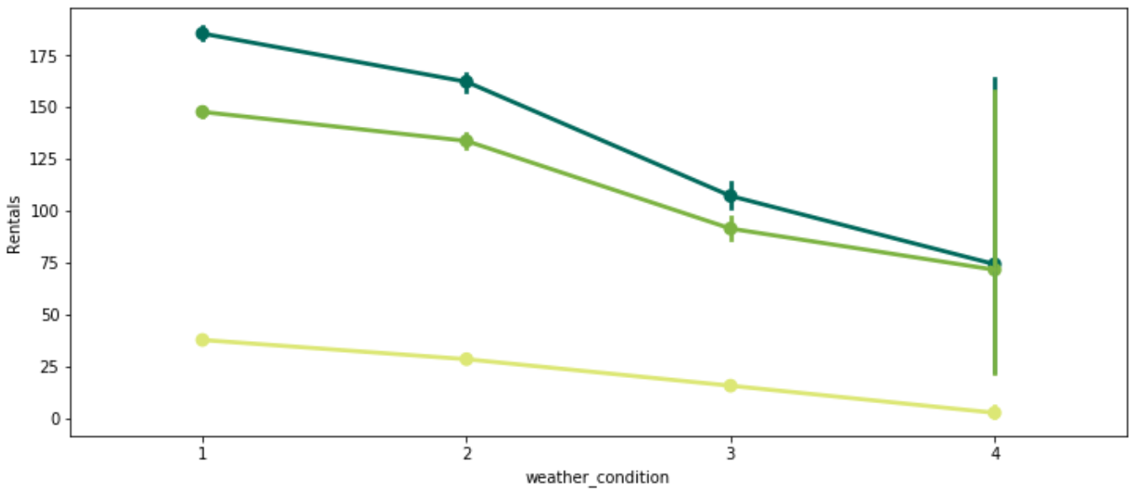
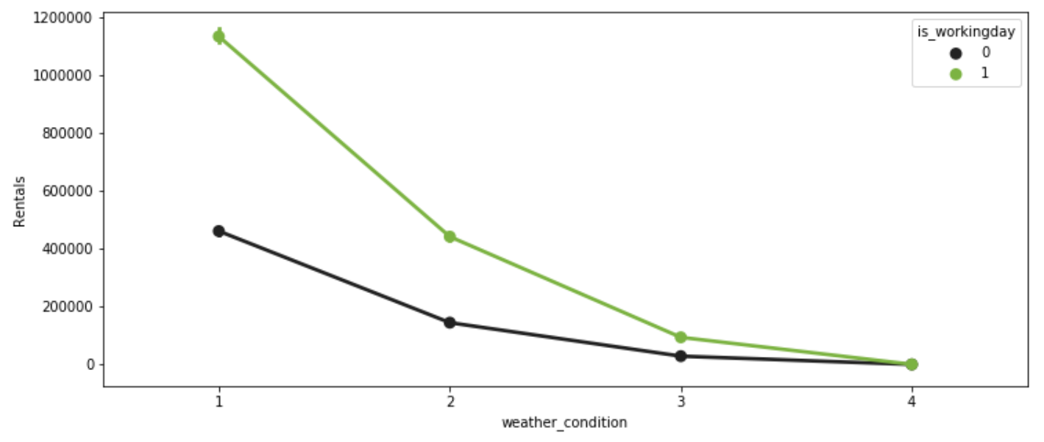
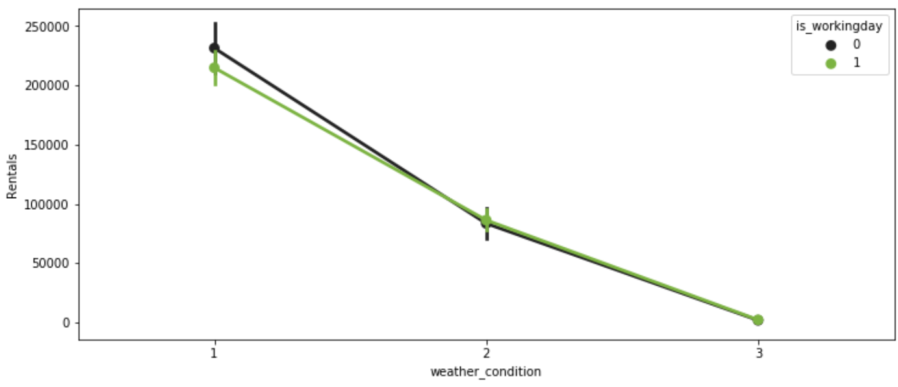
Seasonality Trends
Windspeed vs Rentals
We looked at the trends of rentals against wind speed. While in totality the counts are decreasing, on an average the count was increasing. This meant the there is high variance in the counts number for rentals during high wind speed. On further investigation, we found through the below graph that this variance is caused during the summer season, when high wind may not mean bad weather to ride
Sum
Average
1:winter
2:spring
3:summer
4:fall
Registered Rentals against seasons
Season vs Rentals
Weather vs Rentals
Summer and Spring are the favorite seasons for the bike renters.
Rentals on working days see more drastic dip in rentals with worsening of weather. Where as non working day rentals and casual rentals don’t have that significant drop unless the conditions are extreme
Registered Rentals
1: Clear, Few clouds, Partly cloudy, Partly cloudy 2: Mist + Cloudy, Mist + Broken clouds, Mist + Few clouds, Mist
3: Light Snow, Light Rain + Thunderstorm + Scattered clouds, Light Rain + Scattered clouds
4: Heavy Rain + Ice Pallets + Thunderstorm + Mist, Snow + Fog
Casual Rentals

Slide 8
Applying Models
As instructed during presentation, we implemented al the models separately for casual and registered rentals, against running models for the combined count
Linear Regression with Cross Validation
Ridge Regression
Registered Rentals
Casual Rentals
Lasso Regression
Registered Rentals
Casual Rentals
Polynomials Regression
Registered Rentals
Casual Rentals

Slide 9
Conclusion
We looked at the hourly data of Bike rentals collected for two years. After proper EDA certain data engineering steps were taken which lead to average to good test-train scores for all the. Amongst all the models Lasso Regression was the best. When fitted on the whole dataset it gave score of 0.85252 for alpha = 0.1
Going further with quest to have better learning I plan to implement random forest, and boosting techniques for probable better solution.
As instructed the task of evaluating models and looking trends for casual and registered rentals separately proved to be a better decision than doing everything over the total rental counts.
The model accuracy scores are still less. To improve them we may try to collect geo spatial data, like rental location, classification of location (like residential area, college are, corporate park), renter’s traits, and physically availability factors .
Thanks
Nitansh Gupta

