Slide 1
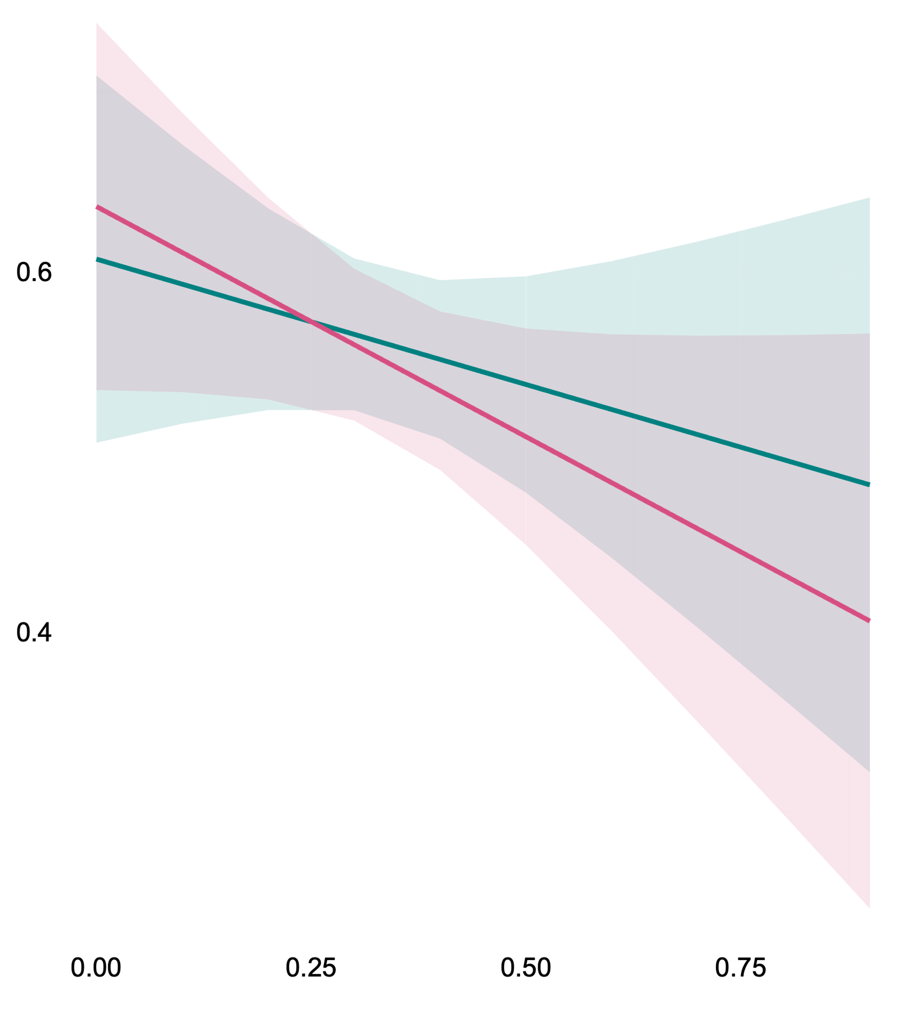
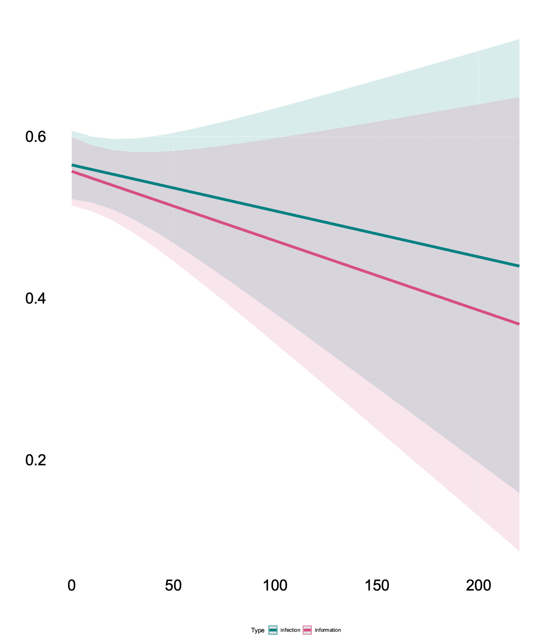
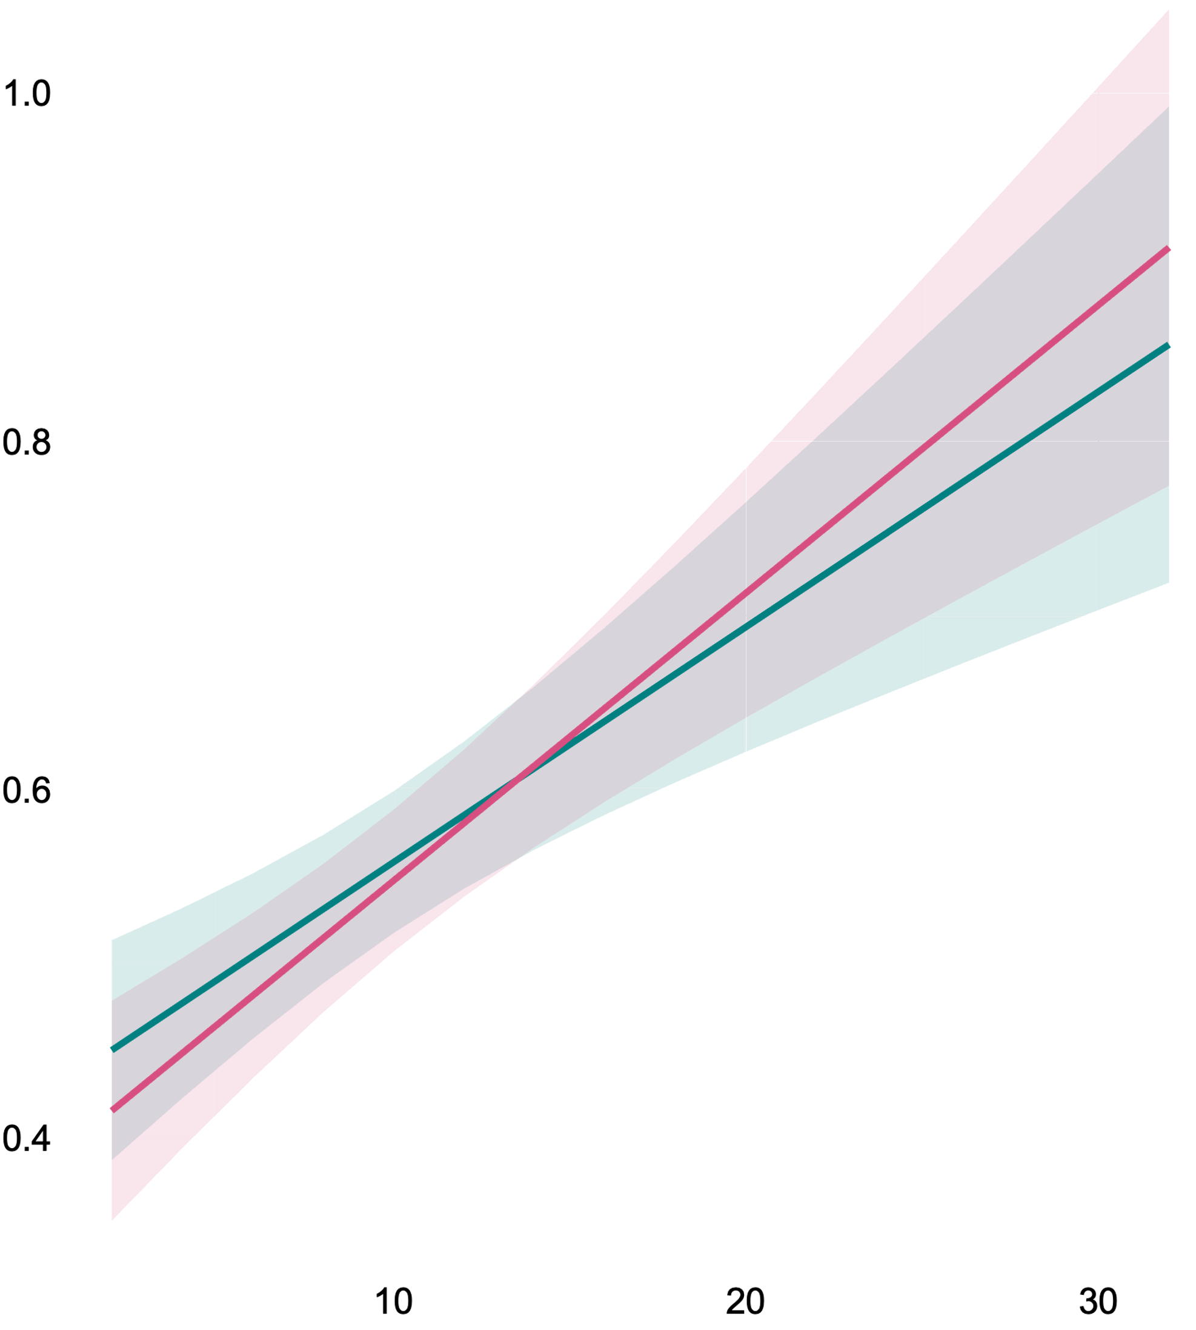
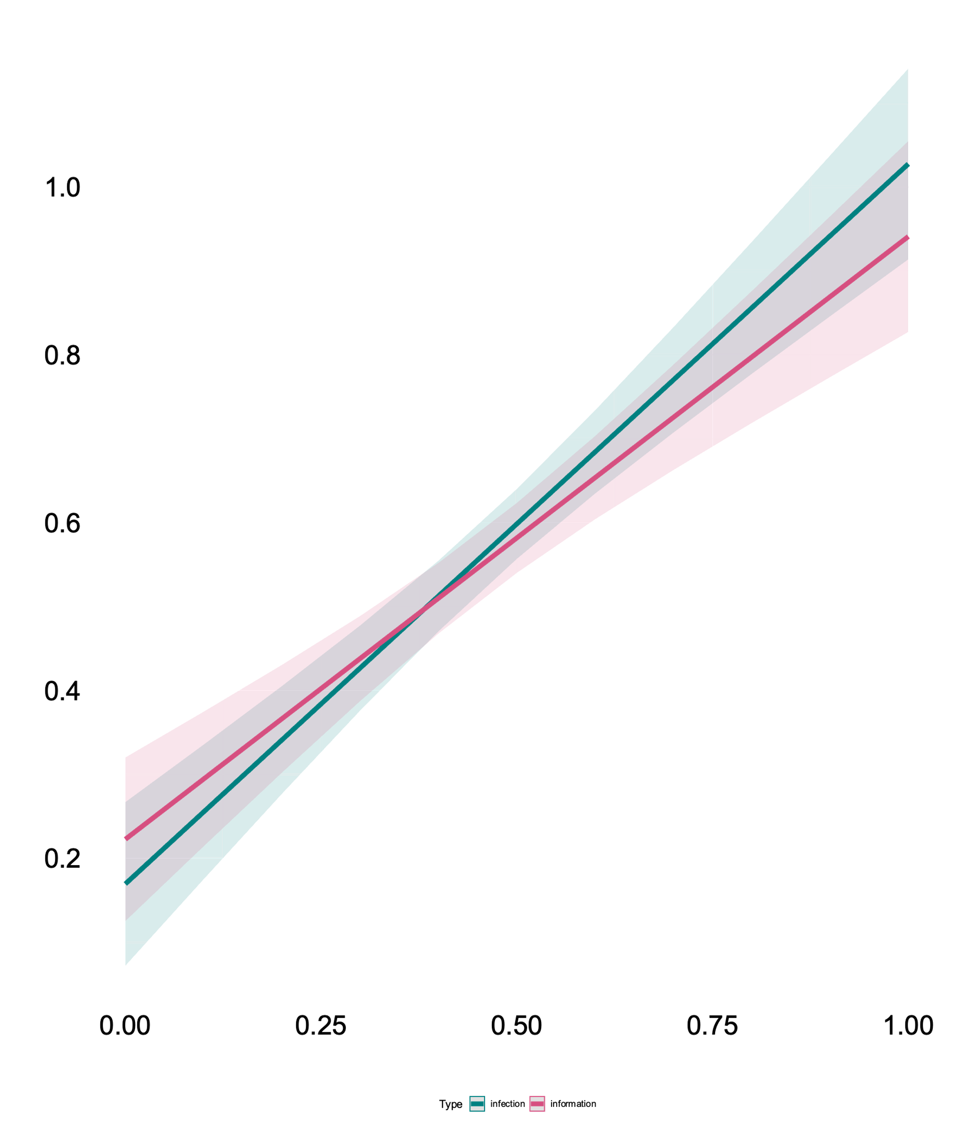
A
B
Outbreak proportion
Modularity
Path length
C
D
Module size
Density

Slide 2
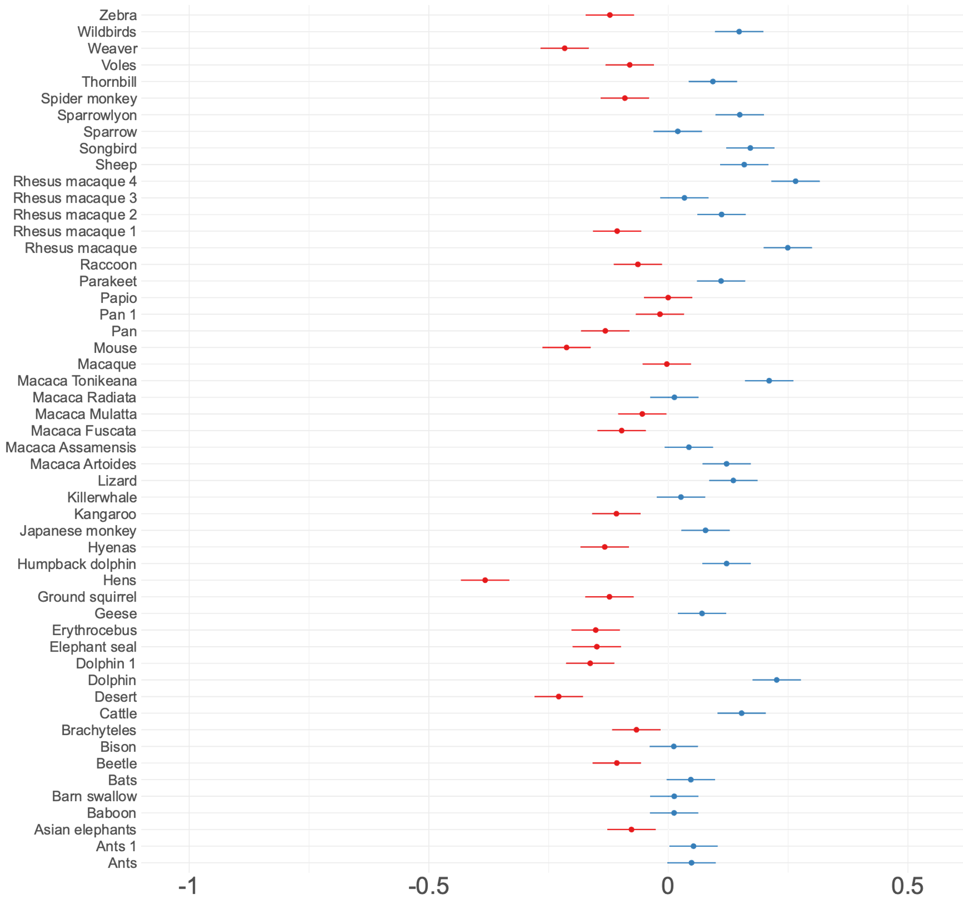

Slide 3
1.00
0.75
gamma (γ)
Gamma
Probability of accepting information
1
0.50
0.7
0.4
0.25
0.00
0.00
0.25
0.50
0.75
1.00
Proportion of informed neighbours

