Slide 1
Software Design and Architecture
Introduction

Slide 2
Larman’s Design Process Craig Larman, Applying UML and Patterns: An Introduction to Object-Oriented Analysis and Design and Iterative Development, 3rd edition, Prentice-Hall, 2005.

Slide 3
Domain Model

Slide 4
Use Case Model

Slide 5
Typical Software Architecture Layers

Slide 6
Typical Software Architecture Layers (Simplified)

Slide 7
Architecture?

Slide 11
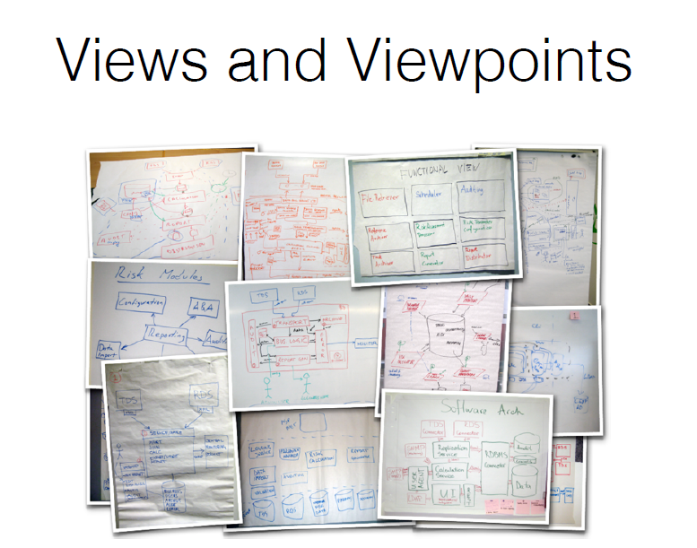

Slide 15
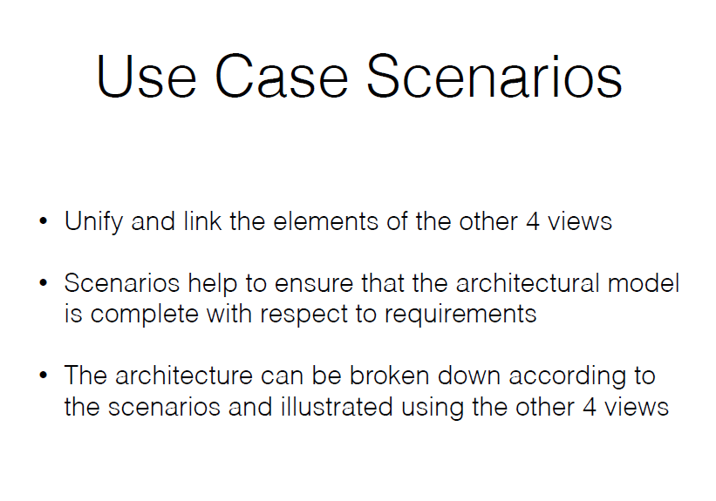

Slide 16
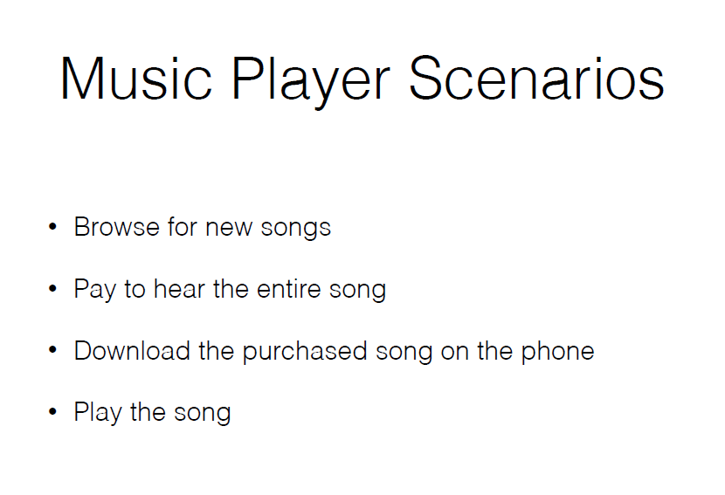

Slide 17
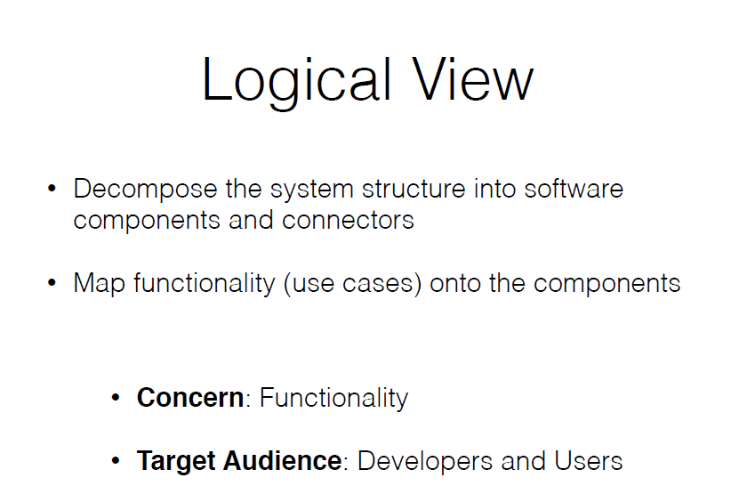

Slide 18
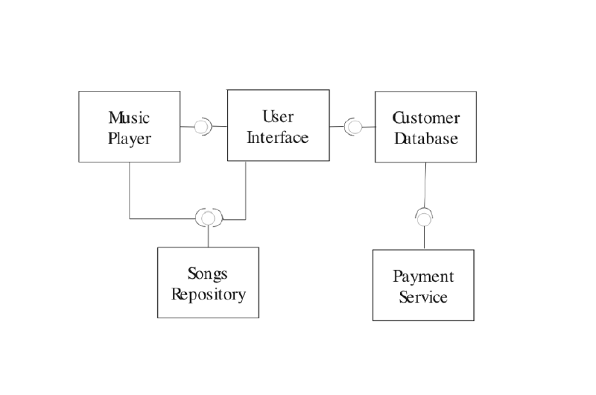

Slide 19
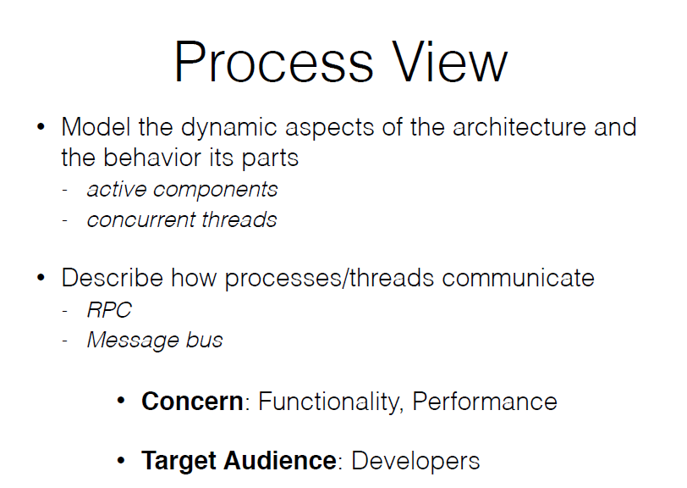

Slide 20
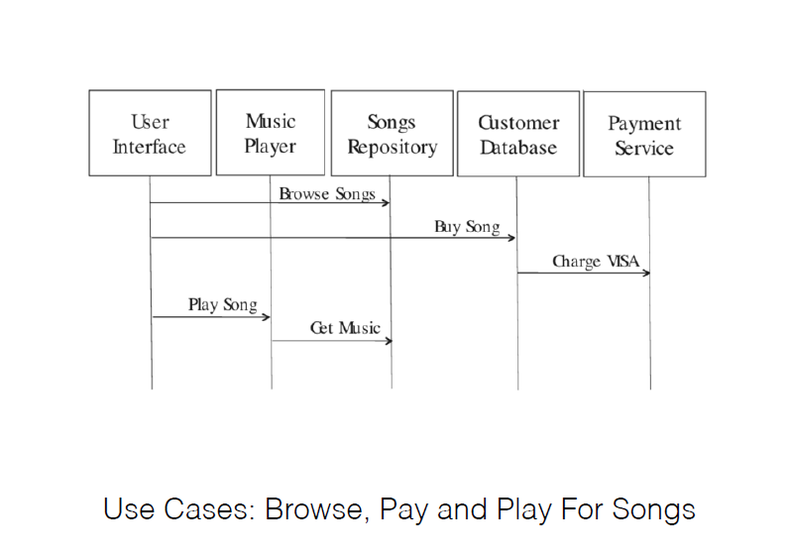

Slide 21
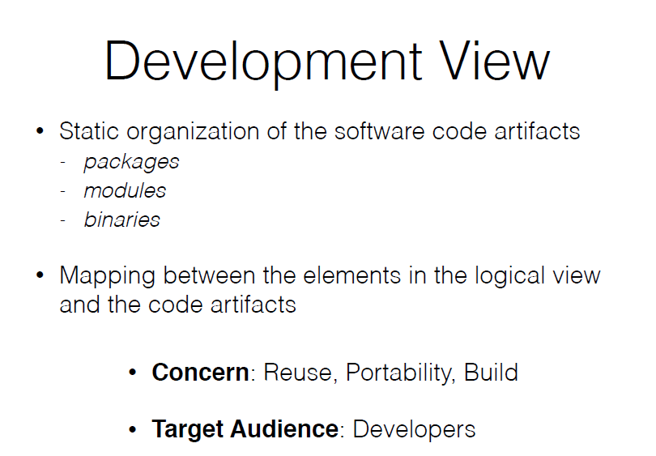

Slide 22
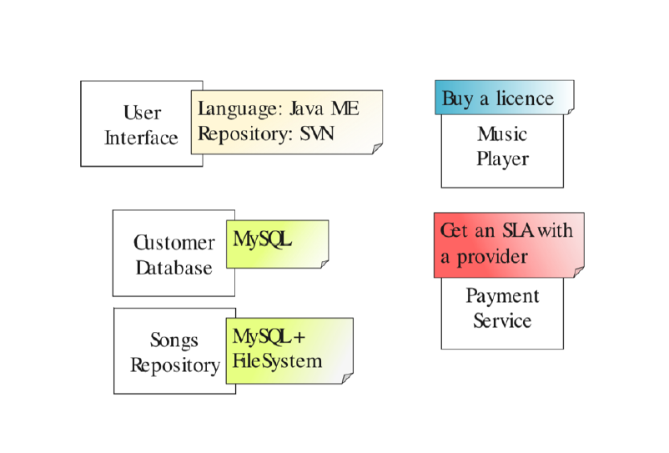

Slide 23
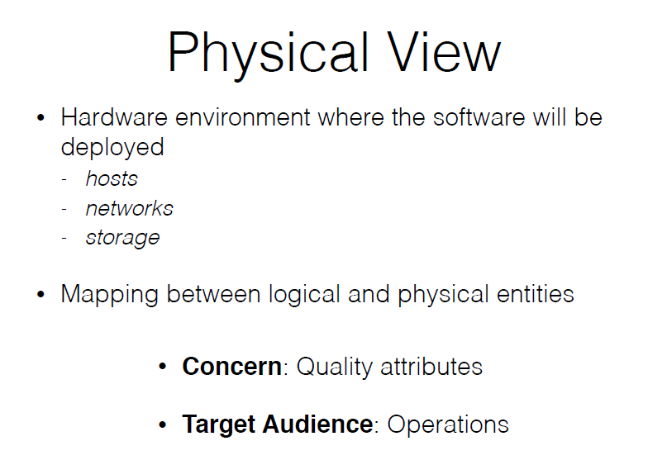

Slide 24
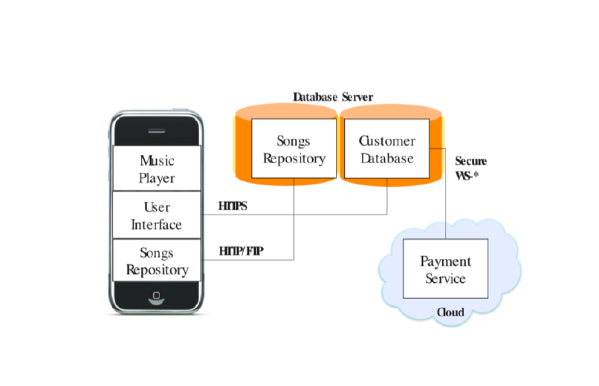

Slide 29
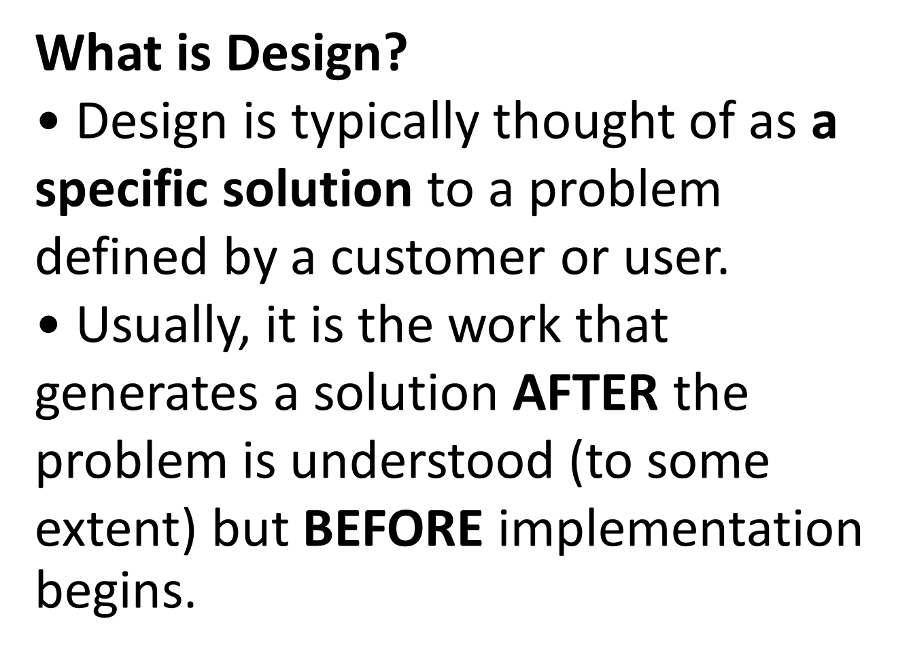

Slide 30
I designed a solution — the developers spent time talking about the characteristics of a solution—the data structures needed, the algorithms, the system components, etc.—reached an agreement and THEN started coding.

Slide 31
I hacked up a solution — typically means the developers started coding before they had a design.
• In these situations, people will say “I needed to code it up once before I understood the problem enough to implement it correctly”.

Slide 32
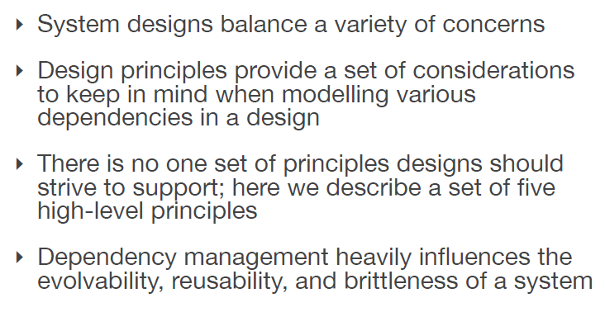
Design principles

Slide 33
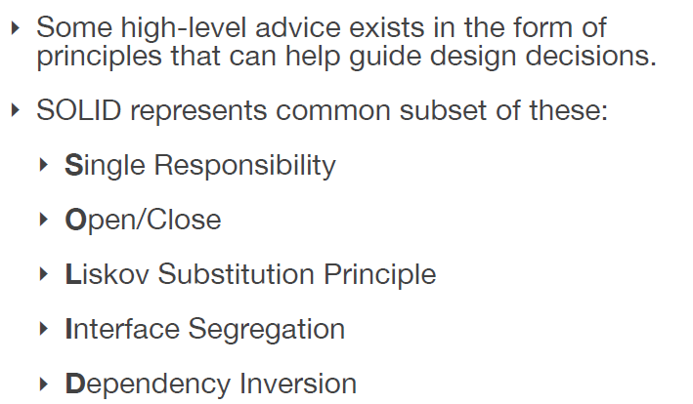
Design principles
(High-Level principles)

Slide 34
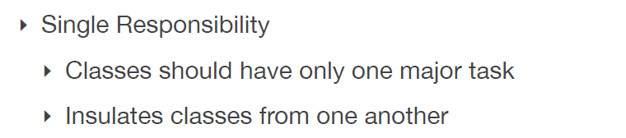
Design principles
(High-Level principles)

Slide 35
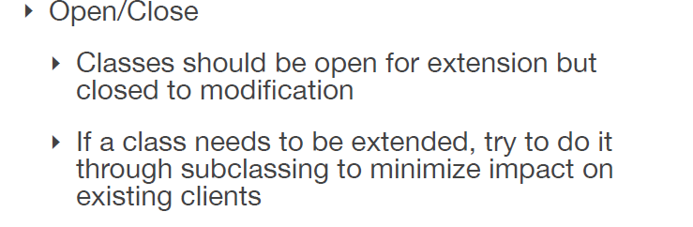
Design principles
(High-Level principles)

Slide 36
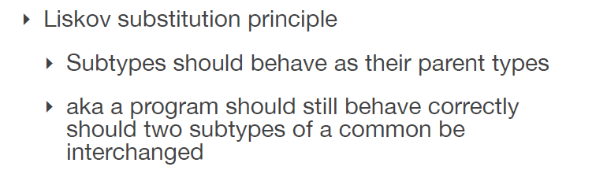
Design principles
(High-Level principles)

Slide 37
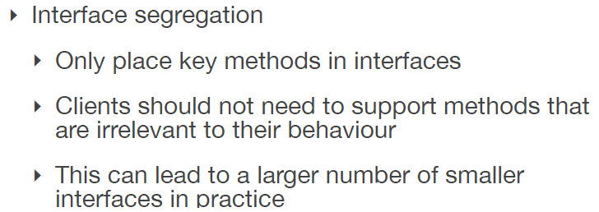
Design principles
(High-Level principles)

Slide 38
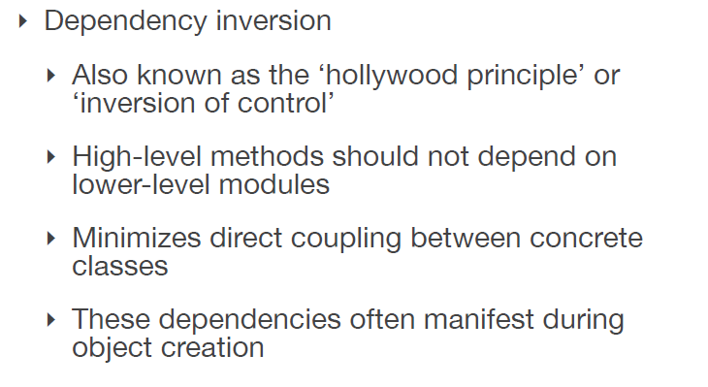
Design principles
(High-Level principles)

Slide 39
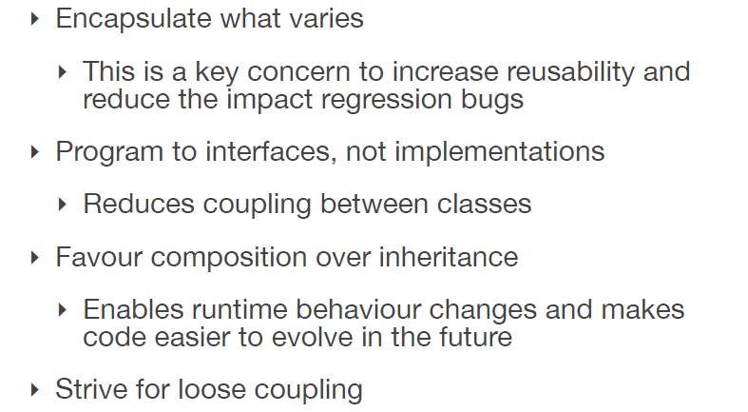
Design principles
(Low-Level principles)

Slide 40
Are there problems in software that occur all the time that can be solved in somewhat the same manner?
Was it possible to design software in terms of patterns?

Slide 41
Design Patterns book by the Gang of Four
Catalogued 23 patterns: successful solutions to common problems that occur in software design

Slide 42
What is architecture?
IEEE 1471-2000
Software architecture is the fundamental organization of a system, embodied in its components, their relationships to each other and the environment, and the principles governing its design and evolution.

Slide 43
Architecture Design
It defines the relationship between major structural elements
It also define the styles and design patterns used to achieve requirements.
Also the constraints that affects the way architecture can be implemented.

Slide 44
Architecture is Early
Architecture represents the set of earliest design decisions.
Hardest to change
Most critical to get right
Architecture is the first design artifact where a system’s quality attributes are addressed.

Slide 45
Architecture Drives
Architecture serves as the blueprint for the system but also the project:
Team structure
Documentation organization
Work breakdown structure
Scheduling, planning, budgeting
Unit testing, integration
Architecture establishes the communication and coordination mechanisms among components

Slide 46
Architecture vs. Design
Architecture: where non-functional decisions are cast, and functional requirements are partitioned.
Design: where functional requirements are accomplished.

