Slide 1

Docker
Developer Guide

Slide 2
Course Objective
Install docker for development project
Use docker command
Sample use

Slide 3
The Audience for this course
Software Developer

Slide 4
Schedule
Chapter 1 : Download Docker for Windows
Chapter 2 : Install software package (Windows)
Chapter 3 : Testing
Chapter 4 : How to use

Slide 5
Chapter 1 : Download Docker (Windows)

Slide 6
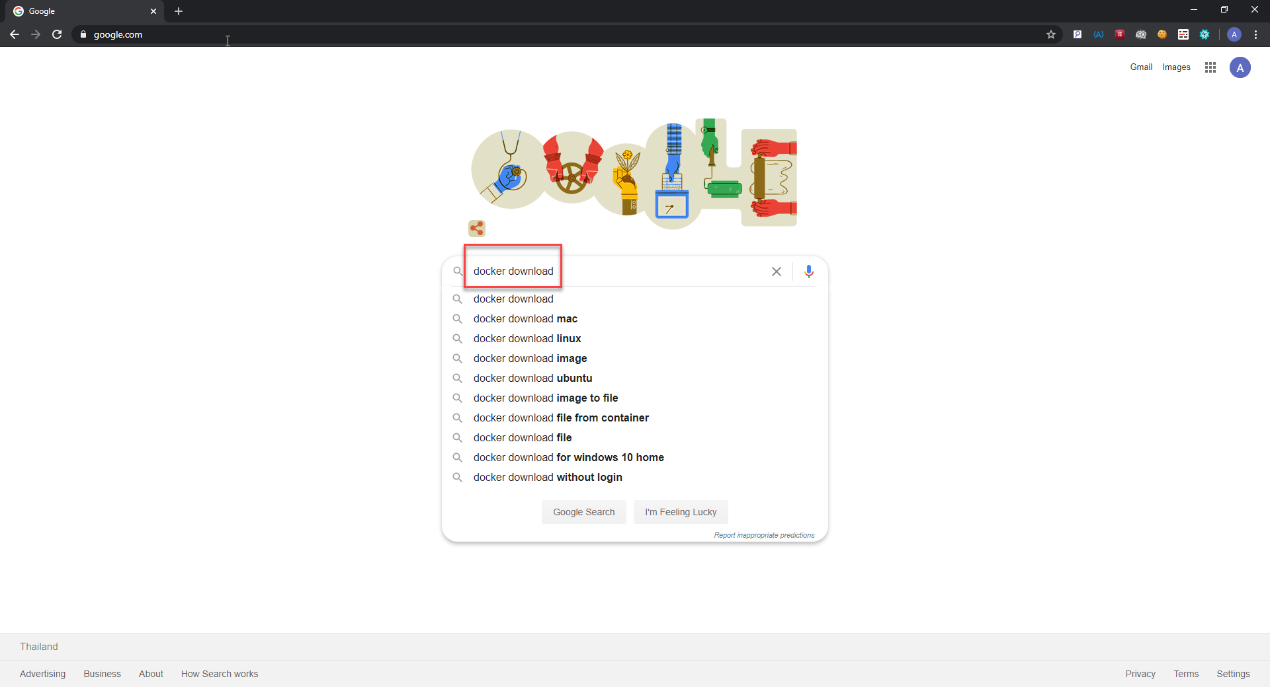
Download Docker for Windows

Slide 7
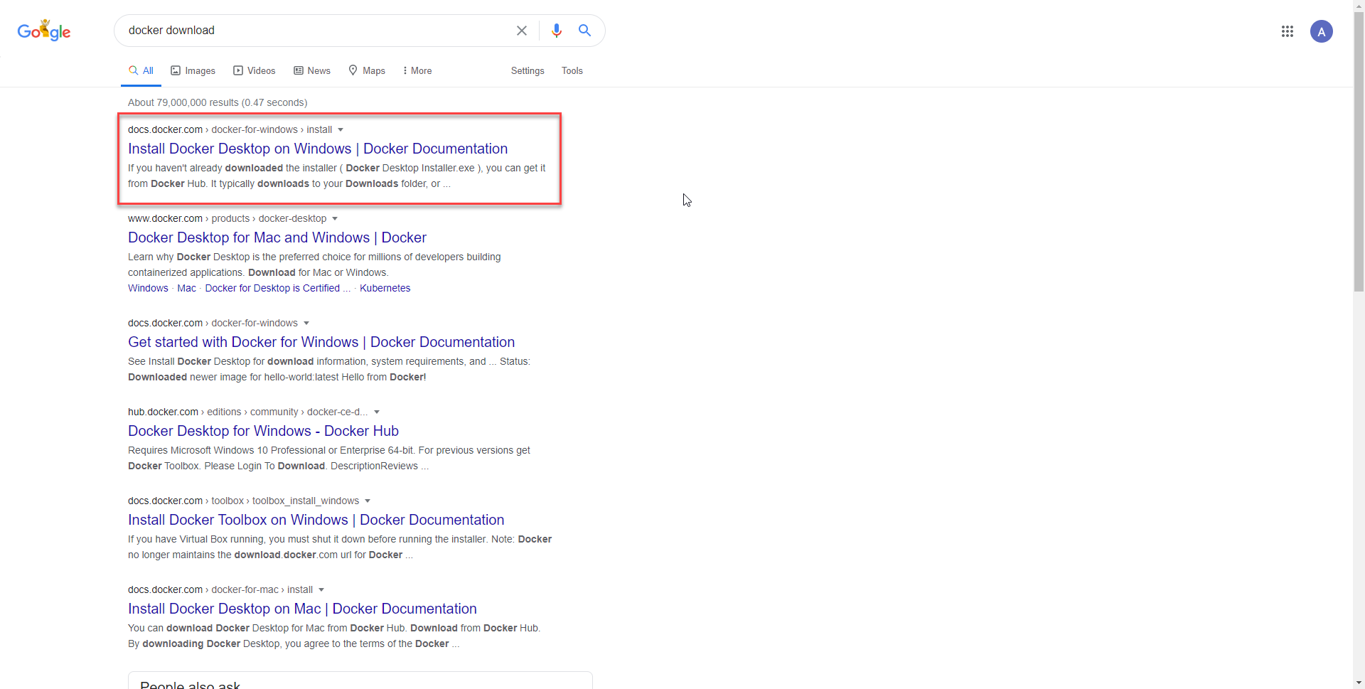
Download Docker for Windows

Slide 8
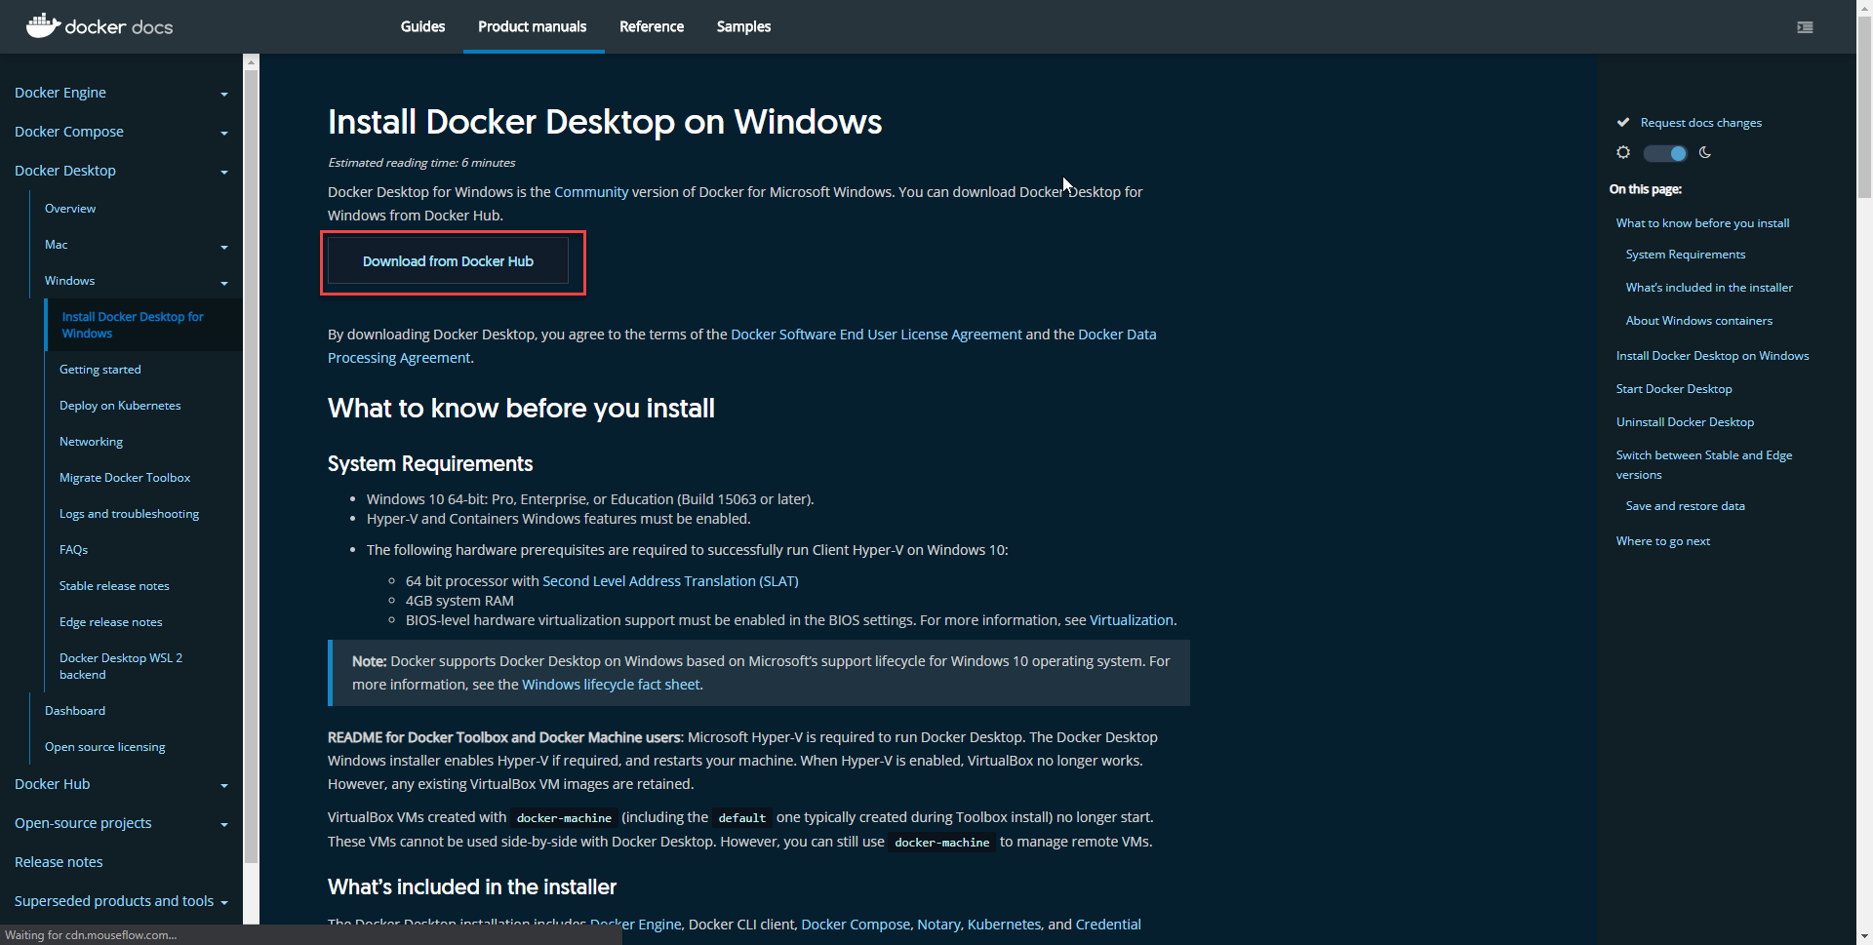
Download Docker for Windows

Slide 9
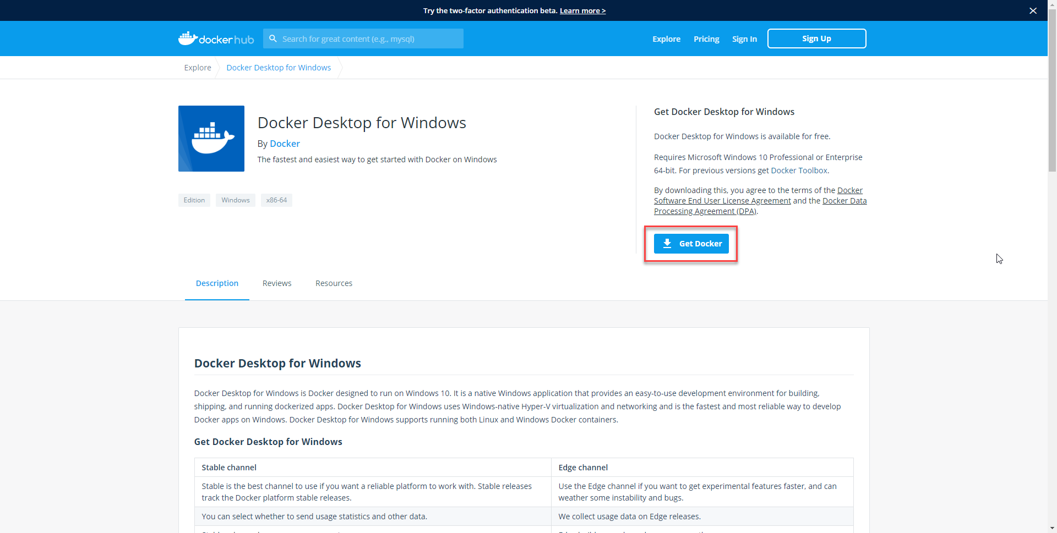
Download Docker for Windows

Slide 10
Chapter 2 : Install software

Slide 11
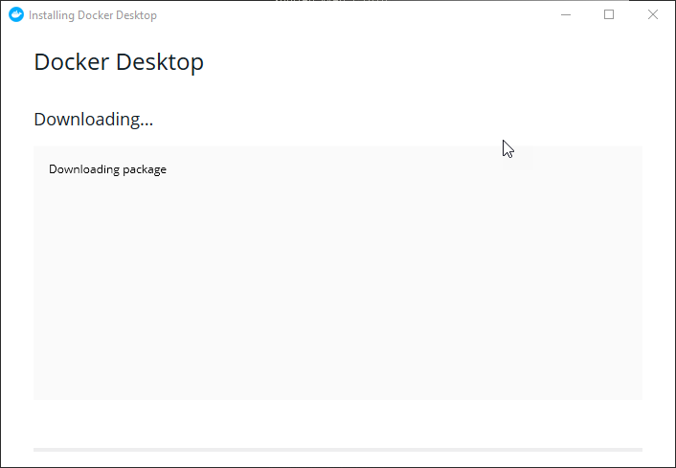
Install Software

Slide 12
Chapter 3 : Testing

Slide 13
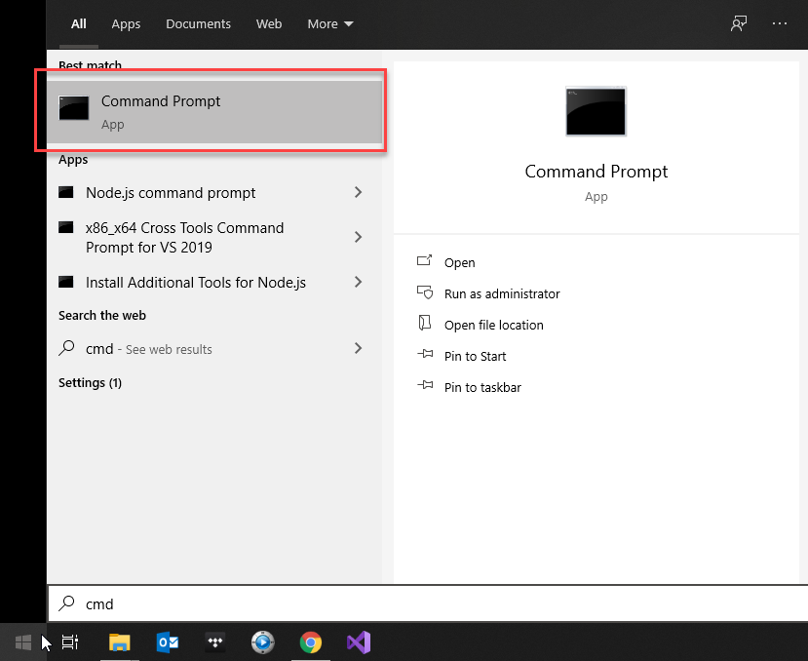
Testing

Slide 14
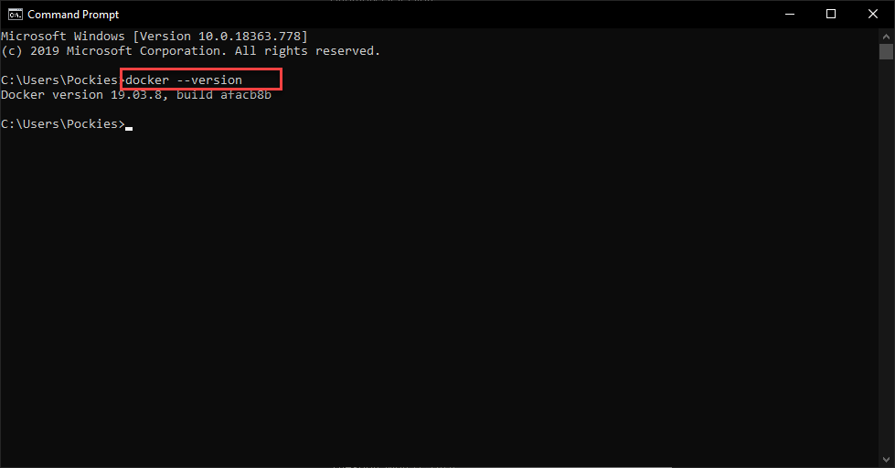
Testing

Slide 15
Chapter 4 : How to use

Slide 16
How to use

Slide 17
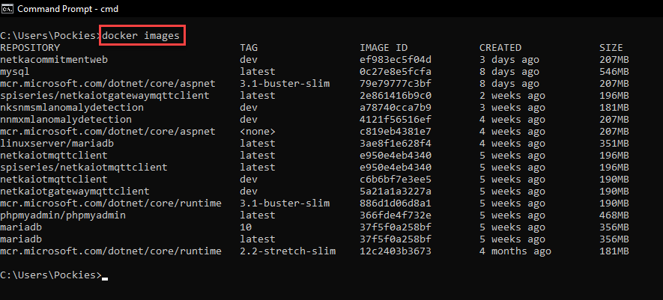
List all images in docker

Slide 18
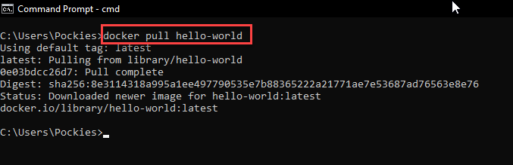
How to get docker images fron docker hub

Slide 19
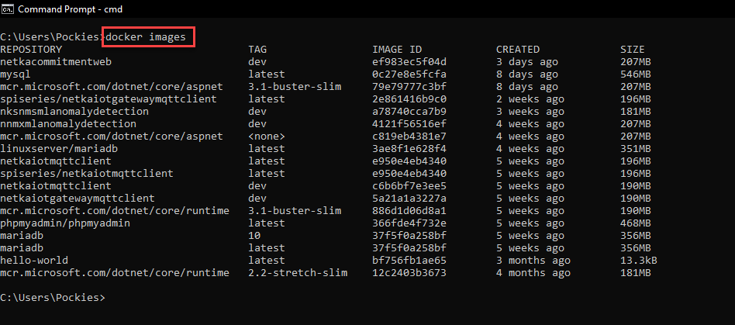
List all docker images

Slide 20
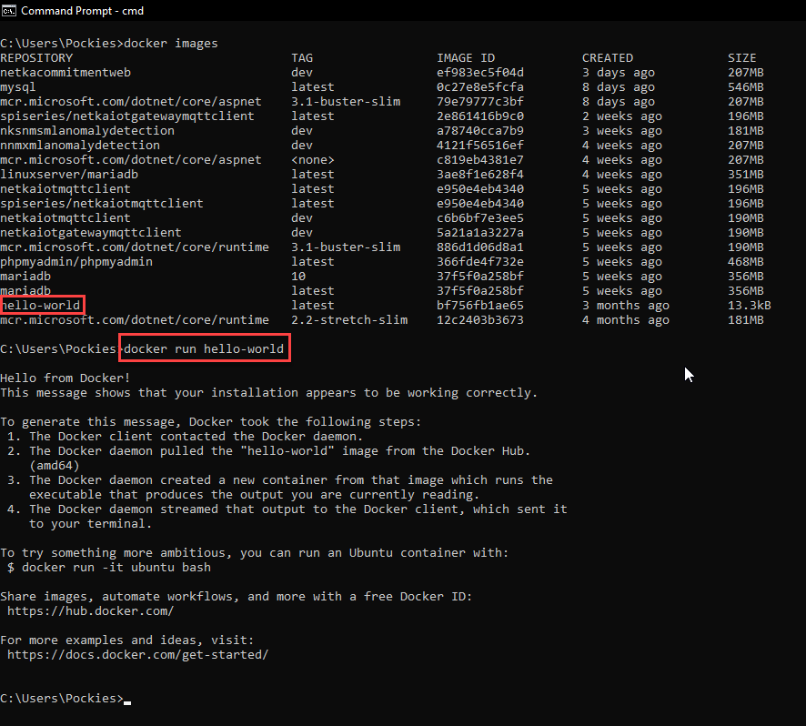
How to run docker container from images

Slide 21
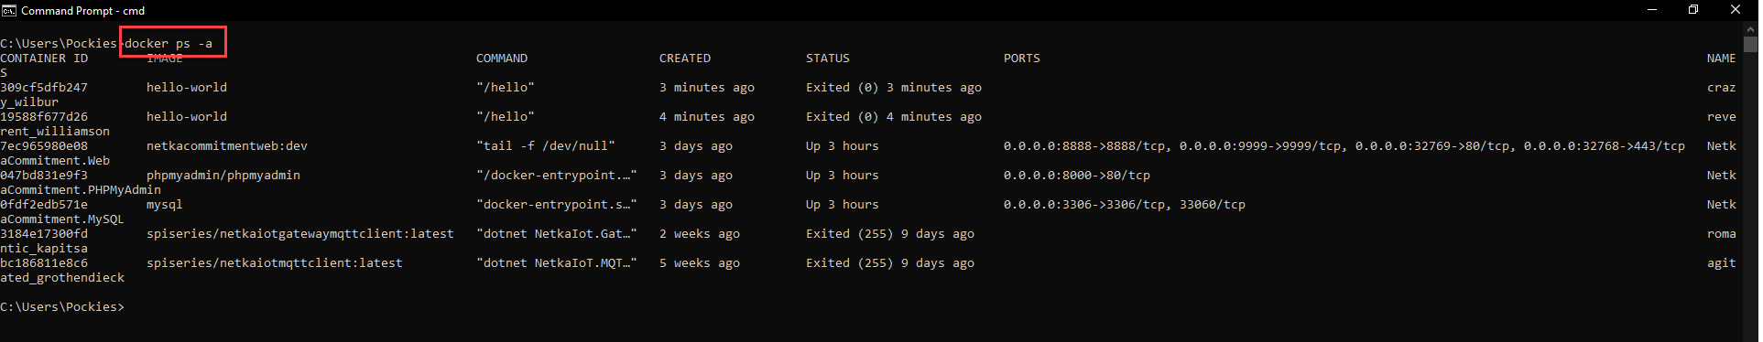
Get status information in docker cortrainer

Slide 22
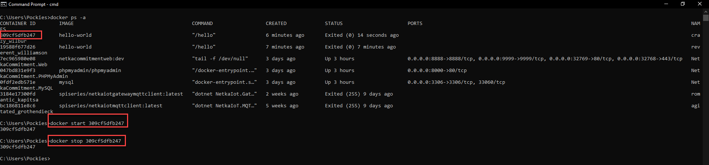
How to start/stop docker container

Slide 23
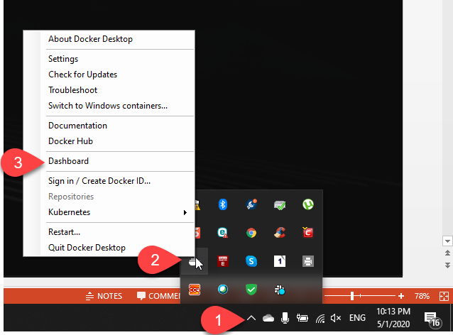
How to open docker dashboard

Slide 24
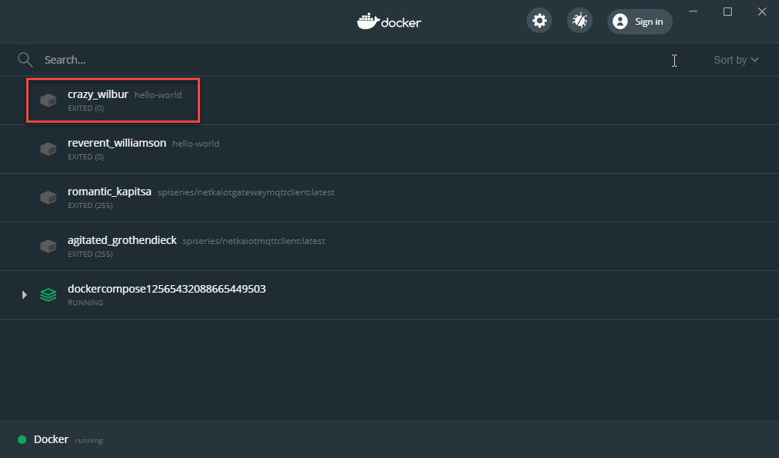
Docker dashboard

Slide 25
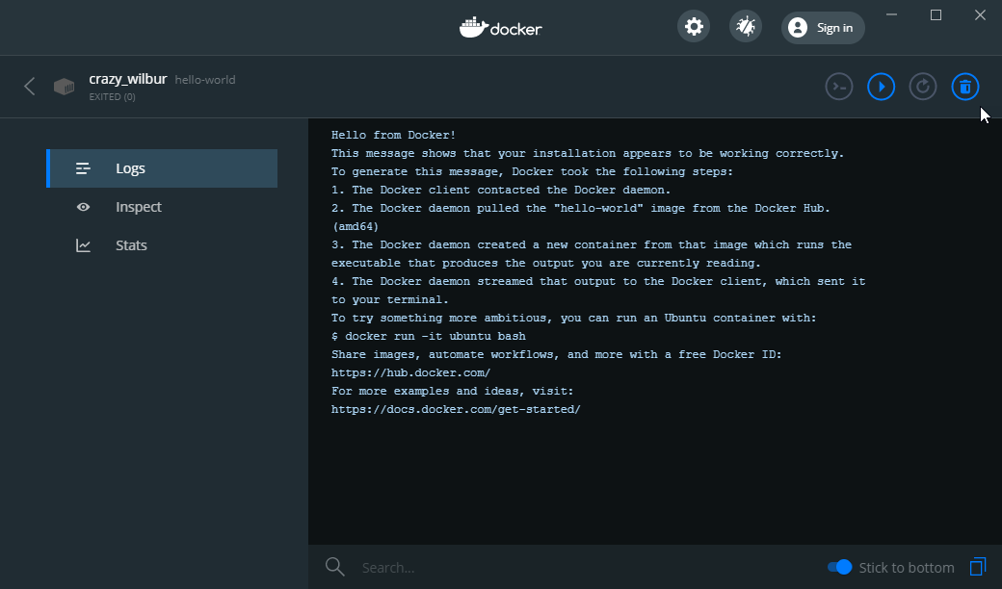
Docker dashboard log

Slide 26
Have fun.

