Slide 1

Backend
Developer Guide

Slide 2
Course Objective
Install software for development this project
Infrastructure overview
Sample

Slide 3
The Audience for this course
Software Developer

Slide 4
Schedule
Chapter 1 : Requirement
Chapter 2 : N-Tier
Chapter 3 : CRUD Rest API
Chapter 4 : EF Core Database First
Chapter 5 : Docker Compose
Chapter 6 : Nuget Installation
Chapter 7 : Deployment to docker

Slide 5
Chapter 1 : Requirement

Slide 6
Requirement
Visual Studio 2019+
Docker

Slide 7
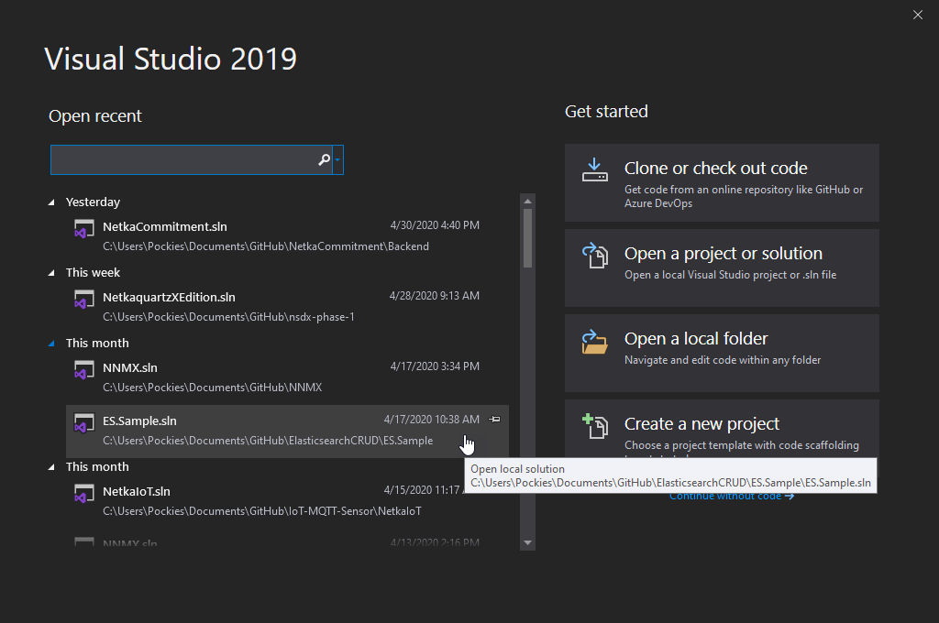
Visual Studio

Slide 8
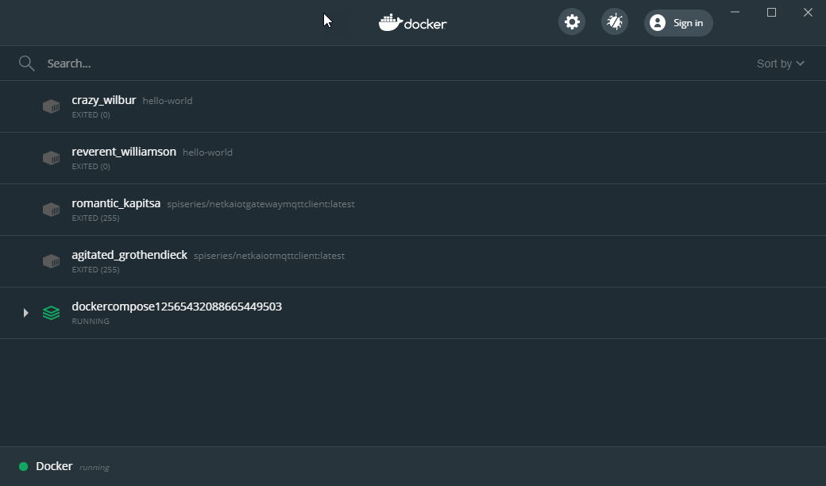
Docker

Slide 9
Chapter 2 : N-Tier

Slide 10
N-Tier
Presentation Layer
Business Layer
Repository Layer
Database Layer
Data Layer

Slide 11
Presentation Layer
User Interface between user or 3th party
Rest API
GET/POST/PUT/DELETE etc.
Web Services
HTML Markup
UI Controls

Slide 12
Business Layer
Logic or processing something
Validate input and expected results
Process specific by conditional

Slide 13
Repository Layer
CRUD Data Transactions
C (Create) : Insert data from database
R (Read) : Select data from database
U (Update) : Modified data from database
D (Delete) : Remove data from database

Slide 14
Data Layer
Connect and interface between database and repository layer
Mapping data from database
Depend on 3rd Database Provider eg. MySQL, SQL Server, Oracle etc.

Slide 15
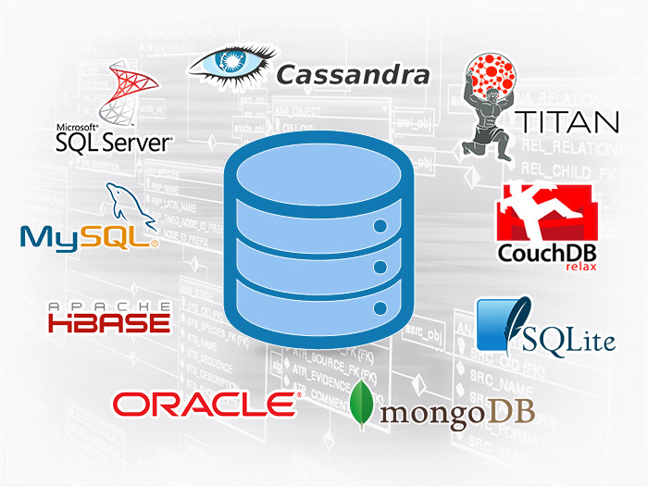
Database Layer

Slide 16
Chapter 3 : CRUD Rest API

Slide 17
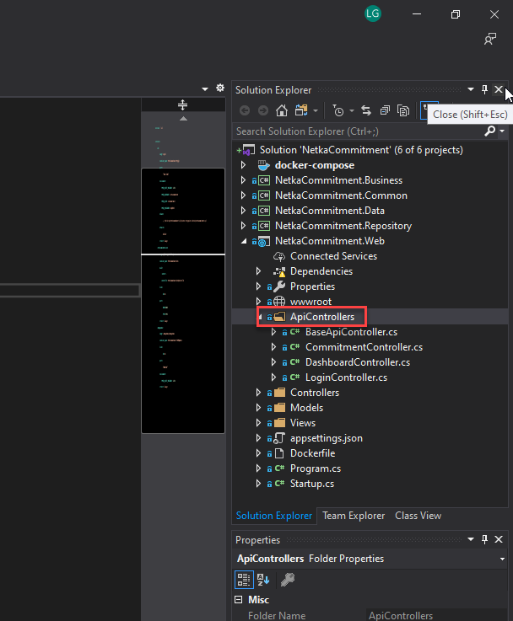
CRUD Rest API

Slide 18
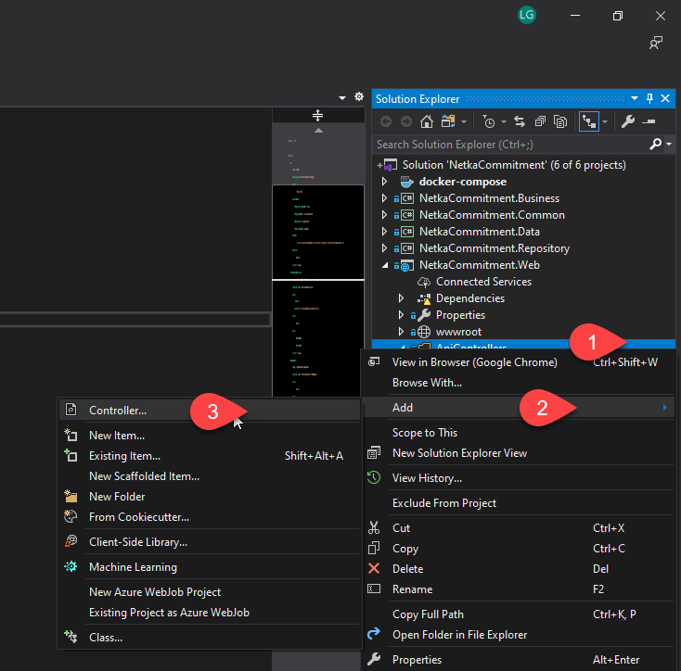
CRUD Rest API

Slide 19
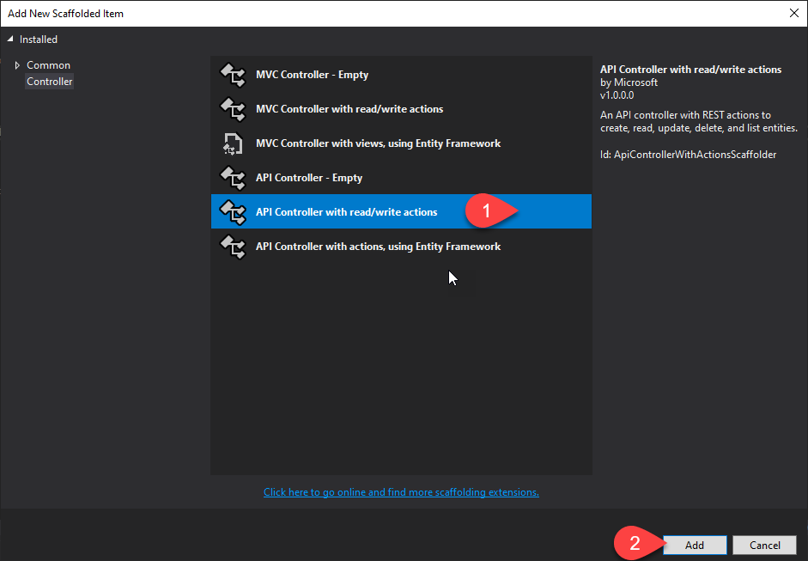
CRUD Rest API

Slide 20
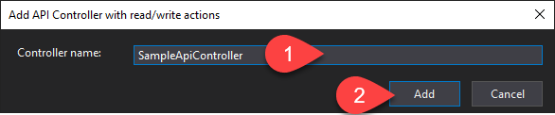
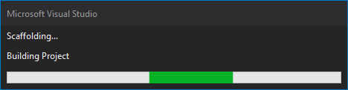
CRUD Rest API

Slide 21
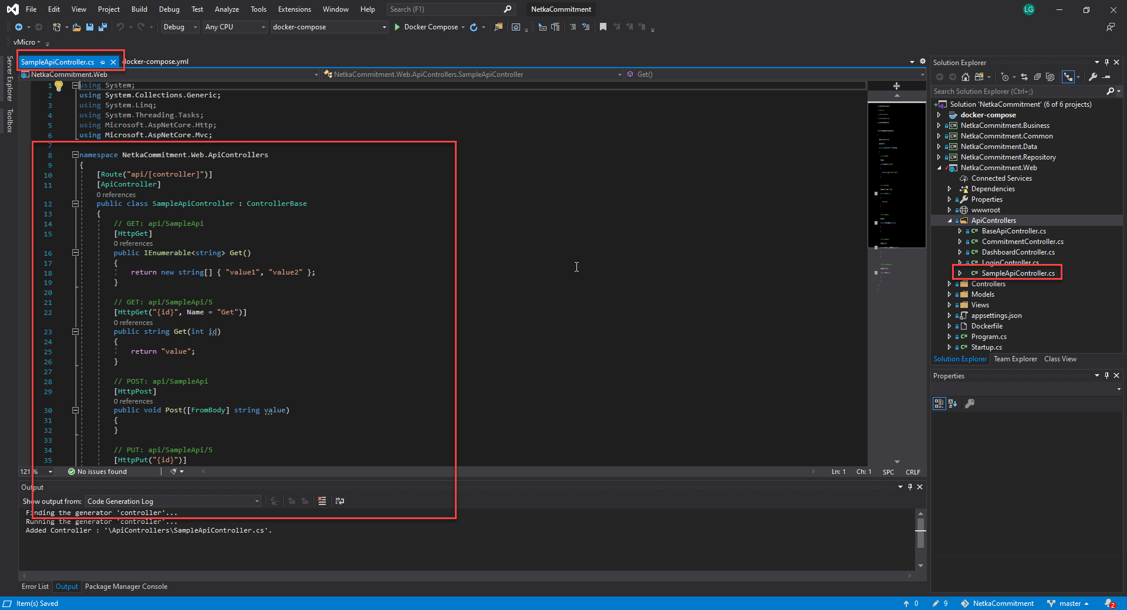
CRUD Rest API

Slide 22
Chapter 4 : EF Core Database First

Slide 23
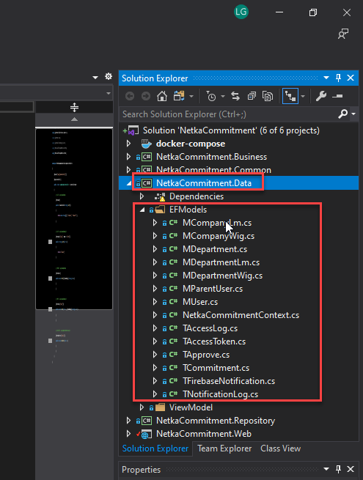
EF Core Database First

Slide 24
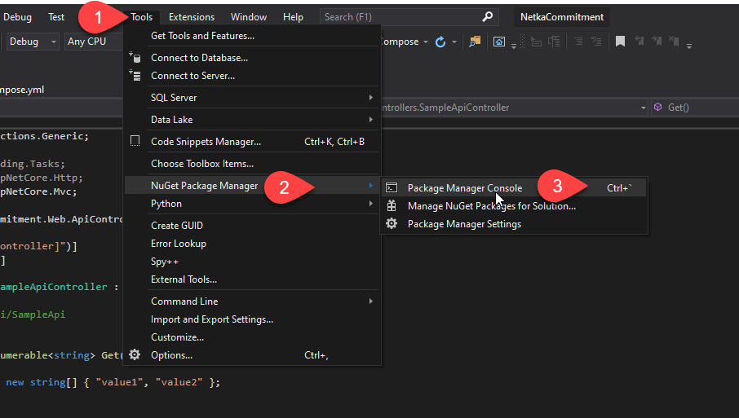
EF Core Database First

Slide 25
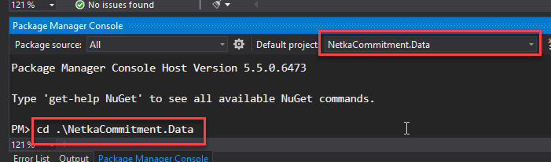
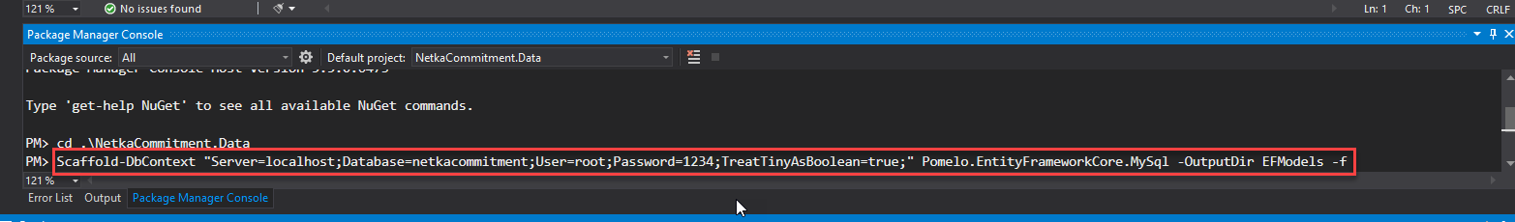
EF Core Database First

Slide 26
Chapter 5 : Docker Compose

Slide 27
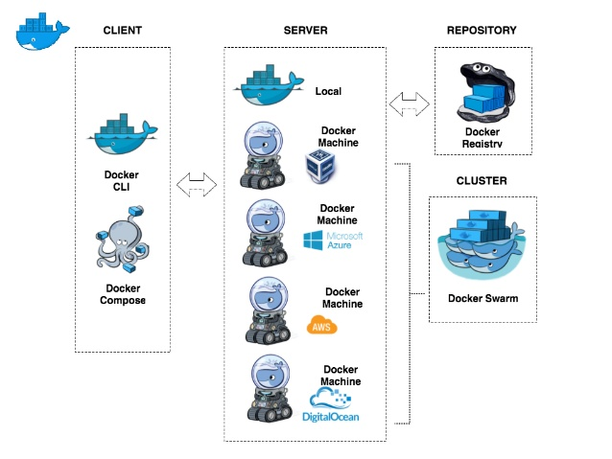
Docker Compose

Slide 28
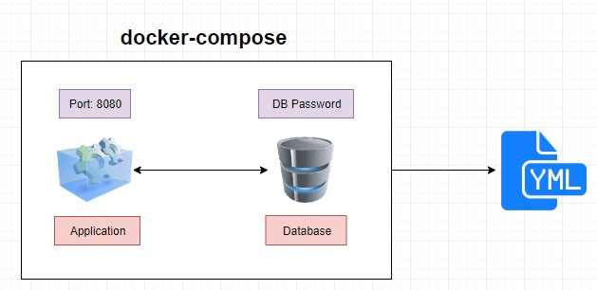
Docker Compose

Slide 29
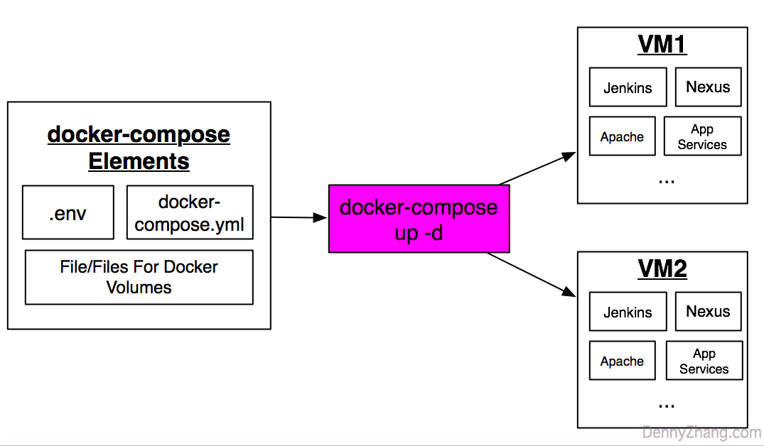
Docker Compose

Slide 30
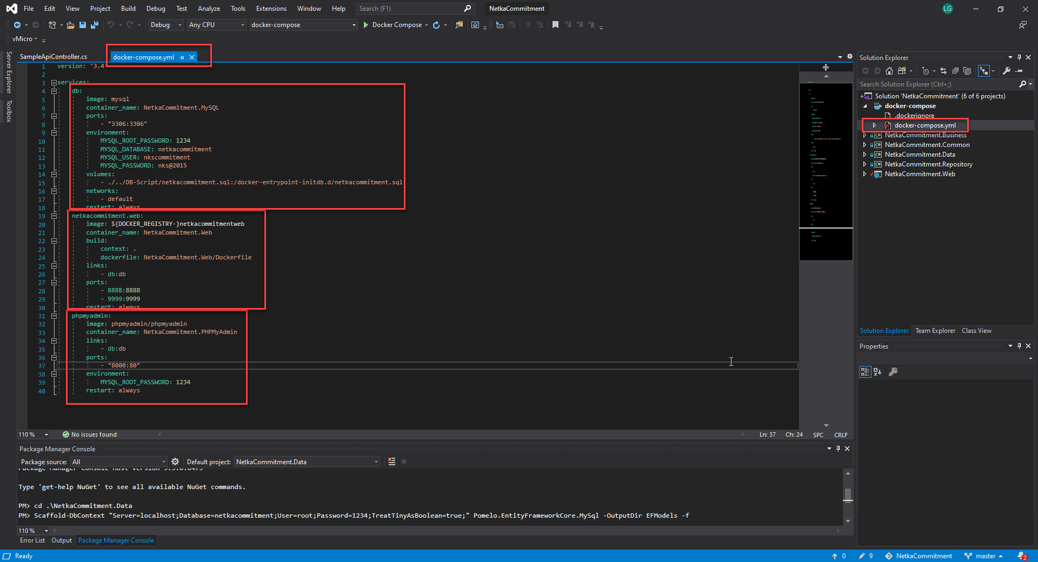
Docker Compose

Slide 31
Docker Compose
Netka Commitment (Docker Compose)
Docker Image : Netka Commitment Web API
Docker Image : PHPMyAdmin
Docker Image : MySQL (with initial database script when first run)

Slide 32
Chapter 6 : Nuget Installation

Slide 33
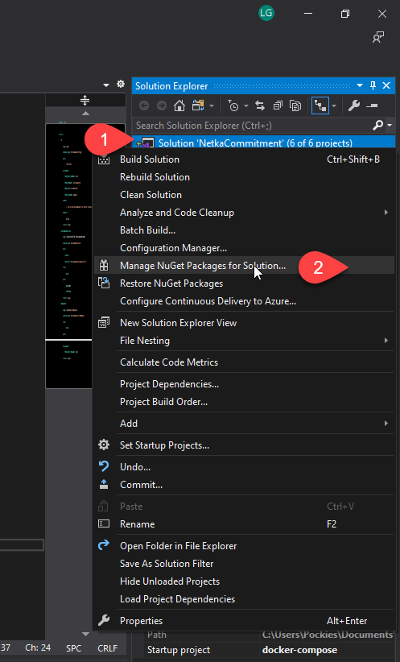
Solution

Slide 34
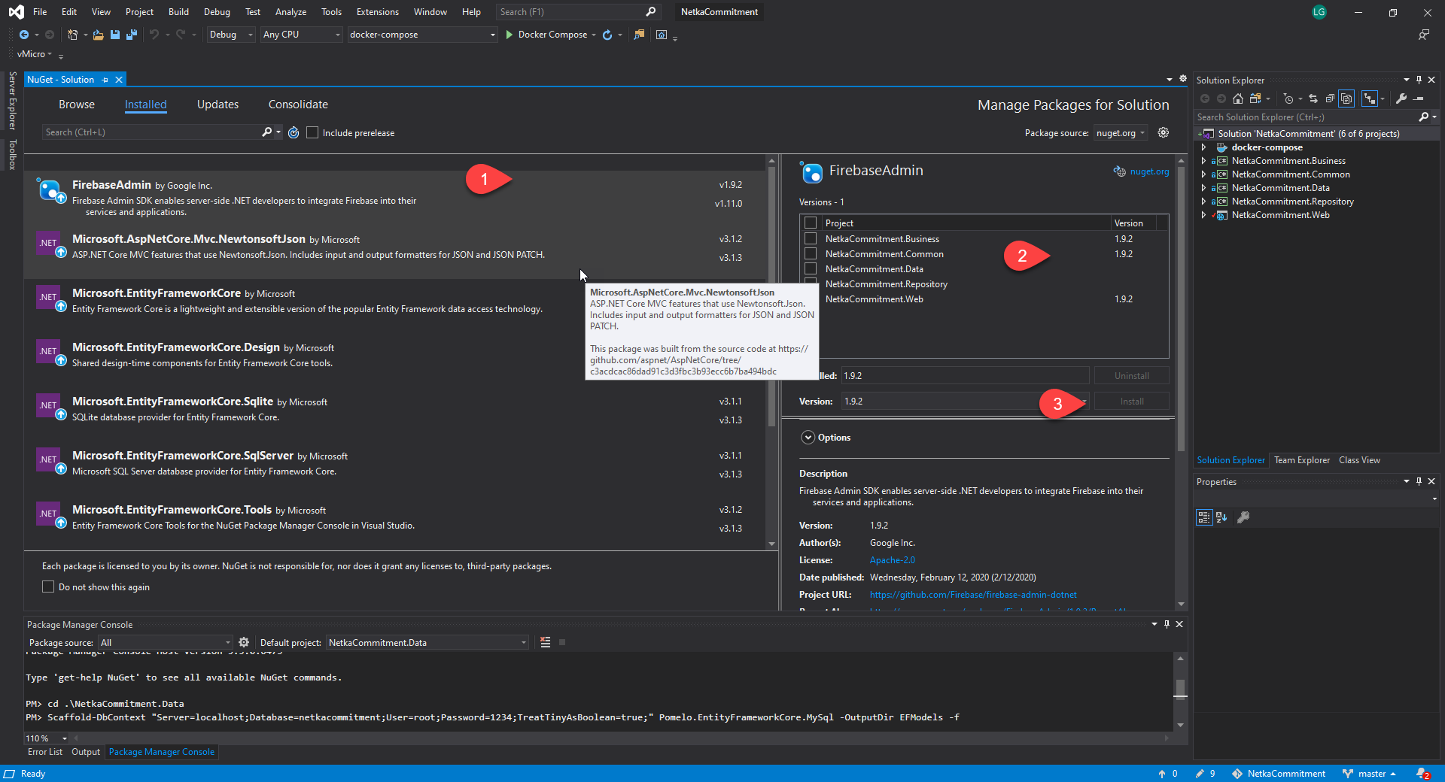
Solution

Slide 35
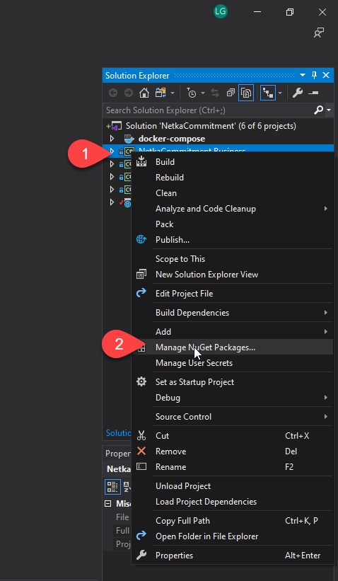
Project

Slide 36
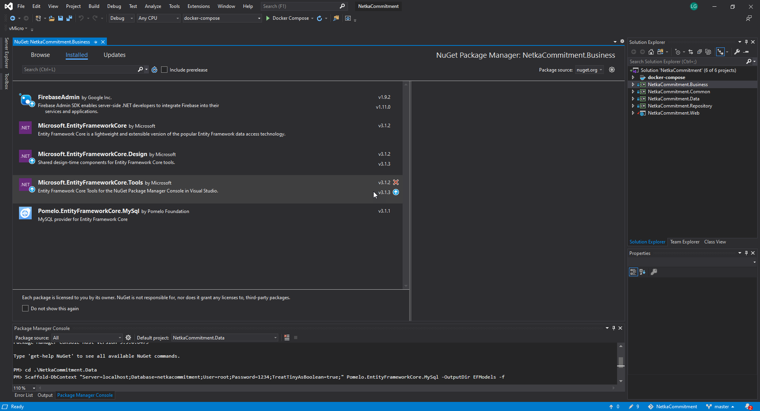
Project

Slide 37
Chapter 7 : Deployment to docker

Slide 38
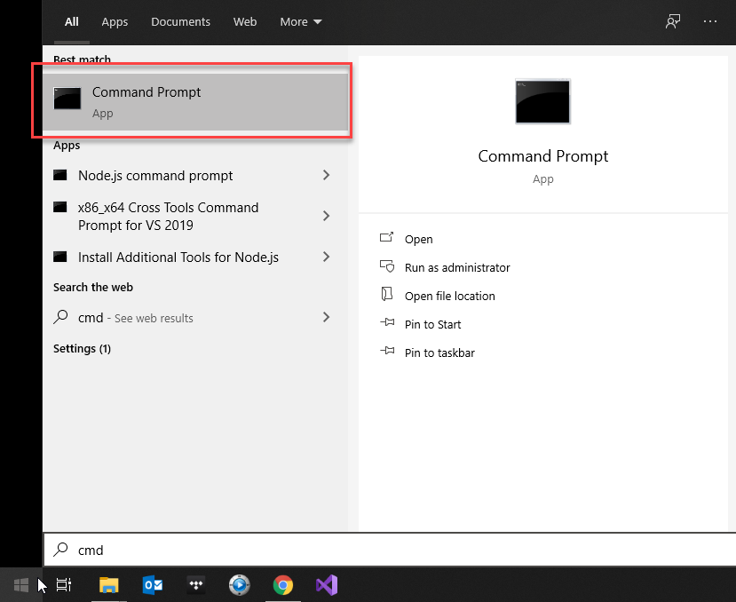
Open command prompt

Slide 39
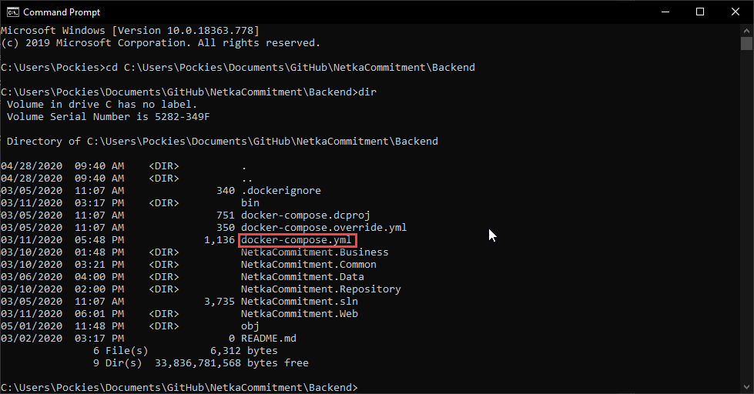
Locate docker-compose.yml

Slide 40
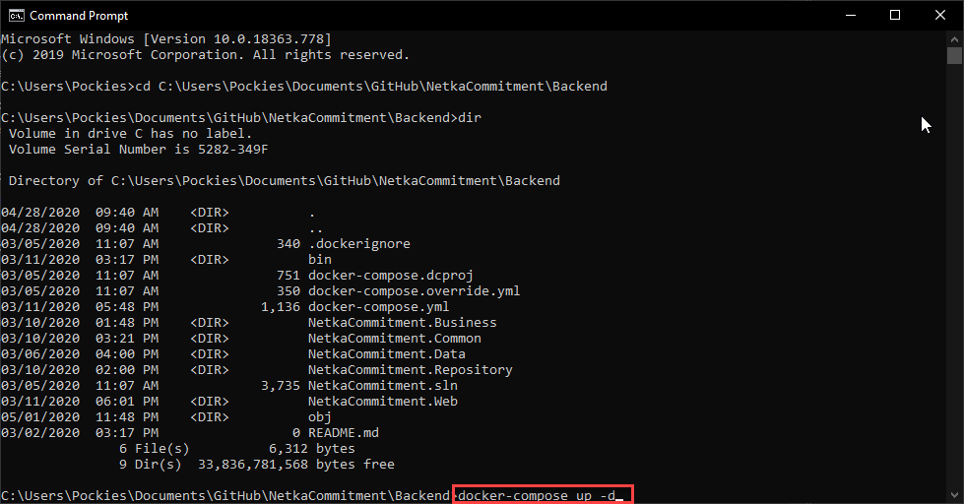
Run docker compose command

Slide 41
Have fun.

