Slide 1

Frontend
Developer Guide

Slide 2
Course Objective
Install dependencies apps for development project
How to run this project
How to development this project

Slide 3
The Audience for this course
Software Developer

Slide 4
Schedule
Chapter 1 : Install apps before develop Netka Commitment
Chapter 2 : Infrastructure overview
Chapter 3 : Testing
Chapter 4 : How to use

Slide 5
Chapter 1 : Install apps before develop Netka Commitment

Slide 6
Topics
Install NodeJS
Install cordova via npm command
Testing command

Slide 7
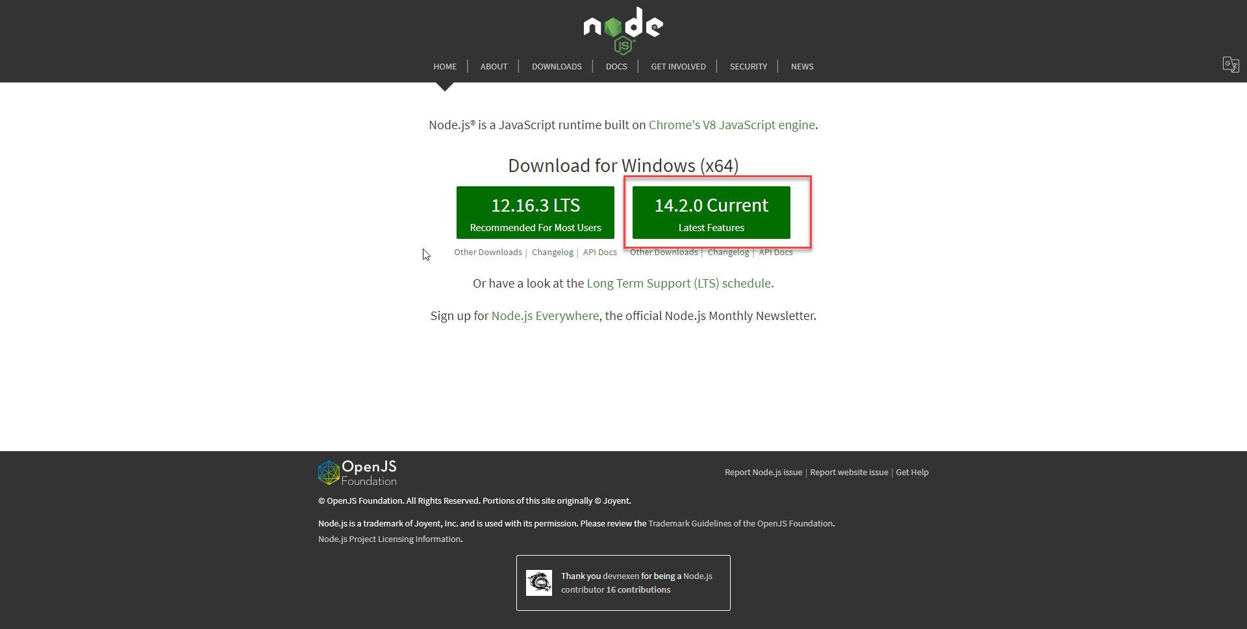
Install NodeJS

Slide 8
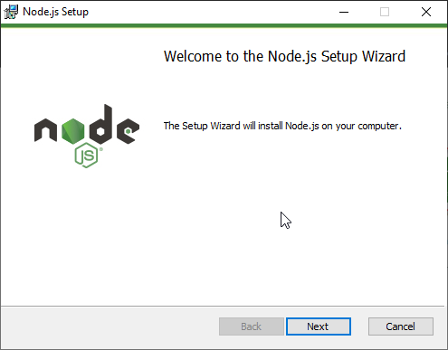
Install NodeJS

Slide 9
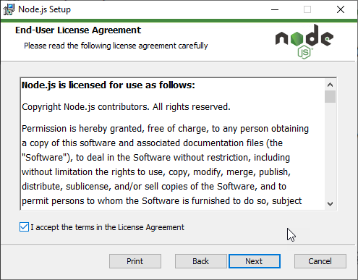
Install NodeJS

Slide 10
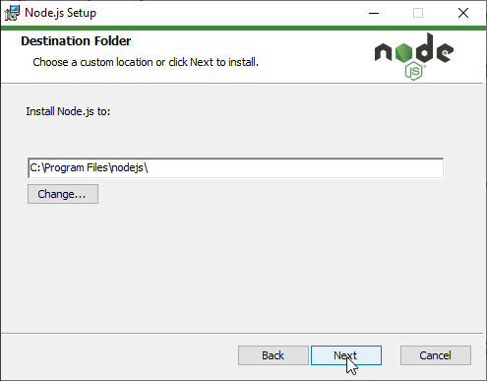
Install NodeJS

Slide 11
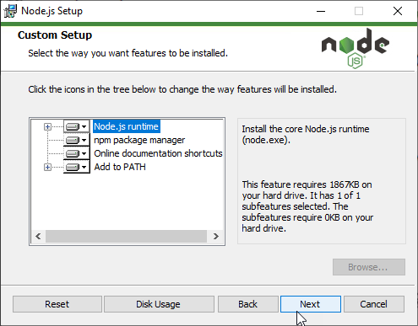
Install NodeJS

Slide 12
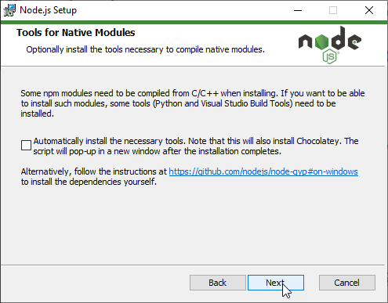
Install NodeJS

Slide 13
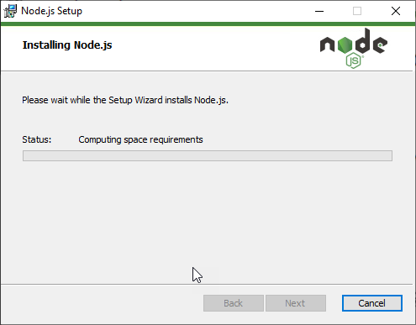
Install NodeJS

Slide 14
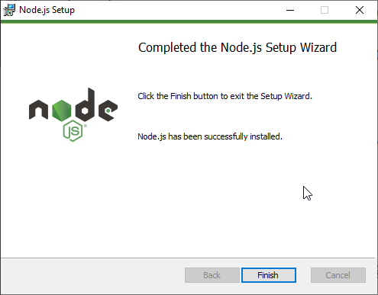
Install NodeJS

Slide 15
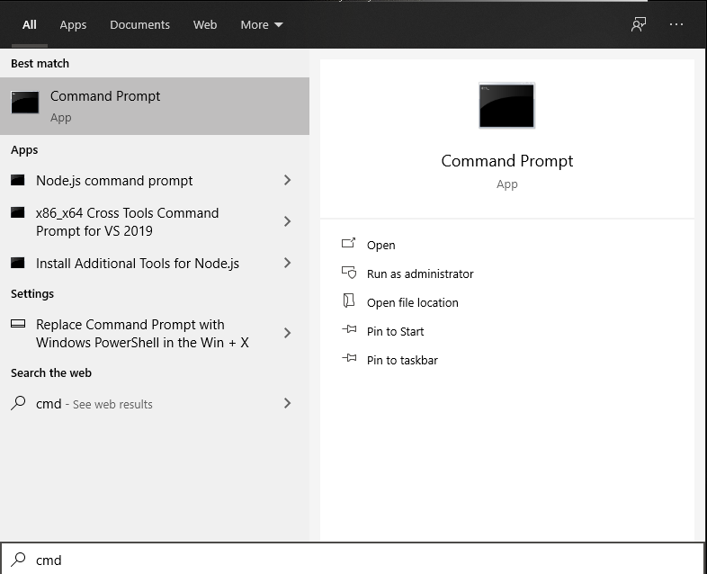
Install cordova via npm command

Slide 16
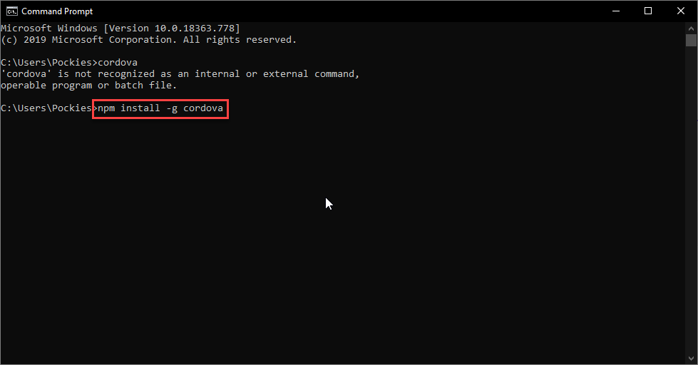
Install cordova via npm command

Slide 17
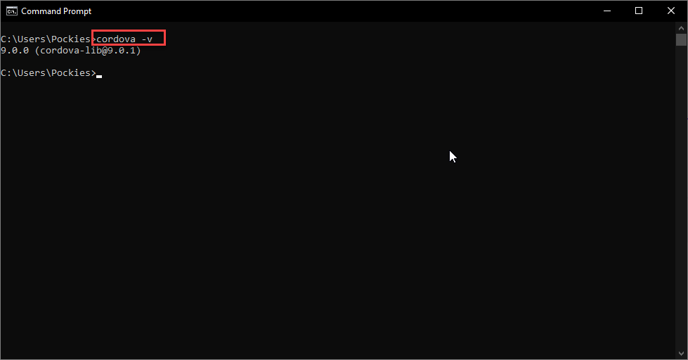
Install cordova via npm command

Slide 18
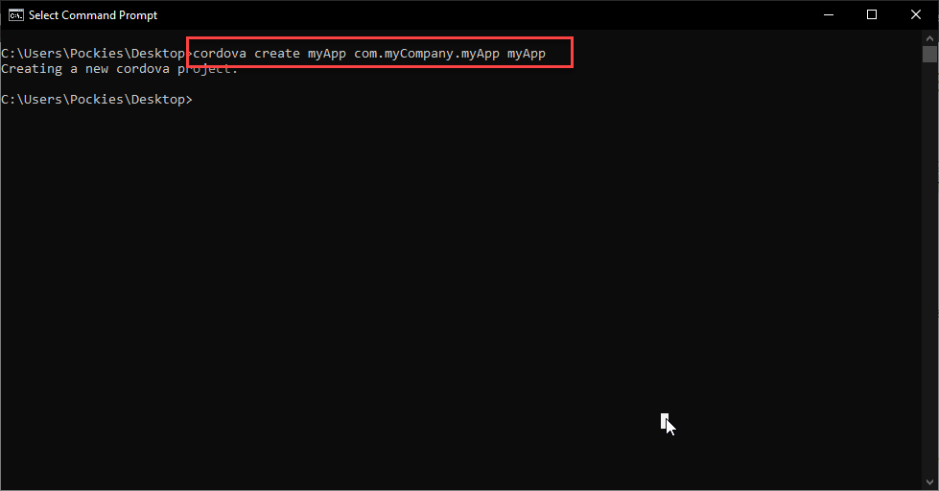
Install cordova via npm command

Slide 19
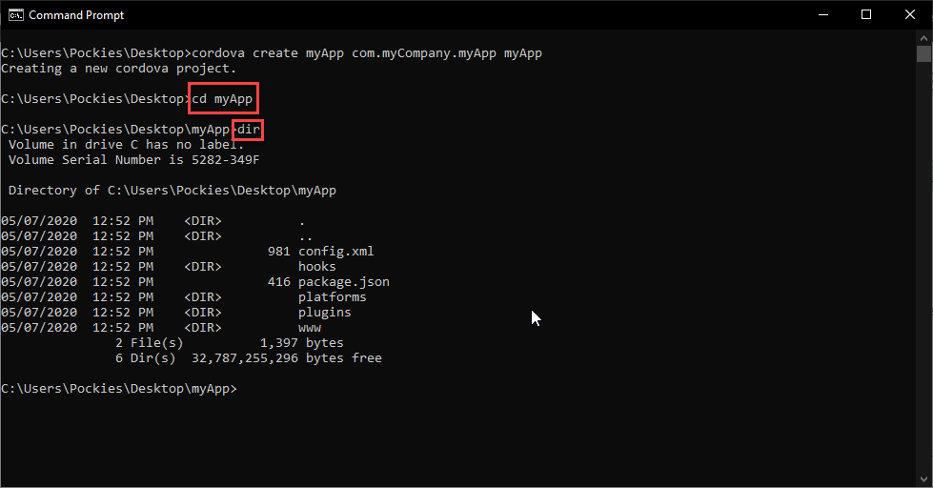
Install cordova via npm command

Slide 20
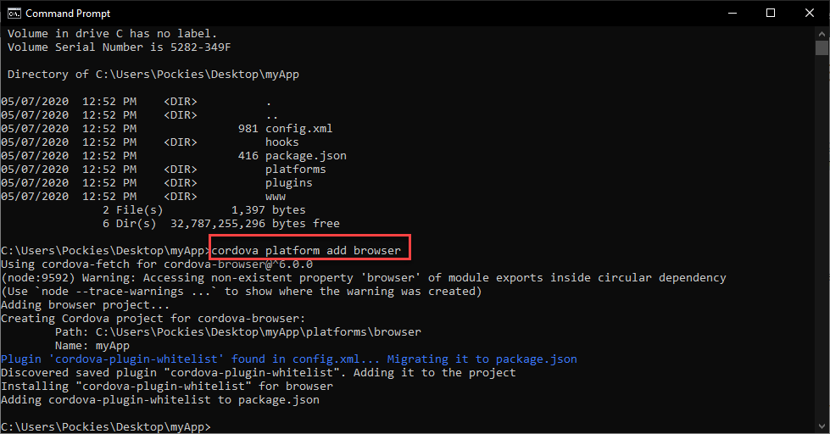
Install cordova via npm command

Slide 21
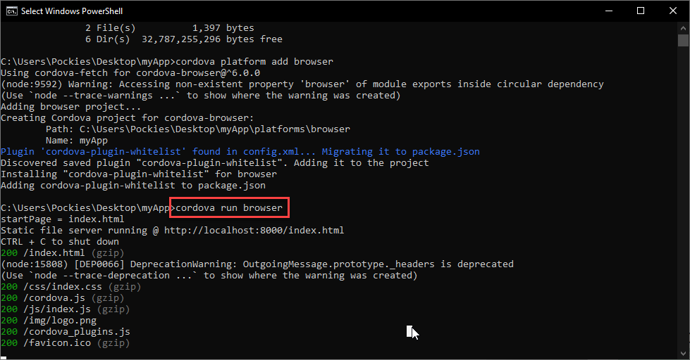
Install cordova via npm command

Slide 22
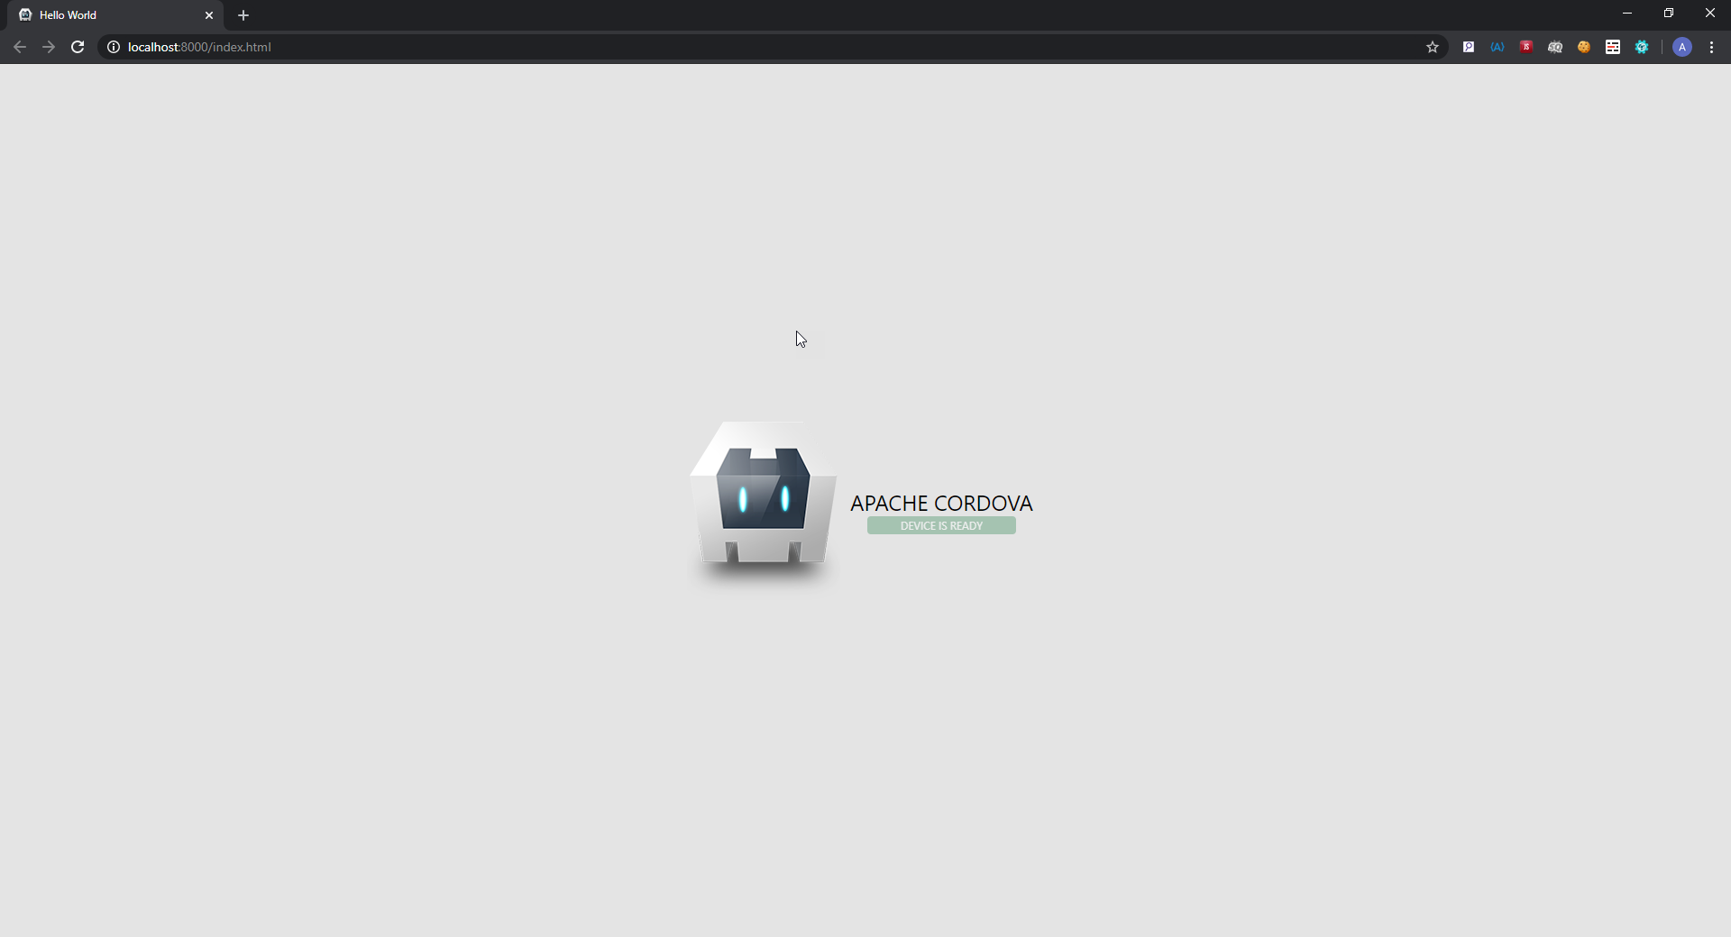
Testing

Slide 23
Have fun.

