Slide 1

DESIGN AND ANALYSIS OF ALGORITHMS
PREPARED BY
AKI SRI CHARAN
181210007
DASARI RAINY
181210018
C.S.E 2ND YEAR

Slide 2
ASSIGNMENT
DIVIDE AND CONQUER
BACKTRACING
DYNAMIC PROGRAMMING
GREEDY METHOD
BRANCH AND BOUND

Slide 3
DIVIDE AND CONQUER
In divide and conquer approach, the problem in hand, is divided into smaller sub-problems and then each problem is solved independently.
When we keep on dividing the subproblems into even smaller sub-problems, we may eventually reach a stage where no more division is possible.

Slide 4
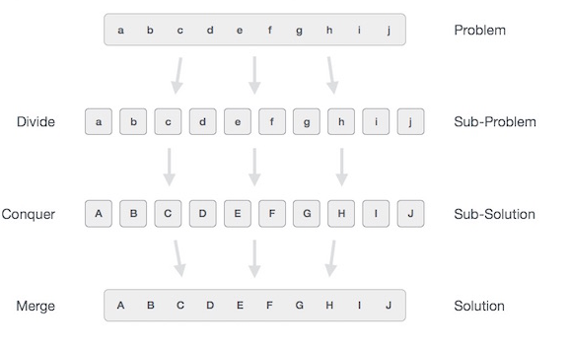
DIVIDE AND CONQUER(CONT.)
The solution of all sub-problems is finally merged in order to obtain the solution of an original problem.

Slide 5
DIVIDE AND CONQUER(STEPS)
Broadly, we can understand divide-and-conquer approach in a three-step process.
1) Divide/Break
This step involves breaking the problem into smaller sub-problems. Sub-problems should represent a part of the original problem. This step generally takes a recursive approach to divide the problem until no sub-problem is further divisible.

Slide 6
DIVIDE AND CONQUER(STEPS)
2) Conquer/Solve
This step receives a lot of smaller sub-problems to be solved. Generally, at this level, the problems are considered 'solved' on their own.
3) Merge/Combine
When the smaller sub-problems are solved, this stage recursively combines them until they formulate a solution of the original problem. This algorithmic approach works recursively and conquer & merge steps works so close that they appear as one.

Slide 7
DIVIDE AND CONQUER(EXAMPLES)
The following algorithms are based on divide-and-conquer programming approach −
Merge Sort
Quick Sort
Binary Search
Strassen's Matrix Multiplication
Closest pair (points)

Slide 8
DIVIDE AND CONQUER (PROBLEM)
Sorting given array using merge sort technique.
The MergeSort function repeatedly divides the array into two halves until we reach a stage where we try to perform MergeSort on a subarray of size 1.
After that, the merge function comes into play and combines the sorted arrays into larger arrays until the whole array is merged.

Slide 9
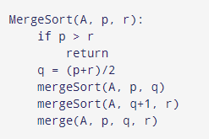
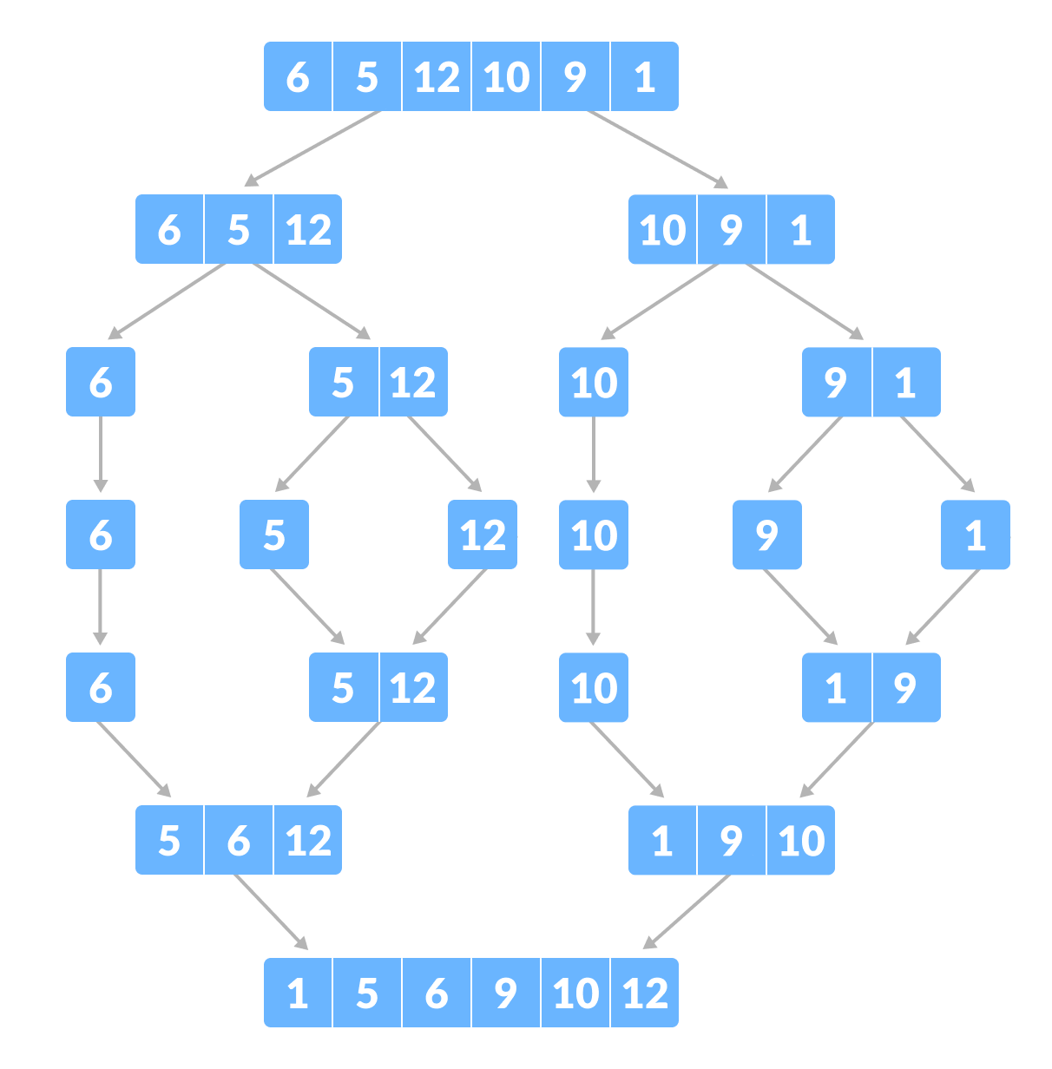
MERGE SORT ALGORITHM AND EXAMPLE

Slide 10
BACK TRACKING
Backtracking can be defined as a general algorithmic technique that considers searching every possible combination in order to solve a computational problem.
Backtracking is an algorithmic-technique for solving problems recursively by trying to build a solution incrementally, one piece at a time, removing those solutions that fail to satisfy the constraints of the problem at any point of time

Slide 11
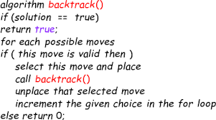
BACKTRACKING ALGORITHM

Slide 12
BACKTRACKING EXAMPLES
Sudoku puzzle
Rat in maze problems
Hamiltonian cycle
Constraint satisfaction

Slide 13
BACKTRACKINGPROBLEM (N-QUEEN PROBLEM)
N-Queens Problem: Given a chess board having N×N cells, we need to place N queens in such a way that no queen is attacked by any other queen. A queen can attack horizontally, vertically and diagonally.

Slide 14
DYNAMIC PROGRAMMING
Dynamic programming is used where we have problems, which can be divided into similar sub-problems, so that their results can be re-used. Mostly, these algorithms are used for optimization.

Slide 15
DYNAMIC PROGRAMMING(CONT.)
Before solving the in-hand sub-problem, dynamic algorithm will try to examine the results of the previously solved sub-problems (memoization). The solutions of sub-problems are combined in order to achieve the best solution.

Slide 16
DYNAMIC PROGRAMMING(EXAMPLES)
The following computer problems can be solved using dynamic programming approach −
Fibonacci number series
Knapsack problem
Tower of Hanoi
All pair shortest path by Floyd-Warshall
Shortest path by Dijkstra
Project scheduling

Slide 17
DYNAMIC PROGRAMMING PROBLEM(FIBONACCI SERIES)
Fibonacci numbers, form a sequence, called the Fibonacci sequence, such that each number is the sum of the two preceding ones, starting from 0 and 1.
We have to print that series for that given number

Slide 18
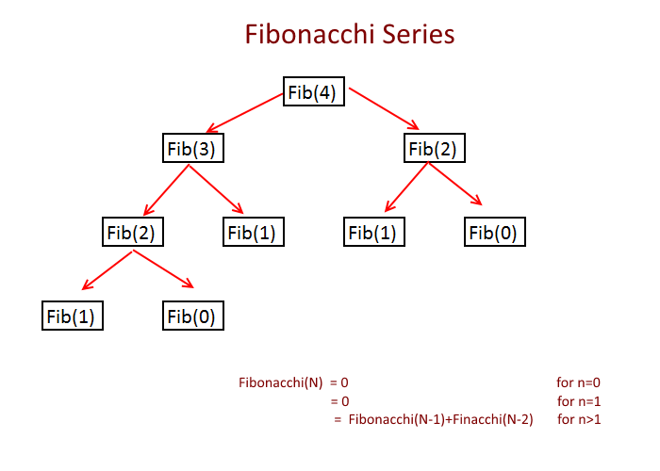
FIBONACCI SERIES

Slide 19
GREEDY METHOD
Greedy is an algorithmic paradigm that builds up a solution piece by piece, always choosing the next piece that offers the most obvious and immediate benefit. So the problems where choosing locally optimal also leads to global solution are best fit for Greedy.

Slide 20
GREEDY METHOD(EXAMPLES)
Huffman coding
Kruskal’s algorithm
Prim’ s algorithm
Dijakstra’s algorithm
Dial’s algorithm

Slide 21
GREEDY METHOD(PROBLEM)
Given a value V, if we want to make change for V Rs, and we have infinite supply of each of the denominations in Indian currency, i.e., we have infinite supply of { 1, 2, 5, 10, 20, 50, 100, 500, 1000} valued coins/notes, what is the minimum number of coins and/or notes needed to make the change?

Slide 22
BRANCH AND BOUND
Branch and bound is an algorithm design paradigm which is generally used for solving combinatorial optimization problems.
The Branch and Bound Algorithm technique solves these problems relatively quickly.(typically exponential in terms of time complexity

Slide 23
BRANCH AND BOUND
It recursively splits the search space into smaller spaces, then minimizing problem on these smaller spaces; the splitting is called branching.
Before enumerating the candidate solutions of a branch, the branch is checked against upper and lower estimated bounds on the optimal solution and is discarded if it cannot produce a better solution than the best one found so far by the algorithm

Slide 24
BRANCH AND BOUND (EXAMPLES)
Implementation of 0/1 Knapsack
8 puzzle Problem
Job Assignment Problem
N Queen Problem
Traveling Salesman Problem

Slide 25
BRANCH AND BOUND (PROBLEM)
Given a set of items, each with a weight and a value, determine the number of each item to include in a collection so that the total weight is less than or equal to a given limit and the total value is as large as possible.

Slide 26

Codes are attached in repository

