Slide 1
Graphs
Name : Ahambarish Saikia
Roll number: 181210005

Slide 2
Introduciton
A Graph is a non-linear data structure consisting of
Nodes aldo called as vertices and edges.
The nodes are sometimes also
referred to as vertices and the edges are lines or arcs
that connect any two nodes in the graph.

Slide 3
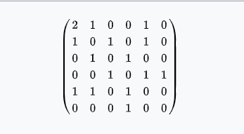
Representing Graphs :
1) Adjacency Matrix :
Its a 2D array of size VxV, where V is the numbr of vertices in the graph. Let the 2D array be adj[][], a slot adj[i][j] = 1/w incadicates that there is an edge form vertex i to vertex j, also W defines a weight.

Slide 4
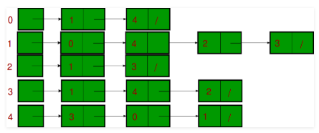
Representation of Graphs
An array of lists is used. Size of the array is equal to the number of vertices. Let the array be array[]. An entry array[i] represents the list of vertices adjacent to the 'ith' vertex. This representation can also be used to represent a weighted graph

Slide 5
REpresentaiton of grpahs
The pair is ordered because (u, v) is not same as (v, u) in
case of a directed graph(di-graph). The pair of the
form (u,v) indicates that there is an
edge from vertex u to vertex v.
The edges may contain weigh/value/cost.

Slide 6
BREADTH FIRST SEARCH OR BFS
Breadth First Traversal (or Search) for a graph is similar to Breadth
First Traversal of a tree. The only catch here is, unlike trees, graphs
may contain cycles, so we may come to the same node again. To
avoid processing a node more than once, we use a boolean visited
array. For simplicity, it is assumed that all vertices are reachable
from the starting vertex.

Slide 7
DEPTH FIRST SEARCH OR DFS
Depth First Traversal (or Search) for a graph is similar to
Depth First Traversal of a tree. The only catch here is,
unlike trees, graphs may contain cycles, so we may come to
the same node again. To avoid processing a node more than
once, we use a boolean visited array.

Slide 8
MINIMUM SPANNING TREES
Given an undirected and connected graph G=(V,E), a
spanning tree of the graph G is a tree that spans G (that is,
it includes every vertex of G) and is a subgraph of G (every
edge in the tree belongs to G)
The cost of the spanning tree is the sum of the weights of
all the edges in the tree. There can be many spanning trees.
Minimum spanning tree is the spanning tree where the cost
is minimum among all the spanning trees. There also can
be many minimum spanning trees.

Slide 9
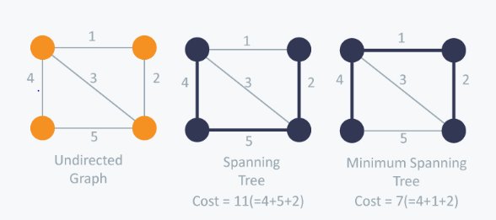

Slide 10
There are two famous algorithms for finding the Minimum Spanning Tree :
Kruskal's Algorithm
Prim's Algorithm

Slide 11
Kruskal's Algorithms :
Kruskal’s Algorithm builds the spanning tree by adding
edges one by one into a growing spanning tree. Kruskal's
algorithm follows greedy approach as in each iteration it
finds an edge which has least weight and add it to the
growing spanning tree.

Slide 12
KRUSKAL’S ALGORITHM :
Algorithms Steps :
Sort the graph edges with respect to their weights.
Start adding edges to the MST from the edge with the smallest weight until the edge of the largest weight.
Only add edges which doesn't form a cycle , edges which connect only
disconnected components.

Slide 13
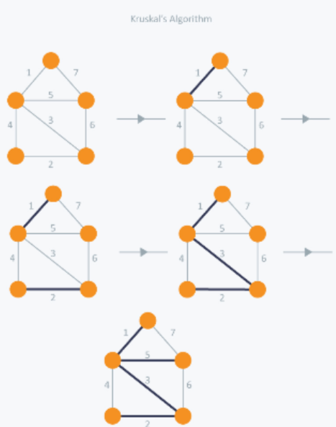

Slide 14
In Kruskal’s algorithm, at each iteration we will select the edge with the
lowest weight. So, we will start with the lowest weighted edge first i.e., the
edges with weight 1.
After that we will select the second lowest weighted edge
i.e., edge with weight 2. Notice these two edges are totally disjoint.
Now, the next edge will be the third lowest weighted edge i.e., edge with weight 3,which connects the two disjoint pieces of the graph.
Now, we are not allowed to pick the edge with weight 4, that will create a cycle and we can’t have any cycles. So we will select the fifth lowest weighted edge i.e., edge with weight 5.
Now the other two edges will create cycles so we will ignore them. In the
end, we end up with a minimum spanning tree with total cost 11 ( = 1 + 2 + 3
+ 5).

Slide 15
PRIM’S ALGORITHM :
Prim’s Algorithm also use Greedy approach to find the
minimum spanning tree. In Prim’s Algorithm we grow the
spanning tree from a starting position. Unlike an edge in
Kruskal's, we add vertex to the growing spanning tree in
Prim's.

Slide 16
Prim's Algorithm :
Algorithm Steps :
Maintain two disjoint sets of vertices. One containing vertices that are in the growing spanning tree and other that are not in the growing spanning tree.
Select the cheapest vertex that is connected to the growing spanning tree and is not in the growing spanning tree and add it into the growing spanning tree. This can be done using Priority Queues. Insert the vertices, that are connected to growing spanning tree, into the Priority Queue.
Check for cycles. To do that, mark the nodes which have been already selected and insert only those nodes in the Priority Queue that are not marked.

Slide 17
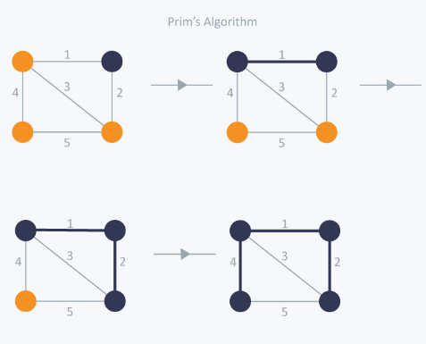

Slide 18
In Prim’s Algorithm, we will start with an arbitrary node (it doesn’t matter which one) and mark it. In each iteration we will mark a new vertex that is adjacent to the one that we have already marked. As a greedy algorithm, Prim’s algorithm will select the cheapest edge and mark the vertex.
So we will simply choose the edge with weight 1. In
the next iteration we have three options, edges with weight 2, 3 and 4. So, we will select the edge with weight 2 and mark the vertex.
Now again we have three options, edges with weight 3, 4 and 5. Butwe can’t choose edge with weight 3 as it is creating a cycle. So wewill select the edge with weight 4 and we end up with the minimumspanning tree of total cost 7 ( = 1 + 2 +4).

Slide 19
SINGLE-SOURCE SHORTEST PATHS –
DIJKSTRA’S ALGORITHM
Given a source vertex s from set of vertices V in a
weighted graph where all its edge weights w(u, v) are
non-negative, we can find the shortest-path weights d(s, v)
from given source s for all vertices v present in the graph.
Vertex | Minimum cost | Path
A ---> B | 4 | A--->E--->B
A--->C | 6 | A--->E--->B--->C
A--->D | 5 | A--->E--->D
A--->E | 3 | A--->E

Slide 20
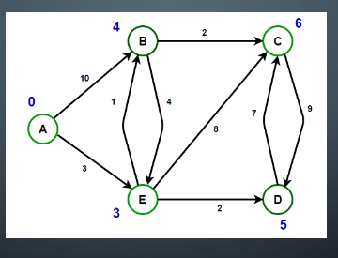

Slide 21
ALL-PAIRS SHORTEST PATHS :
The all pair shortest path algorithm is also known as
Floyd-Warshall algorithm is used to find all pair shortest path
problem from a given weighted graph. As a result of this algorithm, it will generate a matrix,
which will represent the minimum distance
from any node to all other nodes in the graph.

Slide 22
At first the output matrix is same as given cost matrix of the graph. After that the output matrix will be
updated with all vertices k as theintermediate vertex.
The time complexity of this algorithm is O(V3), here V is the
number of vertices in the graph.

Slide 23
THE COST MATRIX OF GRAPH :
0 3 6 ∞ ∞ ∞ ∞
3 0 2 1 ∞ ∞ ∞
6 2 0 1 4 2 ∞
∞ 1 1 0 2 ∞ 4
∞ ∞ 4 2 0 2 1
∞ ∞ 2 ∞ 2 0 1
∞ ∞ ∞ 4 1 1 0

Slide 24
MATRIX OF ALL PAIR SHORTEST
PATH(OUTPUT)
0 3 4 5 6 7 7
3 0 2 1 3 4 4
4 2 0 1 3 2 3
5 1 1 0 2 3 3
6 3 3 2 0 2 1
7 4 2 3 2 0 1
7 4 3 3 1 1 0

Slide 25
ALGORITHM – FLOYD WARSHAL
Begin
for k := 0 to n, do
for i := 0 to n, do
for j := 0 to n, do
if cost[i,k] + cost[k,j] < cost[i,j], then
cost[i,j] := cost[i,k] + cost[k,j]
done
done
done
display the current cost matrix
End

