Slide 1
Design and Analysis of Algorithms
Submitted to: Chandresh Kumar Maurya
Submitted by:Mayank Bhandari(181210030) and
Dharam singh Meena(181210020)
Cse 2nd year(2022)

Slide 2
Dynamic programming
Problem Statement:(0-1 knapsack problem)
Given weights and values of n items, put these items in a knapsack of capacity W to get the maximum total value in the knapsack. In other words, given two integer arrays val[0..n-1] and wt[0..n-1] which represent values and weights associated with n items respectively. Also given an integer W which represents knapsack capacity, find out the maximum value subset of val[] such that sum of the weights of this subset is smaller than or equal to W.
0-1 property :we cannot divide any item ,we have to take it all or leave it

Slide 3
Solution Approach
The idea is to use recursion to solve this problem.For each item, there are two possibilties -
We include current item in KnapSack and recur for remaining items with decreased capacity of KnapSack.If the capacity becomes –ve, do not recur and return –INFINITY.
We exlude current item from KnapSack and recur for remaining items.
Finally, we return maximum value we get by inlcuding or excluding current item.
Base Case: when no items are left or capacity becomes 0.

Slide 4
Recursive approach(without DP)
int knapSack(int W, int wt[], int val[], int n)
{
// Base Case
if (n == 0 || W == 0)
return 0;
// If weight of the nth item is more
// than Knapsack capacity W, then
// this item cannot be included
// in the optimal solution
if (wt[n-1] > W)
return knapSack(W, wt, val, n-1);
// Return the maximum of two cases:
// (1) nth item included
// (2) not included
else return max( val[n-1] + knapSack(W-wt[n-1], wt, val, n-1),
knapSack(W, wt, val, n-1) );
}

Slide 5
.
In the following recursion tree, K() refers to knapSack(). The two parameters indicated in the following recursion tree are n and W. The recursion tree is for following sample inputs. wt[] = {1, 1, 1}, W = 2, val[] = {10, 20, 30} K(3, 2) ---------> K(n, W) / \ / \ K(2,2) K(2,1) / \ / \ / \ / \ K(1,2) K(1,1) K(1,1) K(1,0) / \ / \ / \ / \ / \ / \ K(0,2) K(0,1) K(0,1) K(0,0) K(0,1) K(0,0)
Recursion tree for Knapsack capacity 2 units and 3 items of 1 unit weight.
From the Above tree we can note that,many subproblems are repeating themself.(Overlapping Subproblems)
So we can store them for their reuse(Memoization).

Slide 6
The above solution has an optimal sustructure and overlapping subproblems.
Optimal substructure : optimal solution can be constructed efficiently from optimal solution of its subproblems.
Overlapping subproblems : the problem can be broken down into subproblems which are reused several times.
In order to reuse subproblems solutions, we can apply Dynamic programming, in which subproblem solutions are Memorized rather than computed over and over again.

Slide 7
Solution using Memorization(DP)
#include <bits/stdc++.h>
using namespace std;
Int dp[1001][1001];
// return max value for Weight W
int knapSack(int W, int wt[], int val[], int n){
// Base Case
if (n == 0 || W == 0)
return 0;
//if already calculated
if(dp[n][W] != -1)
return dp[n][W];
// If weight of the nth item is more
// than Knapsack capacity W, then
// this item cannot be included
// in the optimal solution
if (wt[n-1] > W)
return (dp[n][W]=knapSack(W, wt, val, n-1));
// Return the maximum of two cases:
// (1) nth item included
Int inc = knapSack(W-wt[n-1], wt, val, n-1);
// (2) not included
Int exc = knapSack(W, wt, val, n-1);
else return (dp[n][W] = max(val[n-1]+inc,exc);
}
int main()
{
int val[] = {60, 100, 120};
int wt[] = {10, 20, 30};
int W = 50;
int n = 3;
For(int I=0;I<n+1;I++){
For(int j=0;j<W+1;j++){ dp[I][j] = -1;
}
}
cout<<knapSack(W, wt, val, n);
return 0;
}

Slide 8
Branch and Bound approach
Problem Statement:(0-1 knapsack problem)
Given two arrays v[] and w[] that represent values and weights associated with n items respectively. Find out the maximum value subset(Maximum Profit) of v[] such that sum of the weights of this subset is smaller than or equal to Knapsack capacity Cap(W).
0/1 property :we can divide any item ,we can take a proportion of any item.

Slide 9
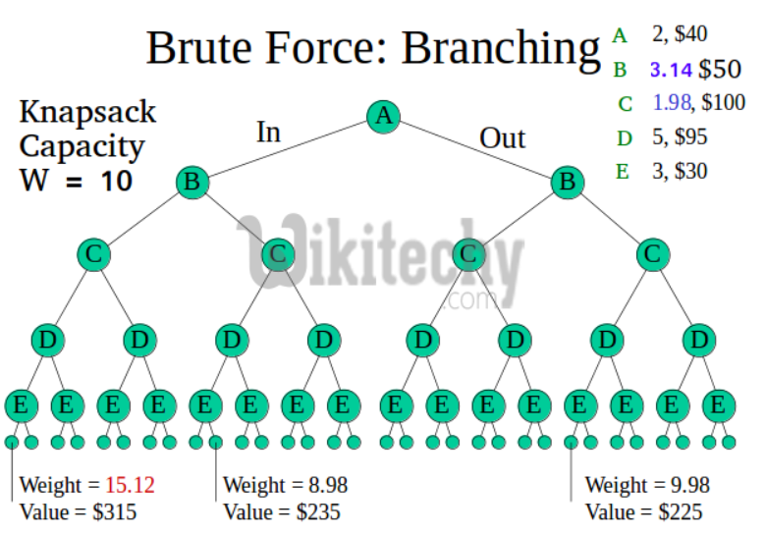
Other Methods to solve Knapsack problem:
Greedy Approach: It gives optimal solution if we are talking about fraction Knapsack. (By taking items according to V/W ratio). For 0/1 Knapsack it may or may not give optimal solution.
Dynamic Approach: In this approach, we use a 2D table of size n x W(capacity). It doesn’t work if the capacity is not integer.
Brute Force: With n items, there are 2^n solutions to be generated, check each to see if they satisfy the constraint, save maximum solution that satisfies constraint. This solution can be expressed as tree.
Backtracking: Use Backtracking to optimize the Brute Force solution. If we reach a point where a solution no longer is feasible, there is no need to continue exploring. In the given example, backtracking would be much more effective if we had even more items or a smaller knapsack capacity.

Slide 10
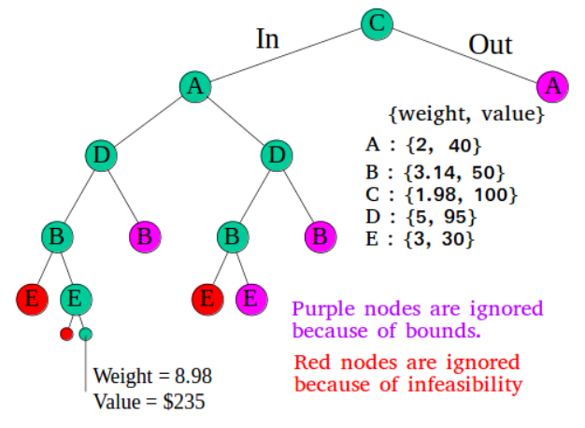
Solution Approach
The backtracking based solution works better than brute force by ignoring infeasible solutions.
To do better (than backtracking) if we know a bound on best possible solution subtree rooted with every node.
If the best in subtree is worse than current best, we can simply ignore this node and its subtrees.
So we compute bound (best solution) for every node and compare the bound with current best solution before exploring the node.

Slide 11
.
To find bound for every node for Knapsack:
To check if a particular node can give us a better solution or not, we compute the optimal solution (through the node) using Greedy method. If the solution computed by Greedy approach is more than the best until now , then we can’t get a better solution through the node.
Branch and bound is very useful technique for searching a solution but in worst case, we need to fully calculate the entire tree. At best, we only need to fully calculate one path through the tree and prune the rest of it.

Slide 12
Algorithm (KnapSack 0/1 using BAB)
Sort all items in decreasing order of V/W so that upper bound can be computed using Greedy Approach.(The nodes taken in the image are accordingly.)
Initialize profit, max = 0
Create an empty queue, Q.
Create a dummy node of decision tree and enqueue it to Q. Profit and weight of dummy node are 0.
Do while (Q is not empty).
Extract an item from Q. Let the item be x.
Compute profit of next level node. If the profit is more than max, then update max. (Profit from root to this node (include this node)).
Compute bound of next level node. If bound is more than max, then add next level node to Q.(Upper Bound of the maximum Profit in subtree of this node)
Consider the case when next level node is not considered as part of solution and add a node to queue with level as next, but weight and profit without considering next level nodes.

Slide 13
Code (KnapSack using BAB)
#include <bits/stdc++.h>
using namespace std;
struct Item {
float weight;
int value; };
struct Node {
int level, profit, bound;
float weight; };
bool cmp (Item a, Item b) {
double r1 = (double) a.value / a.weight;
double r2 = (double)b.value / b.weight;
return r1 > r2; }
int bound(Node u, int n, int W, Item arr[]) {
if (u.weight >= W) return 0;
int profit_bound = u.profit;
int j = u.level + 1; //including next items
int totweight = u.weight;
while ((j < n) && (totweight + arr[j].weight <= W)) {
//checking KnapSack condition
totweight += arr[j].weight;
profit_bound += arr[j].value; //increasing current profit
j++; }
if (j < n) //increase currrent profit for last item
profit_bound += (W - totweight) * arr[j].value / arr[j].weight;
return profit_bound; }

Slide 14
.
// Returns maximum profit we can get with capacity W
int knapsack(int W, Item arr[], int n) {
sort(arr, arr + n, cmp);
queue<Node> Q;
Node u, v;
u.level = -1; u.profit = u.weight = 0; //initialize dummy as starting node
Q.push(u);
int maxProfit = 0;
while (!Q.empty()) { //Do while (Q is not empty).
u = Q.front(); //Extract an item from Q. Let the item be u.
Q.pop();
if (u.level == -1) //if at dummy node next level will be 0
v.level = 0;
if (u.level == n-1) //if it is last level
continue;
v.level = u.level + 1; //Compute profit of next level node.
v.weight = u.weight + arr[v.level].weight;
v.profit = u.profit + arr[v.level].value;
if (v.weight <= W && v.profit > maxProfit)
maxProfit = v.profit; //If the profit is more than max, then update max.
v.bound = bound(v, n, W, arr); //Compute bound of next level node.
if (v.bound > maxProfit)
Q.push(v); //If bound is more than max, then add next level node to Q.
v.weight = u.weight; //when next level node is not considered as part of solution
v.profit = u.profit; //but weight and profit without considering next level nodes.
v.bound = bound(v, n, W, arr);
if (v.bound > maxProfit)
Q.push(v); } ////add a node to queue with level as next
return maxProfit; }
int main() {
int W = 10; // Weight of knapsack
Item arr[] = {{2, 40}, {3.14, 50}, {1.98, 100},
{5, 95}, {3, 30}};
int n = sizeof(arr) / sizeof(arr[0]);
cout << "Maximum possible profit = " << knapsack(W, arr, n);
return 0; }

Slide 15
.
Divide and Conquer
Problem Statement:
The problem statement is simple, we have to implement power function using divide and conquer approach. If we want to implement it the approach is simple as shown:
But the above function will take O(n) time.
long power(int a, int n){
long prod = 1, i=0;
for(; i<n; i++)
prod = prod * a;
return prod;
}

Slide 16
Solution Approach
The solution approach shown above multiplies ‘a’, ‘n’ times. As a result the complexity of the solution approach becomes equal to O(n).
i.e the solution approach does something like this: a*a*……..n-times
Hence, we use Divide and conquer approach to solve the given problem, which reduces the time complexity to O(logn).
Example: if we have to perform the operation a^16, by using the approach of Divide and Conquer, the operation is simplified as shown.
(((a^2)^2)^2)^2
This clearly shows that each time, a is squared, rather than multiplying it with itself for 16 times.

Slide 17
Solution without Divide and Conquer
#include <stdio.h>
// Naive iterative solution to calculate pow(x, n)
int power(int x, unsigned n)
{ // initialize result by 1
int pow = 1;
// multiply x exactly n times
for (int i = 0; i < n; i++)
pow = pow*x;
return pow; }
// main function
int main(void) {
int x = -2;
unsigned n = 10;
printf("pow(%d,%d) = %d", x, n, power(x, n));
return 0; }

Slide 18
Solution using Divide and Conquer
#include <stdio.h>
// Optimized recursive solution to calculate pow(x, n) using divide and conquer
int power(int x, unsigned n) {
// base condition
if (n == 0)
return 1;
// calculate sub-problem recursively
int pow = power(x, n / 2);
if (n & 1) // if y is odd
return x * pow * pow;
// else y is even
return pow * pow; }
int main(void){
int x = -2;
unsigned n = 10;
printf("pow(%d,%d) = %d", x, n, power(x, n));
return 0; }

Slide 19
Backtracking
Problem Statement:
Arrange N queens in an NXN chessboard, so that no two queens can strike down any other queen.
This problem seems to be very complex at the first go, but becomes even more difficult, when it comes to code to find the result. Let’s look at the solution approach to such a problem.

Slide 20
Solution Approach
The solution to this kind of problem lies on whether the step taken will lead us to the solution(success) or not. Hence, after each move, it is important to see whether we can reach the solution or not. If no, then we must take a step back, and move in a way so as to achieve the success. If we find no such way, then we must undo one more step. Similarly, if we reach the root, this means there is no way to reach the solution with the given conditions. This approach of achieving the result by backpropagating is called backtracking.
The solution to the NXN queen problem is shown in the following pages.

Slide 21
#include <stdio.h>
//Number of queens
int N;
//chessboard
int board[100][100];
//function to check if the cell is attacked or not
int is_attack(int i,int j) {
int k,l;
//checking if there is a queen in row or column
for(k=0;k<N;k++) {
if((board[i][k] == 1) || (board[k][j] == 1))
return 1; }
//checking for diagonals
for(k=0;k<N;k++) {
for(l=0;l<N;l++)
{
if(((k+l) == (i+j)) || ((k-l) == (i-j)))
{
if(board[k][l] == 1)
return 1; }
}
}
return 0;
}
int N_queen(int n) {
int i,j;
//if n is 0, solution found
if(n==0)
return 1;
for(i=0;i<N;i++) {
for(j=0;j<N;j++) {
//checking if we can place a queen here or not
//queen will not be placed if the place is being attacked
//or already occupied
if((!is_attack(i,j)) && (board[i][j]!=1)) {
board[i][j] = 1;
//recursion
//wether we can put the next queen with this arrangment or not
if(N_queen(n-1)==1) {
return 1;}
board[i][j] = 0;
} } } return 0; }

Slide 22
int main() {
//taking the value of N
printf("Enter the value of N for NxN chessboard\n");
scanf("%d",&N);
int i,j;
//setting all elements to 0
for(i=0;i<N;i++) {
for(j=0;j<N;j++) {
board[i][j]=0; }
}
//calling the function
N_queen(N);
//printing the matix
for(i=0;i<N;i++)
{
for(j=0;j<N;j++)
printf("%d\t",board[i][j]);
printf("\n");
}

Slide 23
Greedy
Problem Statement:
You are given n activities with their start and finish times. Select the maximum number of activities that can be performed by a single person, assuming that a person can only work on a single activity at a time.

Slide 24
Solution Approach
The greedy choice is to always pick the next activity whose finish time is least among the remaining activities and the start time is more than or equal to the finish time of previously selected activity. We can sort the activities according to their finishing time so that we always consider the next activity as minimum finishing time activity.

Slide 25
#include <bits/stdc++.h>
using namespace std;
// A job has a start time, finish time and profit.
struct Activity {
int start, finish; };
// A utility function that is used for sorting activities according to finish time
bool activityCompare(Activity s1, Activity s2) {
return (s1.finish < s2.finish); }
// Returns count of the maximum set of activities that can
// be done by a single person, one at a time.
void printMaxActivities(Activity arr[], int n) {
// Sort jobs according to finish time
sort(arr, arr+n, activityCompare);
cout << "Following activities are selected n";
// The first activity always gets selected
int i = 0;
cout << "(" << arr[i].start << ", " << arr[i].finish << "), ";
// Consider rest of the activities
for (int j = 1; j < n; j++) {
// If this activity has start time greater than or equal to the finish //time of previously selected activity, then select it
if (arr[j].start >= arr[i].finish) {
cout << "(" << arr[j].start << ", "<< arr[j].finish << "), ";
i = j; }
}
}
// Driver program
int main() {
Activity arr[] = {{5, 9}, {1, 2}, {3, 4}, {0, 6}, {5, 7}, {8, 9}};
int n = sizeof(arr)/sizeof(arr[0]);
printMaxActivities(arr, n);
return 0;
}

