Slide 1
Graphs
Name: Beeta samad
Roll Number: 181210016

Slide 2
Introduction
A Graph is a non-linear data structure consisting of nodes and edges. The nodes are sometimes also referred to as vertices and the edges are lines or arcs that connect any two nodes in the graph.

Slide 3
introduction
A Graph consists of a finite set of vertices(or nodes) and set of Edges which connect a pair of nodes.

Slide 4
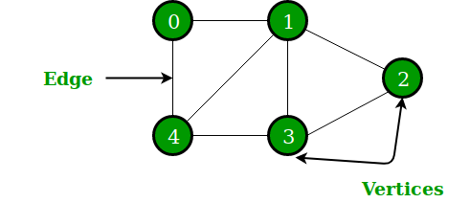
Introduction

Slide 5
Graph and its representations
Graph is a data structure that consists of following two components: 1. A finite set of vertices also called as nodes. 2. A finite set of ordered pair of the form (u, v) called as edge.

Slide 6
Graph and its representations
The pair is ordered because (u, v) is not same as (v, u) in case of a directed graph(di-graph). The pair of the form (u, v) indicates that there is an edge from vertex u to vertex v. The edges may contain weight/value/cost.

Slide 7
Breadth First Search or BFS
Breadth First Traversal (or Search) for a graph is similar to Breadth First Traversal of a tree. The only catch here is, unlike trees, graphs may contain cycles, so we may come to the same node again. To avoid processing a node more than once, we use a boolean visited array. For simplicity, it is assumed that all vertices are reachable from the starting vertex.

Slide 8
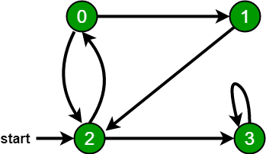
For example, in the following graph, we start traversal from vertex 2. When we come to vertex 0, we look for all adjacent vertices of it. 2 is also an adjacent vertex of 0. If we don’t mark visited vertices, then 2 will be processed again and it will become a non-terminating process. A Breadth First Traversal of the following graph is 2, 0, 3, 1.

Slide 9
Depth First Search or DFS
Depth First Traversal (or Search) for a graph is similar to Depth First Traversal of a tree. The only catch here is, unlike trees, graphs may contain cycles, so we may come to the same node again. To avoid processing a node more than once, we use a boolean visited array.

Slide 10
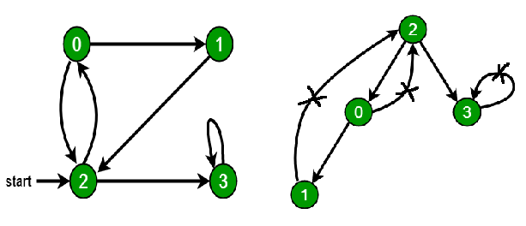
For example, in the following graph, we start traversal from vertex 2. When we come to vertex 0, we look for all adjacent vertices of it. 2 is also an adjacent vertex of 0. If we don’t mark visited vertices, then 2 will be processed again and it will become a non-terminating process. A Depth First Traversal of the following graph is 2, 0, 1, 3.

Slide 11
MINIMUM SPANNING TREES
Given an undirected and connected graph G=(V,E), a spanning tree of the graph G is a tree that spans G (that is, it includes every vertex of G) and is a subgraph of G (every edge in the tree belongs to G)

Slide 12
The cost of the spanning tree is the sum of the weights of all the edges in the tree. There can be many spanning trees. Minimum spanning tree is the spanning tree where the cost is minimum among all the spanning trees. There also can be many minimum spanning trees.

Slide 13
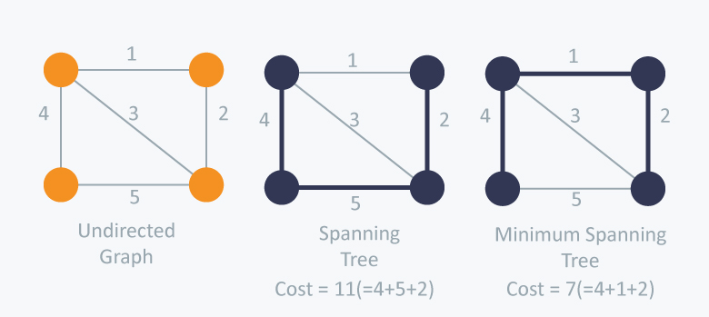

Slide 14
There are two famous algorithms for finding the Minimum Spanning Tree:
- Kruskal’s Algorithm
- Prim’s Algorithm

Slide 15
Kruskal’s Algorithm
Kruskal’s Algorithm builds the spanning tree by adding edges one by one into a growing spanning tree. Kruskal's algorithm follows greedy approach as in each iteration it finds an edge which has least weight and add it to the growing spanning tree.

Slide 16
Kruskal’s Algorithm
Algorithm Steps:
Sort the graph edges with respect to their weights.
Start adding edges to the MST from the edge with the smallest weight until the edge of the largest weight.
Only add edges which doesn't form a cycle , edges which connect only disconnected components.

Slide 17
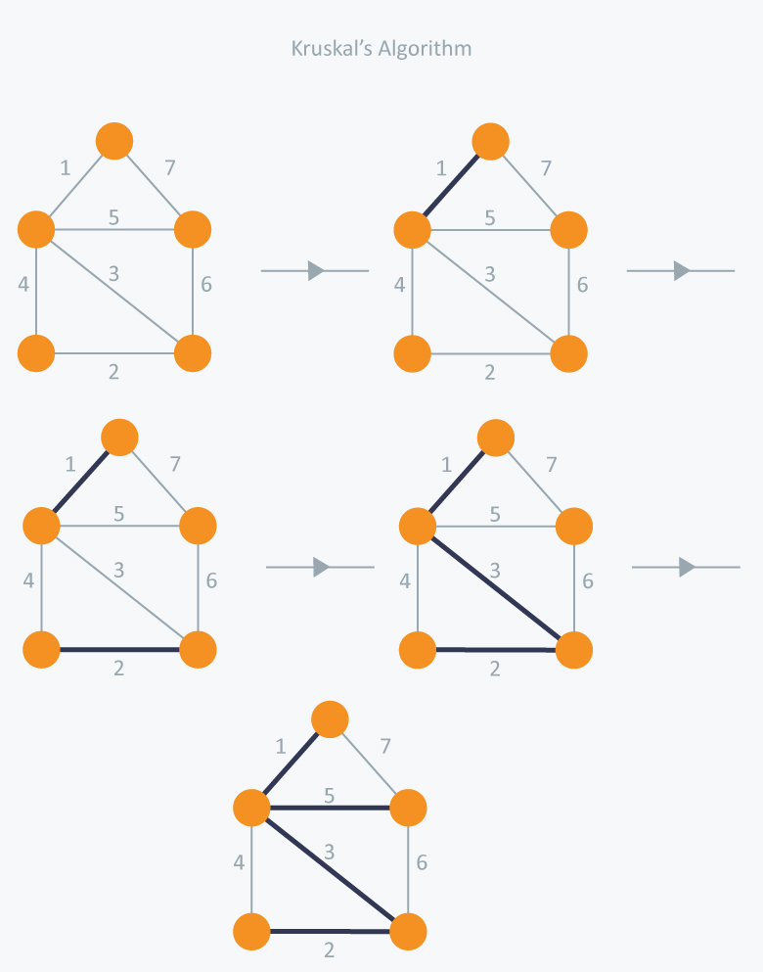

Slide 18
In Kruskal’s algorithm, at each iteration we will select the edge with the lowest weight. So, we will start with the lowest weighted edge first i.e., the edges with weight 1. After that we will select the second lowest weighted edge i.e., edge with weight 2. Notice these two edges are totally disjoint. Now, the next edge will be the third lowest weighted edge i.e., edge with weight 3, which connects the two disjoint pieces of the graph. Now, we are not allowed to pick the edge with weight 4, that will create a cycle and we can’t have any cycles. So we will select the fifth lowest weighted edge i.e., edge with weight 5. Now the other two edges will create cycles so we will ignore them. In the end, we end up with a minimum spanning tree with total cost 11 ( = 1 + 2 + 3 + 5).

Slide 19
Prim’s Algorithm
Prim’s Algorithm also use Greedy approach to find the minimum spanning tree. In Prim’s Algorithm we grow the spanning tree from a starting position. Unlike an edge in Kruskal's, we add vertex to the growing spanning tree in Prim's.

Slide 20
Prim’s Algorithm
Algorithm Steps:
Maintain two disjoint sets of vertices. One containing vertices that are in the growing spanning tree and other that are not in the growing spanning tree.
Select the cheapest vertex that is connected to the growing spanning tree and is not in the growing spanning tree and add it into the growing spanning tree. This can be done using Priority Queues. Insert the vertices, that are connected to growing spanning tree, into the Priority Queue.
Check for cycles. To do that, mark the nodes which have been already selected and insert only those nodes in the Priority Queue that are not marked.

Slide 21
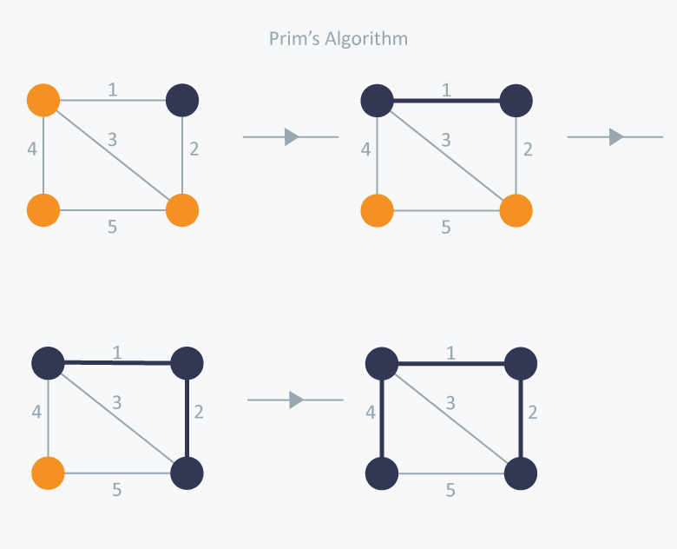

Slide 22
In Prim’s Algorithm, we will start with an arbitrary node (it doesn’t matter which one) and mark it. In each iteration we will mark a new vertex that is adjacent to the one that we have already marked. As a greedy algorithm, Prim’s algorithm will select the cheapest edge and mark the vertex. So we will simply choose the edge with weight 1. In the next iteration we have three options, edges with weight 2, 3 and 4. So, we will select the edge with weight 2 and mark the vertex. Now again we have three options, edges with weight 3, 4 and 5. But we can’t choose edge with weight 3 as it is creating a cycle. So we will select the edge with weight 4 and we end up with the minimum spanning tree of total cost 7 ( = 1 + 2 +4).

Slide 23
Single-Source Shortest Paths – Dijkstra’s Algorithm
Given a source vertex s from set of vertices V in a weighted graph where all its edge weights w(u, v) are non-negative, we can find the shortest-path weights d(s, v) from given source s for all vertices v present in the graph.

Slide 24
For example,
Vertex | Minimum Cost | Route
A -> B | 4 | A -> E -> B
A -> C | 6 | A -> E -> B -> C
A -> D | 5 | A -> E -> D
A -> E | 3 | A -> E

Slide 25
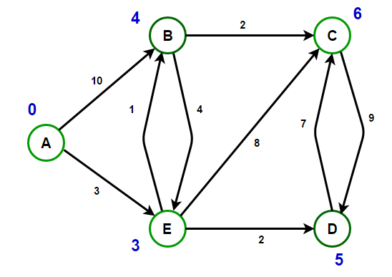

Slide 26
Dijkstra’s Algorithm is an algorithm for finding the shortest paths between nodes in a graph. For a given source node in the graph, the algorithm finds the shortest path between that node and every other node. It can also be used for finding the shortest paths from a single node to a single destination node by stopping the algorithm once the shortest path to the destination node has been determined.

Slide 27
All-Pairs Shortest Paths
The all pair shortest path algorithm is also known as Floyd-Warshall algorithm is used to find all pair shortest path problem from a given weighted graph. As a result of this algorithm, it will generate a matrix, which will represent the minimum distance from any node to all other nodes in the graph.

Slide 28
At first the output matrix is same as given cost matrix of the graph. After that the output matrix will be updated with all vertices k as the intermediate vertex.
The time complexity of this algorithm is O(V3), here V is the number of vertices in the graph.

Slide 29
Input − The cost matrix of the graph
0 3 6 ∞ ∞ ∞ ∞
3 0 2 1 ∞ ∞ ∞
6 2 0 1 4 2 ∞
∞ 1 1 0 2 ∞ 4
∞ ∞ 4 2 0 2 1
∞ ∞ 2 ∞ 2 0 1
∞ ∞ ∞ 4 1 1 0

Slide 30
Output − Matrix of all pair shortest path
0 3 4 5 6 7 7
3 0 2 1 3 4 4
4 2 0 1 3 2 3
5 1 1 0 2 3 3
6 3 3 2 0 2 1
7 4 2 3 2 0 1
7 4 3 3 1 1 0

Slide 31
Algorithm – Floyd Warshal
Begin
for k := 0 to n, do
for i := 0 to n, do
for j := 0 to n, do
if cost[i,k] + cost[k,j] < cost[i,j], then
cost[i,j] := cost[i,k] + cost[k,j]
done
done
done
display the current cost matrix
End

