Slide 1
BAckTRAcking

Slide 2
What is back tracking??
Backtracking is an algorithmic-technique for solving problems recursively by trying to build a solution incrementally, one piece at a time, removing those solutions that fail to satisfy the constraints of the problem at any point of time .
Backtracking is a systematic way of trying out different sequences of decisions until we find one that "works.“
Backtracking, it is all about knowing when to stop and step back to explore other possible solutions

Slide 3
The Algorithmic Approach
Backtracking systematically try and search possibilities to find the solution. Also it is an important process for solving constraint satisfaction problem like crossword, Sudoku and many other puzzles. It can be more continent technique for parsing other combinatorial optimization problem.
Basically the process is used when the problem has a number of option and just one solution have to be selected. After having a new option set means recursion, the procedure is repeated over and over until final stage.

Slide 4
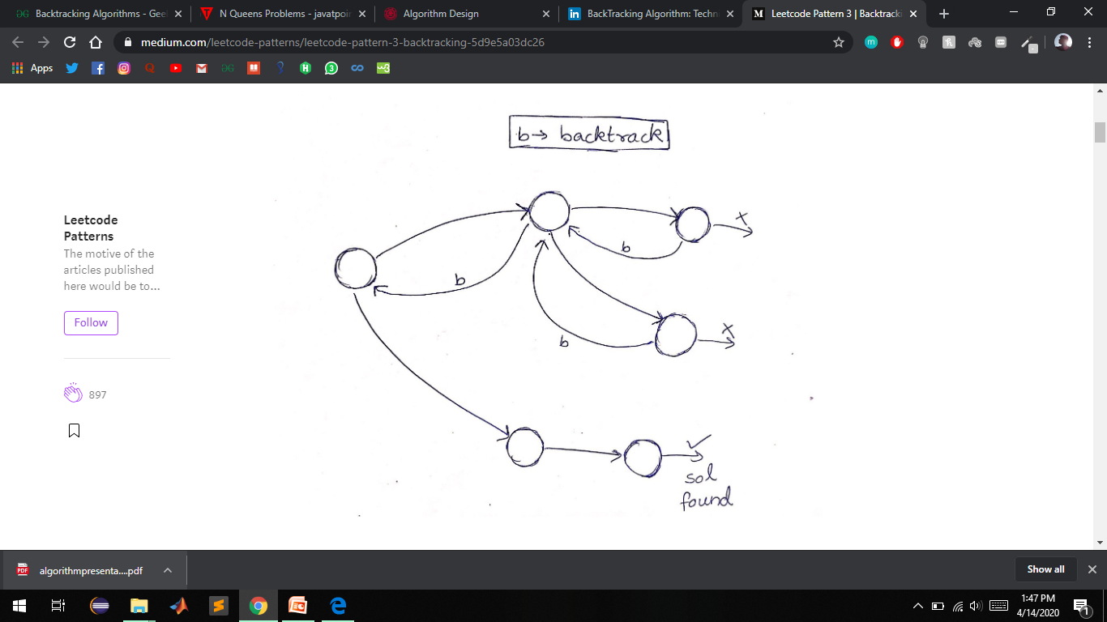

Slide 5
ADVANTAGES
Comparison with the Dynamic Programming, Backtracking Approach is more effective in some cases.
Backtracking Algorithm is the best option for solving tactical problem.
Also Backtracking is effective for constraint satisfaction problem.
In greedy Algorithm, getting the Global Optimal Solution is a long procedure and depends on user statements but in Backtracking It Can Easily getable.
Backtracking technique is simple to implement and easy to code.
Different states are stored into stack so that the data or Info can be usable anytime.
The accuracy is granted

Slide 6
DISADVANTAGES
Backtracking Approach is not efficient for solving strategic Problem.
The overall runtime of Backtracking Algorithm is normally slow
To solve Large Problem Sometime it needs to take the help of other techniques like Branch and bound.
Need Large amount of memory space for storing different state function in the stack for big problem.
The Basic Approach Detects the conflicts too late

Slide 7
Application of back tracking.
Optimization and tactical problems
Constraints Satisfaction Problem
Electrical Engineering
Robotics
Artificial Intelligence
Genetic and bioinformatics Algorithm
Materials Engineering
Network Communication
Solving puzzles and path

Slide 8
Nqueen Problem using backtacking
First Introduced in 1848 which was known as 8- queens Puzzle. Surprisingly, The First Solution was created in 1950 by Franz Nauck. Nauck made an 8X8 Chessboard to find the first Feasible Solution
We try placing queens column by column. Place a queen, go to next column and try placing another queen such that it doesn’t face a queen in the same row or diagonals and keep going.
If we encounter an invalid spot we backtrack and keep trying other spots in that column vertically.

Slide 9
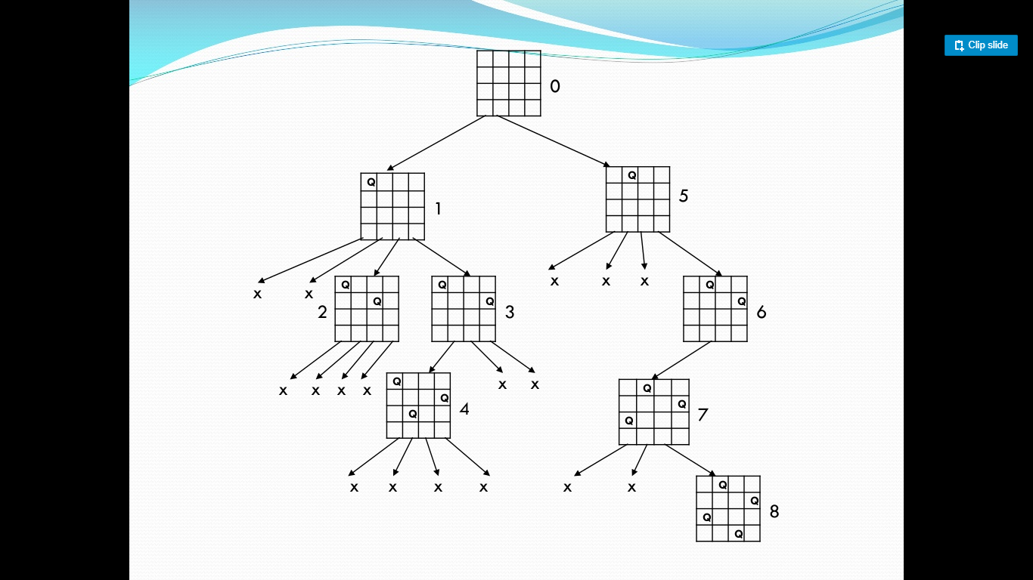

Slide 10
Algorithm-
Start in the leftmost column
If all queens are placed return true
Try all rows in the current column. Do following for every tried row.
a) If the queen can be placed safely in this row then mark this [row, column] as part of the solution and recursively check if placing queen here leads to a solution.
b) If placing the queen in [row, column] leads to a solution then return true.
c) If placing queen doesn't lead to a solution then unmark this [row, column] (Backtrack) and go to step (a) to try other rows.
If all rows have been tried and nothing worked, return false to trigger backtracking.

Slide 11
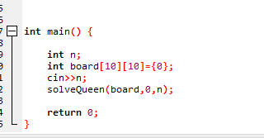
Code--

Slide 12
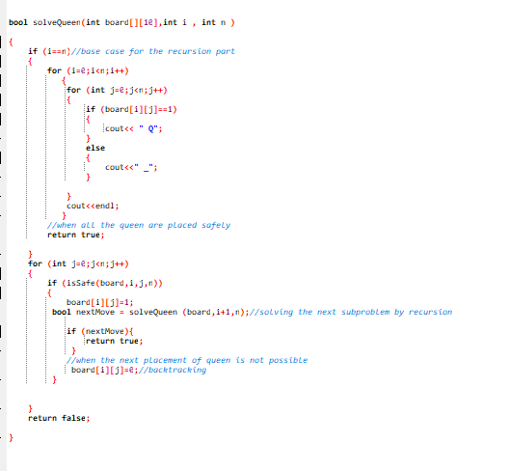

Slide 13
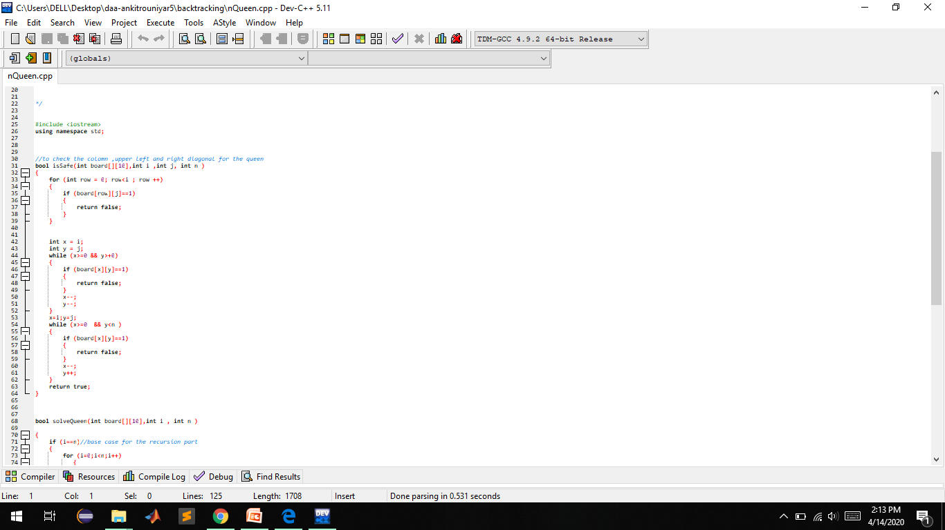

Slide 14
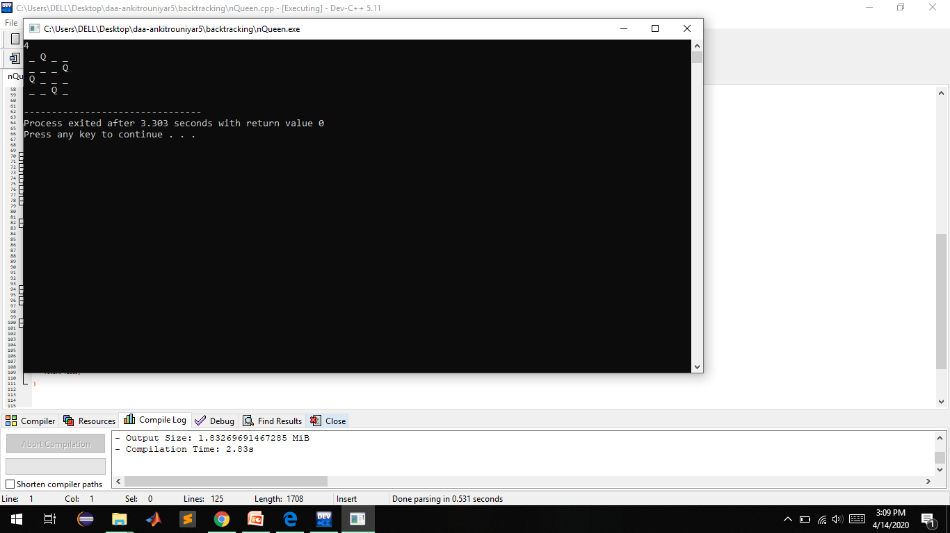
OUTPUT:--

