Slide 1
MINIMUM SPANNING TREE
ASHISH AGGARWAL
181210012

Slide 2
WHAT IS MINIMUM SPANNING TREE
Given an undirected and connected graph G=(V,E), a spanning tree of the graph G is a tree that spans G (that is, it includes every vertex of G) and is a subgraph of G (every edge in the tree belongs to G)
The cost of a spanning tree is the sum of weights given to each edge of the spanning tree.

Slide 3
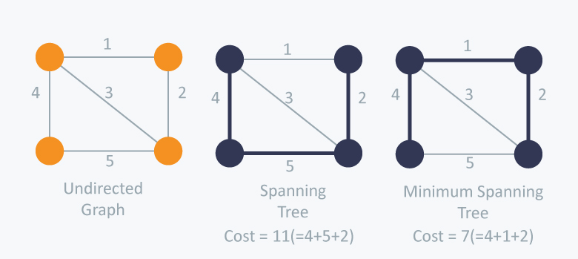
MINIMUM SPANNING TREE
A minimum spanning tree (MST) or minimum weight spanning tree for a weighted, connected and undirected graph is a spanning tree with weight less than or equal to the weight of every other spanning tree.
A minimum spanning tree has (V – 1) edges where V is the number of vertices in the given graph.
There can be many spanning trees, as well as many minimum spanning trees.

Slide 4
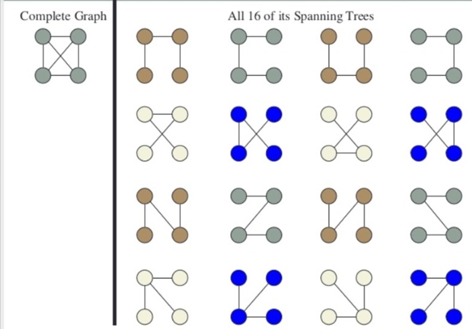

Slide 5
There are mainly two methods used to find minimum spanning out of a connected weighted graph
Prim’s algorithm
Kruskal’s algorithm

Slide 6
Prim’s algorithm
Prim’s Algorithm also use Greedy approach to find the minimum spanning tree.
We grow the spanning tree from a starting position.
Unlike an edge in Kruskal's, we add vertex to the growing spanning tree in Prim's.
We start from one vertex and keep adding edges with the lowest weight until we reach our goal.

Slide 7
Prim’s algorithm
The steps for implementing Prim's algorithm are as follows:
Maintain two disjoint sets of vertices. One containing vertices that are in the growing spanning tree and other that are not in the growing spanning tree.
Select the cheapest vertex that is connected to the growing spanning tree and is not in the growing spanning tree and add it into the growing spanning tree.
This can be done using Priority Queues. Insert the vertices, that are connected to growing spanning tree, into the Priority Queue.
Check for cycles, mark the nodes which have been already selected and insert only those nodes in the Priority Queue that are not marked.
Time Complexity:
It is O((V+E) logV) because each vertex is inserted in the priority queue only once and insertion in priority queue take logarithmic time.

Slide 8
PSEUDO-CODE
Prim’s (G) :
T = ∅;
U = { 1 };
while (U ≠ V)
let (u, v) be the lowest cost edge such that u ∈ U and v ∈ V - U;
T = T ∪ {(u, v)}
U = U ∪ {v}
We create two sets of vertices U and V-U. U contains the list of vertices that have been visited and V-U the list of vertices that haven't. One by one, we move vertices from set V-U to set U by connecting the least weight edge

Slide 9
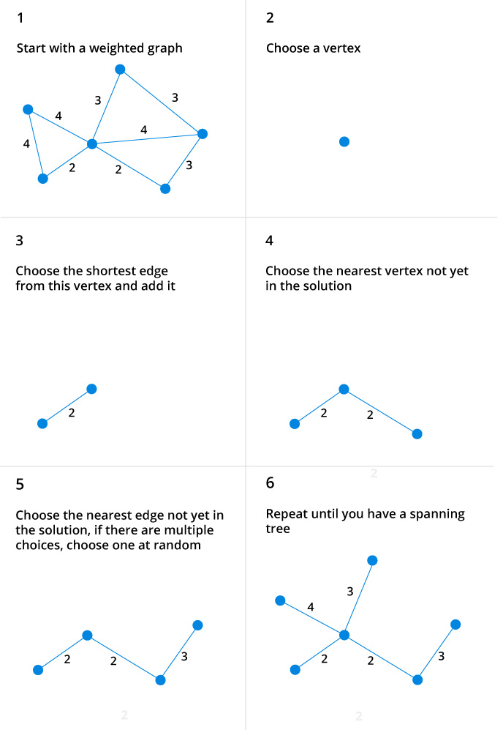
ILLUSTRATION

Slide 10
KRUSKAL’S ALGORITHM
Kruskal’s Algorithm builds the spanning tree by adding edges one by one into a growing spanning tree. Kruskal's algorithm follows greedy approach as in each iteration it finds an edge which has least weight and add it to the growing spanning tree.
Algorithm Steps:
(1) Sort the graph edges with respect to their weights
(2) Start adding edges to the MST from the edge with the smallest weight until the edge of the largest weight.
(3) Only add edges which doesn't form a cycle , edges which connect only disconnected components.

Slide 11
KRUSKAL’S ALGORITHM
In Kruskal’s algorithm, at each iteration we will select the edge with the lowest weight. So, we will start with the lowest weighted edge first i.e., the edges with weight 1.
After that we will select the second lowest weighted edge i.e., edge with weight 2. Notice these two edges are totally disjoint.
Now, the next edge will be the third lowest weighted edge i.e., edge with weight 3, which connects the two disjoint pieces of the graph.
Now, we are not allowed to pick the edge with weight 4, that will create a cycle and we can’t have any cycles.
So we will select the fifth lowest weighted edge i.e., edge with weight 5. Now the other two edges will create cycles so we will ignore them.
In the end, we end up with a minimum spanning tree with total cost 11 ( = 1 + 2 + 3 + 5).

Slide 12
PSEUDO-CODE
Kruskal(G) :
A := ∅
for each v ∈ G.V do
MAKE-SET(v)
for each (u, v) in G.E ordered by weight(u, v), increasing do
if FIND-SET(u) ≠ FIND-SET(v) then
A := A ∪ {(u, v)}
UNION(FIND-SET(u), FIND-SET(v))
return A

Slide 13
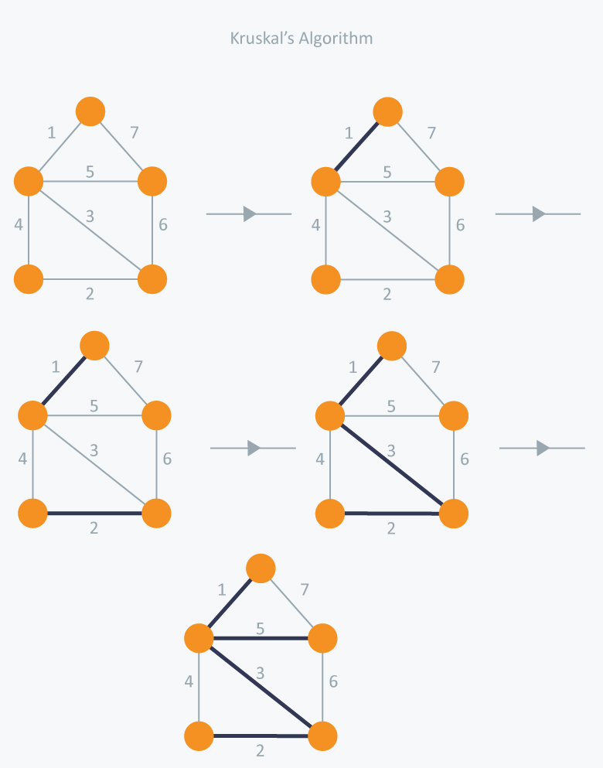
ILLUSTRATION

