Slide 1
DAA ASSIGNMENT
Submitted To : Mr.Chandresh Kumar Maurya
Submitted By : Diksha Goyal
AKHILESH NANDWAL
Roll No : 181210021
181210006

Slide 2
1. Divide and Conquer
Problem Statement:
Find the longest common prefix using Divide and Conquer Technique
In this algorithm, a divide and conquer approach is used . We first divide the arrays of string into two parts. Then we do the same for left part and after that for the right part. We will do it until and unless all the strings become of length 1. Now after that, we will start conquering by returning the common prefix of the left and the right strings.
Example :
INPUT : {“apple” , “ape”,”apron” }
OUTPUT : “ap”
INPUT : {“string”,”stood”,”stop”}
OUTPUT : “st”

Slide 3
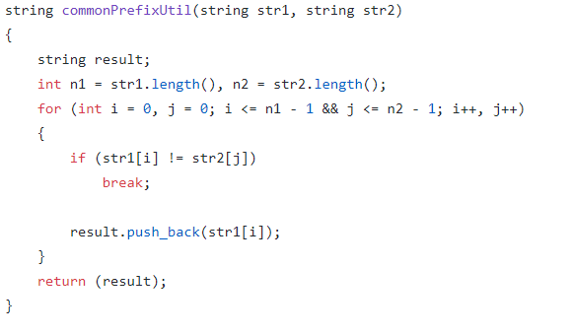
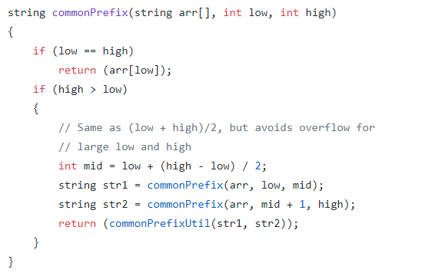
This is the method to find common prefix between two given strings
This is a Divide and Conquer based function to find the longest common prefix. This is similar to the merge sort technique.

Slide 4
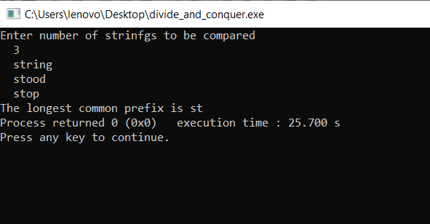
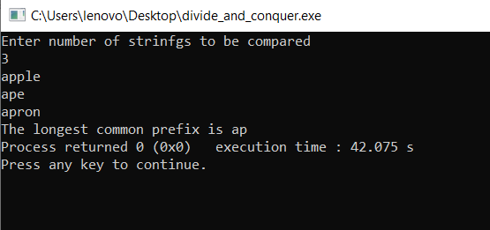
OUTPUT WINDOW

Slide 5
2. DYNAMIC PROGRAMMING
Problem Statement:
Given two sequences, find the length of longest subsequence present in both of them. A subsequence is a sequence that appears in the same relative order, but not necessarily contiguous. For example, “abc”, “abg”, “bdf”, “aeg”, ‘”acefg”, .. etc are subsequences of “abcdefg”.
Example :
INPUT : {“ABCDGH” ,“AEDFHR” }
OUTPUT: “ADH”
INPUT : {“AGGTAB” , “GXTXAYB”}
OUTPUT : “GTAB”

Slide 6
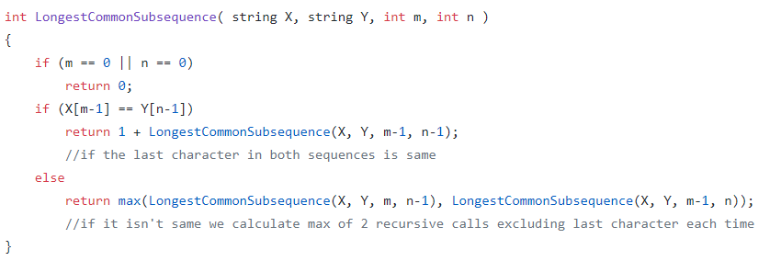
To solve this problem through Dynamic Programming we use recursive approach .
What we do is :
Start comparing strings in reverse order one character at a time.
Now we have 2 cases –
Both characters are same add 1 to the result and remove the last character from both the strings and make recursive call to the modified strings.
Both characters are different
Remove the last character of String 1 and make a recursive call and remove the last character from String 2 and make a recursive and then return the max from returns of both recursive calls.

Slide 7
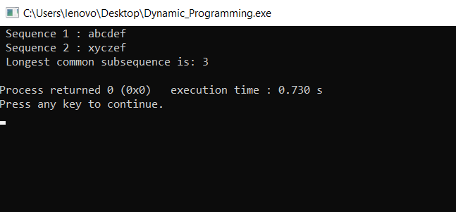
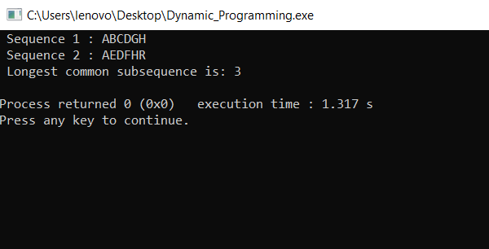
OUTPUT WINDOW

Slide 8
3. GREEDY APPROACH
Problem Statement:
Generate Egyptian Fractions Using Greedy Algorithm
Every positive fraction can be represented as sum of unique unit fractions. A fraction is unit fraction if numerator is 1 and denominator is a positive integer, for example 1/3 is a unit fraction. Such a representation is called Egyptian Fraction as it was used by ancient Egyptians.
Example :
INPUT : 2/3
OUTPUT : 1/2 + 1/6
INPUT : 6/14
OUTPUT : 1/3 + 1/11 + 1/231

Slide 9
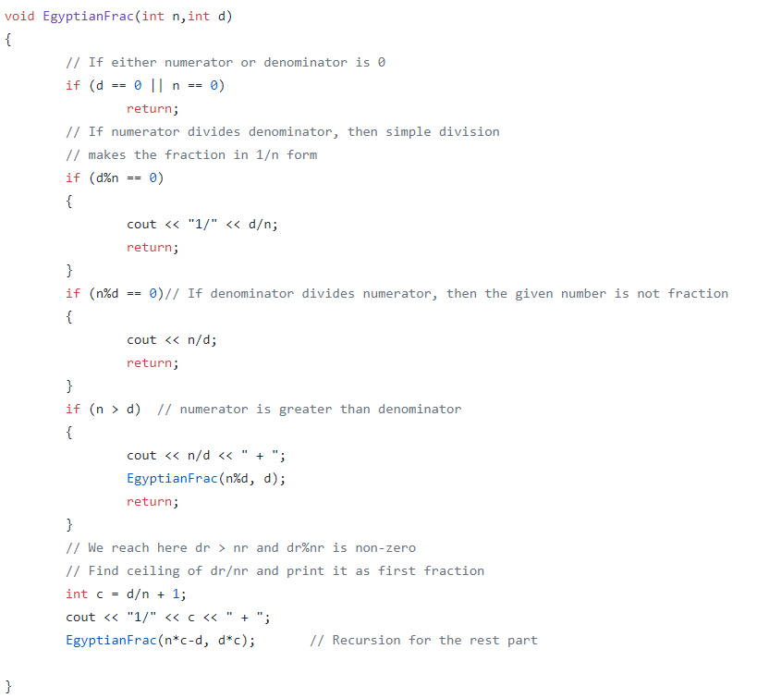
For a given number of the form ‘nr/dr’ where dr > nr we can solve the problem of finding its fractions using greedy algorithm . To solve this problem of Egyptian Fractions using Greedy Algorithm we first find the greatest possible unit fraction, then recur for the remaining part. For example, consider 6/14, we first find ceiling of 14/6, i.e., 3. So the first unit fraction becomes 1/3, then recur for (6/14 – 1/3) i.e., 4/42.

Slide 10
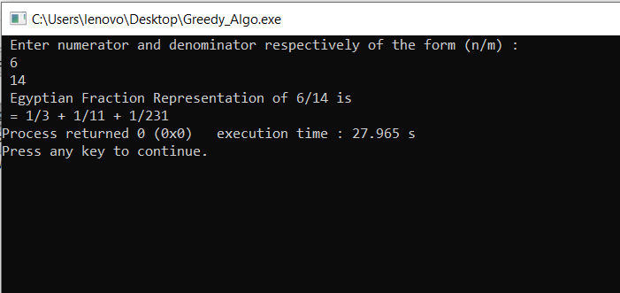
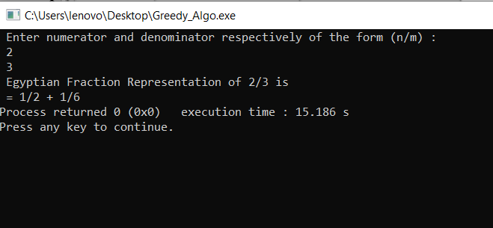
OUTPUT WINDOW

Slide 11
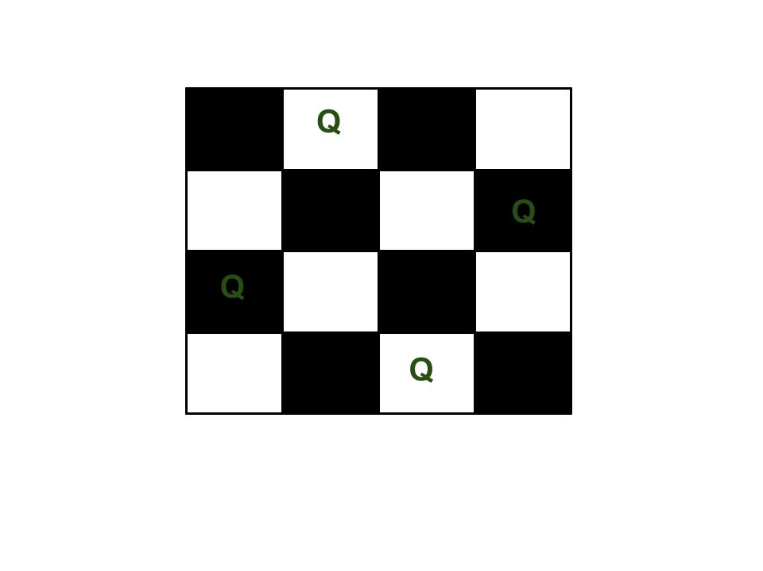
4. Backtracking Method
Problem Statement :
N Queens Problem
It is the problem to place n queens on a nxn chessboard so that no two queens attack each other.
Example :
INPUT : 4
OUTPUT :

Slide 12
Approach :
Place the queens column wise, start from the left most column
If all queens are placed.
return true and print the solution matrix.
Else
Try all the rows in the current column.
Check if queen can be placed here safely if yes mark the current cell in solution matrix as 1 and try to solve the rest of the problem recursively.
If placing the queen in above step leads to the solution return true.
If placing the queen in above step does not lead to the solution , BACKTRACK, mark the current cell in solution matrix as 0 and return false.
If all the rows are tried and nothing worked, return false and print NO SOLUTION.
The idea is to place queens one by one in different columns, starting from the leftmost column. When we place a queen in a column, we check for clashes with already placed queens. In the current column, if we find a row for which there is no clash, we mark this row and column as part of the solution. If we do not find such a row due to clashes then we backtrack and return false.

Slide 13
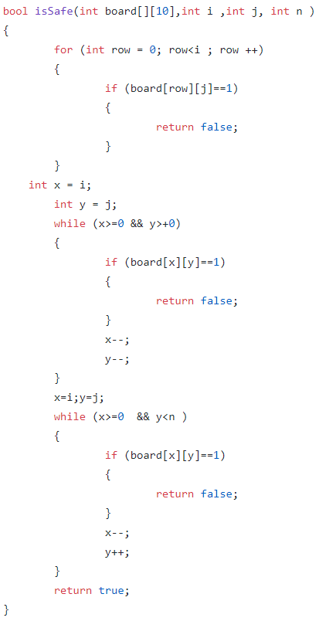
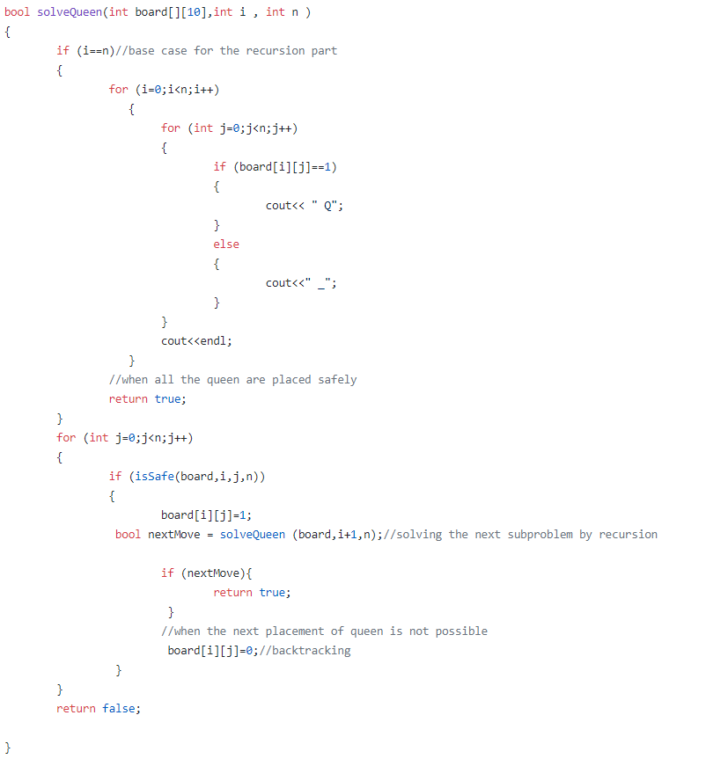

Slide 14
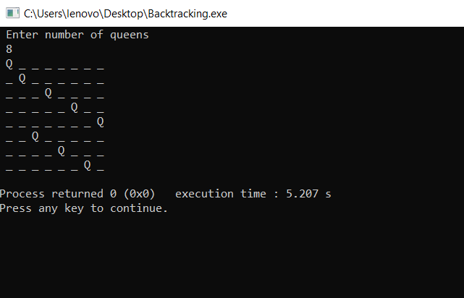
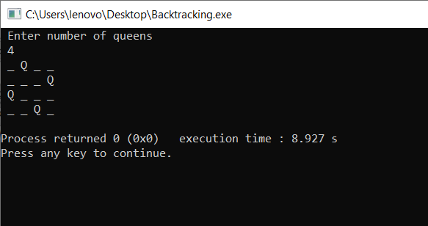
OUTPUT WINDOW

Slide 15
5. BRANCH AND BOUND
Problem Statement : Knapsack Problem using Branch and Bound
Example :
INPUT : //First thing in every pair is weight of item
//Second thing is value of item
Item arr[]={{2,40},{3.14,50},{1.98,100},{5,95},{3,30}}
OUTPUT : The maximum possible profit = 235

Slide 16
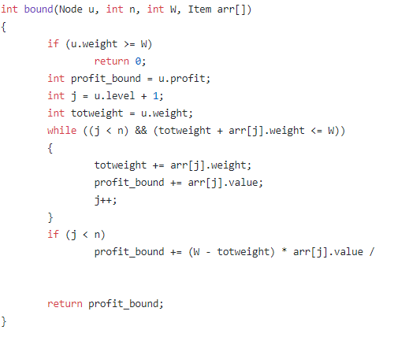
APPROACH
1. Sort all items in decreasing order of ratio of value per unit weight so that an upper bound can be computed using Greedy Approach.
2. Initialize maximum profit, maxProfit = 0
3. Create an empty queue, Q.
4. Create a dummy node of decision tree and enqueue it to Q. Profit and weight of dummy node are 0.
5. Do following while Q is not empty.
Extract an item from Q. Let the extracted item be u.
Compute profit of next level node. If the profit is more than maxProfit, then update maxProfit.
Compute bound of next level node. If bound is more than maxProfit, then add next level node to Q.
Consider the case when next level node is not considered as part of solution and add a node to queue with level as next, but weight and profit without considering next level nodes.

Slide 17
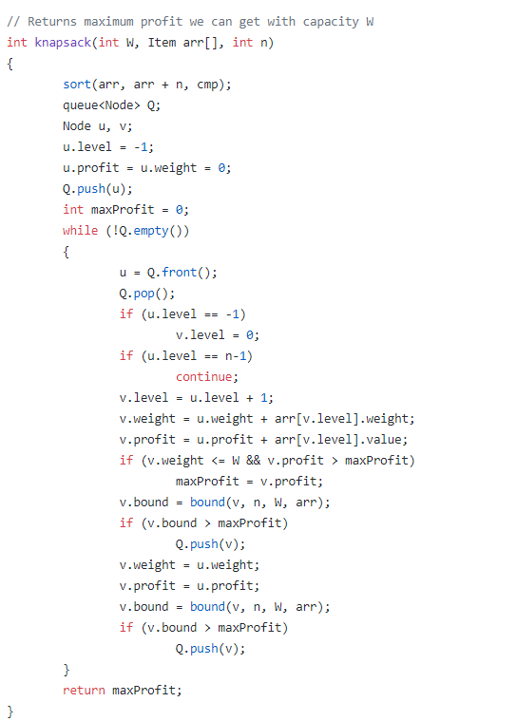
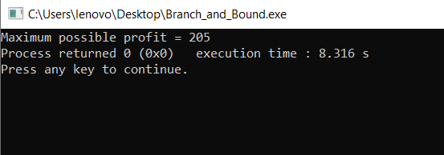
OUTPUT WINDOW

Slide 18
THANK YOU !!

