Slide 1
BACKTRACKING
SUBMITTED BY - ABHINAV SINGH
roll no. – 181210001
DIMPAL KATANIYA
roll no. - 181210022
CSE 2ND YEAR

Slide 2
BACKTRACKING:-
BACKTRACKING
Backtracking is a general algorithm technique that considers every possible combination in order to solve optimization problem.
Backtracking uses depth-first-search approach.
The search tree can be pruned to avoid considering cases that do not look promising.
While backtracking is useful for hard problems to which we do not know more efficient solutions.
It is poor solution for everyday problems that other techniques are much better at solving.

Slide 3
Example:-
BACKTRACKING
Let's take a situation. Suppose you are standing in front of three tunnels, one of which is having a bag of gold at its end, but you don't know which one. So you'll try all three. First go in tunnel 1, if that is not the one, then come out of it, and go into tunnel 2, and again if that is not the one, come out of it and go into tunnel 3. So basically in backtracking we attempt solving a subproblem, and if we don't reach the desired solution, then undo whatever we did for solving that subproblem, and try solving another subproblem.

Slide 4
Example problems:-
BACKTRACKING
N queens problem
Hamiltonian cycle problem
Sum of subsets problem
Sum of subsets problem

Slide 5
1. N-Queens problem:-
BACKTRACKING – N-QUEENS PROBLEM
Given a chess board having N×N cells, we need to place N queens in such a way that no queen is attacked by any other queen.
A queen can attack horizontally, vertically and diagonally.

Slide 6
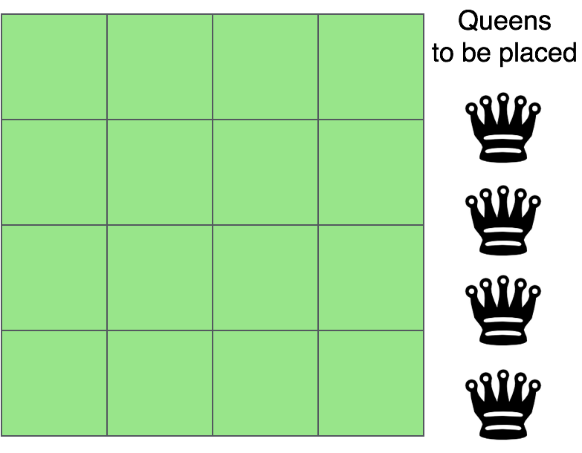
Example problem:-
BACKTRACKING – N-QUEENS PROBLEM
So firstly we have 4x4 chessboard and four queens
Now we have to arrange queens in such a way that no 2 queens are in same row, same column or same diagonal.
So we will place queens row wise in such a way that no 2 queens are in same column and same diagonal.

Slide 7
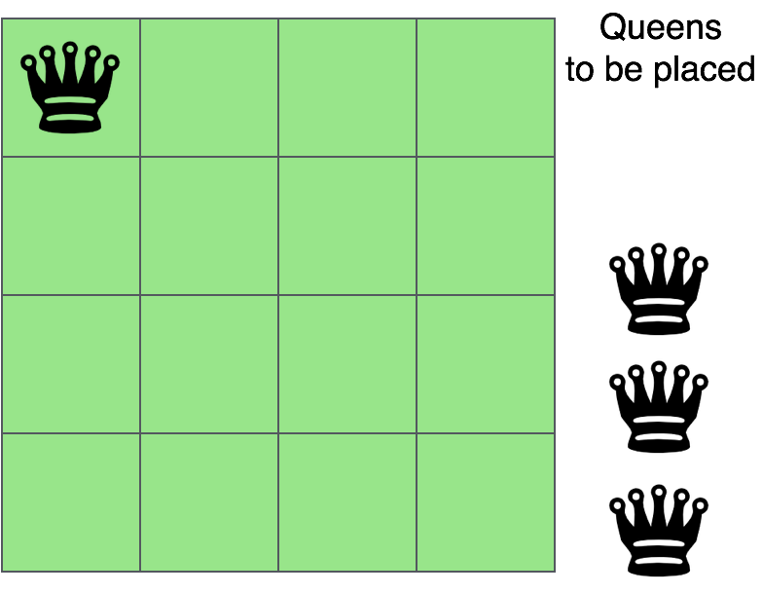
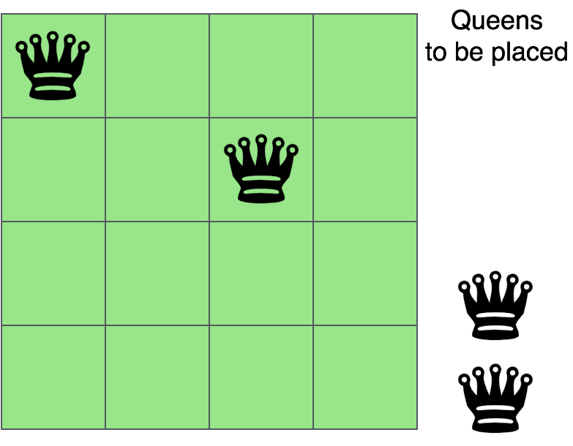
Start by placing first queen :-
BACKTRACKING – N-QUEENS PROBLEM
We will place first queen in 1st row
Now we will place second queen in 2nd row
such that 1st and 2nd queens are not in
same column and same diagonal.

Slide 8
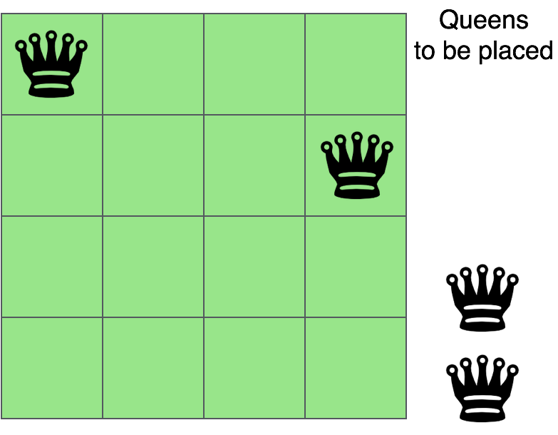
Now we will put third queen in next row
BACKTRACKING – N-QUEENS PROBLEM
So we can see that there is no
safe place in 3rd row foe 3rd queen
So we will backtrack and go to 2nd row
and change the column of 2nd queen
Now we put 2nd queen in 4th column

Slide 9
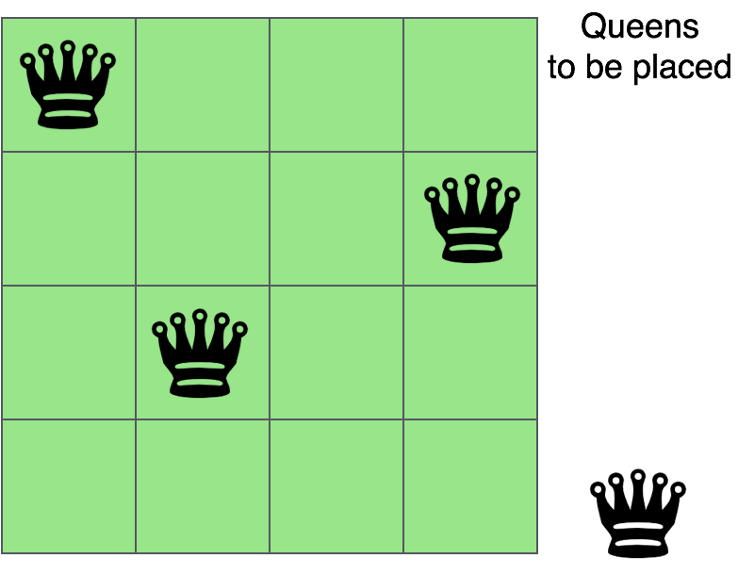
Now we will put 3rd queen in next row
BACKTRACKING – N-QUEENS PROBLEM
Here we can put 3rd queen in 2nd column
Now we will put 4th queen in 4th row in a safe position
But there in no safe position for 4th queen so we backtrack to third queen but there is no changes possible in third queens position
So we backtrack to 2nd queen there were 2 possibilities for 2nd queen and we tried both so now
We will backtrack to first queen and change the column of first queen.

Slide 10
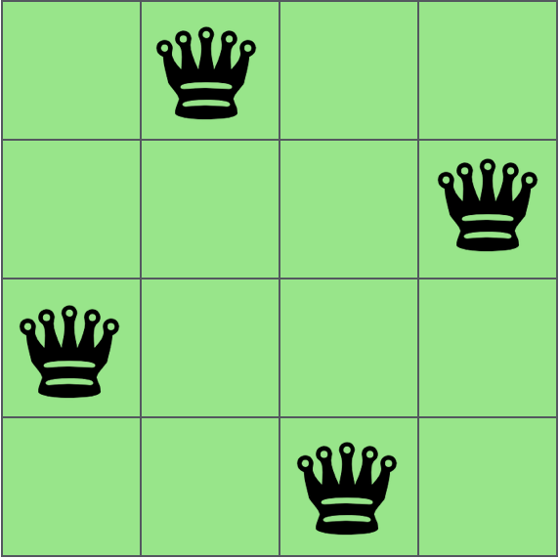
Now we will place 1st queen in 2nd column
BACKTRACKING – N-QUEENS PROBLEM
and by following above process of backtracking we will get solution as shown below:-

Slide 11
Algorithm:-
BACKTRACKING – N-QUEENS PROBLEM
Nqueen(board[1…n,1….n], row)
{
if row > n then
return true
for i = 1 to n
if (issafe(board,row,i))// check if we can place queen in column i
then board[row,i] = 1
if (Nqueen(board, row+ 1) == true) // recure to place rest of the queens
return true
board[i,row] = 0 // if placing queen here does not lead to solution and we will backtrack
}

Slide 12
Algorithm:-
BACKTRACKING – N-QUEENS PROBLEM
Issafe(board, row, col)
{
for i = 0 to row // check this column
if (board[i][col] == 1)
then return false
for (i = row, j = col; i >= 0 && j >= 0; i--, j--) // check left upper diagonal
if (board[i][j] == 1)
return false;
for (i = row, j = col; i >= 0 && j< N; i--, j++) //check right upper diagonal
if (board[i][j] == 1)
return false;
return true;
}

Slide 13
2.Hamiltonian Circuit Problem:-
BACKTRACKING – HAMILTONIAN CIRCUIT PROBLEM
Given a graph G = (V, E) we have to find the Hamiltonian Circuit using Backtracking approach.
We start our search from any arbitrary vertex say 'a.’
This vertex 'a' becomes the root of our implicit tree.
The first element of our partial solution is the first intermediate vertex of the Hamiltonian Cycle that is to be constructed.
The next adjacent vertex is selected by alphabetical order.
If at any stage any arbitrary vertex makes a cycle with any vertex other than vertex 'a' then we say that dead end is reached.
In this case, we backtrack one step, and again the search begins by selecting another vertex and backtrack the element from the partial; solution must be removed.
The search using backtracking is successful if a Hamiltonian Cycle is obtained.

Slide 14
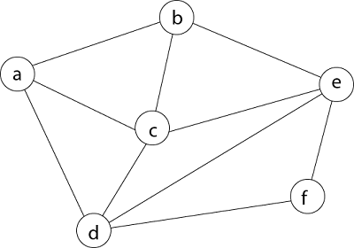
Example problem:-
BACKTRACKING – HAMILTONIAN CIRCUIT PROBLEM
Consider a graph G = (V, E) shown in fig. we have to find a Hamiltonian circuit using Backtracking method.

Slide 15

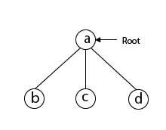
SOLUTION:-
BACKTRACKING – HAMILTONIAN CIRCUIT PROBLEM
Firstly, we start our search with vertex 'a.' this vertex 'a' becomes the root of our implicit tree.
Next, we choose vertex 'b' adjacent to 'a' as it comes first in lexicographical order (b, c, d).

Slide 16
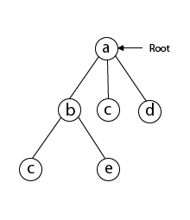
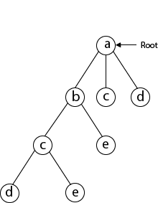
Next, we select 'c' adjacent to 'b.'
BACKTRACKING – HAMILTONIAN CIRCUIT PROBLEM
Next, we select 'd' adjacent to 'c.’

Slide 17
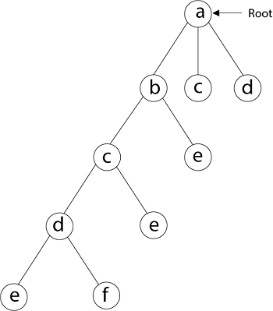
Next, we select 'e' adjacent to 'd.'
BACKTRACKING – HAMILTONIAN CIRCUIT PROBLEM

Slide 18
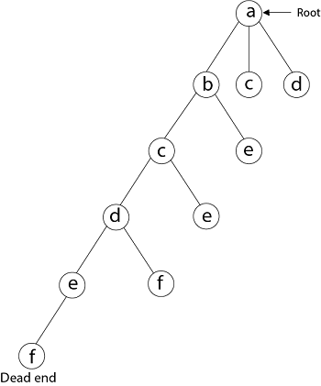
Next, we select vertex 'f' adjacent to 'e’. The vertex adjacent to 'f' is d and e, but they have already visited. Thus, we get the dead end, and we backtrack one step and remove the vertex 'f' from partial solution.
BACKTRACKING – HAMILTONIAN CIRCUIT PROBLEM

Slide 19
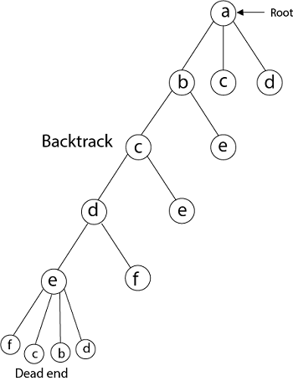
From backtracking, the vertex adjacent to 'e' is b, c, d, and f from which vertex 'f' has already been checked, and b, c, d have already visited.
BACKTRACKING – HAMILTONIAN CIRCUIT PROBLEM

Slide 20
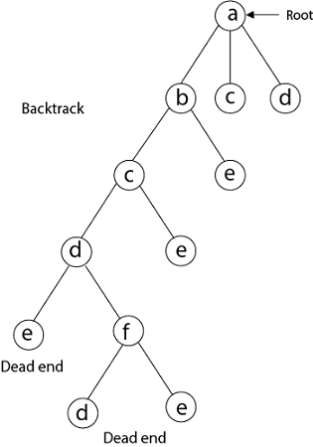
So, again we backtrack one step. Now, the vertex adjacent to d are e, f from which e has already been checked, and adjacent of 'f' are d and e. If 'e' vertex, revisited them we get a dead state.
BACKTRACKING – HAMILTONIAN CIRCUIT PROBLEM

Slide 21
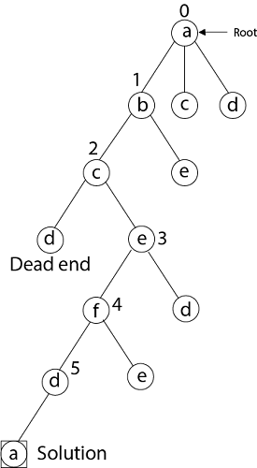
So again we backtrack one step. Now, adjacent to c is 'e' and adjacent to 'e’ is 'f' and adjacent to 'f' is 'd' and adjacent to 'd' is 'a.' Here, we get the Hamiltonian Cycle as all the vertex other than the start vertex 'a' is visited only once. (a - b - c - e - f -d - a). Here we have generated one Hamiltonian circuit, but another Hamiltonian circuit can also be obtained by considering another vertex.
BACKTRACKING – HAMILTONIAN CIRCUIT PROBLEM

Slide 22
Algorithm:-
BACKTRACKING – HAMILTONIAN CIRCUIT PROBLEM
cycleFound(node k)
if all nodes are included, then
if there is an edge between nodes k and 0, then
return true
else
return false;
for all vertex v except starting point, do
if isValid(v, k), then //when v is a valid edge
add v into the path
if cycleFound(k+1) is true, then
return true
otherwise remove v from the path
done
return false
End

Slide 23
Algorithm:-
BACKTRACKING – HAMILTONIAN CIRCUIT PROBLEM
isValid(v, k)
if there is no edge between node(k-1) to v, then
return false
if v is already taken, then
return false
return true; //otherwise it is valid
End

Slide 24
SUBSET SUM PROBLEM:-
BACKTRACKING – SUBSET SUM PROBLEM
Subset sum problem is the problem of finding a subset such that the sum of elements equal a given number. The backtracking approach generates all permutations in the worst case but in general, performs better than the recursive approach towards subset sum problem.
A subset A of n positive integers and a value sum is given, find whether or not there exists any subset of the given set, the sum of whose elements is equal to the given value of sum.

Slide 25
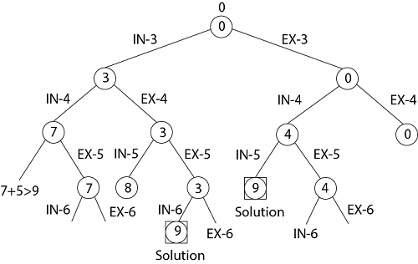
Example problem:-
BACKTRACKING – SUBSET SUM PROBLEM
Given a set S = (3, 4, 5, 6) and X =9. Obtain the subset sum using Backtracking approach.
Solution:-

Slide 26
Algorithm:-
BACKTRACKING – SUBSET SUM PROBLEM
void subset_sum(int list[], int sum, int starting_index, int target_sum)
{
if( target_sum == sum )
{
subset_count++;
if(starting_index < list.length)
subset_sum(list, sum - list[starting_index-1], starting_index, target_sum);
}
else
{
for( int i = starting_index; i < list.length; i++ )
{
subset_sum(list, sum + list[i], i + 1, target_sum);
}
}
}

