Slide 1
DESIGN AND ANALYSIS OF ALGORITHMS (CSB-252)
AUTHOR : AYUSH MAHAJAN, SHUBHAM AGGARWAL
ROLL NO : 181210014,181210052
CSE 2nd Year (G1)

Slide 2
1. Divide And Conquer
In computer science, divide and conquer is an algorithm design paradigm based on multi-branched recursion. A divide-and-conquer algorithm works by recursively breaking down a problem into two or more sub-problems of the same or related type, until these become simple enough to be solved directly. The solutions to the sub-problems are then combined to give a solution to the original problem.
This divide-and-conquer technique is the basis of efficient algorithms for all kinds of problems, such as sorting (e.g., quicksort, merge sort),multiplying large numbers, etc.

Slide 3
This technique can be divided into the following three parts:
Divide: This involves dividing the problem into some sub problem.
Conquer: Sub problem by calling recursively until sub problem solved.
Combine: The Sub problem Solved so that we will get find problem solution.
PROBLEM:
To sort a given sequence of elements.

Slide 4
Algorithm
MergeSort(arr[], l, r)
If r > l
1. Find the middle point to divide the array into two halves: middle m = (l+r)/2
2. Call mergeSort for first half: Call mergeSort(arr, l, m)
3. Call mergeSort for second half: Call mergeSort(arr, m+1, r)
4. Merge the two halves sorted in step 2 and 3: Call merge(arr, l, m, r)

Slide 5
2. Backtracking
Backtracking is a general algorithm for finding all (or some) solutions to some computational problems, notably constraint satisfaction problems, that incrementally builds candidates to the solutions, and abandons a candidate ("backtracks") as soon as it determines that the candidate cannot possibly be completed to a valid solution.
The backtracking algorithm enumerates a set of partial candidates that, in principle, could be completed in various ways to give all the possible solutions to the given problem. The completion is done incrementally, by a sequence of candidate extension steps.
Conceptually, the partial candidates are represented as the nodes of a tree structure, the potential search tree. Each partial candidate is the parent of the candidates that differ from it by a single extension step; the leaves of the tree are the partial candidates that cannot be extended any further.

Slide 6
The backtracking algorithm traverses this search tree recursively, from the root down, in depth-first order. At each node c, the algorithm checks whether c can be completed to a valid solution. If it cannot, the whole sub-tree rooted at c is skipped (pruned). Otherwise, the algorithm (1) checks whether c itself is a valid solution, and if so reports it to the user; and (2) recursively enumerates all sub-trees of c. The two tests and the children of each node are defined by user-given procedures.
Therefore, the actual search tree that is traversed by the algorithm is only a part of the potential tree. The total cost of the algorithm is the number of nodes of the actual tree times the cost of obtaining and processing each node. This fact should be considered when choosing the potential search tree and implementing the pruning test.

Slide 7
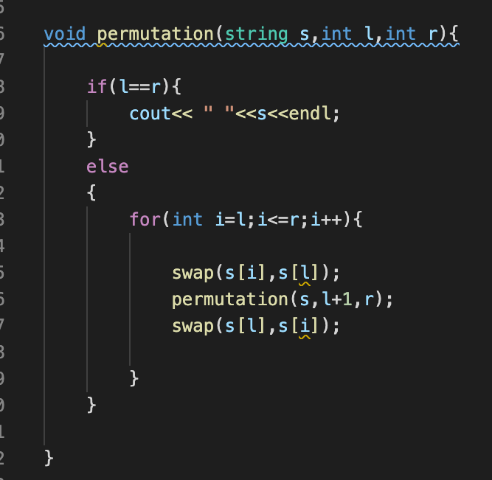
Problem: To generate all possible permutations of a given string.
ALGORITHM:

Slide 8
3. Greedy Method
Greedy is an algorithmic paradigm that builds up a solution piece by piece, always choosing the next piece that offers the most obvious and immediate benefit. So the problems where choosing locally optimal also leads to global solution are best fit for Greedy.
In general, greedy algorithms have five components:
A candidate set, from which a solution is created
A selection function, which chooses the best candidate to be added to the solution
A feasibility function, that is used to determine if a candidate can be used to contribute to a solution
An objective function, which assigns a value to a solution, or a partial solution, and
A solution function, which will indicate when we have discovered a complete solution

Slide 9
Greedy algorithms mostly (but not always) fail to find the globally optimal solution because they usually do not operate exhaustively on all the data. They can make commitments to certain choices too early which prevent them from finding the best overall solution later. For example, all known greedy colouring algorithms for the graph colouring problem and all other NP-complete problems do not consistently find optimum solutions. Nevertheless, they are useful because they are quick to think up and often give good approximations to the optimum.
If a greedy algorithm can be proven to yield the global optimum for a given problem class, it typically becomes the method of choice because it is faster than other optimization methods like DP. Examples of such greedy algorithms are Kruskal’s algorithm and Prim’s algorithm for finding MST, and the algorithm for finding optimum Huffman trees.

Slide 10
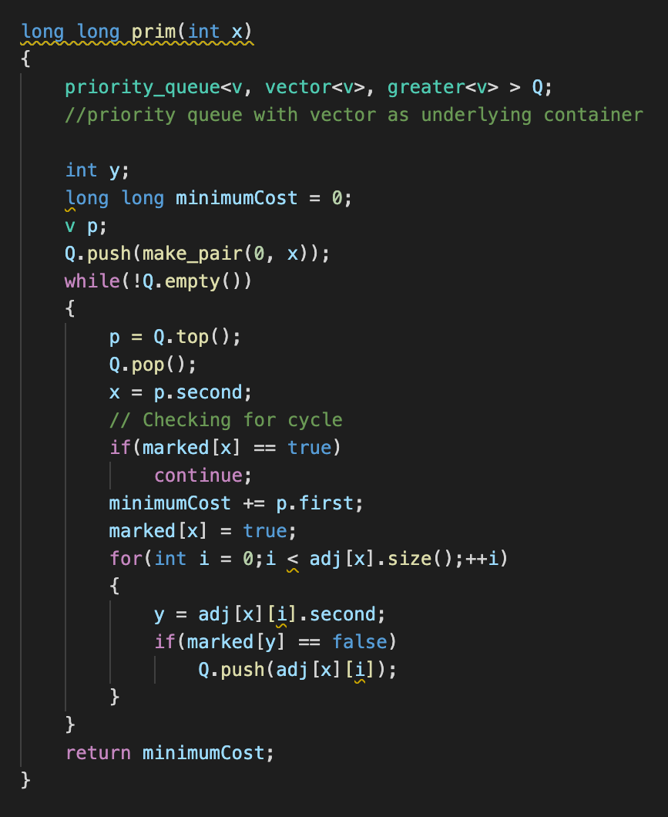
Problem: Find minimum spanning tree of a given weighted graph using prim’s algorithm.
Algorithm:

Slide 11
4. Dynamic Programming
Dynamic Programming is mainly an optimization over plain recursion. Wherever we see a recursive solution that has repeated calls for same inputs, we can optimize it using Dynamic Programming. The idea is to simply store the results of subproblems, so that we do not have to re-compute them when needed later. This simple optimization reduces time complexities from exponential to polynomial. For example, if we write simple recursive solution for Fibonacci numbers, we get exponential time complexity and if we optimize it by storing solutions of subproblems, time complexity reduces to linear.
If sub-problems can be nested recursively inside larger problems, so that dynamic programming methods are applicable, then there is a relation between the value of the larger problem and the values of the sub-problems. In the optimization literature this relationship is called the Bellman equation.

Slide 12
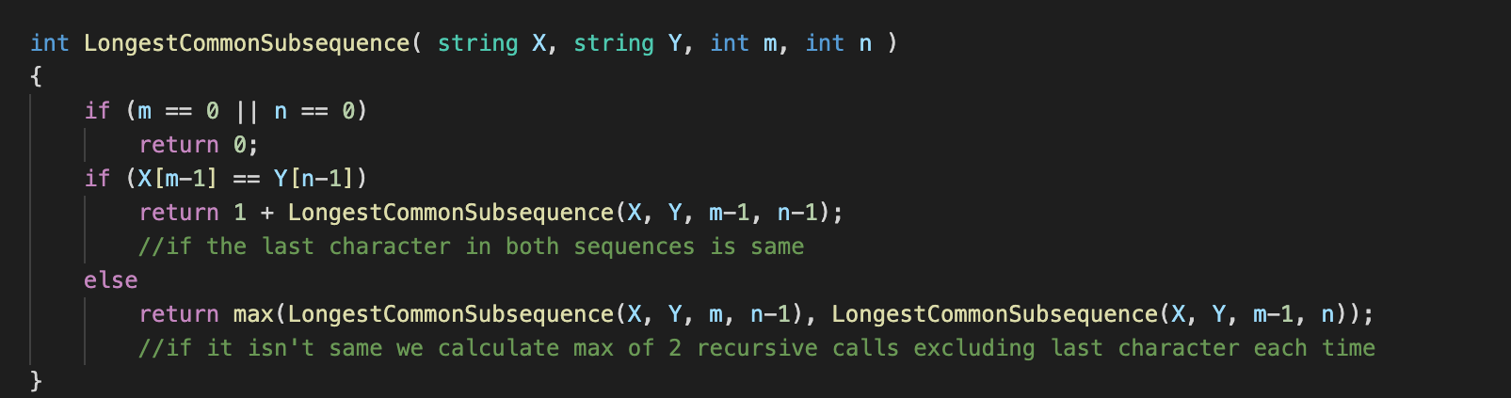
Problem: Given 2 sequences, find longest common subsequence between them.
Algorithm:

Slide 13
5. Branch and Bound
Branch and bound
is an algorithm design paradigm for discrete and combinatorial optimization problems, as well as mathematical optimization. A branch-and-bound algorithm consists of a systematic enumeration of candidate solutions by means of state space search: the set of candidate solutions is thought of as forming a rooted tree with the full set at the root. The algorithm explores branches of this tree, which represent subsets of the solution set. Before enumerating the candidate solutions of a branch, the branch is checked against upper and lower estimated bounds on the optimal solution and is discarded if it cannot produce a better solution than the best one found so far by the algorithm.

Slide 14
It recursively splits the search space into smaller spaces, then minimizing problem on these smaller spaces; the splitting is called branching.
Branching alone would amount to brute-force enumeration of candidate solutions and testing them all. To improve on the performance of brute-force search, a B&B algorithm keeps track of bounds on the minimum that it is trying to find, and uses these bounds to ”prune" the search space, eliminating candidate solutions that it can prove will not contain an optimal solution.

Slide 15
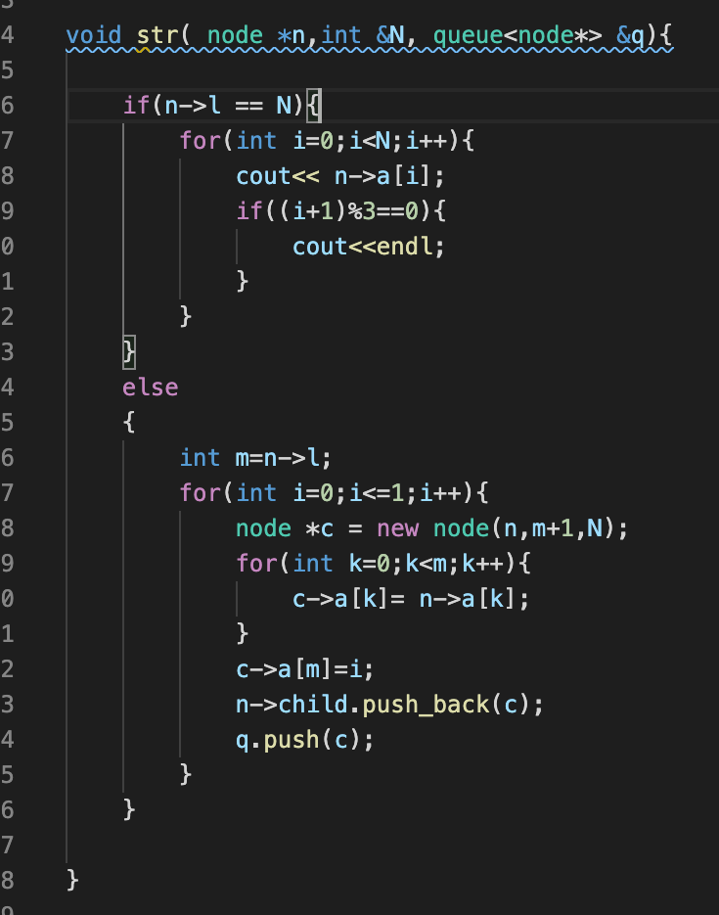
Problem: Generate all binary strings of length “n”.
Algorithm:

Slide 16
THANK YOU.

