Slide 1
DESIGN AND ANALYSIS OF ALGORITHMS Topic: Graph Algorithms
AYUSH MAHAJAN
181210014
CSE 2nd Year(g1)

Slide 2
INTRODUCTION: GRAPHS
Graphs are a generalization of trees. Like trees, graphs have nodes and edges. (The nodes are sometimes called vertices, and the edges are sometimes called arcs.) However, graphs are more general than trees: In a graph, a node can have any number of incoming edges (in a tree, the root node cannot have any incoming edges, and the other nodes can only have one incoming edge). Every tree is a graph, but not every graph is a tree.
There are two kinds of graphs, directed and undirected
In a directed graph, you can only go from node to node following the direction of the arrows, while in an undirected graph, you can go either way along an edge. This means that in a directed graph it is possible to reach a "dead end" (to get to a node from which you cannot leave).

Slide 3
TRAVERSALS
To visit each node or vertex which is a connected component, tree-based algorithms are used. You can do this easily by iterating through all the vertices of the graph, performing the algorithm on each vertex that is still unvisited when examined.
Two algorithms are generally used for the traversal of a graph: Depth first search (DFS) and Breadth first search (BFS)
BFS gives level order print of the graph whereas inorder traversal is a type of DFS.

Slide 4
1. BREADTH FIRST SEARCH (BFS)
It starts at the tree root (or some arbitrary node of a graph, sometimes referred to as a ‘search key’), and explores all of the neighbour nodes at the present depth prior to moving on to the nodes at the next depth level.
The only catch here is, unlike trees, graphs may contain cycles, so we may come to the same node again. To avoid processing a node more than once, we use a Boolean visited array. For simplicity, it is assumed that all vertices are reachable from the starting vertex.

Slide 5


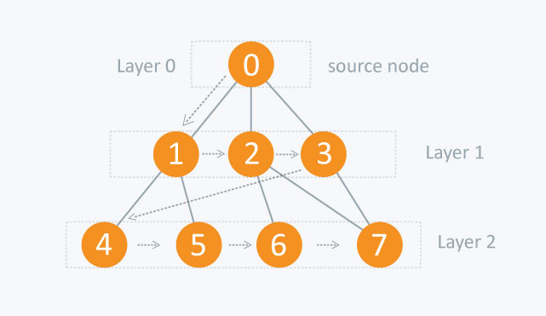
What we do in a BFS is a simple step-by-step process:
1. Start from a vertex S. Let this vertex be at what is called…. “Level 0”.
2. Find all the other vertices that are immediately accessible from this starting vertex S, that is they are only a single edge away (the adjacent vertices).
3. Mark these adjacent vertices to be at “Level 1”.
4. You might be coming back to the same vertex due to a loop or a ring in the graph. If this happens, your BFS will take ∞ time. So, you will go only to those vertices who do not have their “Level” set to some value.
5. Mark which is the parent vertex of the current vertex you’re at, i.e., the vertex from which you accessed the current vertex. Do this for all the vertices at Level 1.
6. Now, find all those vertices that are a single edge away from all the vertices which are at “Level 1”. These new set of vertices will be at “Level 2”.
7. Repeat this process until you run out of graph.

Slide 6
Pseudocode:
BFS (G, s) //Where G is the graph and s is the source node let Q be queue.
Q.enqueue( s ) //Inserting s in queue until all its neighbour vertices are marked.
mark s as visited.
while ( Q is not empty)
//Removing that vertex from queue,whose neighbour will be visited now
v = Q.dequeue( )
//processing all the neighbours of v
for all neighbours w of v in Graph G
if w is not visited
Q.enqueue( w )
//Stores w in Q to further visit its neighbour
mark w as visited.

Slide 7
TIME COMPLEXITY:
It takes O(V) time to initialize the distance and predecessor for each vertex (Θ(V) time, actually).
Each vertex is visited at most one time, because only the first time that it is reached is its distance null, and so each vertex is enqueued at most one time.
Since we examine the edges incident on a vertex only when we visit from it, each edge is examined at most twice, once for each of the vertices it's incident on.
Thus, breadth-first search spends O(V+E) , time visiting vertices.

Slide 8
2. DEPTH FIRST SEARCH (DFS)
Depth-first search is a common way that many people naturally use when solving problems like mazes.
First, we select a path in the maze (for the sake of this example, let’s choose a path according to some rule we lay out ahead of time) and we follow it until we hit a dead end or reach the end of the maze. If a given path doesn’t work, we backtrack and take an alternative path from a past junction and try that path.
To turn this into a graph traversal algorithm, we basically replace “child” with “neighbour”. But to prevent infinite loops, we only want to visit each vertex once. Just like in BFS, we can use marks to keep track of the vertices that have already been visited, so we don’t visit them again. Also, just like in BFS, we can use this search to build a spanning tree with certain useful properties.

Slide 9
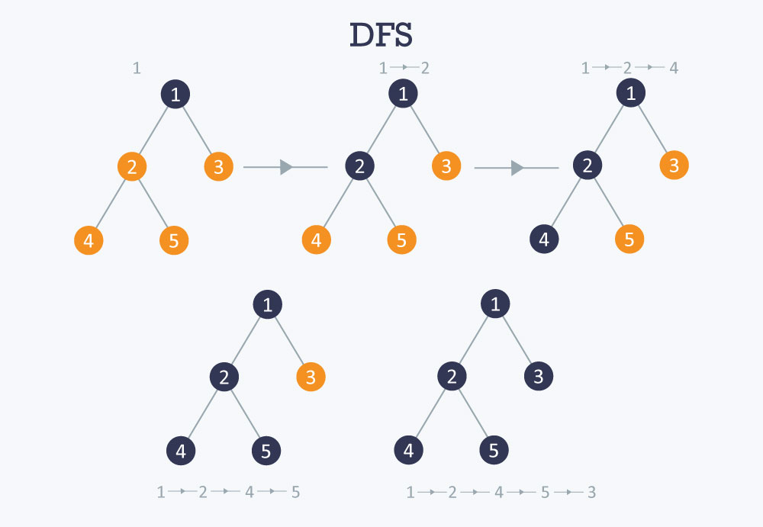
Algorithm:
dfs(vertex v) { visit(v); for each neighbour w of v if w is unvisited { dfs(w); add edge vw to tree T } }

Slide 10
TIME COMPLEXITY:
Each node maintains a list of all its adjacent edges, then, for each node, you could discover all its neighbours by traversing its adjacency list just once in linear time.
For a directed graph, the sum of the sizes of the adjacency lists of all the nodes is E (total number of edges). So, the complexity of DFS is O(V) + O(E) = O(V + E).

Slide 11
Minimum spanning tree (mst)
A minimum spanning tree is a special kind of tree that minimizes the lengths (or “weights”) of the edges of the tree. An example is a cable company wanting to lay line to multiple neighbourhoods; by minimizing the amount of cable laid, the cable company will save money.
A tree has one path joins any two vertices. A spanning tree of a graph is a tree that:
(a) Contains all the original graph’s vertices.
(b) Reaches out to (spans) all vertices.
(c) Is acyclic. In other words, the graph doesn’t have any nodes which loop back to itself.

Slide 12
1. PRIM’S Algorithm
Prim’s Algorithm also use Greedy approach to find the minimum spanning tree. In Prim’s Algorithm we grow the spanning tree from a starting position. Unlike an edge in Kruskal's, we add vertex to the growing spanning tree in Prim’s.
Algorithm Steps:
(1) Maintain two disjoint sets of vertices. One containing vertices that are in the growing spanning tree and other that are not in the growing spanning tree.
(2) Select the cheapest vertex that is connected to the growing spanning tree and is not in the growing spanning tree and add it into the growing spanning tree. This can be done using Priority Queues. Insert the vertices, that are connected to growing spanning tree, into the Priority Queue.
(3) Check for cycles. To do that, mark the nodes which have been already selected and insert only those nodes in the Priority Queue that are not marked.

Slide 13
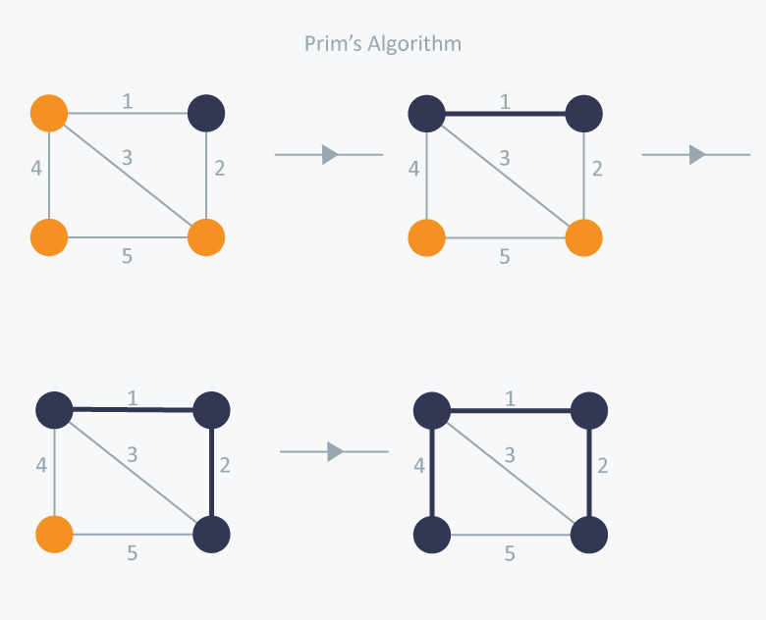
In Prim’s Algorithm, we will start with an arbitrary node (it doesn’t matter which one) and mark it.
In each iteration we will mark a new vertex that is adjacent to the one that we have already marked.
As a greedy algorithm, Prim’s algorithm will select the cheapest edge and mark the vertex. So we will simply choose the edge with weight 1.
In the next iteration we have three options, edges with weight 2, 3 and 4. So, we will select the edge with weight 2 and mark the vertex.
Now again we have three options, edges with weight 3, 4 and 5. But we can’t choose edge with weight 3 as it is creating a cycle.
So we will select the edge with weight 4 and we end up with the minimum spanning tree of total cost 7 ( = 1 + 2 +4).

Slide 14
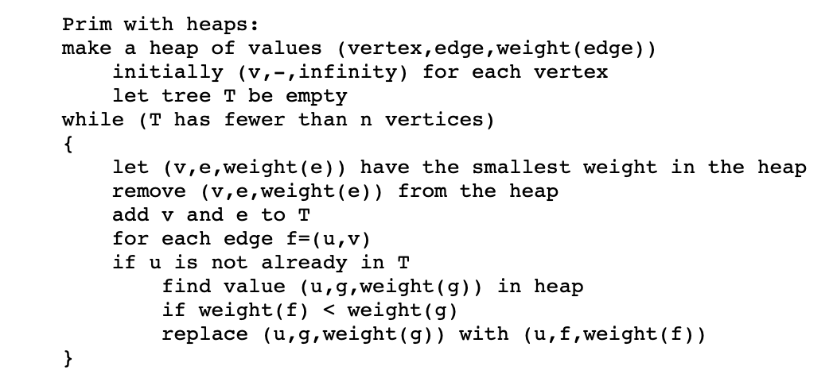
ALGORITHM:
ANALYSIS:
We perform n steps in which we remove the smallest element in the heap, and at most 2m steps in which we examine an edge f=(u,v).
For each of those steps, we might replace a value on the heap, reducing its weight. (You also have to find the right value on the heap, but that can be done easily enough by keeping a pointer from the vertices to the corresponding values.) I haven't described how to reduce the weight of an element of a binary heap, but it's easy to do in O(log n) time.
The result is a total time bound of O(m + n log n).

Slide 15
2. KRUSKAL’S Algorithm
Kruskal’s Algorithm builds the spanning tree by adding edges one by one into a growing spanning tree. Kruskal's algorithm follows greedy approach as in each iteration it finds an edge which has least weight and add it to the growing spanning tree.
Algorithm Steps:
(1) Sort the graph edges with respect to their weights
(2) Start adding edges to the MST from the edge with the smallest weight until the edge of the largest weight.
(3) Only add edges which doesn't form a cycle , edges which connect only disconnected components.

Slide 16
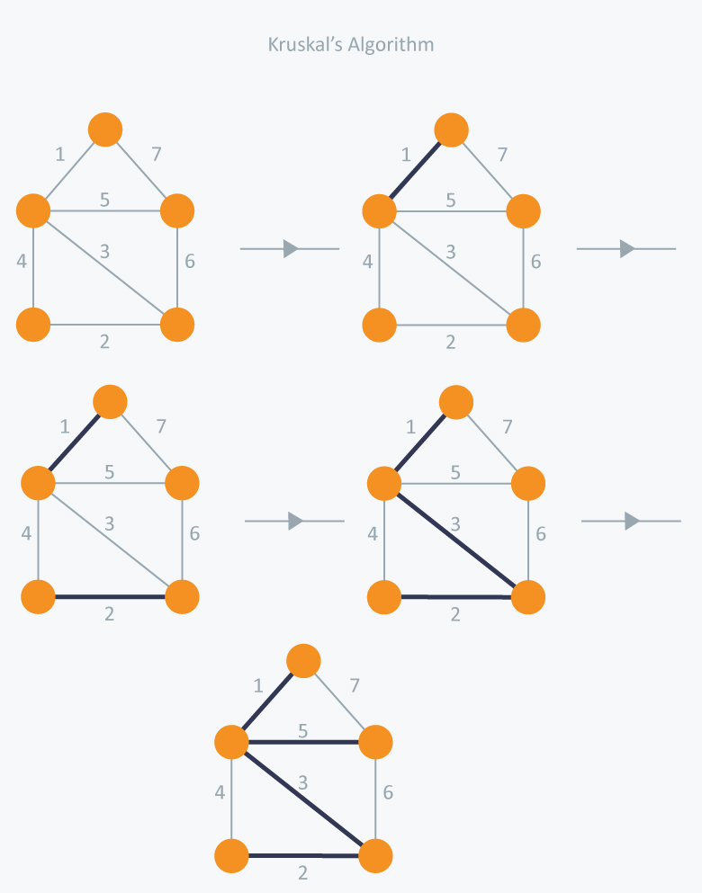
In Kruskal’s algorithm, at each iteration we will select the edge with the lowest weight. So, we will start with the lowest weighted edge first i.e., the edges with weight 1.
After that we will select the second lowest weighted edge i.e., edge with weight 2. Notice these two edges are totally disjoint.
Now, the next edge will be the third lowest weighted edge i.e., edge with weight 3, which connects the two disjoint pieces of the graph.
Now, we are not allowed to pick the edge with weight 4, that will create a cycle and we can’t have any cycles.
So we will select the fifth lowest weighted edge i.e., edge with weight 5. Now the other two edges will create cycles so we will ignore them.
In the end, we end up with a minimum spanning tree with total cost 11 ( = 1 + 2 + 3 + 5).

Slide 17
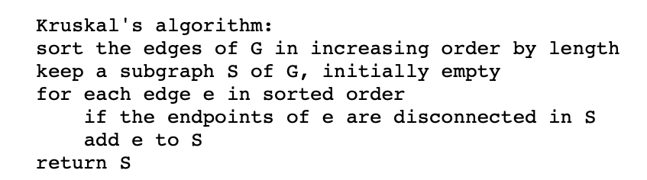
ALGORITHM:
ANALYSIS:
The line testing whether two endpoints are disconnected looks like it should be slow (linear time per iteration, or O(mn) total).
The slowest part turns out to be the sorting step, which takes O(m log n) time.

Slide 18
SHORTEST PATH PROBLEMS
Shortest path algorithms are a family of algorithms designed to solve the shortest path problem. The shortest path problem is something most people have some intuitive familiarity with: given two points, A and B, what is the shortest path between them?
In computer science, however, the shortest path problem can take different forms and so different algorithms are needed to be able to solve them all.
Shortest path algorithms have many applications. Mapping software like Google or Apple maps makes use of shortest path algorithms. They are also important for road network, operations, and logistics research. Shortest path algorithms are also very important for computer networks, like the Internet.

Slide 19
1. Single source shortest path
Single-source shortest path algorithms operate under the following principle:
Given a graph GG, with vertices VV, edges EE with weight function w(u,v)=wu,v​ , and a single source vertex, ss, return the shortest paths from ss to all other vertices in VV.
If the goal of the algorithm is to find the shortest path between only two given vertices, ss and tt, then the algorithm can simply be stopped when that shortest path is found. Because there is no way to decide which vertices to "finish" first, all algorithms that solve for the shortest path between two given vertices have the same worst-case asymptotic complexity as single-source shortest path algorithms.

Slide 20
Dijkstra’s algorithm:
Dijkstra's algorithm makes use of breadth-first search (which is not a single source shortest path algorithm) to solve the single-source problem. It does place one constraint on the graph: there can be no negative weight edges. However, for this one constraint, Dijkstra greatly improves on the runtime of Bellman-Ford.
Algorithm Steps:
(1) Set all vertices distances = infinity except for the source vertex, set the source distance = 0.
(2) Push the source vertex in a min-priority queue in the form (distance , vertex), as the comparison in the min-priority queue will be according to vertices distances.
(3) Pop the vertex with the minimum distance from the priority queue (at first the popped vertex = source).
(4) Update the distances of the connected vertices to the popped vertex in case of "current vertex distance + edge weight < next vertex distance", then push the vertex with the new distance to the priority queue.
(5) If the popped vertex is visited before, just continue without using it.
(6) Apply the same algorithm again until the priority queue is empty.

Slide 21
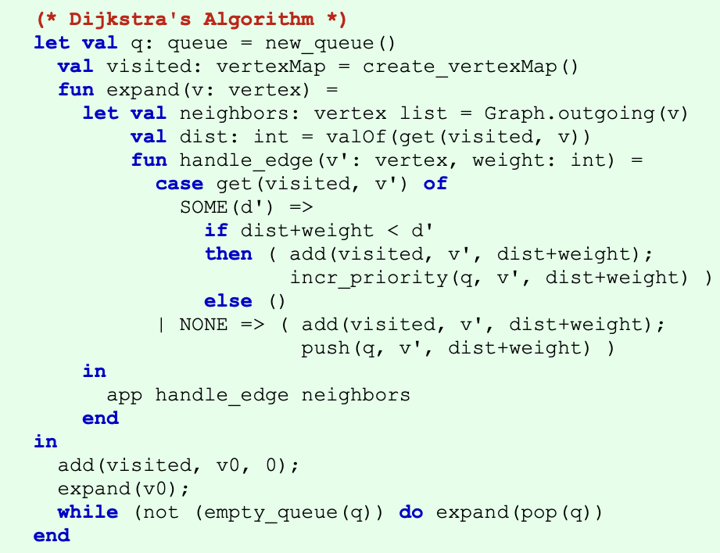
ALGORITHM:

Slide 22
ANALYSIS:
Every time the main loop executes, one vertex is extracted from the queue. Assuming that there are V vertices in the graph, the queue may contain O(V) vertices.
Each pop operation takes O(lg V) time assuming the heap implementation of priority queues. So the total time required to execute the main loop itself is O(V lg V).
In addition, we must consider the time spent in the function expand, which applies the function handle_edge to each outgoing edge. Because expand is only called once per vertex, handle_edge is only called once per edge. It might call push(v'), but there can be at most V such calls during the entire execution, so the total cost of that case arm is at most O(V lg V).
The other case arm may be called O(E) times, however, and each call to increase_prioritytakes O(lg V) time with the heap implementation.
Therefore the total run time is O(V lg V + E lg V), which is O(E lg V) because V is O(E) assuming a connected graph.

Slide 23
2. all-pairs shortest path
All-pairs shortest path algorithms follow this definition:
Given a graph GG, with vertices VV, edges EE with weight function w(u,v)=w u,v return the shortest path from uu to vv for all u,v) in VV.
The most common algorithm for the all-pairs problem is the Floyd-warshall algorithm. This algorithm returns a matrix of values MM, where each cell Mi,j​ is the distance of the shortest path from vertex i to vertex j. Path reconstruction is possible to find the actual path taken to achieve that shortest path, but it is not part of the fundamental algorithm.

Slide 24
Floyd-warshall’s algorithm:
Floyd–Warshall's Algorithm is used to find the shortest paths between between all pairs of vertices in a graph, where each edge in the graph has a weight which is positive or negative. The biggest advantage of using this algorithm is that all the shortest distances between any 2vertices could be calculated in O(V3), where V is the number of vertices in a graph.
Algorithm Steps:
For a graph with N vertices:
(1) Initialize the shortest paths between any 2 vertices with Infinity.
(2) Find all pair shortest paths that use 0 intermediate vertices, then find the shortest paths that use 1 intermediate vertex and so on.. until using all N vertices as intermediate nodes.
(3) Minimize the shortest paths between any 2 pairs in the previous operation.
(4) For any 2 vertices (i,j) , one should actually minimize the distances between this pair using the first K nodes, so the shortest path will be: min(dist[i][k]+dist[k][j],dist[i][j]).

Slide 25
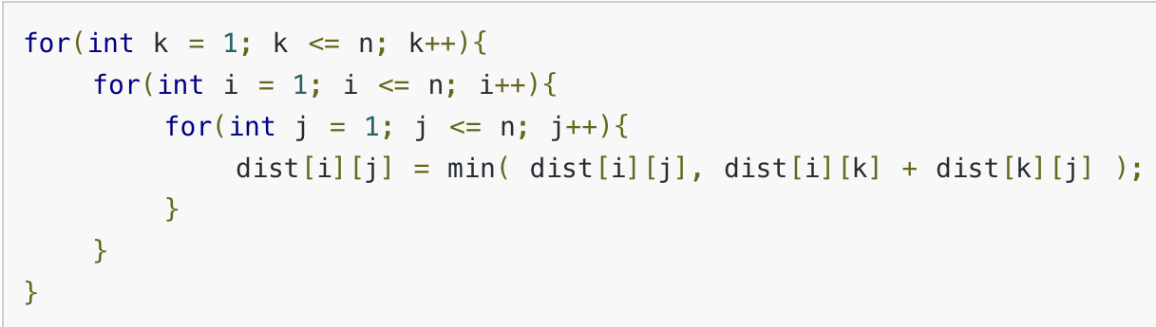
ALGORITHM:
ANALYSIS:
The Floyd-Warshall algorithm runs in O(∣V∣^3) time.
This is because of the three nested for loops that are run after the initialization and population of the distance matrix, M.

Slide 26
THANK YOU

