Slide 1
DAA Assignment-II
-submitted to
Dr. Chandresh Kumar Maurya
-by
Manish Meena (181210028)

Slide 2
Elementary Graph algorithm
(a) BFS(Breadth First Search)
(b) DFS(Depth First Search)

Slide 3
BFS(Breadth First Search)
Breadth-first search is an algorithm for traversing graph data structure. It starts a node, and explores all of the neighbor nodes at the present depth prior to moving on to the nodes at the next depth level.
Then it move to the next depth of each node one by one.
Each node traversed is flaged as true by a boolean variable and is not visited again.

Slide 4
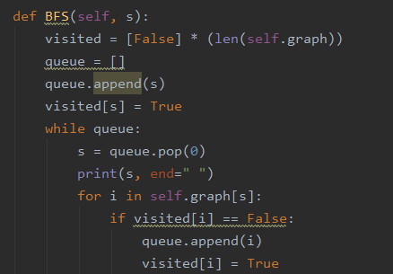
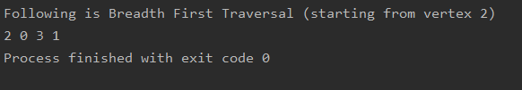
INPUT
OUTPUT

Slide 5
DFS(Depth First Search)
Depth-first search is an algorithm for traversing graph data structure. The algorithm starts at the root node (selecting some arbitrary node as the root node) and explores as far as possible along each branch before backtracking.
Then it move back to the initial level and one by one applies the same procedure to each node.
Each node traversed is flaged as true by a boolean variable and is not visited again.

Slide 6
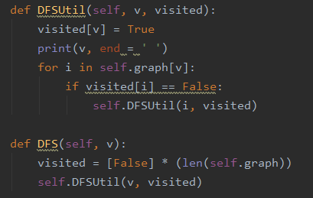

INPUT
OUTPUT

Slide 7
Minimum Spanning Tree
(a) Prim’s Algorithm
(b) Kruskal’s Algorithm

Slide 8
Prim’s Algorithm
Prim’s algorithm is a greedy algorithm that finds a minimum spanning tree for a weighted undirected graph. This means it finds a subset of the edges that forms a tree that includes every vertex, where the total weight of all the edges in the tree is minimized. The algorithm operates by building this tree one vertex at a time, from an arbitrary starting vertex, at each step adding the cheapest possible connection from the tree to another vertex.

Slide 9
Algorithm
Initialize a tree with a single vertex, chosen arbitrarily from the graph.
Grow the tree by one edge: of the edges that connect the tree to vertices not yet in the tree, find the minimum-weight edge, and transfer it to the tree.
Repeat step 2 (until all vertices are in the tree).

Slide 10
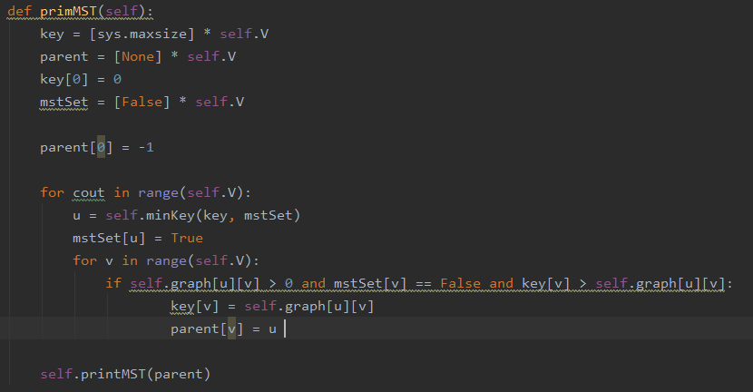
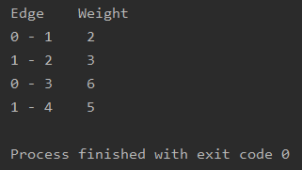
INPUT
OUTPUT

Slide 11
Kruskal’s Algorithm
Kruskal’s algorithm is a greedy algorithm that finds a minimum spanning tree for a weighted undirected graph. This means it finds a subset of the edges that forms a tree that includes every vertex, where the total weight of all the edges in the tree is minimized. The algorithm operates by building this tree such that it includes one edge at a time which is cheapest at that time from anywhere in the tree.

Slide 12
Algorithm
Initially all the vertices are considered.
find the minimum-weight edge, and transfer it to the tree.
Repeat step 2 (until all vertices in the tree are connected with each other).

Slide 13
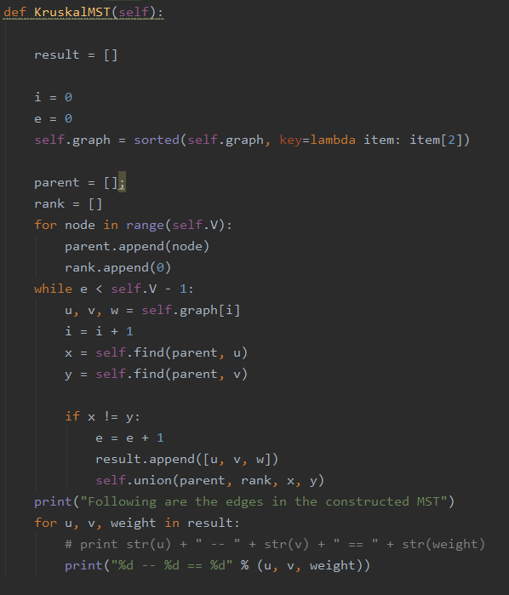
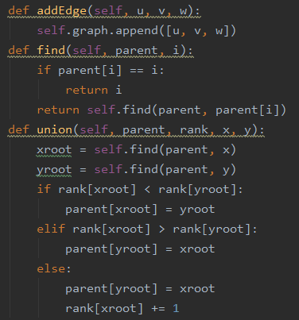
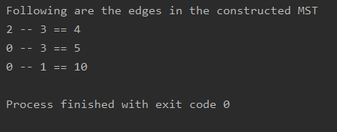
INPUT
OUTPUT

Slide 14
Shortest Path Algorithm
(a) Single Source shortest path Algorithm
(b) All Pair shortest path Algorithm

Slide 15
Single Source shortest path Algorithm (Dijkstra’s Algorithm)
Dijkstra's algorithm is an algorithm we can use to find shortest distances.
Suppose a graph is given with a few vertices and weighted edges, we will be able to find a shortest distance path covering all the vertices with minimum cost.

Slide 16
Algorithm
Step 1: Select the starting vertex mark distance as 0 and mark all other vertices as MAXINT i.e. the distance of these vertices from starting vertex.
Step 2: check the distance of all adjacent vertex from selected one, if the distance is less than already written, update the distance.
Step 3: Label the current vertex as visited. Once a vertex is visited, we won't look at it again.
Step 4: Of the vertices you just marked visited, find the one with the smallest distance from start, and make it your current vertex. Now, you can start again from step 2.
Step 5: Once we've visited all the vertices, the marked distance on each vertex is the shortest distance of that vertex from the starting vertex.

Slide 17
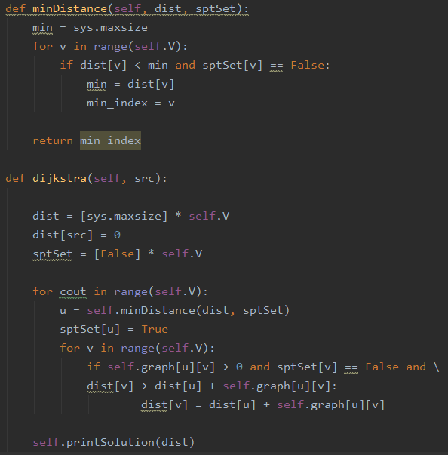
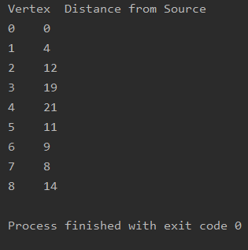
INPUT
OUTPUT

Slide 18
All pair shortest path Algorithm (Floyd Warshall Algorithm)
Floyd-Warshall Algorithm is an algorithm for finding the shortest path between all the pairs of vertices in a weighted graph. This algorithm works for both the directed and undirected weighted graphs.
Suppose a graph is given with a few vertices and weighted edges, we will be able to find a shortest distance between each pair of vertices.

Slide 19
Algorithm
Make a distance matrix A⁰ of all the pairs of vertices with given distance and if no distance is given, fill infinity.
[[ 0, inf, inf, -3],
[inf, 0, inf, 8],
[inf, 4, 0, -2],
[ 5, 3, inf, 0],]
Now make a matrix A¹ using A⁰ as follows:
Let k be the intermediate vertex in the shortest path from source to destination. In this step, k is the first vertex. A[i][j] is filled with (A[i][k] + A[k][j]) if (A[i][j] > A[i][k] + A[k][j]) i.e. if the direct distance from the source to the destination is greater than the path through the vertex k, then the cell is filled with A[i][k] + A[k][j].
In this step, k is vertex 1. We calculate the distance from source vertex to destination vertex through this vertex k.
In a similar way, A² is created using A¹ with k =2 and so on.
A⁴ gives the shortest path between each pair of vertices.

Slide 20
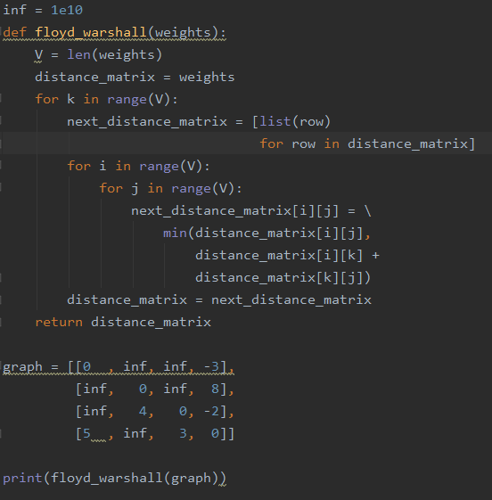

INPUT
OUTPUT

Slide 21
THANK YOU

