Slide 1
GRAPH ALGORITHMS
SUBMITTED BY-MAYANK BHANDARI
ROLL NO – 181210030
CLASS – CSE 2nd Year
SUBMITTED TO – Chandresh kumar Maurya

Slide 2
Elementary Graph Algorithms:
Breadth First Search and Depth First Search
Breadth first search (BFS) and Depth First Search (DFS) are the simplest two graph search algorithms.
The crucial difference between trees and graphs (which creates a difference in the DFS/BFS implementation) is that in trees there are no cycles. In graph theory, a cycle exists in any graph where you can leave a node and travel through the graph back to that node.
Undirected graphs always contain cycles because you can simple go back and forth between any two neighbors. Exception graph with no edges.
In a directed graph, you might or might not have cycles(Directed Acyclic Graphs (DAGs)).

Slide 3
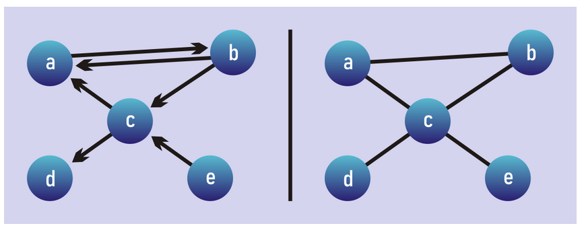
Search or Traversal Algorithms:
Algorithm(BFS and DFS):
Start with a Frontier that contains the initial node.
Start with an empty explored set.
Repeat
If the Frontier is empty, then no solution
Remove a node from the Frontier
If node contains goal state return the solution
Add the node to the explored set
Expand node, add resulting nodes to the Frontier if they are not already in the frontier or the explored set

Slide 4
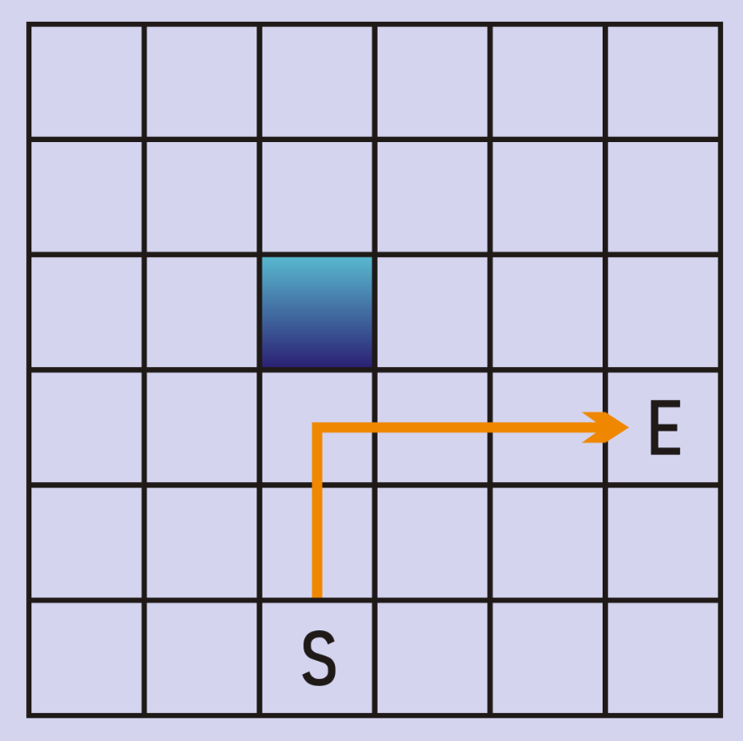
Example DFS on a maze:
Consider our maze, and a DFS implementation that breaks ties by searching up first, then right, then left, then right. Our algorithm will go straight up until it hits a wall, then straight to the right to arrive at our end node.

Slide 5
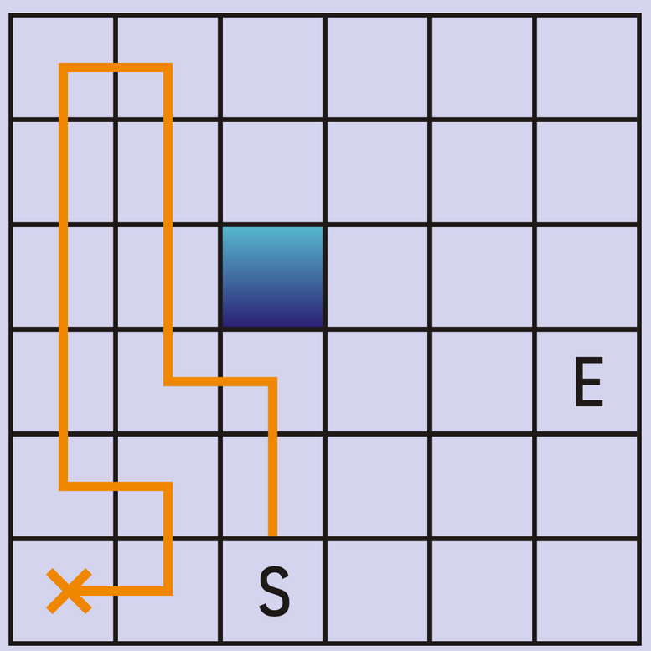
Now, consider an implementation of DFS where ties are broken by searching up, then left then right, then down. Now we’ll search nodes in a very inefficient pattern, and reach a point where the algorithm has to backtrack and simulate a different decision in order to find a path to the goal.

Slide 6
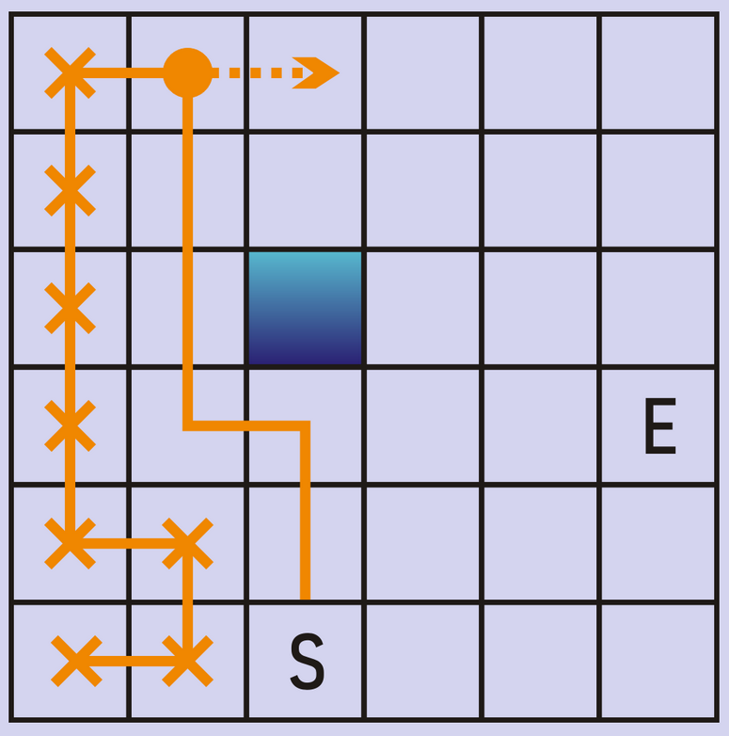
In this specific case we will backtrack repeatedly. All of the squares with an orange line through it are “explored” already — we have to backtrack until we reach a node with at least one unexplored neighbor.

Slide 7
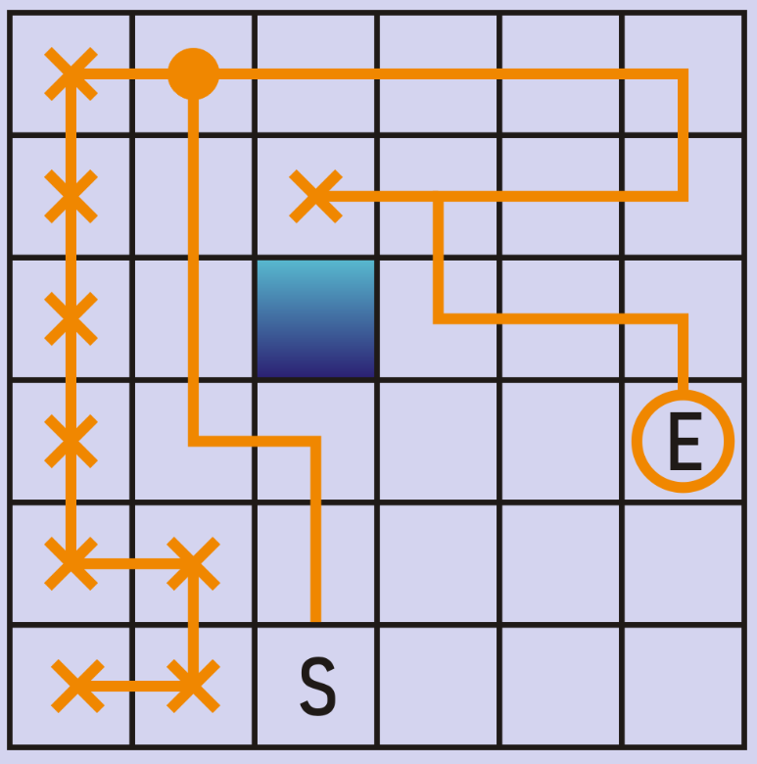
If we were to follow this instance of DFS all the way to it’s completion (remember, ties are broken up, left, right, down) the path we’d ultimately find looks like this:
After backtracking one more time, just above the wall, we find the end node. This time around we processed more nodes and found a much longer path from start to end. This illustrates an important point about DFS: while it is sure to find a path if a path exists, it is not sure to find the shortest path.

Slide 8
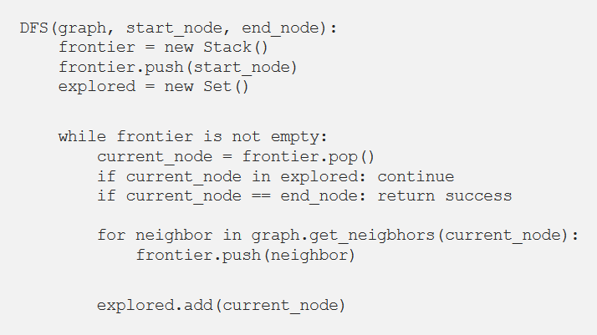

Slide 9
There are two things to note about this code.
1) There is no “backtracking” step making itself obvious. Instead, backtracking occurs in the form of popping nodes off of the frontier.
2) The use of a stack for the frontier ensures that nodes are searched in a depth first ordering, since the most recently added node will always be explored next.

Slide 10
#include<bits/stdc++.h>
using namespace std;
int to_search;
bool found = true;
// This class represents a directed graph using adjacency list representation
class Graph {
int V; // No. of vertices
list<int> *adj; // adjacency lists
public:
Graph(int V); // Constructor
void addEdge(int v, int w); // to add an edge to graph
void DFS(); // prints all vertices in DFS manner
void DFSUtil(int s, vector<bool> &visited); };
Graph::Graph(int V) {
this->V = V;
adj = new list<int>[V]; }
void Graph::addEdge(int v, int w) {
adj[v].push_back(w); }
void Graph::DFSUtil(int s, vector<bool> &visited) {
stack<int> stack;
stack.push(s); // Push the current source node.
while (!stack.empty()) {
stack.pop();
if (!visited[s]) { cout << s << " ";
DFS CODE:
visited[s] = true;
}
for (auto i = adj[s].begin(); i != adj[s].end(); ++i)
if (!visited[*i])
stack.push(*i);
if(s == to_search){
found = false;
break;
}}}
// prints all vertices in DFS manner
void Graph::DFS() {
// Mark all the vertices as not visited
vector<bool> visited(V, false);
for (int i = 0; i < V; i++)
if (!visited[i] && found == true) {
DFSUtil(i, visited);
}}
int main() {
Graph g(5); // Total 5 vertices in graph
g.addEdge(1, 0);
g.addEdge(2, 1);
g.addEdge(3, 4);
g.addEdge(4, 0);
to_search = 3;
cout << "this is the path from the start node to the goal node:\n";
g.DFS();
return 0; }

Slide 11
Breadth First Search (BFS):
The only difference between DFS and BFS is the order in which nodes are processed.
In DFS we prioritized the deepest node in the frontier, in BFS we do the opposite.
We explore all the neighbors of our starting node before exploring any other node.
After we have explored all the immediate neighbors we explore nodes that are 2 hops away from the starting node. Then 3 hops, then 4 hops, and so on.

Slide 12
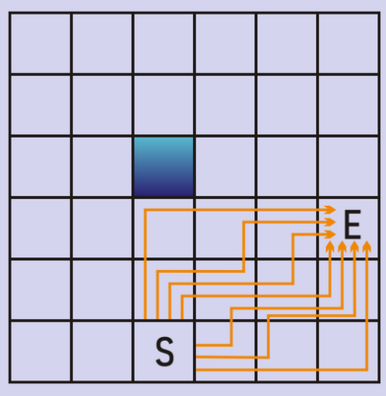
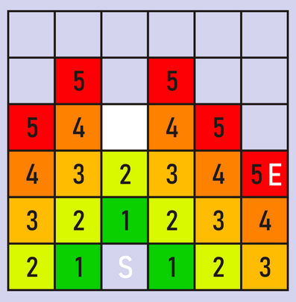
Mechanism:
Notice how the frontier expands like a ripple in a pond — first the 1’s are added.
By processing all the 1’s, all the 2’s are added to the frontier, and so on.
Also note that there are several possible paths of length 5 from the start to the end in this maze; the tie breaking mechanism will determine which of these paths is ultimately found.
In DFS we’d search along a single path, then “backtrack” when we reach a dead end.
With BFS we’re not really exploring along a path, instead we’re exploring along several possible paths at once

Slide 13
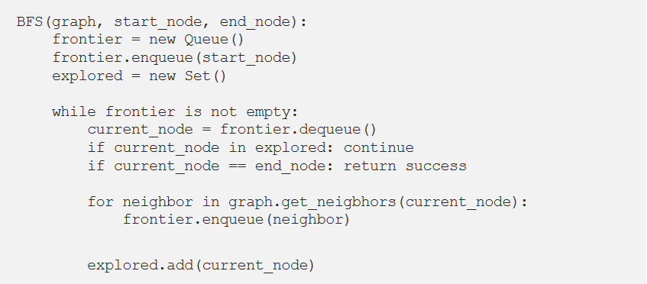
Pseudocode:
if the graph is unweighted BFS will always find the shortest path.
The pseudocode for BFS is remarkably close to DFS, the only difference is that the frontier is a queue instead of a stack.

Slide 14
#include <bits/stdc++.h>
#define pb push_back
using namespace std;
vector<bool> v;
vector<vector<int> > g;
int to_search;
bool found = false;
void edge(int a, int b) {
g[a].pb(b);
}
void bfs(int u) {
queue<int> q;
q.push(u);
v[u] = true;
while (!q.empty()) {
int f = q.front();
q.pop();
cout << f << " ";
// Enqueue all adjacent of f and mark them visited
for (auto i = g[f].begin(); i != g[f].end(); i++) {
if(f == to_search) {
found = true;
Break;
Code:
}
if (!v[*i]) {
q.push(*i);
v[*i] = true;
} } } }
int main()
{
int n, e;
cin >> n >> e;
v.assign(n, false);
g.assign(n, vector<int>());
int a, b;
for (int i = 0; i < e; i++) {
cin >> a >> b;
edge(a, b);
}
to_search = 4;
for (int i = 0; i < n; i++) {
if (!v[i] && found == false)
bfs(i);
}
return 0;
}

Slide 15
Minimum spanning tree:
A minimum spanning tree (MST) or minimum weight spanning tree is a subset of the edges of a connected, edge-weighted undirected graph that connects all the vertices together, without any cycles and with the minimum possible total edge weight.
A minimum spanning tree is a special kind of tree that minimizes the lengths (or “weights”) of the edges of the tree.
An example is a cable company wanting to lay line to multiple neighborhoods; by minimizing the amount of cable laid, the cable company will save money.

Slide 16
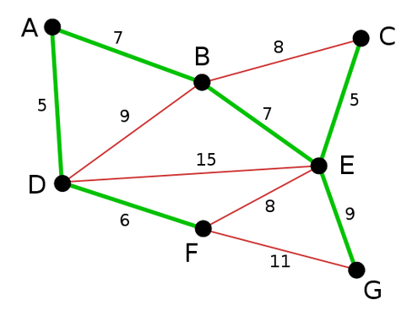
Continue:
One simple definition is that a tree is a connected graph with no cycles, where a cycle let’s you go from a node to itself without repeating an edge.
A few popular algorithms for finding this minimum distance include: 1.Kruskal’s algorithm, 2.Prim’s algorithm

Slide 17
Kruskal’s algorithm:
Kruskal’s algorithm is a minimum-spanning-tree algorithm which finds an edge of the least possible weight that connects any two trees in the forest.
It is a greedy algorithm in graph theory as it finds a minimum spanning tree for a connected weighted graph adding increasing cost arcs at each step.
This means it finds a subset of the edges that forms a tree that includes every vertex, where the total weight of all the edges in the tree is minimized.

Slide 18
Continue:
If the graph is not connected, then it finds a minimum spanning forest (a minimum spanning tree for each connected component).
Total edges=no.of vertices –1
Kruskal’s algorithm says that always select minimum cost edge but if it is forming a cycle don’t include that edge.

Slide 19
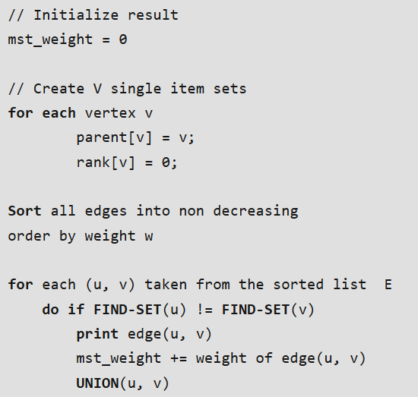
Algorithm and Pseudo Code:
Algorithms:
Sort all the edges in non-decreasing order of their weight.
Pick the smallest edge. Check if it forms a cycle with the spanning tree formed so far. If cycle is not formed, include this edge. Else, discard it.
Repeat step#2 until there are (V-1) edges in the spanning tree.

Slide 20
Code:
DisjointSets(int n)
{
this->n = n;
parent = new int[n+1];
rnk = new int[n+1];
for (int i = 0; i <= n; i++) {
rnk[i] = 0;
parent[i] = i;
} }
int find(int u) {
if (u != parent[u])
parent[u] = find(parent[u]);
return parent[u];
}
void merge(int x, int y) {
x = find(x), y = find(y);
if (rnk[x] > rnk[y])
parent[y] = x;
else // If rnk[x] <= rnk[y]
parent[x] = y;
if (rnk[x] == rnk[y])
rnk[y]++;
}
};
#include<bits/stdc++.h>
using namespace std;
typedef pair<int, int> iPair;
struct Graph {
int V, E;
vector< pair<int, iPair> > edges;
Graph(int V, int E) {
this->V = V;
this->E = E;
}
void addEdge(int u, int v, int w)
{
edges.push_back({w, {u, v}});
}
int kruskalMST();
};
struct DisjointSets
{
int *parent, *rnk;
int n;

Slide 21
int Graph::kruskalMST()
{
int mst_wt = 0; // Initialize result
sort(edges.begin(), edges.end());
// Create disjoint sets
DisjointSets ds(V);
vector< pair<int, iPair> >::iterator it;
for (it=edges.begin(); it!=edges.end(); it++) {
int u = it->second.first;
int v = it->second.second;
int set_u = ds.find(u);
int set_v = ds.find(v);
if (set_u != set_v)
{
cout << u << " - " << v << endl;
mst_wt += it->first;
ds.merge(set_u, set_v);
} }
return mst_wt;
}
int main()
{
int V = 9, E = 14;
Graph g(V, E);
g.addEdge(0, 1, 4);
g.addEdge(0, 7, 8);
g.addEdge(1, 2, 8);
g.addEdge(1, 7, 11);
g.addEdge(2, 3, 7);
g.addEdge(2, 8, 2);
g.addEdge(2, 5, 4);
g.addEdge(3, 4, 9);
g.addEdge(3, 5, 14);
g.addEdge(4, 5, 10);
g.addEdge(5, 6, 2);
g.addEdge(6, 7, 1);
g.addEdge(6, 8, 6);
g.addEdge(7, 8, 7);
cout << "Edges of MST are \n";
int mst_wt = g.kruskalMST();
cout << "\nWeight of MST is " << mst_wt;
return 0;
}

Slide 22
Prim's Algorithms:
Prim’s (also known as Jarník’s) algorithm is a greedy algorithm that finds a minimum spanning tree for a weighted undirected graph.
Finds a subset of the edges that forms a tree that includes every vertex, where the total weight of all the edges in the tree is minimized.
The algorithm operates by building this tree one vertex at a time, from an arbitrary starting vertex, at each step adding the cheapest possible connection from the tree to another vertex.

Slide 23
Algorithm:
we will start with an arbitrary node (it doesn’t matter which one) and mark it.
In each iteration we will mark a new vertex that is adjacent to the one that we have already marked.
As a greedy algorithm, Prim’s algorithm will select the cheapest edge and mark the vertex.

Slide 24
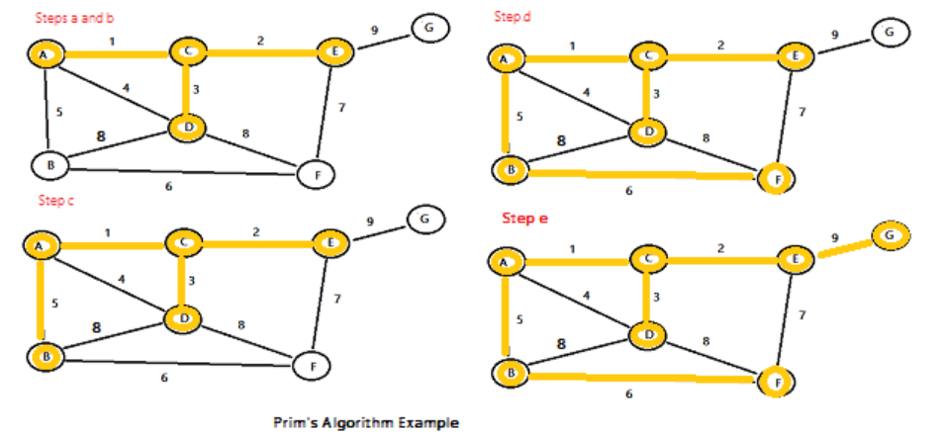
Pseudocode:
Start at any node in the graph
Mark the starting node as reached
Mark all the other nodes in the graph as unreached
Find an edge e with minimum cost in the graph that connects:
A reached node x to an unreached node y
Add the edge e found in the previous step to the Minimum cost Spanning Tree
Mark the unreached node y as reached
Repeat the steps 2 and 3 until all nodes in the graph have become reached

Slide 25
Code:
for (int i = 0; i < V; i++)
key[i] = INT_MAX, mstSet[i] = false;
key[0] = 0;
parent[0] = -1; // First node is always root of MST
// The MST will have V vertices
for (int count = 0; count < V - 1; count++)
{
int u = minKey(key, mstSet);
mstSet[u] = true;
for (int v = 0; v < V; v++)
if (graph[u][v] && mstSet[v] == false && graph[u][v] < key[v])
parent[v] = u, key[v] = graph[u][v];
}
printMST(parent, graph);
}
int main()
{
int graph[V][V] = { { 0, 2, 0, 6, 0 },
{ 2, 0, 3, 8, 5 },
{ 0, 3, 0, 0, 7 },
{ 6, 8, 0, 0, 9 },
{ 0, 5, 7, 9, 0 } };
primMST(graph);
return 0;
}
#include <bits/stdc++.h>
using namespace std;
#define V 5
int minKey(int key[], bool mstSet[])
{
int min = INT_MAX, min_index;
for (int v = 0; v < V; v++)
if (mstSet[v] == false && key[v] < min)
min = key[v], min_index = v;
return min_index; }
void printMST(int parent[], int graph[V][V])
{
cout<<"Edge \tWeight\n";
for (int i = 1; i < V; i++)
cout<<parent[i]<<" - "<<i<<" \t"<<graph[i][parent[i]]<<" \n";
}
void primMST(int graph[V][V])
{
int parent[V];
int key[V];
bool mstSet[V];

Slide 26
Prim’s vs Kruskal’s algorithm:
PRIMS ALGORITHM
KRUSHAL ALGORITHM
A greedy algorithm that finds a MST for a weighted undirected graph
Generated the MST starting from the root vertex.
Selects the root vertex
Selects the shortest edge connected to the root vertex
A MST algorithm which finds an edge of the least possible weight that connects any two trees in the forest
Generates the MST starting from the least weighted edge
Selects the shortest edge.
Selects the next shortest edge

Slide 27
Single source shortest path:
In graph theory, the shortest path problem is the problem of finding a path between two vertices (or nodes) in a graph such that the sum of the weights of its constituent edges is minimized.
The single-source shortest path problem, in which we have to find shortest paths from a source vertex v to all other vertices in the graph.

Slide 28
Dijkstra’s algorithm:
One of the famous algorithm used for single source shortest path is Dijkstra's algorithm
Dijkstra’s algorithm is to determine the shortest path from one node in a graph to every other node within the same graph data structure, provided that the nodes are reachable from the starting node.
Like Prim’s MST, we generate a SPT (shortest path tree) with given source as root.

Slide 29
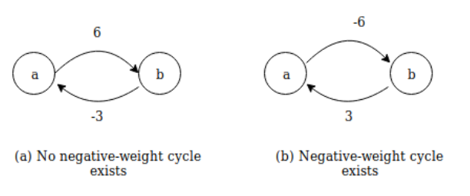
Continue...
The condition for the algorithm is that all edge weights should be non-negative.
Thus, Dijkstra’s algorithm is efficient than the Bellman-Ford algorithm because it processes each edge only once, since it knows that there are no negative-weight edges in the graph.

Slide 30
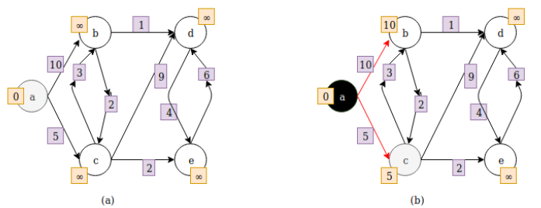
Example:
Here the source vertex is a. When the vertex is selected it becomes gray and when it is processed it becomes black.
vertex a is selected and after it is processed there are two edges to choose, one with weight 10 and one with weight 5.
(b) edge with weight 5 is selected because the weight is smaller than other edge weight and vertex c is selected. The shortest distance from the source vertex is also update at each vertex.

Slide 31
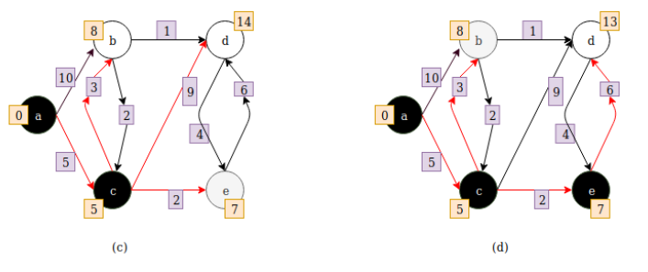
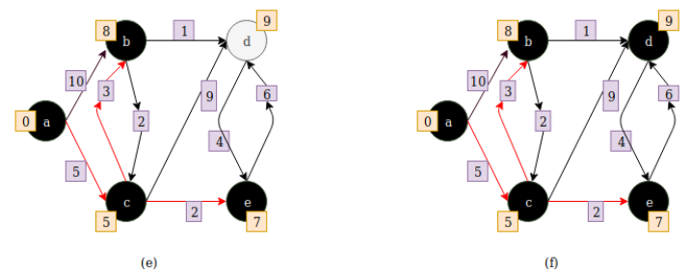
c. distance to vertex e is 7 from source vertex and to vertex d it is 14 from source vertex.
d.After vertex e is processed the distance to vertex d is 13 from source vertex.
f. all vertices are processed and their shortest distance from source vertex is updated.
Greedy Approach:At each step, Dijkstra’s algorithm selects a vertex that has not been processed yet and whose distance is as small as possible.

Slide 32
Algorithm:
1) Create a set sptSet that keeps track of vertices included in shortest path tree.
2) Assign a distance value to all vertices in the input graph. Initialize all distance values as INFINITE. Assign distance value as 0 for the source vertex so that it is picked first.
3) While sptSet doesn’t include all vertices
….a) Pick a vertex u which is not there in sptSet and has minimum distance value.
….b) Include u to sptSet.
….c) Update distance value of all adjacent vertices of u. To update the distance values, iterate through all adjacent vertices. For every adjacent vertex v, if sum of distance value of u (from source) and weight of edge u-v, is less than the distance value of v, then update the distance value of v.

Slide 33
Code:
dist[src] = 0;
for (int count = 0; count < V - 1; count++) {
int u = minDistance(dist, sptSet);
sptSet[u] = true; vertex.
for (int v = 0; v < V; v++)
if (!sptSet[v] && graph[u][v] && dist[u] != INT_MAX
&& dist[u] + graph[u][v] < dist[v])
dist[v] = dist[u] + graph[u][v];
}
printSolution(dist);
}
int main()
{
int graph[V][V] = { { 0, 4, 0, 0, 0, 0, 0, 8, 0 },
{ 4, 0, 8, 0, 0, 0, 0, 11, 0 },
{ 0, 8, 0, 7, 0, 4, 0, 0, 2 },
{ 0, 0, 7, 0, 9, 14, 0, 0, 0 },
{ 0, 0, 0, 9, 0, 10, 0, 0, 0 },
{ 0, 0, 4, 14, 10, 0, 2, 0, 0 },
{ 0, 0, 0, 0, 0, 2, 0, 1, 6 },
{ 8, 11, 0, 0, 0, 0, 1, 0, 7 },
{ 0, 0, 2, 0, 0, 0, 6, 7, 0 } };
dijkstra(graph, 0);
return 0; }
#include <limits.h>
#include <stdio.h>
#define V 9
int minDistance(int dist[], bool sptSet[])
{
int min = INT_MAX, min_index;
for (int v = 0; v < V; v++)
if (sptSet[v] == false && dist[v] <= min)
min = dist[v], min_index = v;
return min_index; }
void printSolution(int dist[])
{
printf("Vertex \t\t Distance from Source\n");
for (int i = 0; i < V; i++)
printf("%d \t\t %d\n", i, dist[i]);
}
void dijkstra(int graph[V][V], int src)
{
int dist[V];
bool sptSet[V];
for (int i = 0; i < V; i++)
dist[i] = INT_MAX, sptSet[i] = false;

Slide 34
All-pairs shortest paths:
The problem is to find shortest distances between every pair of vertices in a given edge weighted directed Graph.
The Floyd Warshall Algorithm is for solving the All Pairs Shortest Path problem.
This Algorithm follow Dynamic Programming approach.

Slide 35
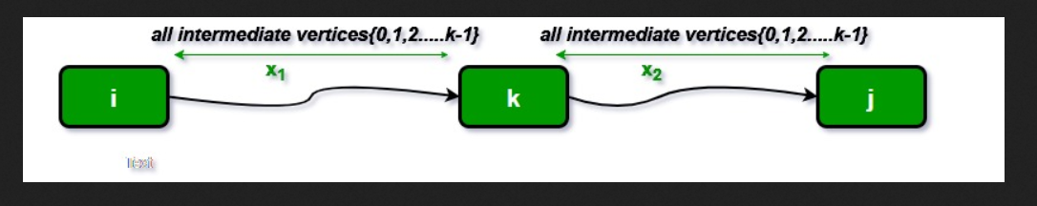
Floyd Warshall Algorithm:
We initialize the solution matrix same as the input graph matrix as a first step. Then we update the solution matrix by considering all vertices as an intermediate vertex.
The idea is to one by one pick all vertices and updates all shortest paths which include the picked vertex as an intermediate vertex in the shortest path.
When we pick vertex number k as an intermediate vertex, we already have considered vertices {0, 1, 2, .. k-1} as intermediate vertices.

Slide 36
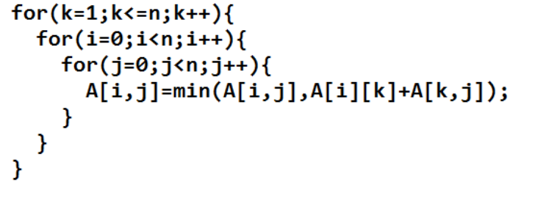
For every pair (i, j) of the source and destination vertices respectively, there are two possible cases.
1) k is not an intermediate vertex in shortest path from i to j. We keep the value of dist[i][j] as it is.
2) k is an intermediate vertex in shortest path from i to j.
We update the value of dist[i][j] = dist[i][k] + dist[k][j]
if dist[i][j] > dist[i][k] + dist[k][j]

Slide 37
Code:
void printSolution(int dist[][V])
{
cout<<"The following matrix shows the shortest distances"
" between every pair of vertices \n";
for (int i = 0; i < V; i++)
{
for (int j = 0; j < V; j++)
{
if (dist[i][j] == INF)
cout<<"INF"<<" ";
else
cout<<dist[i][j]<<" ";
}
cout<<endl;
} }
int main()
{
int graph[V][V] = { {0, 5, INF, 10},
{INF, 0, 3, INF},
{INF, INF, 0, 1},
{INF, INF, INF, 0}
};
floydWarshall(graph);
return 0; }
#include <bits/stdc++.h>
using namespace std;
#define V 4
#define INF 99999
void printSolution(int dist[][V]);
void floydWarshall (int graph[][V])
{
int dist[V][V], i, j, k;
for (i = 0; i < V; i++)
for (j = 0; j < V; j++)
dist[i][j] = graph[i][j];
for (k = 0; k < V; k++)
{
for (i = 0; i < V; i++)
{
for (j = 0; j < V; j++)
{
if (dist[i][k] + dist[k][j] < dist[i][j])
dist[i][j] = dist[i][k] + dist[k][j];
}
}
}
printSolution(dist);
}

