Slide 1
Back Tracking
Yash N.C.
181210062

Slide 2
Back Tracking
Backtracking is an algorithmic-technique for solving problems recursively by trying to build a solution incrementally, one piece at a time, removing those solutions that fail to satisfy the constraints of the problem at any point of time. Backtracking can be applied only for problems which admit the concept of a "partial candidate solution" and a relatively quick test of whether it can possibly be completed to a valid solution. It is useless, for example, for locating a given value in an unordered table. When it is applicable, however, backtracking is often much faster than brute force enumeration of all complete candidates, since it can eliminate many candidates with a single test.

Slide 3
How BackTracking Works ?
Backtracking algorithm determines the solution by systematically searching the solution space for the given problem. Backtracking is a depth-first search with any bounding function. All solution using backtracking is needed to satisfy a complex set of constraints. The constraints may be explicit or implicit.
Explicit Constraint is ruled : which restrict each vector element to be chosen from the given set.
Implicit Constraint is ruled : which determine which each of the tuples in the solution space, actually satisfy the criterion function.

Slide 4
Advantages
It is a step-by-step representation of a solution to a given problem ,which is very easy to understand
It easy to first develop an algorithm & then convert into a program
The accuracy of the solution is very high
Disadvantages
Backtracking requires recursion which can be something worse, because CPU stack space is limited and can be consumed quickly by recursion.
Backtracking approach detects conflicts very late
More comparisons are needed which in turn increases the execution time

Slide 5
Real Life Applications of Backtracking Approach
Eight queens puzzle
Crosswords
Verbal arithmetic
Sudoku
Knapsack problem
Rat in a Maze
Knight’s tour

Slide 6
N Queen Problem (By Backtracking)
The N Queen is the problem of placing N chess queens on an N×N chessboard so that no two queens attack each other.

Slide 7
N Queen Problem
This problem is to find an arrangement of N queens on a chess board, such that no queen can attack any other queens on the board. The chess queens can attack in any direction as horizontal, vertical, horizontal and diagonal way. A binary matrix is used to display the positions of N Queens, where no queens can attack other queens.

Slide 8
N Queen Problem (Algorithm)
1) Start in the leftmost column
2) If all queens are placed return true
3) Try all rows in the current column. Do following for every tried row.
a) If the queen can be placed safely in this row then mark this [row, column] as part of the solution and recursively check if placing queen here leads to a solution.
b) If placing the queen in [row, column] leads to a solution then return true.
c) If placing queen doesn't lead to a solution then unmark this [row, column] (Backtrack) and go to step (a) to try other rows.
4) If all rows have been tried and nothing worked, return false to trigger backtracking.

Slide 9
Idea of solving N Queen Problem
The idea behind solving this problem is to place queens one by one in different columns, starting from the leftmost column. When we place a queen in a column, we check for clashes with already placed queens. In the current column, if we find a row for which there is no clash, we mark this row and column as part of the solution. If we do not find such a row due to clashes then we backtrack and return false.

Slide 10
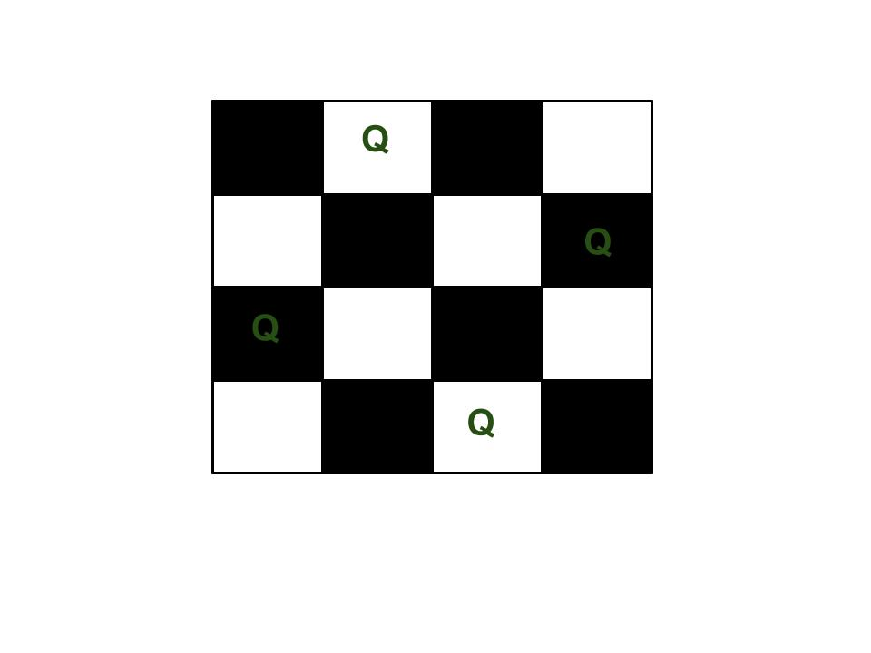
Idea of solving N Queen Problem
Example :
For N = 4

Slide 11
Why Backtracking For this problem?
Backtracking is Ideal for this problem as there can be numerous solutions to the problem when the value of N is entered by the user. Backtracking provides the best change to find the solution for the problem. In this case using brute force or greedy approach may prove to be problematic as backtracking is solving all sub-problems one by one in order to reach the best possible solution. This is the reason we use backtracking for solving puzzles.

