Slide 1
Greedy Method Approach
Yash N.C.
181210062

Slide 2
Greedy Method
The simplest and straightforward approach is the Greedy method. In this approach, the decision is taken on the basis of current available information without worrying about the effect of the current decision in future. Greedy is an algorithmic paradigm that builds up a solution piece by piece, always choosing the next piece that offers the most obvious and immediate benefit. So the problems where choosing locally optimal also leads to global solution are best fit for Greedy

Slide 3
How Greedy Approach Works ?
Greedy algorithms build a solution part by part, choosing the next part in such a way, that it gives an immediate benefit. This approach never reconsiders the choices taken previously. This approach is mainly used to solve optimization problems. Greedy method is easy to implement and quite efficient in most of the cases. Hence, we can say that Greedy algorithm is based on heuristic that follows local optimal choice at each step with the hope of finding global optimal solution. In many problems, it does not produce an optimal solution though it gives an approximate solution in a reasonable time.

Slide 4
How Greedy Approach Works ?
Greedy algorithms have the following five components
A candidate set − A solution is created from this set.
A selection function − Used to choose the best candidate to be added to the solution.
A feasibility function − Used to determine whether a candidate can be used to contribute to the solution.
An objective function − Used to assign a value to a solution or a partial solution.
A solution function − Used to indicate whether a complete solution has been reached.

Slide 5
Advantages
It is quite easy to come up with a greedy algorithm (or even multiple greedy algorithms) for a problem.
Analyzing the run time for greedy algorithms will generally be much easier than for other techniques (like Divide and conquer). For the Divide and conquer technique, it is not clear whether the technique is fast or slow. This is because at each level of recursion the size of gets smaller and the number of sub-problems increases.
Disadvantages
It is not suitable for problems where a solution is required for every subproblem. In such problems, the greedy strategy can be wrong in the worst case even lead to a non-optimal solution.
They not always the global optimum solution sometimes they provide sub-optimal solutions and in worst cases may even provide non - optimal solutions

Slide 6
Real Life Applications of Greedy Approach
Dijkstra's algorithm for finding shortest path to all nodes given a start node
Prim's algorithm for finding a minimum spanning tree
Huffman trees for data compression
Egyptian Fraction
Huffman Decoding
Egyptian Fraction

Slide 7
Minimum Spanning Tree
(Prim’s Algorithm)
To find a spanning tree whose sum of edge weights is as small as possible for a weighted undirected graph

Slide 8
Prim’s Minimum Spanning Tree
Prim’s algorithm is a Greedy Approach.
The algorithm operates by building this tree one vertex at a time, from an arbitrary starting vertex, at each step adding the cheapest possible connection from the tree to another vertex.
The time complexity of Prim's algorithm depends on the data structures used for the graph and for ordering the edges by weight.
O(N^2) - Adjacency matrix (what we will be using in this problem)

Slide 9
Idea Behind Prim’s Algorithm
The idea behind Prim’s algorithm is simple, a spanning tree means all vertices must be connected. So the two disjoint subsets of vertices must be connected to make a Spanning Tree. And they must be connected with the minimum weight edge to make it a Minimum Spanning Tree.Two sets of vertices are maintained. The first set contains the vertices already included in the MST, the other set contains the vertices not yet included. At every step, it considers all the edges that connect the two sets, and picks the minimum weight edge from these edges. After picking the edge, it moves the other endpoint of the edge to the set containing MST.

Slide 10
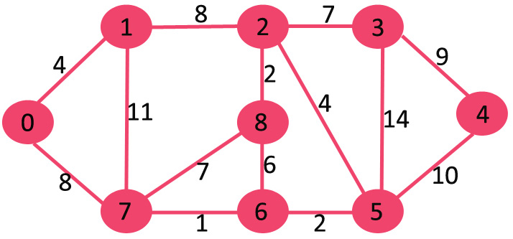
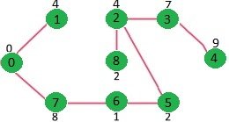
Idea of solving problems using Prim’s Algo.
Given weighted Undirected Graph
Minimum Spanning Tree of the Graph ( Prim’s Algorithm )

Slide 11
Prim’s Algorithm (Algo.)
1) Create a set mstSet that keeps track of vertices already included in MST.
2) Assign a key value to all vertices in the input graph. Initialize all key values as INFINITE. Assign key value as 0 for the first vertex so that it is picked first.
3) While mstSet doesn’t include all vertices :
i)Pick a vertex u which is not there in mstSet and has minimum key value.
ii)Include u to mstSet.
iii)Update key value of all adjacent vertices of u. To update the key values, iterate through all adjacent vertices. For every adjacent vertex v, if weight of edge u-v is less than the previous key value of v, update the key value as weight of u-v

Slide 12
Why use Prim’s Algorithm ?
We use Prim’s Algorithm for finding the Minimum Spanning Tree problem as the Prim’s Algorithm is based on a Greedy Approach. Greedy Approach is very beneficial in this problem as the time complexity reduces significantly due to the fact that the number of edges is at least the number of vertices in a closed connected graph. In dense graph such as given in the example the Prim’s algorithm is usually used.

