Slide 1
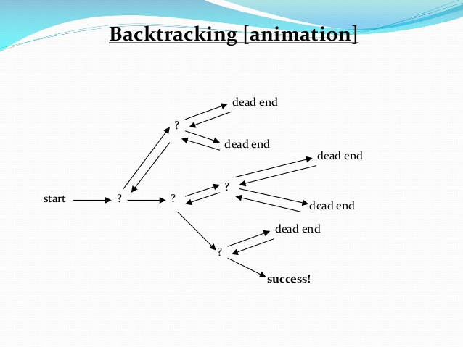
BACKTRACKING
-Namrata Prasad
-181210032
-CSE 2nd Year

Slide 2
Description
Backtracking is nothing but the modified process of the brute force approach, where the technique systematically searches for a solution to a problem among all available options.
There are three types of problems in backtracking –
Decision Problem – We search for a feasible solution.
Optimization Problem – We search for the best solution.
Enumeration Problem – We find all feasible solutions.
Backtracking is an important tool for solving constraint satisfaction problems, such as crosswords, Sudoku etc.

Slide 3
Algorithm
void findSolutions(n, other params) :
if (found a solution) :
solutionsFound = solutionsFound + 1;
displaySolution();
if (solutionsFound >= solutionTarget) :
System.exit(0);
return
for (val = first to last) :
if (isValid(val, n)) :
applyValue(val, n);
findSolutions(n+1, other params);
removeValue(val, n);

Slide 4
Applications of Backtracking
Optimization and tactical problems
Constraints Satisfaction Problem
Artificial Intelligence
Materials Engineering
Network Communication
Solving puzzles and path
Some problems based on backtracking technique:
N Queens Problem
Warnsdorff’s Algorithm
Remove Invalid Parenthesis
Find Path from corner cell to middle cell in a maze
Hamiltonian cycle
Sudoku
M Coloring Problem

Slide 5
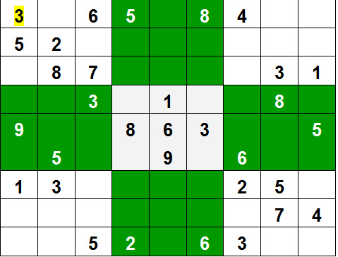
Problem Statement 1:
Sudoku Solver
In a N X N Square Board, The Numbers 1 to N to be Placed in a way that:
– All the Number from 1 to N can be Placed in each row.
– All the Number from 1 to N can be Placed in each Column. – All The Number from 1 to N Can be Placed in Sub Square boxes of the given box.

Slide 6
Backtracking Approach
Algorithm Sudoku_Solver(canvas, row, col){
If(anyEmptyLocation(canvas, row, col)) Return true;
For I = 1 to n do, {
If (find_location(canvas, row,col, i)) {
Canvas[row][col] = i;
If (Sudoku_Solver(canvas))
Return true;
Canvas [row][col] = -1;
}
}
Return false;
}
The Algorithm Will Check Each Box’s value if the value is in the same row, or same column or same sub-square box. If not,then it placed the value in the box. And go to the next box for the next value, and check the Above Condition. If there is any duplicate value, then The Algorithm check for the next value.

Slide 7
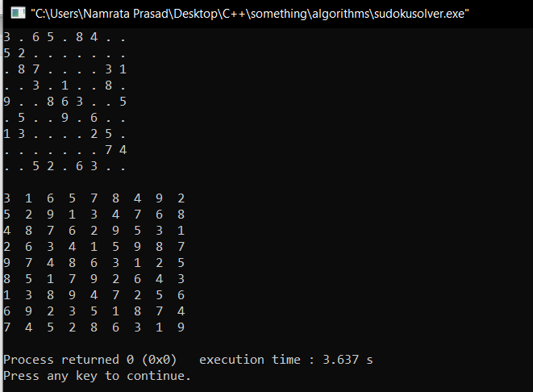
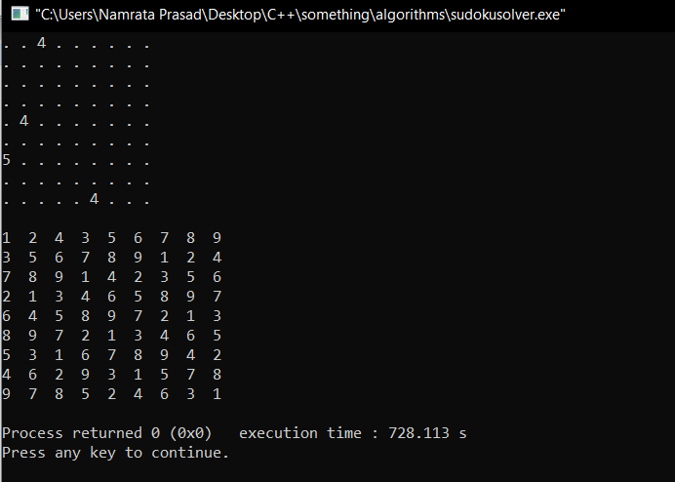
OUTPUTS
INPUT 1:
INPUT 2:

Slide 8
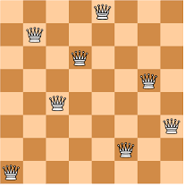
PROBLEM STATEMENT 2
In a NxN square board N – number of queens need to be placed considering three Condition ---
No two Queens can be placed in same row.
No two Queens Can be places in same Column
No two queens Can be placed in same Diagonal.

Slide 9
Backtracking Approach
Algorithm Nqueen(K,n){
For i= 1 to n {
If Place(K,i){
X[k] = I; If(k = n) then Write x[1:n]; Else
Nqueen(k+1, n) ;
}
}
}
Place(k,i){
For j=1 to k-1{
If((x[j] = i) or abs(x[j] – 1 = abs(j-k))) Return false;
}
Return true;
}
The Algorithm will check each position [i , j] for each queens . If any Suitable places found , it will place a queen on that position. If not, the Algorithm will try same approach for next position.

Slide 10
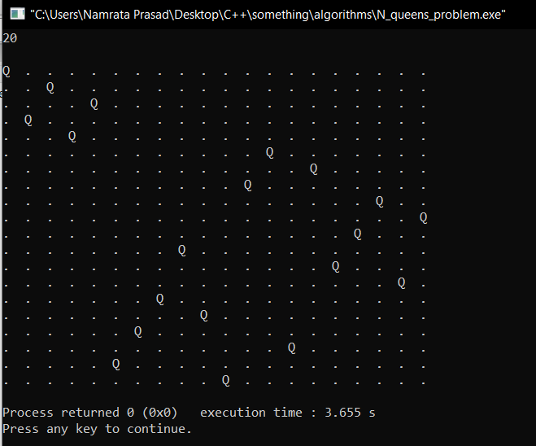
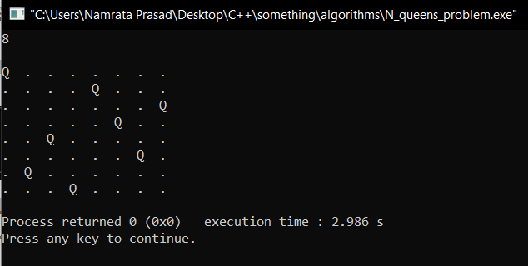
OUTPUTS:
OUTPUT 1:
OUTPUT 2:

