Slide 1
DESIGN AND ANALYSIS OF ALGORITHMS
MADE BY-ANAND PANDEY
CSE ii YEAR 181210009

Slide 2
GRAPHS
Graphs are mathematical structures that represent pairwise relationships between objects. A graph is a flow structure that represents the relationship between various objects. It can be visualized by using the following two basic components:
Nodes: These are the most important components in any graph. Nodes are entities whose relationships are expressed using edges.
Edges: Edges are the components that are used to represent the relationships between various nodes in a graph.

Slide 3
BREADTH FIRST SEARCH
Breadth-first search (BFS) is an algorithm for traversing or searching tree or graph data structures. It starts at tree root, and explores all of the neighbor nodes at the present depth prior to moving on to the nodes at the next depth level.

Slide 4
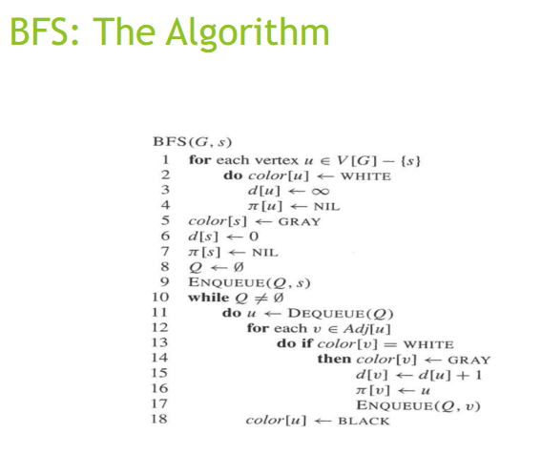
BFS ALGORITHM

Slide 5
DEPTH FIRST SEARCH
Depth-first search (DFS) is an algorithm for traversing or searching trEE or graph data structures. The algorithm starts at the root node (selecting some arbitrary node as the root node in the case of a graph) and explores as far as possible along each branch before backtracking .

Slide 6
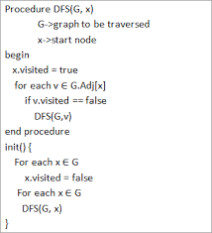
ALGORITHM OF DEPTH FIRST SEARCH

Slide 7
PRIM’S ALGORITHM
Prim's algorithm is a greedy algorithm that finds a minimum spanning tree for a weighted undirected graph. This means it finds a subset of the edges that forms a tree that includes every vertex, where the total weight of all the edges in the tree is minimized. The algorithm operates by building this tree one vertex at a time, from an arbitrary starting vertex, at each step adding the cheapest possible connection from the tree to another vertex.

Slide 8
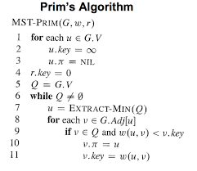

Slide 9
KRUSKAL’S ALGORITHM
In this algorithm, first we sort the edges of the graph with respect to their weights in increasing order in a list.
Then, we start adding the edges from that list one-by-one, such that the small weight edges are added first.
We only add the edges with at least one unvisited node such that no loops are made.
We keep adding edges till all the nodes are visited and no cycles are formed.

Slide 10
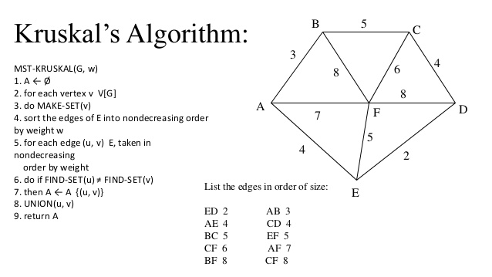

Slide 11
DIJKSTRA’S ALGORITHM
In this algorithm, we maintain a list of all the vertices for which, the minimum distance from the source is already calculated.
Initially, all distances are set to infinity. Assign the distance for the source vertex as 0.
Pick a vertex not included in the list yet and has minimum distance value. Add that to the list. Update distance value for all the vertices adjacent to u. If the path through u to a vertex v is less costly than the previous path, we change the minimum distance value for v.

Slide 12
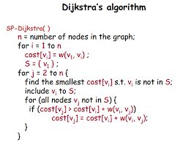

Slide 13
Floyd- Warshall Algorithm
In this algorithm, we make a minimum distance matrix, showing the minimum distance from every vertex to every other vertex, initially equal to the weight of the edge between them, or infinity(INF) if no edge exists.
Then, between every v_{i} and v_{j}, we select and add the vertices from the first k vertices as intermediate if adding the vertex reduces the minimum distance and update the distance accordingly.
Thus, for every pair of vertices, the minimum distance is calculated including some of the other vertices as intermediates if required.

Slide 14
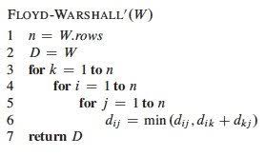

Slide 15
THANK YOU

