Slide 1
ALL PAIRS SHORTEST PATHS -DESIGN AND ANALYSIS OF ALGORITHMS-
Name : PRASUN VERMA
Roll No. : 181210036
Branch : CSE - 2nd Year

Slide 2
CONTENTS
Title Slide No.
Introduction 3
Floyd-Warshall Algorithm 5
Uses of Algorithm 15

Slide 3
What is All Pairs Shortest Path Problem?
The all-pairs shortest path problem is the determination of the shortest graph distances between every pair of vertices in a given graph.
We have to calculate the minimum cost to find the shortest path.

Slide 4
Procedure to find the all pairs shortest path
First we consider “G” as a directed graph
The cost of the graph is the length or cost of each edges and cost(i,i)=0
If there is an edge between i and J then cost of (i,j)=length/cost of the edge from i to j and id there is no edge then (i, j)= ∞
Need to calculate the shortest path/ cost between ant two nodes using intermediary nodes.
The following equation is used to calculate the minimum cost
Ak(i,j)=min{Ak-1(i,j), Ak-1(i,k), Ak-1(k,j)}

Slide 5
Floyd-Warshall Algorithm
It is used to find the shortest paths between between all pairs of vertices in a graph.
Each edge in the graph has a weight which is positive or negative.
This algorithm works for both the directed and undirected weighted graphs. But, it does not work for the graphs with negative cycles (where the sum of the edges in a cycle is negative).
Algorithm follows the dynamic programming approach to find the shortest paths.

Slide 6
Algorithm
For a graph with V vertices:
Initialize the shortest paths between any 2 vertices with Infinity.
Find all pair shortest paths that use 0 intermediate vertices, then find the shortest paths that use 1 intermediate vertex and so on.. until using all N vertices as intermediate nodes.
Minimize the shortest paths between any 2 pairs in the previous operation.
For any 2 vertices (i,j) , one should actually minimize the distances between this pair using the first K nodes, so the shortest path will be: min(dist[i][k]+dist[k][j],dist[i][j]).

Slide 7
PSEUDO-CODE
let dist be a |V| × |V| array of minimum distances initialized to ∞ (infinity) for each vertex v do dist[v][v] = 0 for each edge (u, v) do dist[u][v] = w(u, v) // The weight of the edge (u, v) for k from 0 to |V|-1 for i from 0 to |V|-1 for j from 0 to |V|-1 if dist[i][j] > dist[i][k] + dist[k][j] dist[i][j] ← dist[i][k] + dist[k][j] end if

Slide 8
Time Complexity
There are three loops.
Each loop has constant complexities.
So, the time complexity of the Floyd-Warshall algorithm is O(n³).

Slide 9
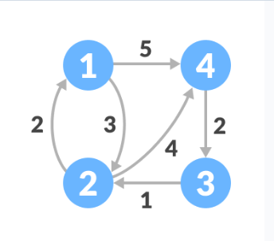
Illustration
Consider the following example :

Slide 10
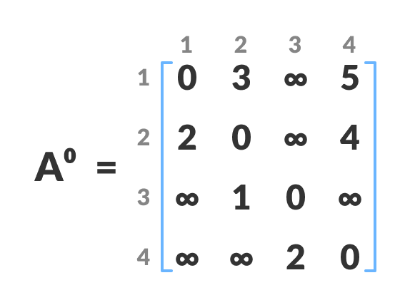
Illustration
Create a matrix A⁰ of dimension n*n, where ‘n’ is the no. of vertices.
Remaining Cells are filled :-
if(A[i][j]>A[i][k]+A[k][j]) then
Do A[i][j] = A[i][k] + A[k][j]
‘k’ is the intermediate vertex in the shortest
path from source to destination.

Slide 11
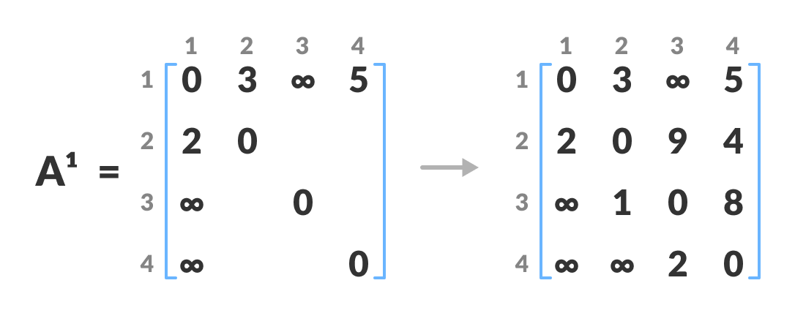
Illustration
Now Create a Matrix A¹ using A⁰ . The elements in the first column and row are left as they are.

Slide 12
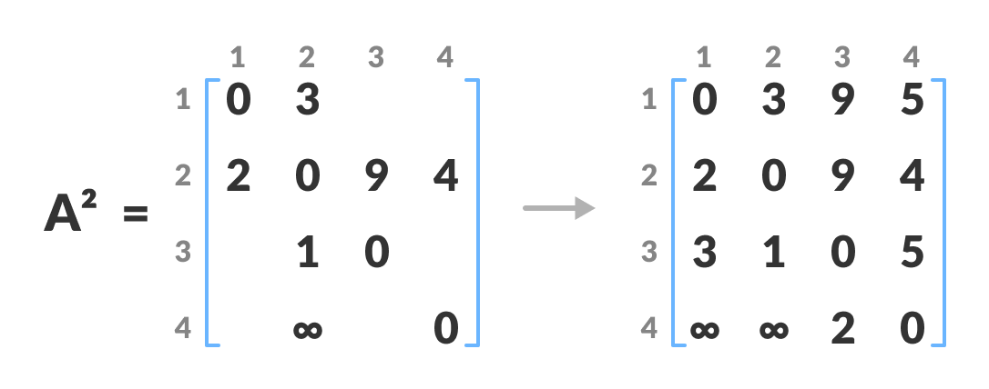
Illustration
Similarly, We create A² , The elements in the second column and the second row are left as they are.

Slide 13
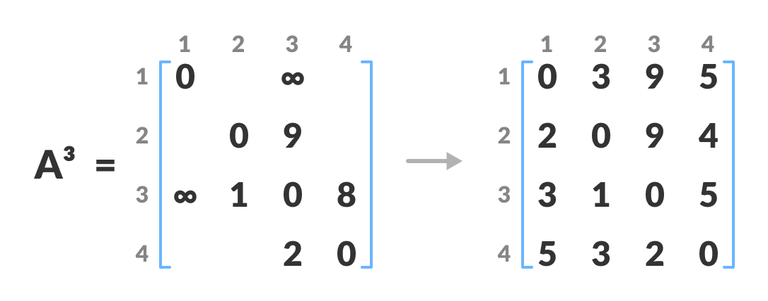
Illustration
A³ is created in a similar fashion.

Slide 14
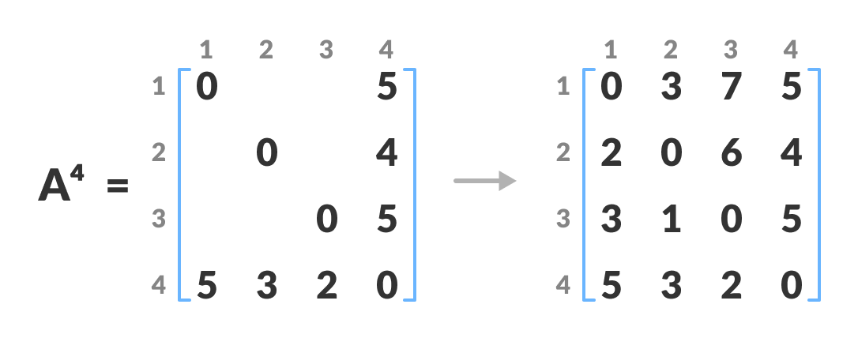
Illustration
A⁴ is created, which gives the shortest path between each pair of vertices.

Slide 15
Application of the Algorithm
To find the shortest path is a directed graph
To find the transitive closure of directed graphs
To find the Inversion of real matrices
For testing whether an undirected graph is bipartite

Slide 16
THANK YOU

