Slide 1
ELEMENTARY GRAPH ALGORITHMS -DESIGN AND ANALYSIS OF ALGORITHMS-
Name : PRASUN VERMA
Roll No. : 181210036
Branch : CSE - 2nd Year

Slide 2
CONTENTS
Title Slide No.
What is a Graph? 3
Applications of Graph in Real World 4
Some Basic Terminologies 5
Representation of Graphs 7
Breadth First Search 10
Depth First Search 15

Slide 3
Elementary Graph Algorithms What is a graph?
A graph is a non-linear data structure (V,E) that consists of :-
A finite set of vertices V also called as nodes.
A finite set of edges E, represented as ordered pairs of vertices (u,v), which connect a pair of nodes.
The edges may contain weight/value/cost.

Slide 4
Applications of Graph in Real World
On Facebook, everything is a node. That includes User Profile, Photo, Album, Event, Group, Page, Comment, Story, Video, Link, Note...anything that has data is a node. Every relationship is an edge from one node to another.
To find the fastest route to a specific location, Google Maps does it with the help of graph algorithms.
On e-Commerce websites relationship graphs are used to show recommendations.

Slide 5
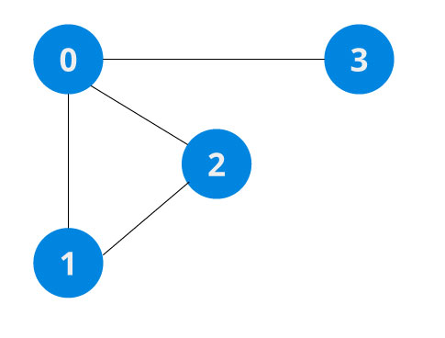
Some Basic Terminologies
Adjacency: A vertex is said to be adjacent to another vertex if there is an edge connecting them. Vertices 2 and 3 are not adjacent because there is no edge between them.
Path: A sequence of edges that allows you to go from vertex A to vertex B is called a path. 0-1, 1-2 and 0-2 are paths from vertex 0 to vertex 2.
Directed Graph: A graph in which an edge (u,v) doesn't necessary mean that there is an edge (v, u) as well. The edges in such a graph are represented by arrows to show the direction of the edge.
|V|= Number of Vertices , |V|=4
|E| = Number of Edges ,|E|=4 in figure 1
Fig 1 : An undirected graph

Slide 6
Running Times
The running time of graph algorithms is in terms of both vertices |V| and edges |E|.
We can remove cardinality when in asymptotic notation.
Example : O(VE) , which basically means O (|V||E|)

Slide 7
Representation of Graphs
Let a Graph G= (V,E) , may be directed or undirected
There’re two ways ‘G’ can be represented for algorithms :-
1. Adjacency Lists.
2. Adjacency Matrix.

Slide 8
Adjacency Lists
Consists of an array Adj of |V| lists, one for each vertex ∈ V.
For each u ∈ V , the adjacency list, Adj[u] contains all the vertices v, such that there’s an edge (u,v) ∈ E.
Used mainly to represent sparse graphs.
Example : Consider the undirected graph ‘G’ with 5 vertices and 7 edges, in Fig.2
The Adjacency list representation is :-
1
2
1
2
5
/
3
2
1
5
3
4
/
5
4
3
2
4
/
Fig 2 : An undirected graph
4
5
2
3
/
5
4
2
1
/

Slide 9
Adjacency Matrix
The representation of ‘G’ consists of a |V| x |V| matrix A= ( a_{ij} ), such that
a_{ij} = 1 , if (i,j) ∈ E,
0 , otherwise
where vertices are numbered 1,2,…,|V|.
Used mainly to represent dense graphs
It provides quicker way to identify the presence of an edge, but at the cost of more memory.
Example : Consider the undirected graph ‘G’ with 6 vertices and 8 edges, in Fig.3
The Adjacency Matrix representation is :-
We’ve a 6x6 Matrix
A presence of edge is marked as ‘1’.
V | 1 | 2 | 3 | 4 | 5 | 6
1 | 0 | 1 | 0 | 1 | 0 | 0
2 | 0 | 0 | 0 | 1 | 1 | 0
3 | 0 | 0 | 0 | 0 | 1 | 1
4 | 0 | 1 | 0 | 0 | 0 | 0
5 | 0 | 0 | 0 | 1 | 0 | 0
6 | 0 | 0 | 0 | 0 | 0 | 1
1
2
3
4
5
6
Fig 3 : A directed graph

Slide 10
BREADTH FIRST SEARCH (BFS) What is it ?
An algorithm for searching all the vertices of a graph, works on both directed and undirected graphs.
The purpose of the algorithm is to mark each vertex as visited while avoiding cycles.
Input : graph G=(V,E) and a distinguished source vertex ‘s’ ∈ V.
Output :
i) d[v] , distance (smallest no. of edges) from s to every reachable vertex v ∈ V.
ii) π[v] = ‘u’ such that (u,v) is last edge on shortest path s->v
‘u’ is the predecessor or parent of v in BFS tree.
Set of edges {(π[v],v): v ≠ s} forms a tree
This technique discovers all vertices at distance ‘k’ from s before discovering any vertices at distance ‘k+1’.
Time complexity of BFS is O(|V| + |E|).

Slide 11
BFS Algorithm
The algorithm works as follows:-
Set the color of all the nodes to white,distances d to the given vertex from the starting node equal to infinity , and all the parent pointers to NIL.
Then it sets the color of the starting node to gray. Take the front item of the queue and add it to the visited list.
Gray denotes all of the nodes that are on the frontier,the nodes that we have just found but have not yet fully explored.
A queue Q is created and puts ‘s’ into the queue.
A WHILE loop that continues until the queue is empty.
We pop out the first vertex in Q and then we loop through all of the adjacent vertices of u.
We only care about adding the vertices that we have not yet discovered into Q so as to not be stuck in an infinite loop.

Slide 12
Why did we set all of the starting distances of the vertices to infinity?
This is because there may be vertices that BFS can not reach. Since it is impossible to get to those vertices, we say that their distance is infinity.

Slide 13
PSEUDO-CODE
BFS(G, s) // G is the graph, and s is the source vertex
Let Q be queue.
Q.enqueue( s ) //Inserting s in queue until all its neighbour vertices are marked.
mark s as visited.
while ( Q is not empty)
//Removing that vertex from queue,whose neighbour will be visited now
v = Q.dequeue( )
//processing all the neighbours of v
for all neighbours w of v in Graph G
if w is not visited
Q.enqueue( w ) //Stores w in Q to further visit its neighbour
mark w as visited.

Slide 14
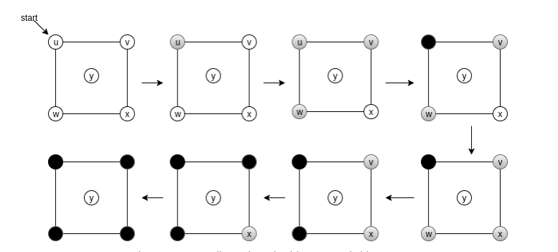
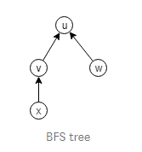
Illustration of BFS
Fig 5 : BFS Tree
Fig 4 : Running BFS on an undirected graph with an unreachable vertex y

Slide 15
DEPTH FIRST SEARCH (DFS) What is it ?
This strategy works by searching ‘deeper’ in the graph whenever possible, works on both directed and undirected graphs.
The algorithm starts at the source (top) node of a tree and goes as far as it can down a given branch (path), then backtracks until it finds an unexplored path, and then explores it.
It is a recursive algorithm that uses the idea of backtracking.
DFS uses a stack data structure to keep track of vertices.
Representation of DFS is shown in Fig. 6
The time complexity of DFS is O(|V| + |E|), when graph is represented using adjacency list.
Fig 6 : DFS Traversal

Slide 16
DFS Algorithm
Depth-first search explores edges that come out of the most recently discovered vertex, s.
Only edges going to unexplored vertices are explored.
When all of s’s edges have been explored, the search backtracks until it reaches an unexplored neighbour.
This process continues until all of the vertices that are reachable from the original source vertex are discovered.
If there are any unvisited vertices, depth-ﬁrst search selects one of them as a new source and repeats the search from that vertex.
The entire process is repeated until every vertex has been discovered.

Slide 17
PSEUDO-CODE
DFS-iterative (G, s): //Where G is graph and s is source vertex
let S be stack
S.push( s ) //Inserting s in stack
mark s as visited.
while ( S is not empty):
//Pop a vertex from stack to visit next
v = S.top( )
S.pop( )
//Push all the neighbours of v in stack that are not visited
for all neighbours w of v in Graph G:
if w is not visited :
S.push( w )
mark w as visited
DFS-recursive(G, s):
mark s as visited
for all neighbours w of s in Graph G:
if w is not visited:
DFS-recursive(G, w

Slide 18
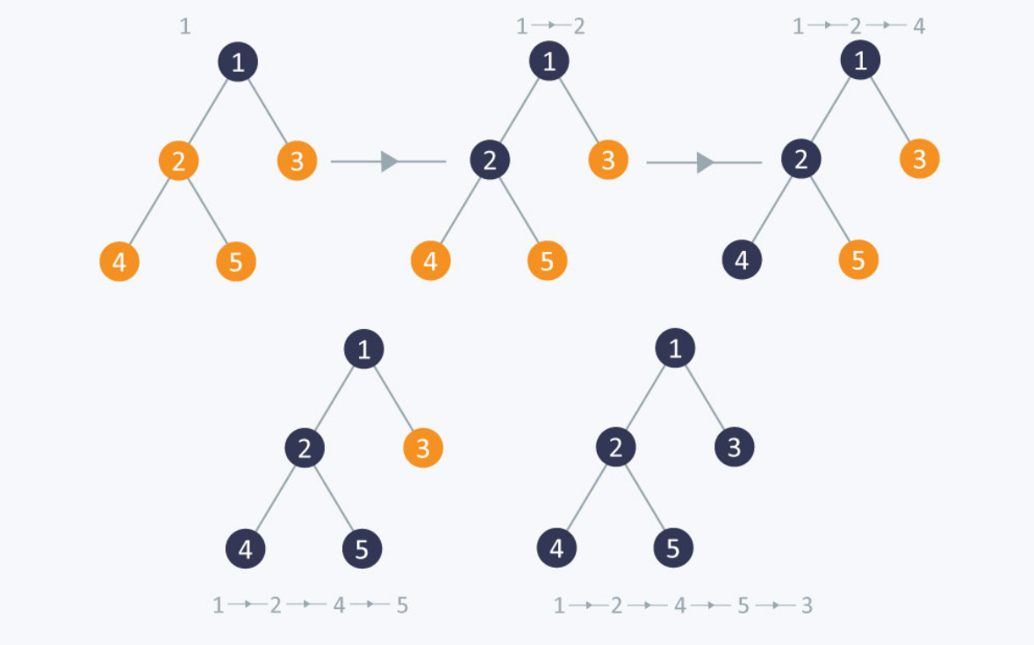
Illustration of DFS
Fig 7 : DFS Working

Slide 19
THANK YOU

