Slide 1
MINIMUM SPANNING TREE -DESIGN AND ANALYSIS OF ALGORITHMS-
Name : PRASUN VERMA
Roll No. : 181210036
Branch : CSE - 2nd Year

Slide 2
CONTENTS
Growing a minimum Spanning Tree
Kruskal’s Algorithm
Prim’s Algorithm
Title Slide No.
3
5
11

Slide 3
GROWING A MINIMUM SPANNING TREE What is a Spanning Tree?
Given an undirected and connected graph G=(V,E), a spanning tree of the graph G is a tree that spans G (that is, it includes every vertex of G) and is a subgraph of G (every edge in the tree belongs to G)
The cost of a spanning tree is the sum of weights given to each edge of the spanning tree.

Slide 4
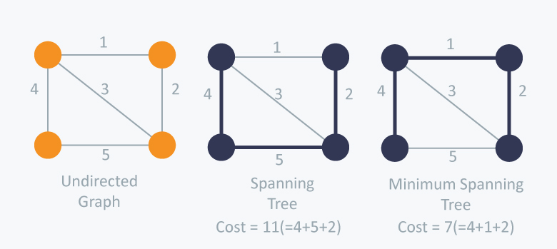
So, What is a minimum Spanning Tree?
A minimum spanning tree (MST) or minimum weight spanning tree for a weighted, connected and undirected graph is a spanning tree with weight less than or equal to the weight of every other spanning tree.
A minimum spanning tree has (V – 1) edges where V is the number of vertices in the given graph.
There can be many spanning trees, as well as many minimum spanning trees.
Fig. 1 : Illustration of Minimum Spanning Tree

Slide 5
KRUSKAL’S ALGORITHM
Kruskal's algorithm is a minimum spanning tree algorithm that takes a graph as input and finds the subset of the edges of that graph which :-
i) form a tree that includes every vertex
ii) has the minimum sum of weights among all the trees that can be formed from the graph

Slide 6
How Kruskal’s Algorithm works?
It falls under a class of algorithms called greedy algorithms which find the local optimum in the hopes of finding a global optimum.
We start from the edges with the lowest weight and keep adding edges until we reach our goal.

Slide 7
Algorithm
The steps for implementing Kruskal's algorithm are as follows:
1. Sort all the edges from low weight to high
2. Take the edge with the lowest weight and add it to the spanning tree.
3. If adding the edge created a cycle, then reject this edge.
4. Keep adding edges until we reach all vertices.

Slide 8
How to check if 2 vertices are connected or not ?
This could be done using DFS. But DFS will make time complexity large as it has an order of O(V+E).
So the best solution is
"Disjoint Sets":
Disjoint sets are sets whose intersection is the empty set so it means that they don't have any element in common.
Time Complexity:
The most time consuming operation is sorting because the total complexity of the Disjoint-Set operations will be O(ElogV), which is the overall Time Complexity of the algorithm

Slide 9
PSEUDO-CODE
Kruskal(G) :
A := ∅
for each v ∈ G.V do
MAKE-SET(v)
for each (u, v) in G.E ordered by weight(u, v), increasing do
if FIND-SET(u) ≠ FIND-SET(v) then
A := A ∪ {(u, v)}
UNION(FIND-SET(u), FIND-SET(v))
return A

Slide 10
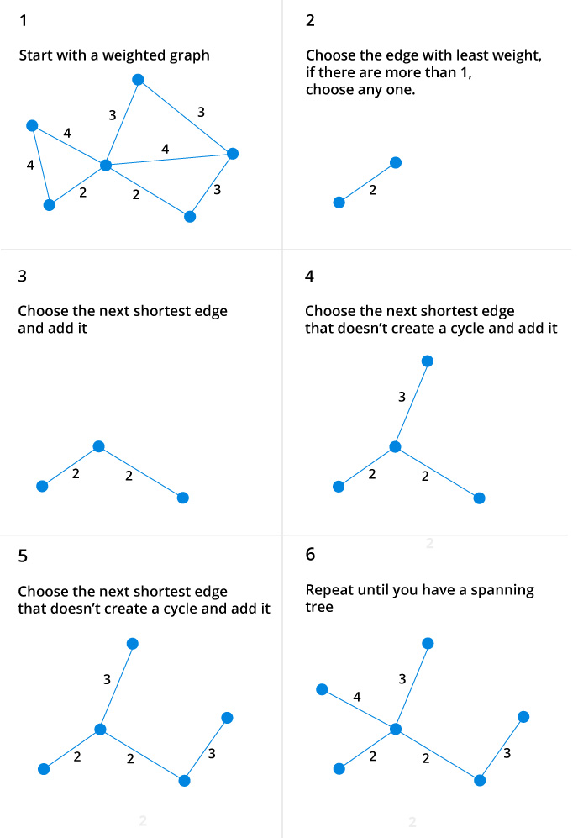
ILLUSTRATION

Slide 11
PRIM’S ALGORITHM
Prim’s Algorithm also use Greedy approach to find the minimum spanning tree.
We grow the spanning tree from a starting position.
Unlike an edge in Kruskal's, we add vertex to the growing spanning tree in Prim's.
We start from one vertex and keep adding edges with the lowest weight until we reach our goal.

Slide 12
Algorithm
The steps for implementing Prim's algorithm are as follows:
Maintain two disjoint sets of vertices. One containing vertices that are in the growing spanning tree and other that are not in the growing spanning tree.
Select the cheapest vertex that is connected to the growing spanning tree and is not in the growing spanning tree and add it into the growing spanning tree.
This can be done using Priority Queues. Insert the vertices, that are connected to growing spanning tree, into the Priority Queue.
Check for cycles, mark the nodes which have been already selected and insert only those nodes in the Priority Queue that are not marked.
Time Complexity:
It is O((V+E) logV) because each vertex is inserted in the priority queue only once and insertion in priority queue take logarithmic time.

Slide 13
PSEUDO-CODE
Prim’s (G) :
T = ∅;
U = { 1 };
while (U ≠ V)
let (u, v) be the lowest cost edge such that u ∈ U and v ∈ V - U;
T = T ∪ {(u, v)}
U = U ∪ {v}
We create two sets of vertices U and V-U. U contains the list of vertices that have been visited and V-U the list of vertices that haven't. One by one, we move vertices from set V-U to set U by connecting the least weight edge

Slide 14
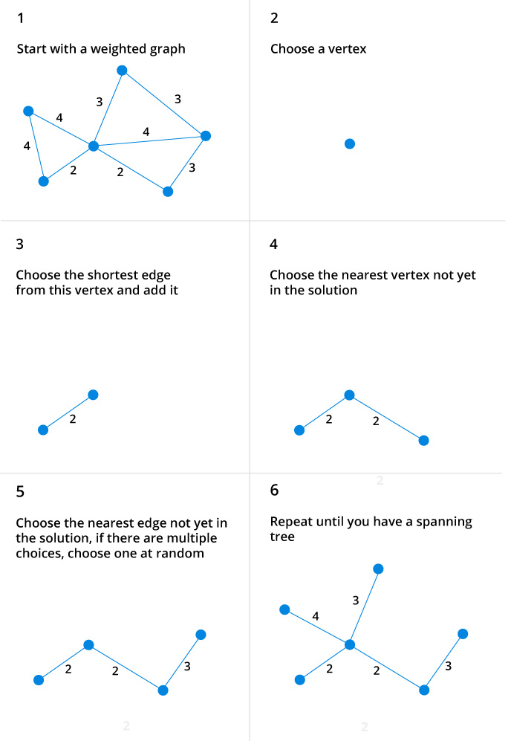
ILLUSTRATION

Slide 15
THANK YOU

