Slide 1
SINGLE SOURCE SHORTEST PATHS
-DESIGN AND ANALYSIS OF ALGORITHMS-
Name : PRASUN VERMA
Roll No. : 181210036
Branch : CSE - 2nd Year

Slide 2
CONTENTS
Title Slide No.
Shortest Path Variants 3
Single Source Shortest Path 4
Negative Weight Edges 5
Relaxation 6
The Bellman-Ford Algorithm 9
Dijkstra’s Algorithm 22

Slide 3
Shortest-Path Variants
Shortest-Path problems
– Single-source shortest-paths problem : Find the shortest path from s to each vertex v. (e.g. BFS)
– Single-destination shortest-paths problem : Find a shortest path to a given destination vertex t from each vertex v.
– Single-pair shortest-path problem : Find a shortest path from u to v for given vertices u and v.
– All-pairs shortest-paths problem : Find a shortest path from u to v for every pair of vertices u and v.

Slide 4
SINGLE SOURCE SHORTEST PATH
To find the shortest path from a source vertex v to all other vertices in the graph.
For a connected ,weighted, directed graph G(V,E), associated with each edge ⟨u,v⟩ ∈ E, there is a weight ω(u,v).
The weight ω(p) of path p=⟨ v₀ , v₁ ,…, v_{k} ⟩ is the sum of the weights of its constituent edges:
ω(p)= ∑ ω( v_{i-1} , v_{i} ).
      min{ω(p) : u v}; if there is a path from u to v,
δ(u,v)= ∞ , otherwise.
Shortest Path = Path of minimum weight
k
i=1

Slide 5
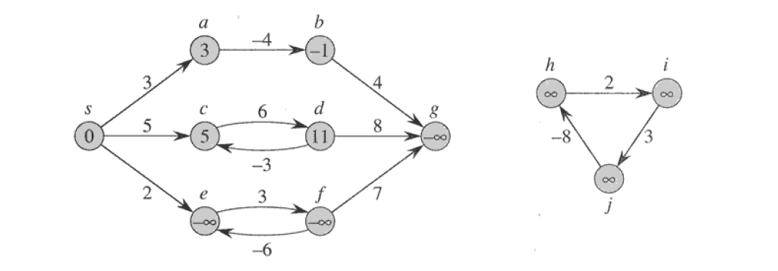
Negative-weight edges
A Graph, G = (V,E) ,might include edges whose weights are negative.
If G, contains no negative- weight cycles reachable from ‘s’, then the shortest path weight remains well-defined.
Otherwise, we can just keep going around it, and get ω(s, v) = −∞ for all v on the cycle.
Fig. 1 : Negative edge weight in a directed graph

Slide 6
Why would one ever have edges with negative weights in real life?
Negative weight edges might seem useless at first but they can explain a lot of phenomena like cashflow, heat released/absorbed in a chemical reaction etc.
For instance, if there are different ways to reach from one chemical A to another chemical B, each method will have sub-reactions involving both heat dissipation and absorption.
If we want to find the set of reactions where minimum energy is required, then we will need to be able to factor in the heat absorption as negative weights and heat dissipation as positive weights.

Slide 7
Relaxation
For each vertex v ∈ V
Maintain an attribute v.d
• v.d is called shortest-path weight estimate and it is upper bound on δ(s,v)
Relaxing an edge, tests whether we can improve the shortest path found so far, if yes then update v.d and v.π.
INITIALIZESINGLESOURCE(G, s)
for each v ∈ G.V do
v.d = ∞
v.π = NIL
s.d = 0

Slide 8
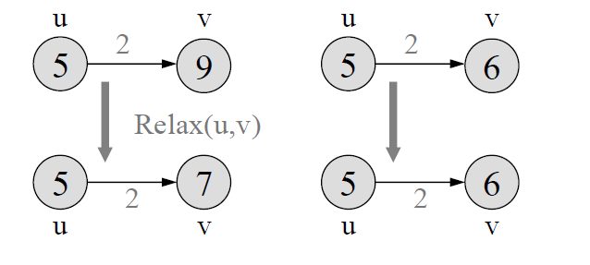
Relaxation
RELAX(u, v, w) //Performs relaxation step on edge (u,v) in O(1) time.
if v.d > u.d + w(u,v) then
v.d = u.d +w(u,v)
v.π = u
Fig. 2 : Relaxing an edge (u,v) with weight w(u,v)=2

Slide 9
Relaxation
RELAX(u, v, w) //Performs relaxation step on edge (u,v) in O(1) time.
if v.d > u.d + w(u,v) then
v.d = u.d +w(u,v)
v.π = u
v.d>u.d+w(u,v),
The value v.d decreases
v.d<u.d+w(u,v)
v.d is unchanged
Fig. 2 : Relaxing an edge (u,v) with weight w(u,v)=2

Slide 10
BELLMAN-FORD ALGORITHM
Bellman Ford's algorithm is used to find the shortest paths from the source vertex to all other vertices in a weighted graph.
It depends on the following concept: Shortest path contains at most n−1 edges, because the shortest path couldn't have a cycle.
It is extension to Dijkstra’s Algorithm ,it can work with graphs in which edges can have negative weights.

Slide 11
So why shortest path shouldn't have a cycle ?
There is no need to pass a vertex again, because the shortest path to all other vertices could be found without the need for a second visit for any vertices.

Slide 12
Algorithm
List down all the edges of the graph. This can be done easily if the graph is represented by an adjacency list.
Calculate the number of iterations with “V - 1”. The number of iterations will be equal to the number of vertices because the shortest distance to an edge can be adjusted ‘V-1’ times at maximum.
Start with an arbitrary vertex and assign it the minimum distance of zero. All other nodes should be assigned infinity since we are exaggerating the actual distances.
In each iteration, update the distance for each edge if the new distance is smaller than the one assigned before. The distance to each node will be the cumulative distance from the starting node to this particular node.
We need to consider all the iterations to make sure that all ​possible paths are considered. If we do this, we will end up with the shortest distance.

Slide 13
PSEUDO-CODE
function bellmanFord(G,w, S)
INITIALIZESINGLESOURCE(G, s)
for i =1 to |G.V|-1
for each edge (u,v) in G.E
RELAX(u, v, w)
for each edge (u,v) in G.E
If u.d + w(u, v) < v.d
Error: Negative Cycle Exists
return distance[], previous[]

Slide 14
Time Complexity
First nested for-loop performs |V|-1 relaxation passes; relax every edge at each pass.
Last for-loop checks the existence of a negative-weight cycle reachable from s.
Time Complexity of Bellman Ford algorithm is O(V⋅E)

Slide 15
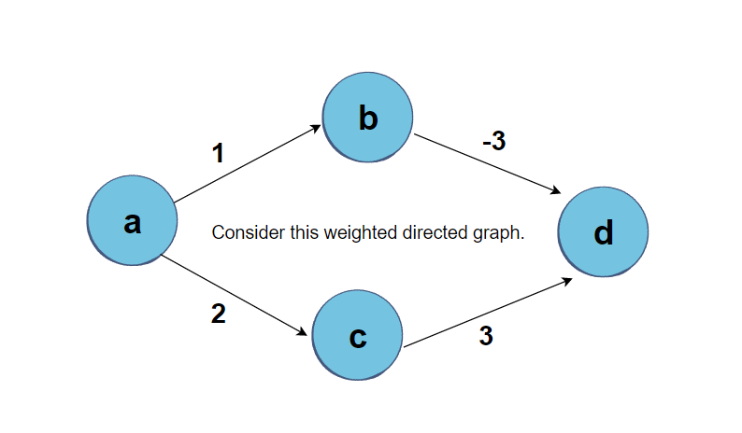
Illustration

Slide 16
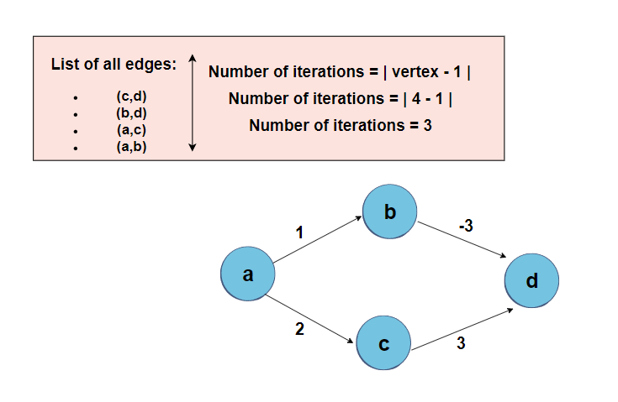
Illustration

Slide 17
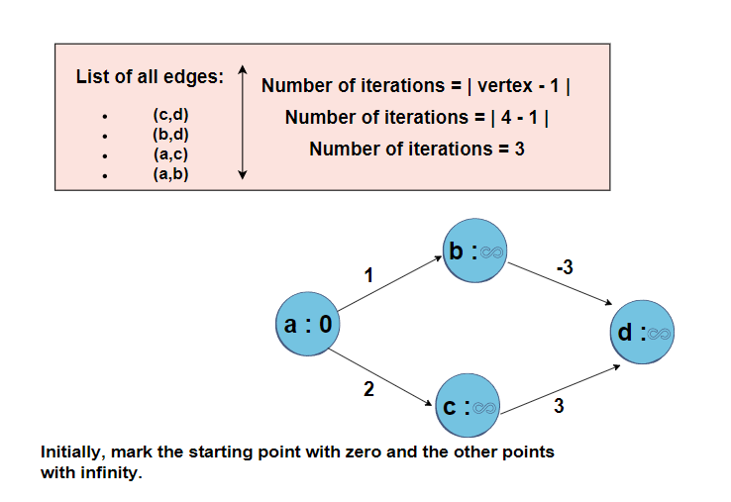
Illustration

Slide 18
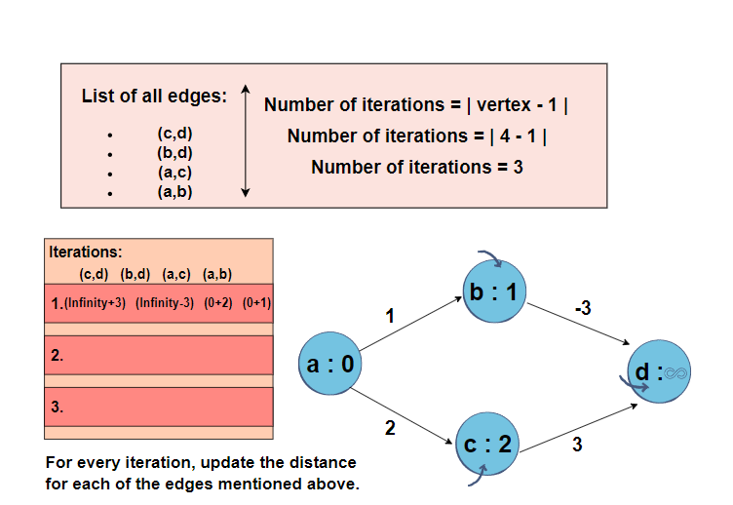
Illustration

Slide 19
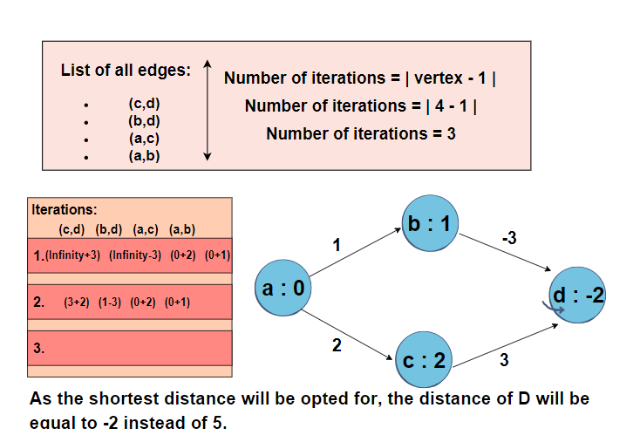
Illustration

Slide 20
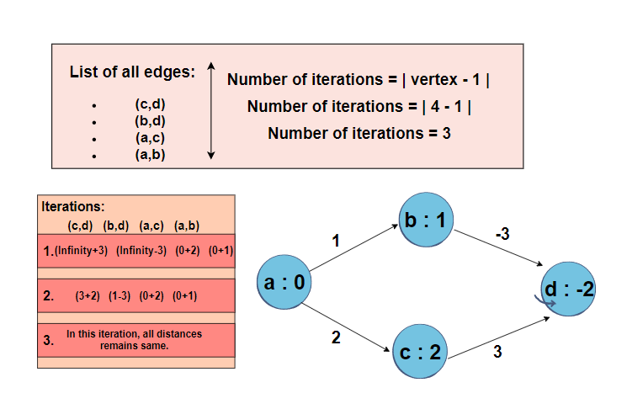
Illustration

Slide 21
USES OF BELLMAN-FORD ALGORITHM
The Bellman-Ford algorithm has several real-world use cases, including:
Finding negative weight cycles.
Calculating the smallest possible heat gain/loss in a chemical reaction.
Finding the most efficient way to convert currencies

Slide 22
DIJKSTRA’S ALGORITHM
Dijkstra's algorithm allows us to find the shortest path between any two vertices of a graph.
All edges must have non-negative weights !
Graph must be connected.
We overestimate the distance of each vertex from the starting vertex.
Then we visit each node and its neighbours to find the shortest sub path to those neighbours.
The algorithm uses a greedy approach ,we find the next best solution hoping that the end result is the best solution for the whole problem.

Slide 23
Algorithm
Mark all nodes as unvisited.
Mark the selected initial node with a current distance of 0 and the rest with infinity.
Set the initial node as current node.
For the current node, consider all of its unvisited neighbours and calculate their distances by adding the current distance of current node to the weight of the edge connecting neighbour node and current node.
Compare the newly calculated distance to the current distance assigned to the neighbouring node and set is as the new current distance of neighbouring node.
When done considering all of the unvisited neighbours of the current node, mark the current node as visited.
If the destination node has been marked visited then stop. The algorithm has finished.
Otherwise, select the unvisited node that is marked with the smallest distance, set it as the new current node, and go back to step 4

Slide 24
PSEUDO-CODE
function dijkstra(G,w, s)
INITIALIZESINGLESOURCE(G, s)
S= Ø // set of discovered nodes
Q = G.V
while Q IS NOT EMPTY
u = Extract MIN from Q
S= S U {u}
for each unvisited neighbour v of G.Adj[u]
RELAX ( u,v,w )

Slide 25
Time Complexity
Time Complexity of Dijkstra's Algorithm is O(V²) but with min-priority queue it drops down to O(V+ E.logV).

Slide 26
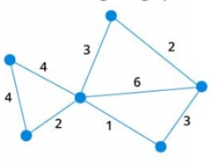
Illustration
1
Consider the following undirected, weighted graph

Slide 27
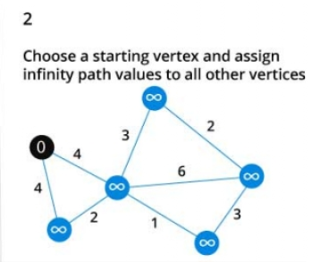
Illustration

Slide 28
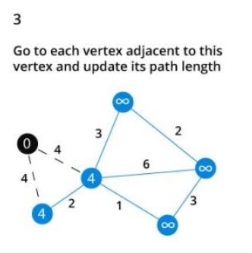
Illustration

Slide 29
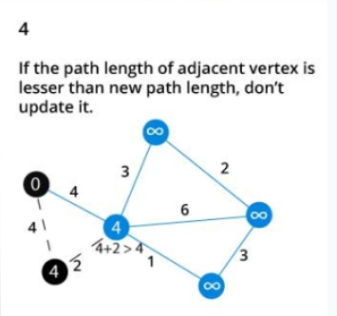
Illustration

Slide 30
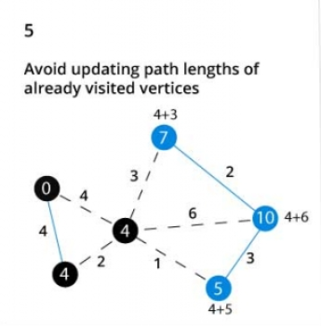
Illustration

Slide 31
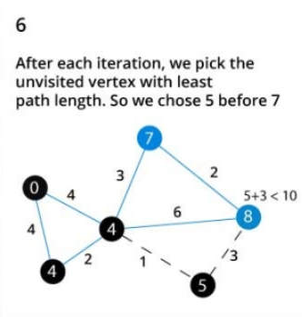
Illustration

Slide 32
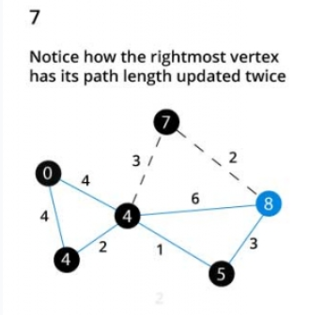
Illustration

Slide 33
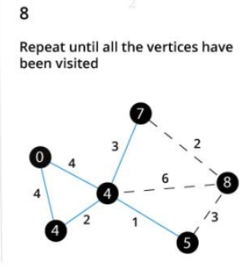
Illustration

Slide 34
USES OF DIJKSTRA’S ALGORITHM
Dijkstra’s Algorithm has several real-world use cases, including the following:
Map applications.
Finding locations of a map referring to vertices of a graph.
IP routing to find Open Shortest Path First.
Telephone networks.

Slide 35
THANK YOU

