Slide 1
DESIGN and ANALYSIS of ALGORITHMS
Raghav Shukla
CSE-2nd Yr
181210038

Slide 2
Elementary Graph Algorithms
Graph is a data structure consisting of a set of nodes called vertices and a set of edges that relate the vertices to each other.
The set of edges describes relationships among the vertices.
Graph G = (V, E)
>> V(G): set of vertices
>> E(G): set of edges

Slide 3
Types of GRAPHS
DIRECTED:- A directed graph is graph, i.e., a set of objects (called vertices or nodes) that are connected together, where all the edges are directed from one vertex to another. A directed graph is sometimes called a digraph or a directed network.
UNDIRECTED:- An undirected graph is graph, i.e., a set of objects (called vertices or nodes) that are connected together, where all the edges are bidirectional. An undirected graph is sometimes called an undirected network. In contrast, a graph where the edges point in a direction is called a directed graph.
WEIGHTED:- A weighted graph is a graph in which each branch is given a numerical weight. A weighted graph is therefore a special type of labeled graph in which the labels are numbers.

Slide 4
Graph Representation
There are two standard ways to represent graphs:-
Adjacency matrix representation
Adjacency lists representation

Slide 5
Adjacency Matrix
A square grid of boolean (1/0) values.
If the graph contains N vertices, then the grid contains N rows and N columns.
For two vertices numbered i and j, the element at row i and column j is true(1), if there is an edge from i to j, otherwise false(0).

Slide 6
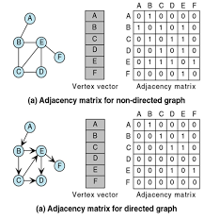
Adjacency Matrix

Slide 7
Adjacency List
A graph of n nodes is represented by a one- dimensional array (L) of linked lists, where
L[i] is the linked list containing all the nodes adjacent
from node i.
The nodes in the list L[i] are in no particular order.

Slide 8
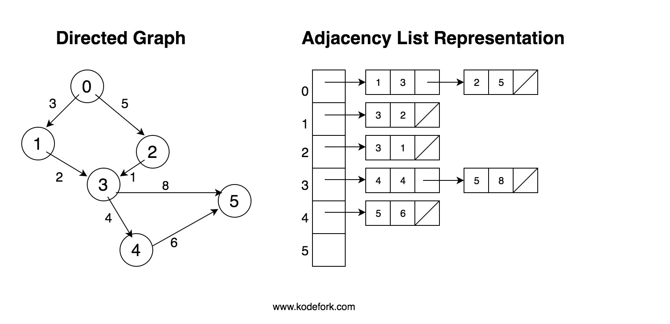
Adjacency List

Slide 9
BREADTH FIRST SEARCH
Given a connected graph G and a source node s, BFS systematically explores G to discover all the nodes reachable from s.
BFS produces a tree (called BFS tree) T such that the path from s to any node w in T is a shortest path (in terms of number of edges) in G from s to w.
BFS expands the frontier between visited and unvisited nodes along the breadth of the frontier; that is, nodes at a distance k from s are discovered before those at a distance of k +1 or more.

Slide 10
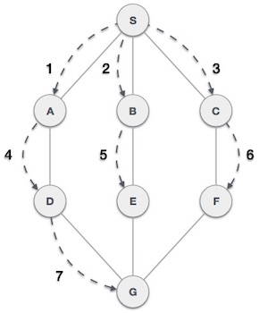
BREADTH FIRST SEARCH
As shown in the example, BFS algorithm traverses from A to B to E to F first then to C and G lastly to D. It employs the following rules.
Rule 1 − Visit the adjacent unvisited vertex. Mark it as visited. Display it. Insert it in a queue.
Rule 2 − If no adjacent vertex is found, remove the first vertex from the queue.
Rule 3 − Repeat Rule 1 and Rule 2 until the queue is empty.

Slide 11
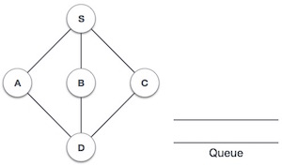
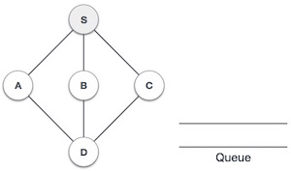
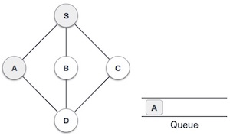
BREADTH FIRST SEARCH
Initialize the queue.
We start from visiting S (starting node), and mark it as visited.
We then see an unvisited adjacent node from S. In this example, we have three nodes but alphabetically we choose A, mark it as visited and enqueue it.

Slide 12
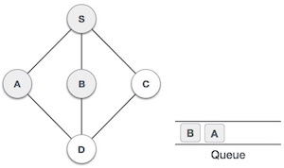
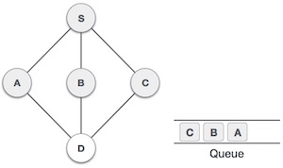
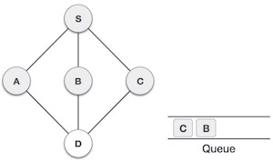
BREADTH FIRST SEARCH
Next, the unvisited adjacent node from S is B. We mark it as visited and enqueue it.
Next, the unvisited adjacent node from S is C. We mark it as visited and enqueue it.
Now, S is left with no unvisited adjacent nodes. So, we dequeue and find A.

Slide 13
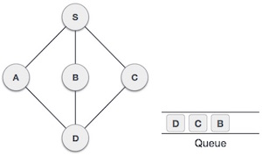
BREADTH FIRST SEARCH
From A we have D as unvisited adjacent node. We mark it as visited and enqueue it.
At this stage, we are left with no unmarked (unvisited) nodes. But as per the algorithm we keep on dequeuing in order to get all unvisited nodes. When the queue gets emptied, the program is over.

Slide 14
DEPTH FIRST SEARCH
The idea is to search “deeper” in the graph whenever possible.
The graph generated by BFS is a depth-ﬁrst spanning tree if the graph G is connected; otherwise, it is a forest of trees.

Slide 15
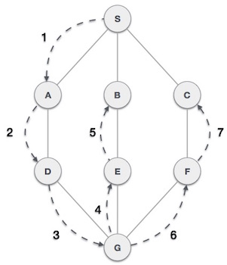
DEPTH FIRST SEARCH
As in the example given above, DFS algorithm traverses from S to A to D to G to E to B first, then to F and lastly to C. It employs the following rules.
Rule 1 − Visit the adjacent unvisited vertex. Mark it as visited. Display it. Push it in a stack.
Rule 2 − If no adjacent vertex is found, pop up a vertex from the stack. (It will pop up all the vertices from the stack, which do not have adjacent vertices.)
Rule 3 − Repeat Rule 1 and Rule 2 until the stack is empty.

Slide 16
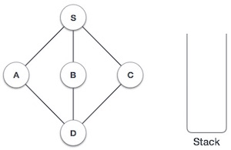
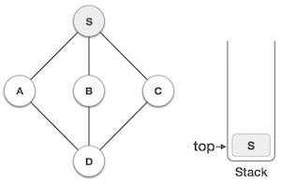
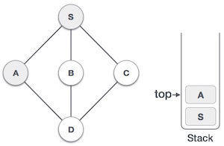
DEPTH FIRST SEARCH
Initialize the stack.
Mark S as visited and put it onto the stack. Explore any unvisited adjacent node from S. We have three nodes and we can pick any of them. For this example, we shall take the node in an alphabetical order.
Mark A as visited and put it onto the stack. Explore any unvisited adjacent node from A. Both S and D are adjacent to A but we are concerned for unvisited nodes only.

Slide 17
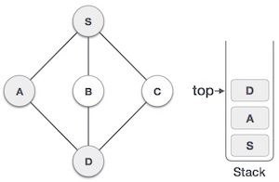
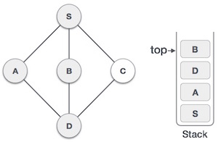
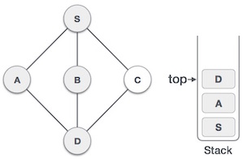
DEPTH FIRST SEARCH
Visit D and mark it as visited and put onto the stack. Here, we have B and C nodes, which are adjacent to D and both are unvisited. However, we shall again choose in an alphabetical order.
We choose B, mark it as visited and put onto the stack. Here B does not have any unvisited adjacent node. So, we pop B from the stack.
We check the stack top for return to the previous node and check if it has any unvisited nodes. Here, we find D to be on the top of the stack.

Slide 18
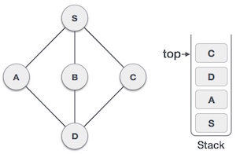
DEPTH FIRST SEARCH
Only unvisited adjacent node is from D is C now. So we visit C, mark it as visited and put it onto the stack.
As C does not have any unvisited adjacent node so we keep popping the stack until we find a node that has an unvisited adjacent node. In this case, there's none and we keep popping until the stack is empty.

