Slide 1
MINIMUM SPANNING TREE
What is Minimum Spanning Tree?
Given a connected and undirected graph, a spanning tree of that graph is a subgraph that is a tree and connects all the vertices together. A single graph can have many different spanning trees. A minimum spanning tree (MST) or minimum weight spanning tree for a weighted, connected and undirected graph is a spanning tree with weight less than or equal to the weight of every other spanning tree. The weight of a spanning tree is the sum of weights given to each edge of the spanning tree.
How many edges does a minimum spanning tree has? A minimum spanning tree has (V – 1) edges where V is the number of vertices in the given graph.

Slide 2
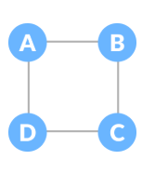
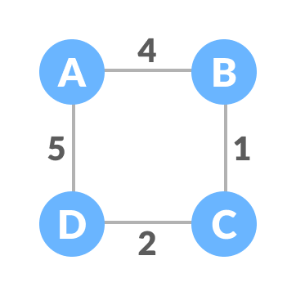
MINIMUM SPANNING TREE
Example of a Spanning Tree
GRAPH:-
WEIGHTED GRAPH:-

Slide 3
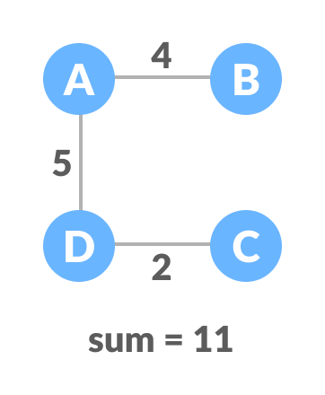
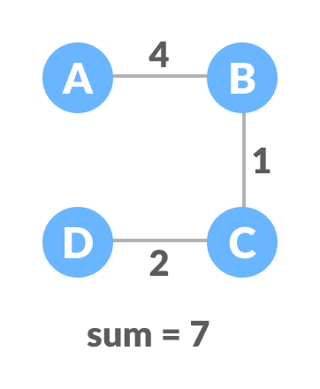
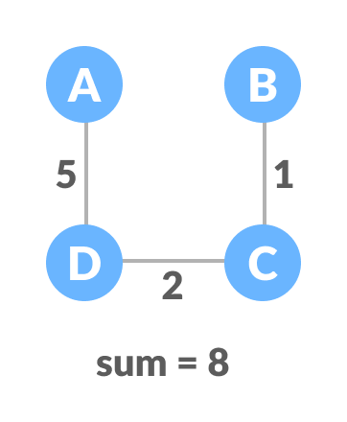
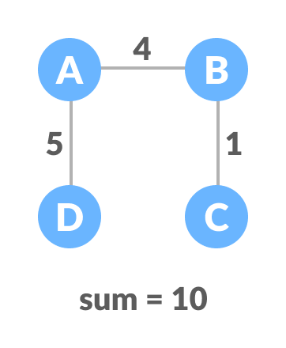
MINIMUM SPANNING TREE
ALL SPANNING TREES WHICH CAN BE DRAWN FROM THIS GRAPH

Slide 4
MINIMUM SPANNING TREE
OUT OF ALL THE TREES DRAWN ABOVE, THE MINIMUM SPANNING TREE WOULD BE THE ONE WHOSE weight IS less than or equal to the weight of every other spanning tree.
MINUMUM SPANNING TREE
A few popular algorithms for finding this minimum distance include: Kruskal’s algorithm, Prim’s algorithm

Slide 5
KRUSKAL ALGORITHM
Kruskal's algorithm is a minimum-spanning-tree algorithm which finds an edge of the least possible weight that connects any two trees in the forest. It is a greedy algorithm in graph theory as it finds a minimum spanning tree for a connected weighted graph adding increasing cost arcs at each step.

Slide 6
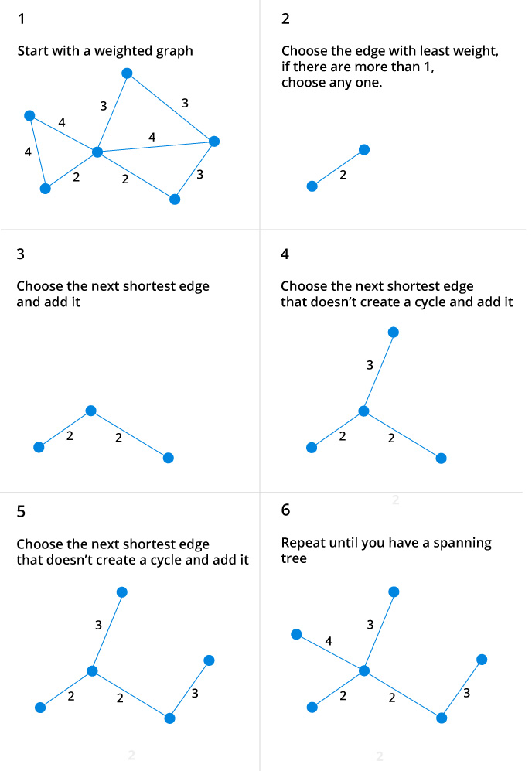
KRUSKAL ALGORITHM
Steps for finding MST using Kruskal's Algorithm:

Slide 7
KRUSKAL ALGORITHM
ALGORITHM:-
MST- KRUSKAL (G, w)
1. A ← ∅
2. for each vertex v ∈ V [G]
3. do MAKE - SET (v)
4. sort the edges of E into non decreasing order by weight w
5. for each edge (u, v) ∈ E, taken in non decreasing order by weight
6. do if FIND-SET (μ) ≠ if FIND-SET (v)
7. then A ← A ∪ {(u, v)}
8. UNION (u, v)
9. return A

Slide 8
PRIM ALGORITHM
The idea behind Prim's algorithm is simple, a spanning tree means all vertices must be connected. So the two disjoint subsets (discussed above) of vertices must be connected to make a Spanning Tree. And they must be connected with the minimum weight edge to make it a Minimum Spanning Tree.

Slide 9
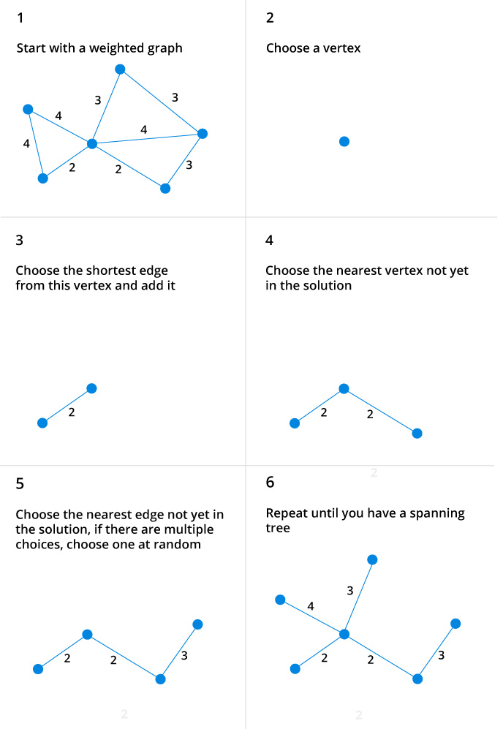
PRIM ALGORITHM
Steps for finding MST using PRIM's Algorithm:

Slide 10
PRIM ALGORITHM
ALGORITHM:-
MST-PRIM (G, w, r)
1. for each u ∈ V [G]
2. do key [u] ← ∞
3. π [u] ← NIL
4. key [r] ← 0
5. Q ← V [G]
6. While Q ? ∅
7. do u ← EXTRACT - MIN (Q)
8. for each v ∈ Adj [u]
9. do if v ∈ Q and w (u, v) < key [v]
10. then π [v] ← u
11. key [v] ← w (u, v)

