Slide 1
SINGLE-SOURCE SHORTEST PATH:-
The single-source shortest path problem is the one in which we have to find shortest paths from a source vertex v to all other vertices in the graph.
Whereas, single-destination shortest path problem is the one in which we have to find shortest paths from all vertices in the directed graph to a single destination vertex v.

Slide 2
DIJSKTRA’s ALGORITHM
Dijkstra's algorithm (or Dijkstra's Shortest Path First algorithm, SPF algorithm) is an algorithm for finding the shortest paths between nodes in a graph, which may represent, for example, road networks. It was conceived by computer scientist Edsger W.

Slide 3
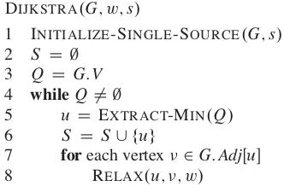
DIJSKTRA’s ALGORITHM
ALGORITHM

Slide 4
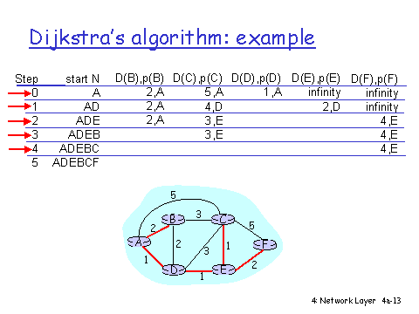
DIJSKTRA’s ALGORITHM

Slide 5
DIJSKTRA’s ALGORITHM
TIME COMPLEXITY:-
The time complexity for the matrix representation is O(V^2). ... With adjacency list representation, all vertices of a graph can be traversed in O(V+E) time using BFS.

Slide 6
BELLMAN FORD ALGORITHM
Given a weighted directed graph G = (V, E) with source s and weight function w: E → R, the Bellman-Ford algorithm returns a Boolean value indicating whether or not there is a negative weight cycle that is attainable from the source. If there is such a cycle, the algorithm produces the shortest paths and their weights. The algorithm returns TRUE if and only if a graph contains no negative - weight cycles that are reachable from the source.

Slide 7
BELLMAN FORD ALGORITHM
ALGORITHM
BELLMAN -FORD (G, w, s)
1. INITIALIZE - SINGLE - SOURCE (G, s)
2. for i ← 1 to |V[G]| - 1
3. do for each edge (u, v) ∈ E [G]
4. do RELAX (u, v, w)
5. for each edge (u, v) ∈ E [G]
6. do if d [v] > d [u] + w (u, v)
7. then return FALSE.
8. return TRUE.

Slide 8
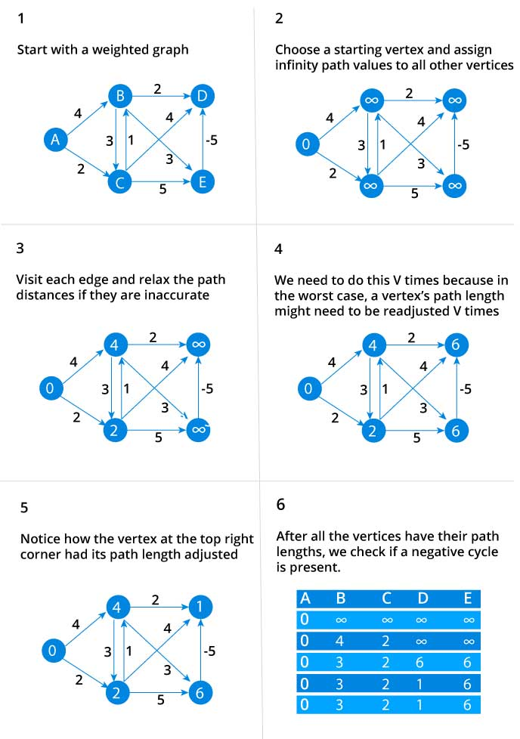
BELLMAN FORD ALGORITHM
EXAMPLE:-

Slide 9
BELLMAN FORD ALGORITHM
RUN-TIME COMPLEXITY:-
Initialization takes O(V ) time, relaxation takes O(E(V − 1)) = O(V E) time, and detecting negative cycles takes O(E) time. Overall, the runtime of Bellman-Ford is O(V E).

Slide 10
ALL PAIR SHORTEST PATH :-
All Pair Shortest Path Problem : Find a shortest path from u to v for every pair of vertices of u and v. Although we can solve this problem by running a single-source algorithm once from each vertex, we usually can solve it faster.
The all pair shortest path algorithm is also known as Floyd-Warshall algorithm is used to find all pair shortest path problem from a given weighted graph.
As a result of this algorithm, it will generate a matrix, which will represent the minimum distance from any node to all other nodes in the graph.

Slide 11
FLOYD-WARSHALL ALGORITHM
The Floyd–Warshall algorithm compares all possible paths through the graph between each pair of vertices. It is able to do this with {\displaystyle \Theta (|V|^{3})}\Theta (|V|^{3}) comparisons in a graph, even though there may be up to {\displaystyle \Omega (|V|^{2})}{\displaystyle \Omega (|V|^{2})} edges in the graph, and every combination of edges is tested. It does so by incrementally improving an estimate on the shortest path between two vertices, until the estimate is optimal.

Slide 12
FLOYD-WARSHALL ALGORITHM
ALGORITHM:-
FLOYD - WARSHALL (W)
1. n ← rows [W].
2. D0 ← W
3. for k ← 1 to n
4. do for i ← 1 to n
5. do for j ← 1 to n
6. do dij(k) ← min (dij(k-1),dik(k-1)+dkj(k-1) )
7. return D(n)

Slide 13
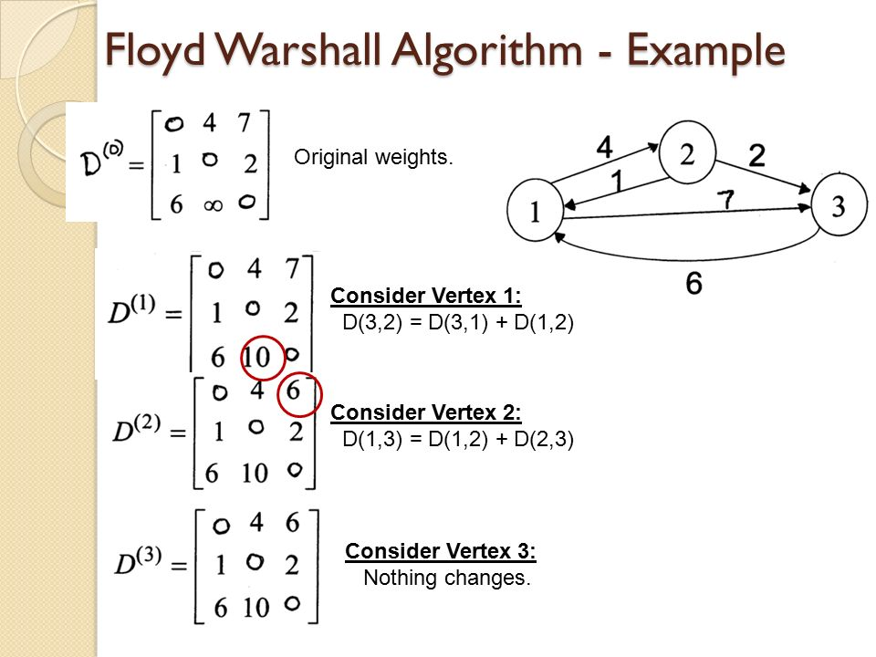
FLOYD-WARSHALL ALGORITHM

Slide 14
FLOYD-WARSHALL ALGORITHM
RUN-TIME COMPLEXITY:-
The Floyd-Warshall algorithm runs in O ( ∣ V ∣ 3 ) O\big(|V|^{3}\big) O(∣V∣3) time. This is because of the three nested for loops that are run after the initialization and population of the distance matrix, M. See also: big O notation.

