Slide 1
BRANCH AND BOUND
TOPIC-0/1 KNAPSACK PROBLEM
BY-ROHIT BYAS SHERWAN
(Roll no - 181210043)

Slide 2
INTRODUCTION
Branch and bound is an algorithm design paradigm which is generally used for solving combinatorial optimization problems.
These problems are typically exponential in terms of time complexity and may require exploring all possible permutations in worst case.
The Branch and Bound Algorithm technique solves these problems relatively quickly.

Slide 3
PRINTING ITEMS IN 0/1 KNAPSACK
Given weights and values of n items, put these items in a knapsack of capacity W to get the maximum total value in the knapsack.
Basically, find out the items such that sum of the weights of those items of given subset is smaller than or equal to W.

Slide 4
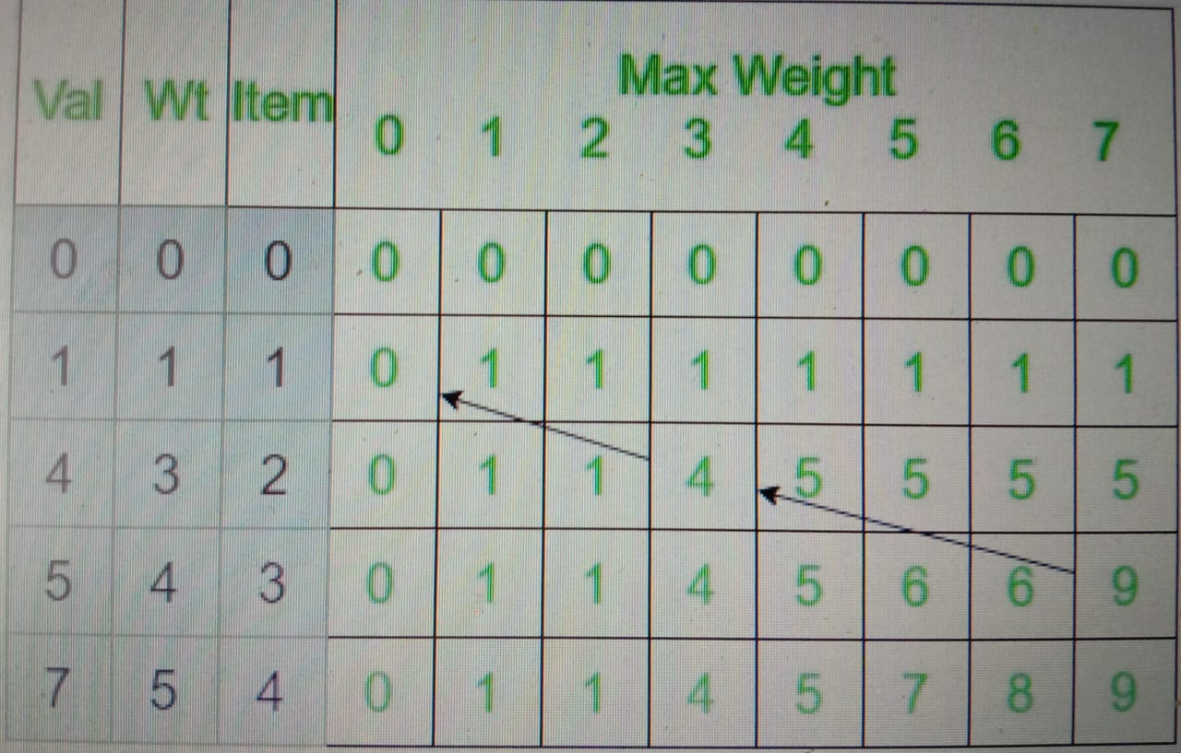
ALGORITHM
Let val[] = {1, 4, 5, 7}, wt[] = {1, 3, 4, 5}
W = 7
Now make a 2d Knapsack table will
Look like this ---->>>
Start backtracking from
K[n][W].Here K[n][W] is 9.

Slide 5
Since, this value comes from the top , the item in this row is not included.
Go vertically upward in the table without including this in the knapsack. Now, this value K[n-1][W] which is 9 doesn’t come from the top which means the item in this row is included and go vertically up and then left by the weight of the included item.
Continuing this process include weights 3 and 4 with total value 9 in the knapsack.

Slide 6
Code explanation-
void printknapSack(int W, int wt[], int val[], int n) {
int i, w; int K[n + 1][W + 1];
for (i = 0; i <= n; i++) { //bottom up
for (w = 0; w <= W; w++) {
if (i == 0 || w == 0) K[i][w] = 0;
else if (wt[i - 1] <= w)
K[i][w] = max(val[i - 1] +
K[i - 1][w - wt[i - 1]], K[i - 1][w]);
else K[i][w] = K[i - 1][w]; } }
;
int res = K[n][W];// store result
printf("%d\n", res);
w = W;
for (i = n; i > 0 && res > 0; i--) {
if (res == K[i - 1][w]) continue;
else { .
printf("%d ", wt[i - 1]); // itme included
res = res - val[i - 1]; // weight included value deducted
w = w - wt[i - 1]; } } }

Slide 7
TIME COMPLEXITY
Time Complexity: O(nW) where n is the number of items and W is the capacity of knapsack.

Slide 8
ANY QUESTION?

