Slide 1
DIVIDE AND CONQUER
TOPIC-MERGE SORT
BY-ROHIT BYAS SHERWAN
(Roll no - 181210043)

Slide 2
INTRODUCTION
Divide and Conquer is an algorithmic paradigm. A typical Divide and Conquer algorithm solves a problem using following three steps.
Divide: Break the given problem into subproblems of same type.
Conquer: Recursively solve these subproblems
Combine: Appropriately combine the answers

Slide 3
MERGE SORT
A classic example of Divide and Conquer is Merge sort. In Merge Sort, we divide array into two halves, sort the two halves recursively, and then merge the sorted halves.

Slide 4
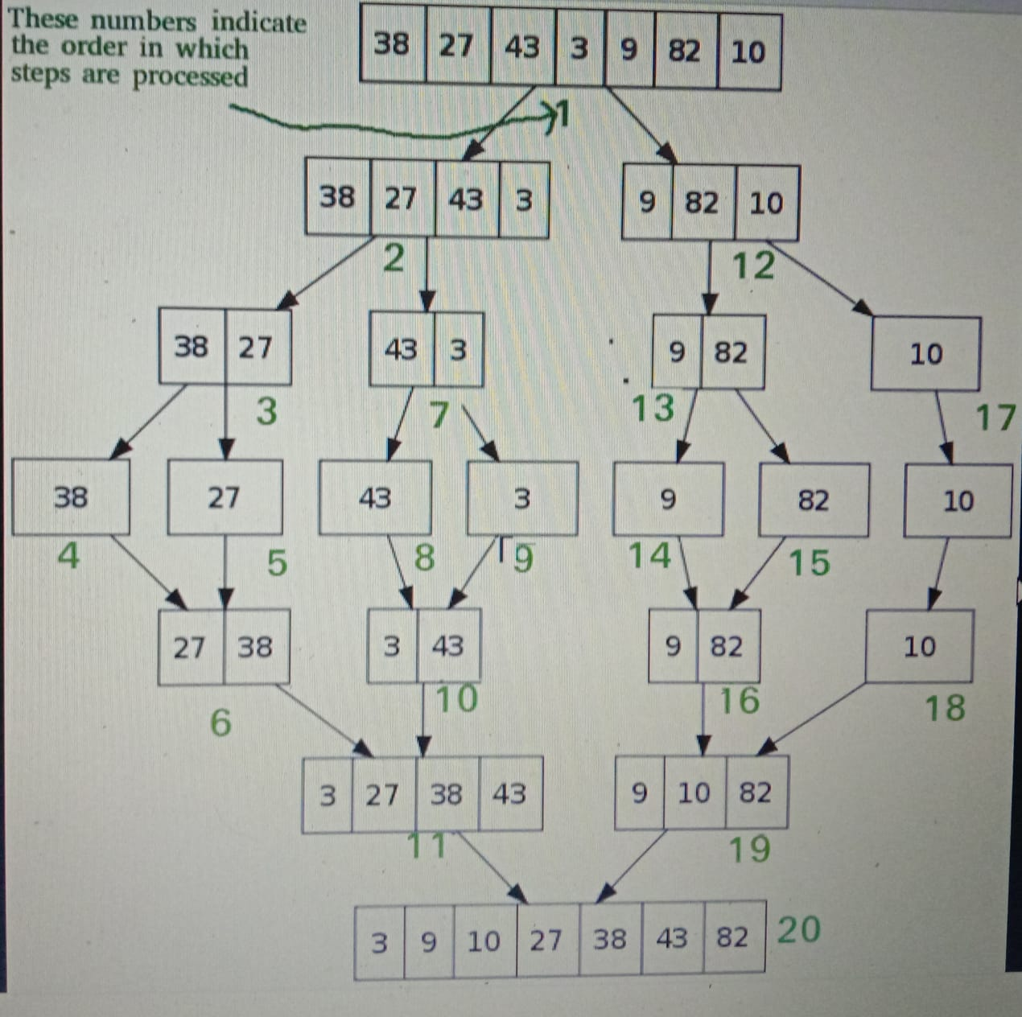
The following diagram from shows the complete merge sort process for an example array {38, 27, 43, 3, 9, 82, 10}.

Slide 5
SOLUTION
It divides input array in two halves, calls itself for the two halves and then merges the two sorted halves. The merge() function is used for merging two halves. The merge(arr, l, m, r) is key process that assumes that arr[l..m] and arr[m+1..r] are sorted and merges the two sorted sub-arrays into one.

Slide 6
Code explanation- Mergesort function
/* l is for left index and r is right index of the
sub-array of arr to be sorted */
void mergeSort(int arr[], int l, int r) {
if (l < r) {
// Same as (l+r)/2, but avoids overflow for
// large l and h
int m = l+(r-l)/2;
// Sort first and second halves
mergeSort(arr, l, m);
mergeSort(arr, m+1, r);
// call merge function to merge the result
merge(arr, l, m, r);
}
}

Slide 7
Code explanation-merge function
void merge(int arr[], int l, int m, int r)
{
int i, j, k;
int n1 = m - l + 1;
int n2 = r - m;
int L[n1], R[n2]; // temp array
for (i = 0; i < n1; i++) L[i] = arr[l + i];
for (j = 0; j < n2; j++) R[j] = arr[m + 1+ j];
/* Merge the temp arrays back into arr[l..r]*/
while (i < n1 && j < n2) {
if (L[i] <= R[j]) { arr[k] = L[i]; i++; }
else{ arr[k] = R[j]; j++; } k++; }
//copy remaining
while (i < n1){ arr[k] = L[i]; i++; k++ ;}
while (j < n2){ arr[k] = R[j]; j++; k++; }
}

Slide 8
TIME AND SPACE COMPLEXITY
Time Complexity: O(nlogn)
Auxiliary Space: O(n)
where
N: number of elements in array

Slide 9
ANY QUESTION?

