Slide 1
P, NP, NP-Complete Problems NAME-ROHIT BYAS ROLL N0.-181210043

Slide 2
Polynomial Problems (P Family)
The set of problems that can be solved in polynomial time
These problems form the P family
All problems we covered so far are in P
P

Slide 3
Nondeterministic Polynomial (NP Family)
The set of decision problems that can be verified in polynomial time
Not necessarily solvable in polynomial time
What does it mean:
“decision problem”
“verifiable”
NP

Slide 4
Nondeterministic Polynomial (NP Family) (Cont’d)
Decision Problem
Problem where its outcome is either Yes or No
Is there assignment of 0’s and 1’s to these Xi variables that make the expression = true?
Is there a way to color the graph 3-way such that no two adjacent nodes have the same color?
Is there a clique of size 5?
Verifiable in Polynomial Time
If I give you a candidate answer, you can verify whether it is correct or wrong in polynomial time
That is different from finding the solution in polynomial time

Slide 5
Verifiable in Polynomial Time
If I give you assignment for each Xi:
>> if the expression is True
If I give you color assignment:
>> Check the number of colors is 3
>> Each that no two vertices are the same O(E)
But the find a solution from scratch, it can be hard

Slide 6
P vs. NP
P is definitely subset of NP
Every problem with poly-time solution is verifiable in poly-time
Is it proper subset or equal?
No one knows the answer
Most guesses are leaning towards P ≠ NP
NP
NP
P
P
NP family has set of problems known as “NP-Complete”
Hardest problems in NP
No poly-time solution for NP-Complete problems yet

Slide 7
NP-Complete (NPC)
A set of problems in NP
So, they are decision problems
Can be verified quickly (poly-time)
They are hardest to solve
The existing solutions are all exponential
Known for 30 or 40 years, and no one managed to find poly-time solution for them
Still, no one proved that no poly-time solution exist for NPC problems
Property in NPC problem
NP
P
NPC

Slide 8
NP-Complete (NPC) Cont’d
Property in NPC problems
Problem X is NPC if any other problem in NP can be mapped (transformed) to X in polynomial time
So, Any two problems in NPC must transform to each other in poly-time
X ----PolyTime-------> Y
Y -----PolyTime ------> X
NPC
Y
NP
X
This means if any problem in NPC is solved in poly-time ➔ Then all NPC problems are solved in Poly-Time
This will lead to P = NP

Slide 9
NPC Example I: Satisfiability Problem
Given an expression of n variables
Has m conjunctive sun-expressions
Is there an assignment of 0’s and 1’s to each Xi that makes the exp = True?

Slide 10
NPC Example 2: Clique Problem
Given a graph G(V, E)
Clique: subset of vertices, where each pair of them is connected by an edge
Is there a clique in G ?
If there a clique of size m in G?

Slide 11
NPC Example 3: Graph Coloring
Given a graph G (V, E)
Is there coloring scheme of the vertices in G using 3-way colors such that no two adjacent vertices have the same color?
BTW: 2-way graph coloring is solvable in poly-time

Slide 12
How to prove a new problem “Y” is NPC?
Show it is in NP
It is a decision problem
Verifiable in poly-time
Select any problem from NPC family (say X)
Show that X transforms to Y in poly-time

Slide 13
NP-Hard Family
It is a family of problems as hard as NPC problems
But they are not decision problems
Can be any type
NP-Hard problems have exponential time solutions

Slide 14
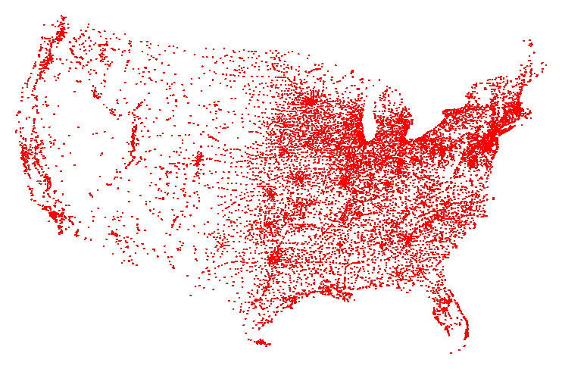
NP-Hard Example: Travelling Salesman Problem
Given a set of n cities and a pairwise distance function d(u, v)
What is the shortest possible route that visits each city once and go back to the starting point

Slide 15
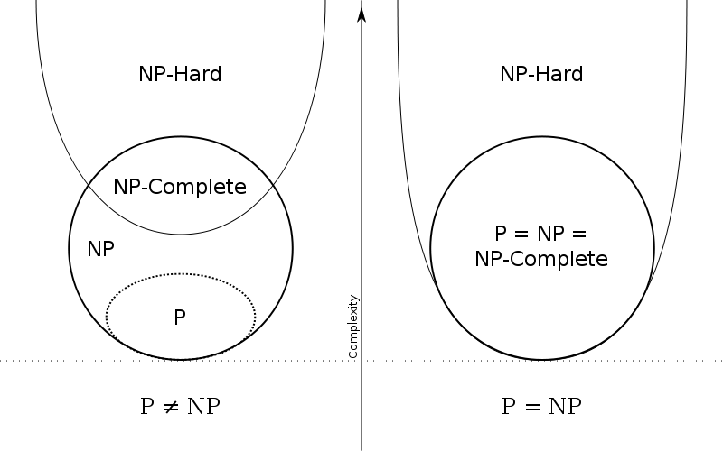
Full Diagram
Most probable

