Slide 1
DESIGN AND ANALYSIS OF ALGORITHM
BY-ROHIT BYAS SHERWAN
(Roll no - 181210043)

Slide 2
CONTENTS
DEPTH FIRST SEARCH (DFS)
BREADTH FIRST SEARCH (BFS)
MINIMUM SPANNING TREE(Kruskal’s Algorithm,Prim’s Algorithm)
DIJKSTRA’S ALGORITHM(single source shortest path)
FLOYD-WARSHALL ALGORITHM(all pairs shortest path)

Slide 3
DEPTH FIRST SEARCH (DFS)
The DFS algorithm is a recursive algorithm that uses the idea of backtracking. It involves exhaustive searches of all the nodes by going ahead, if possible, else by backtracking.
Here, the word backtrack means that when you are moving forward and there are no more nodes along the current path, you move backwards on the same path to find nodes to traverse. All the nodes will be visited on the current path till all the unvisited nodes have been traversed after which the next path will be selected.

Slide 4
This recursive nature of DFS can be implemented using stacks. The basic idea is as follows:
Pick a starting node and push all its adjacent nodes into a stack.
Pop a node from stack to select the next node to visit and push all its adjacent nodes into a stack.
Repeat this process until the stack is empty. However, ensure that the nodes that are visited are marked. This will prevent you from visiting the same node more than once. If you do not mark the nodes that are visited and you visit the same node more than once, you may end up in an infinite loop.

Slide 5
PSEUDOCODE
DFS-iterative (G, s): //Where G is graph and s is source vertex
let S be stack
S.push( s ) //Inserting s in stack
mark s as visited.
while ( S is not empty):
//Pop a vertex from stack to visit next
v = S.top( )
S.pop( )
//Push all the neighbours of v in stack that are not visited
for all neighbours w of v in Graph G:
if w is not visited :
S.push( w )
mark w as visited
DFS-recursive(G, s):
mark s as visited
for all neighbours w of s in Graph G:
if w is not visited:
DFS-recursive(G, w)

Slide 6
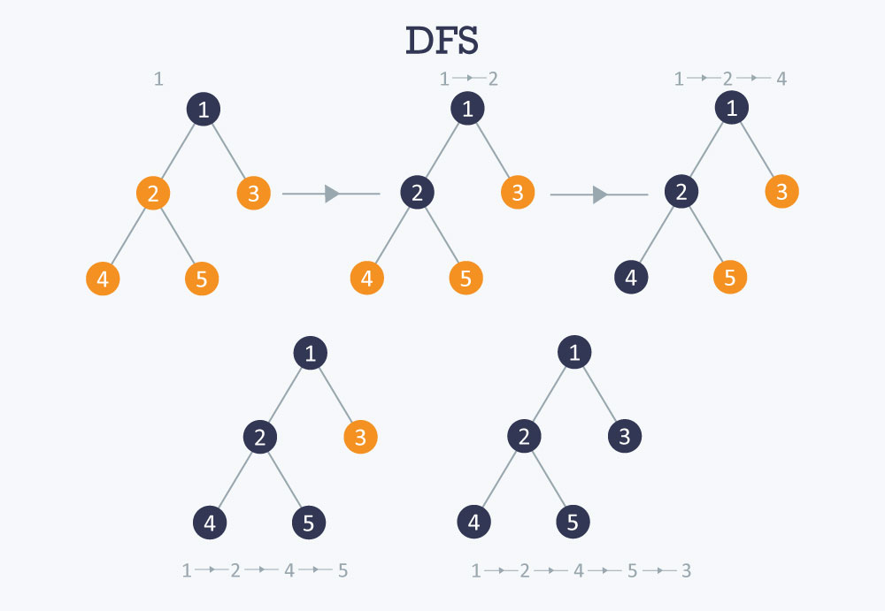
The following image shows how DFS works

Slide 7
TIME COMPLEXITY
Time Complexity: O(V+E) ,where V is number of vertex and E is number of edges

Slide 8
2. BREADTH FIRST SEARCH(BFS)
There are many ways to traverse graphs. BFS is the most commonly used approach.
BFS is a traversing algorithm where you should start traversing from a selected node (source or starting node) and traverse the graph layerwise thus exploring the neighbour nodes (nodes which are directly connected to source node). You must then move towards the next-level neighbour nodes.
As the name BFS suggests, you are required to traverse the graph breadthwise as follows:
First move horizontally and visit all the nodes of the current layer
Move to the next layer

Slide 9
PSEUDOCODE
BFS (G, s) //Where G is the graph and s is the source node
let Q be queue.
Q.enqueue( s ) //Inserting s in queue until all its neighbour vertices are marked.
mark s as visited.
while ( Q is not empty)
//Removing that vertex from queue,whose neighbour will be visited now
v = Q.dequeue( )
//processing all the neighbours of v
for all neighbours w of v in Graph G
if w is not visited
Q.enqueue( w ) //Stores w in Q to further visit its neighbour
mark w as visited.

Slide 10
TIME COMPLEXITY
Time Complexity: O(V+E) ,where V is number of vertex and E is number of edges

Slide 11
3. MINIMUM SPANNING TREE
What is a Spanning Tree?
Given an undirected and connected graph G=(V,E), a spanning tree of the graph Gis a tree that spans G (that is, it includes every vertex of G) and is a subgraph of (every edge in the tree belongs to G)
What is a Minimum Spanning Tree?
The cost of the spanning tree is the sum of the weights of all the edges in the tree. There can be many spanning trees. Minimum spanning tree is the spanning tree where the cost is minimum among all the spanning trees. There also can be many minimum spanning trees.

Slide 12
APPLICATIONS
Minimum spanning tree has direct application in the design of networks. It is used in algorithms approximating the travelling salesman problem, multi-terminal minimum cut problem and minimum-cost weighted perfect matching. Other practical applications are:
Cluster Analysis
Handwriting recognition
Image segmentation

Slide 13
KRUSKAL’S ALGORITHM (MST)
Kruskal’s Algorithm builds the spanning tree by adding edges one by one into a growing spanning tree. Kruskal's algorithm follows greedy approach as in each iteration it finds an edge which has least weight and add it to the growing spanning tree.
Algorithm Steps:
Sort the graph edges with respect to their weights.
Start adding edges to the MST from the edge with the smallest weight until the edge of the largest weight.
Only add edges which doesn't form a cycle , edges which connect only disconnected components.

Slide 14
CHECK 2 VERTICES CONNECTED OR NOT?
This could be done using DFS which starts from the first vertex, then check if the second vertex is visited or not. But DFS will make time complexity large as it has an order of O(V+E) where V is the number of vertices, E is the number of edges. So the best solution is "Disjoint Sets":
Disjoint sets are sets whose intersection is the empty set so it means that they don't have any element in common.

Slide 15
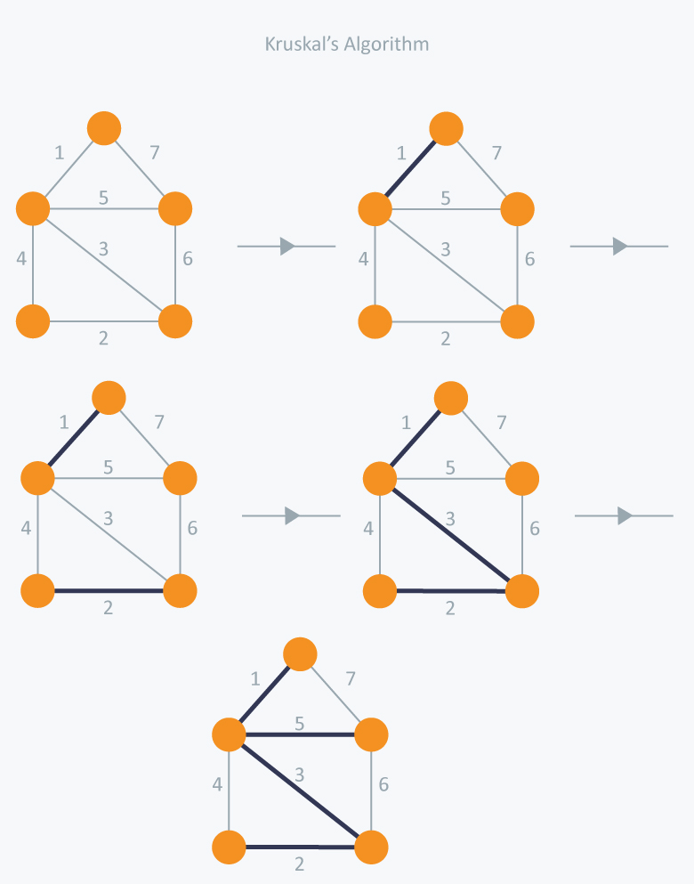
￼

Slide 16
TIME COMPLEXITY
In Kruskal’s algorithm, most time consuming operation is sorting because the total complexity of the Disjoint-Set operations will be O(ElogV), which is the overall Time Complexity of the algorithm.

Slide 17
B) PRIM’S ALGORITHM
Prim’s Algorithm also use Greedy approach to find the minimum spanning tree. In Prim’s Algorithm we grow the spanning tree from a starting position.
Unlike an edge in Kruskal's, we add vertex to the growing spanning tree in Prim's.

Slide 18
ALGORITHM
Maintain two disjoint sets of vertices. One containing vertices that are in the growing spanning tree and other that are not in the growing spanning tree.
Select the cheapest vertex that is connected to the growing spanning tree and is not in the growing spanning tree and add it into the growing spanning tree. This can be done using Priority Queues. Insert the vertices, that are connected to growing spanning tree, into the Priority Queue.
Check for cycles. To do that, mark the nodes which have been already selected and insert only those nodes in the Priority Queue that are not marked.

Slide 19
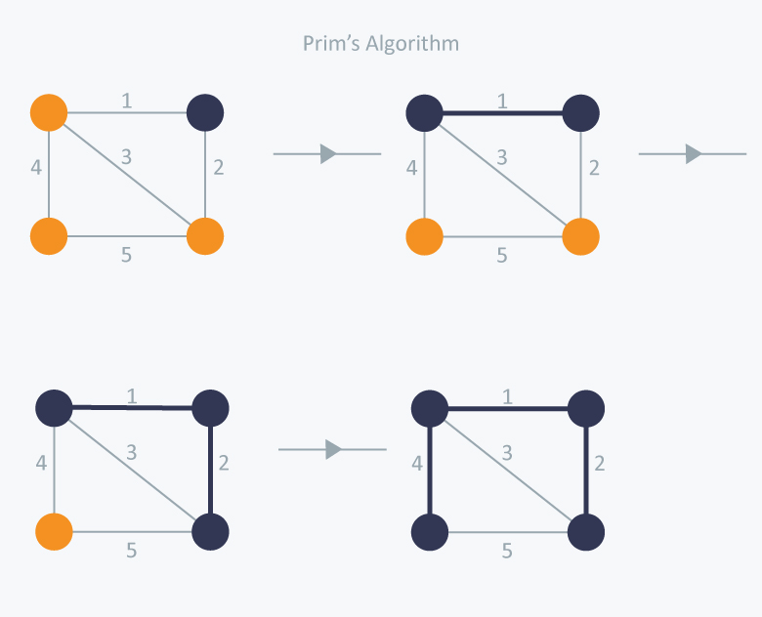

Slide 20
Time Complexity
The time complexity of the Prim’s Algorithm is
O((V+E)logV) because each vertex is inserted in the priority queue only once and insertion in priority queue take logarithmic time.

Slide 21
4. DIJKSTRA’S ALGORITHM
Dijkstra's algorithm has many variants but the most common one is to find the shortest paths from the source vertex to all other vertices in the graph.
Algorithm Steps:
Set all vertices distances = infinity except for the source vertex, set the source distance = 0.
Push the source vertex in a min-priority queue in the form (distance , vertex), as the comparison in the min-priority queue will be according to vertices distances.

Slide 22
ALGO(CONTINUED)
Pop the vertex with the minimum distance from the priority queue (at first the popped vertex = source).
Update the distances of the connected vertices to the popped vertex in case of "current vertex distance + edge weight < next vertex distance", then push the vertex with the new distance to the priority queue.
If the popped vertex is visited before, just continue without using it.
Apply the same algorithm again until the priority queue is empty.

Slide 23
TIME COMPLEXITY
O(V*V) Where V is the number of vertex but with min-priority queue it drops down to O(V+ElogV)

Slide 24
5. FLOYD-WARSHALL’S ALGORITHM
Floyd–Warshall's Algorithm is used to find the shortest paths between between all pairs of vertices in a graph, where each edge in the graph has a weight which is positive or negative. The biggest advantage of using this algorithm is that all the shortest distances between any 2 vertices could be calculated in O(V3), where V is the number of vertices in a graph.

Slide 25
ALGORITHM:
For a graph with N vertices:
Initialize the shortest paths between any 2 vertices with Infinity.
Find all pair shortest paths that use 0 intermediate vertices, then find the shortest paths that use 1 intermediate vertex and so on.. until using all N vertices as intermediate nodes.
Minimize the shortest paths between any 2 pairs in the previous operation.
For any 2 vertices (i,j) , one should actually minimize the distances between this pair using the first K nodes, so the shortest path will be: min(dist[i][k]+dist[k][j],dist[i][j])
.

Slide 26
ALGO(CONTINUED)
dist[i][k] represents the shortest path that only uses the first K vertices, dist[k][j] represents the shortest path between the pair k,j. As the shortest path will be a concatenation of the shortest path from i to k, then from k to j

Slide 27
Time Complexity of Floyd–Warshall's Algorithm
O(V3), where V is the number of vertices in a graph.

Slide 28
ANY QUESTION?

