Slide 1
ASSIGNMENT DATA ANALYSIS AND ALGORITHMS
Submitted by:-
Vartika chaturvedi(181210056)
Japman singh monga (181210024)
SUBMITTED TO :-
DR. CHANDRESH KUMAR MAURYA

Slide 2
TOPIC 1 DIVIDE AND CONQUER APPROACH

Slide 3
INTRODUCTION
In divide and conquer approach, the problem in hand, is divided into smaller sub-problems and then each problem is solved independently.
When we keep on dividing the sub problems into even smaller sub-problems, we may eventually reach a stage where no more division is possible.
Those "atomic" smallest possible sub-problem (fractions) are solved. The solution of all sub-problems is finally merged in order to obtain the solution of an original problem.
A typical Divide and Conquer algorithm solves a problem using following three steps.
Divide: Break the given problem into subproblems of same type.
Conquer: Recursively solve these subproblems
Combine: Appropriately combine the answers

Slide 4
EXAMPLE
A classic example of Divide and Conquer is Merge Sort . In Merge Sort, we divide array into two halves, sort the two halves recursively, and then merge the sorted halves.
For a real life example , suppose that , overnight your office was totally thrashed by some thieves or such and all your numerous file cabinets of folders and contents strewn every where. Every file has an assigned number . It is now 9 a.m. the auditors are due at 11 a.m. for a crucial inspection. You must have all these file back in stack by 11.You run down the hall and get every one you can find to come and sort big similar size file into order so that you can MERGE the files back into how they were when you turned of the lights last night.
This problem uses Merge Sort which is an example of divide and conquer to sort out the files . We can see this as:-
Divide: dividing the files and assigning them to various people
Conquer: Each person sorts the specific stack
Combining : Combining the small stacks into the original order

Slide 5
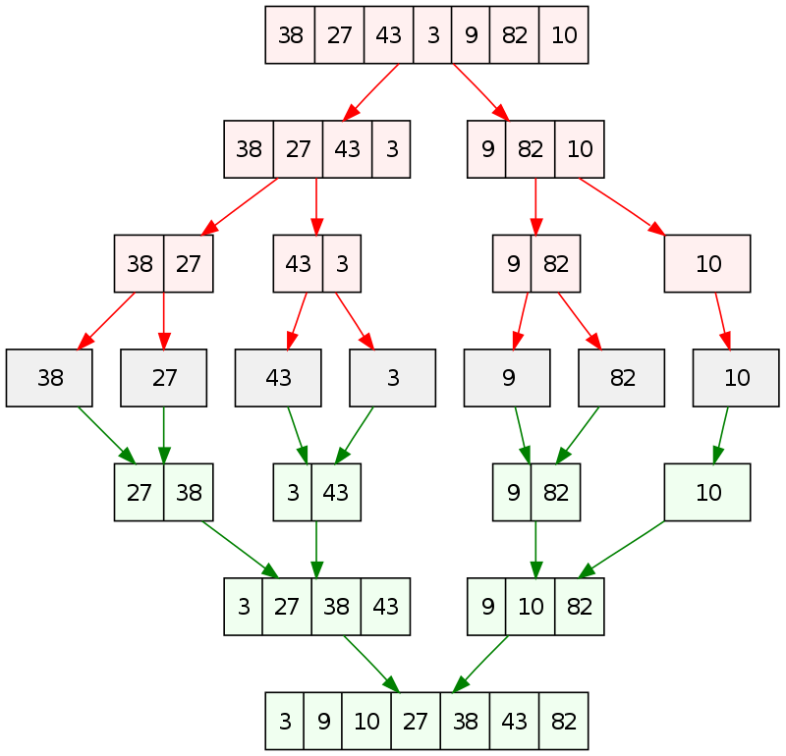
DIAGRAMMATIC REPRESENTATION
The numbers represent the
assigned File Number.

Slide 6
ALGORITHM
Mergefiles(A,low,high,mid)
{ i<- low
j<- mid +1
K<- low
C[500]<-0
while(i<=mid && j<=high)
{ if(A[i]<A[j])
c[k++]<-A[i++]
if(A[j]<A[i])
c[k++]<-A[j++]
}
while(i<=mid)
c[k++]=A[i++]
while(j<=high)
c[k++]=A[j++]
l<-0
for(l=low;l<k;l++))
A[i]=c[i]
}
Sort_files(A,low,high)
{ mid<-(low+high)/2
Sort_files(A,low,mid)
Sort_files(A,mid+1,high)
Merge_files(A,low,high,mid)
}
Key points:-
Input array A contains the file numbers
Low is the index of first element
High is the index of last element

Slide 7
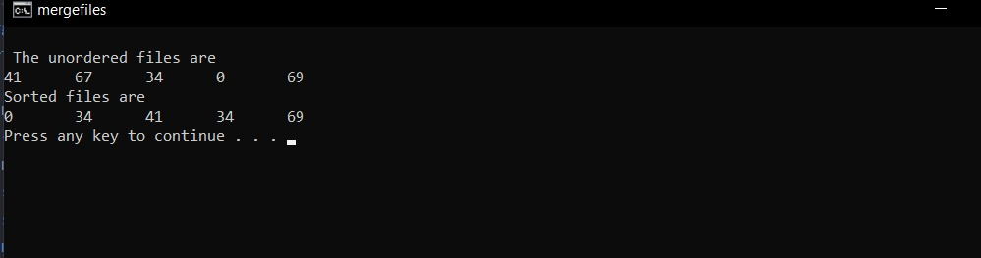
OUTPUT

Slide 8
TOPIC 2 BACKTRACKING

Slide 9
INTRODUCTION
Backtracking is a technique based on algorithm to solve problem. It uses recursive calling to find the solution by building a solution step by step increasing values with time. It removes the solutions that doesn't give rise to the solution of the problem based on the constraints given to solve the problem.
Backtracking algorithm is applied to some specific types of problems,
Decision problem used to find a feasible solution of the problem.
Optimization problem used to find the best solution that can be applied.
Enumeration problem used to find the set of all feasible solutions of the problem.
In backtracking problem, the algorithm tries to find a sequence path to the solution which has some small checkpoints from where the problem can backtrack if no feasible solution is found for the problem.

Slide 10
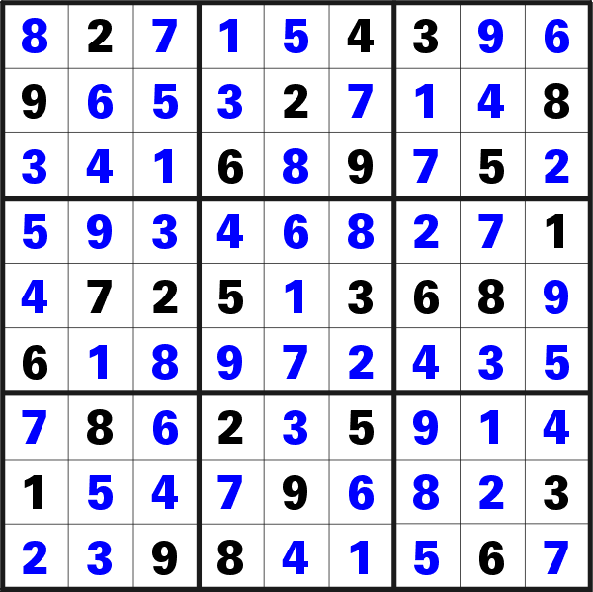
EXAMPLE- A SUDOKU PUZZLE
Description:-
In a N x N Square board, the numbers 1 to N to be placed in a way that:
- All the numbers from 1 to N can be placed in each row
- All the numbers from 1 to N can be placed in each column.
- All the numbers from 1 to N can be placed in Sub Square boxes of
the given box .
Backtracking Approach:-
We solve Sudoku with backtracking approach by one by one assigning numbers to empty cells . Before assigning the value in the cell, the algorithm will check if that value is in the same row, or same column or same sub square box . If not, then it is placed in the cell . Then we recursively check whether this assignment leads to a solution or not . If not, then we try the next number for the current empty cell.

Slide 11
ALGORITHM
Find row, col of an unassigned cell
If there is none, return true
For digits from 1 to N
a) If there is no conflict for digit at row, col assign digit to row, col and recursively try fill in rest of grid
b) If recursion successful, return true
c) Else, remove digit and try another
If all digits have been tried and nothing worked, return false
Sudoku_solver(canvas,row,col)
{ If(anyEmptyLocation(canvas,row,col)
return true;
for i= 1 to N do
{ if ( find_location(canvas,row,col,i))
{ canvas[row][col]=I;
if ( Sudoku_solver(canvas))
return true ;
canvas[rw][col]=-1;
}
}
return false;
}

Slide 12
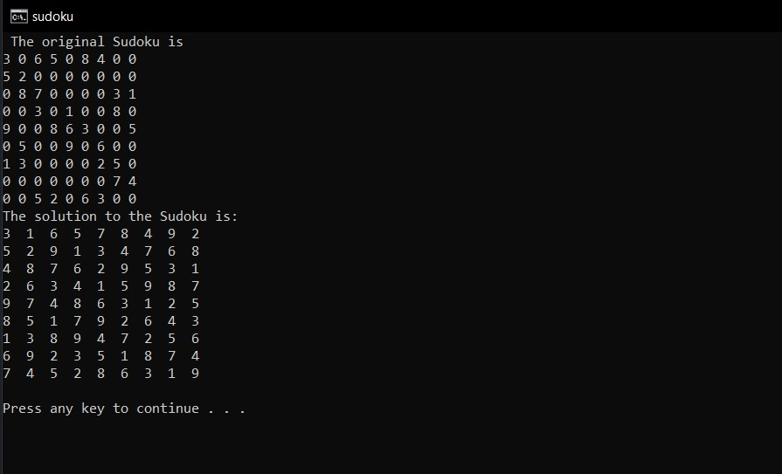
OUTPUT

Slide 13
TOPIC 3 GREEDY APPROACH

Slide 14
INTRODUCTION
A greedy algorithm, always makes the choice that seems to be the best at that moment. This means that it makes a locally-optimal choice in the hope that this choice will lead to a globally-optimal solution.
To decide an optimal choice :-
Assume that you have an objective function that needs to be optimized at a given point. A Greedy algorithm makes greedy choices at each step to ensure that the objective function is optimized. The Greedy algorithm has only one shot to compute the optimal solution so that it never goes back and reverses the decision.
Advantage:- It is quite easy to come up with a greedy algorithm (or even multiple greedy algorithms) for a problem.
Disadvantage:- The difficult part is that for greedy algorithms you have to work much harder to understand correctness issues. Even with the correct algorithm, it is hard to prove why it is correct.

Slide 15
EXAMPLE- MINIMUM COIN EXCHANGE PROBLEM
Description:-
Given coins of various different denominations ; find out a way to give a customer an amount with the fewest number of coins. For example, if I ask you to return me change for 30, there are more than two ways to do so,so we’ve to find a way which requires the least number of coins.
Greedy approach:-
At every iteration in search of a coin, take the largest coin which can fit into remaining amount we need change for at the instance. At the end you will have optimal solution.

Slide 16
ALGORITHM
1) Initialize result as empty.
2) find the largest denomination that is smaller than V.
3) Add found denomination to result. Subtract
value of found denomination from V.
If V becomes 0, then print result.
Else repeat steps 2 and 3 for new value of V
get_change(n)
{ i<-0
count<-0
coins<-{10.5,1}
for i=1 to n
{ count+= n/ coins[i];
m=m%coins[i];
}
return count
}

Slide 17
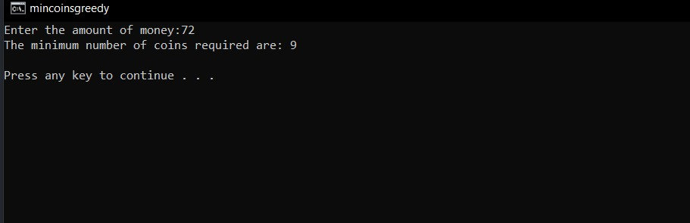
OUTPUT

Slide 18
TOPIC 4 BRANCH AND BOUND

Slide 19
INTRODUCTION
Branch and bound is a systematic method for solving optimization problems
Branch and bound is a rather general optimization technique that applies where the greedy method and dynamic programming fail.
However, it is much slower. Indeed, it often leads to exponential time complexities in the worst case.
On the other hand, if applied carefully, it can lead to algorithms that run reasonably fast on average.
The general idea of B&B is a BFS-like search for the optimal solution, but not all nodes get expanded (i.e., their children generated). Rather, a carefully selected criterion determines which node to expand and when, and another criterion tells the algorithm when an optimal solution has been found.

Slide 20
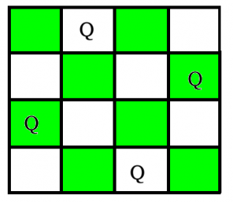
EXAMPLE- N QUEEN PROBLEM
Description:-
The N queens puzzle is the problem of placing N chess queens on an N×N chessboard so that no two queens threaten each other. Thus, a solution requires that:
- no two queens share the same row
- no two queens share the same column
- no two queens share the same diagonal.
Branch and bound approach:-
The idea is to place queens one by one in different columns, starting from the leftmost column. When we place a queen in a column, we check for clashes with already placed queens. In the current column, if we find a row for which there is no clash, we mark this row and column as part of the solution. If we do not find such a row due to clashes, then we backtrack and return false.

Slide 21
ALGORITHM
isValid(board, row, col)
Input: The chess board, row and the column of the board.
Output: True when placing a queen in row and place position is a valid or not.
Begin
if there is a queen at the left of current col, then
return false
if there is a queen at the left upper diagonal, then
return false
if there is a queen at the left lower diagonal, then
return false;
return true
End
solveNQueen(board, col)
Input: The chess board, the col where the queen is trying to be placed.
Output: The position matrix where queens are placed.
Begin
if all columns are filled, then
return true
for each row of the board, do
if isValid(board, i, col), then
set queen at place (i, col) in the board
if solveNQueen(board, col+1) = true, then
return true
otherwise remove queen from place (i, col) from board.
done
return false
End

Slide 22
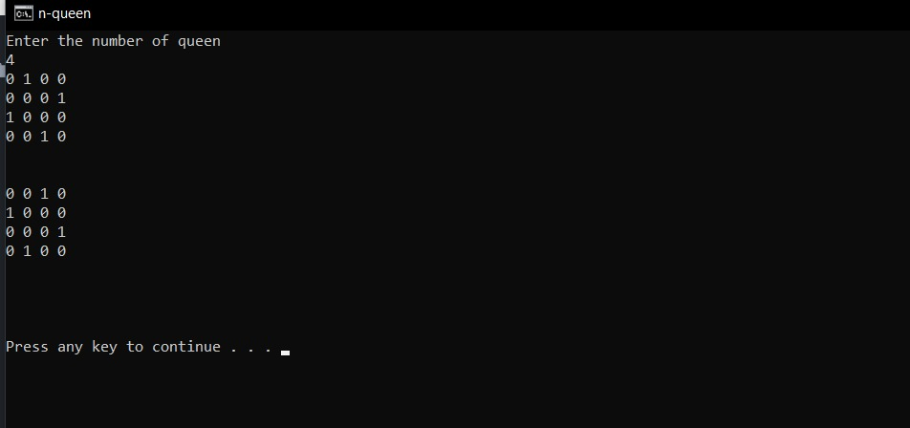
OUTPUT

Slide 23
TOPIC 5 DYNAMIC PROGRAMMING

Slide 24
INTRODUCTION
Dynamic programming approach is similar to divide and conquer in breaking down the problem into smaller and yet smaller possible sub-problems.
But unlike, divide and conquer, these sub-problems are not solved independently. Rather, results of these smaller sub-problems are remembered and used for similar or overlapping sub-problems.
Dynamic programming is used where we have problems, which can be divided into similar sub-problems, so that their results can be re-used. Mostly, these algorithms are used for optimization.
Before solving the in-hand sub-problem, dynamic algorithm will try to examine the results of the previously solved sub-problems. The solutions of sub-problems are combined in order to achieve the best solution.
Overlapping sub problems property-The problem should be able to be divided into smaller overlapping sub-problem.
Optimal substructure property- An optimum solution can be achieved by using an optimum solution of smaller sub-problems.
Dynamic algorithms use Memorization.

Slide 25
EXAMPLE- MINIMUM COIN EXCHANGE PROBLEM
Description:-
Given coins of various different denominations ; find out a way to give a customer an amount with the fewest number of coins. For example, if I ask you to return me change for 30, there are more than two ways to do so, so we’ve to find a way which requires the least number of coins.
Earlier ,we solved this problem with the greedy approach. This problem can also be solved by simple recursion, but while using simple recursion we see that the same sub problems are called again and again causing the problem of overlapping sub problems property,
We can use Dynamic programming to solve this problem as it possesses both the properties of dynamic programming. Idea is that, re computations of same sub problem can by avoided by constructing a temporary array table[][] in bottom up manner.

Slide 26
ALGORITHM
Count( S[],m,n)
{ for i= 0 to m-1
table[0][i]=1;
for i= 1 to n
{ for j= 0 to m-1
{ if(i-S[j]>=0)
x=table[i-S[j]][j];
else
x=0;
if (j>=1)
y=table[i][j-1];
else
y=0;
table[i][j]=x+y;
}
}
return table[n][m-1];
}
Key points:-
Input array S contains the various denominations
m is the number of denominations
n is the sum

Slide 27
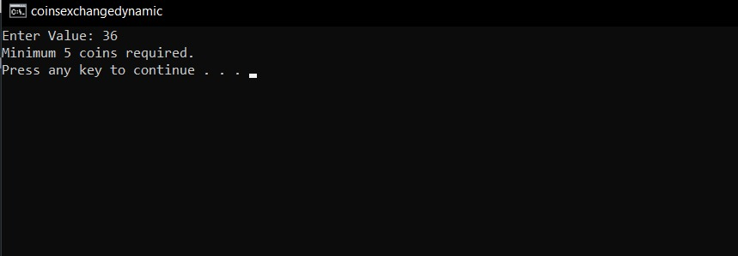
OUTPUT

Slide 28
THANK YOU!!

