Slide 1
Python Presentation
Group 3:Liew Jun Jie, Lennon Su Chee, Nurun Nashuha

Slide 2
Version Control
Using Git

Slide 3
Why version Control
Having a Backup copy of our program
keep track with each change of the code
Easier to share the workload with team members

Slide 4
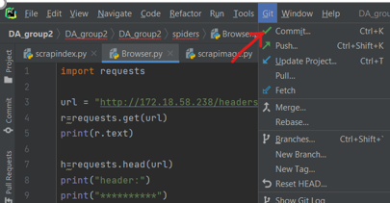
Step 1 (VC)
Once you are done editing with your code hit commit to select the changes that you would like to upload, alternatively you can hit ctrl+k for easier access

Slide 5
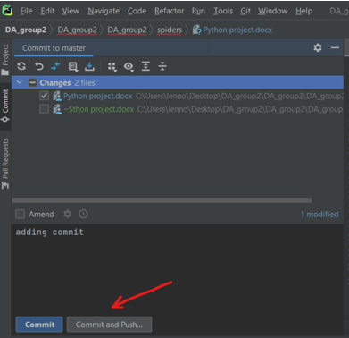
Step 2 (VC)
This screen should pop up on the top left of the IDE, this is where you choose the file to commit and add comments to make your upload more meaningful.
Once all is done hit Commit and Push.

Slide 6
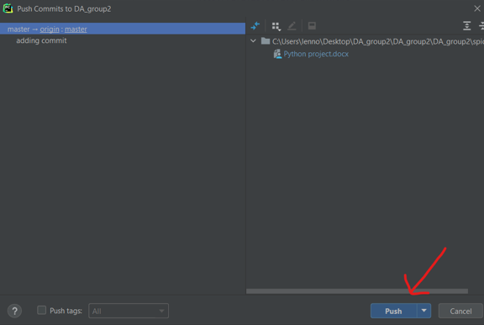
Step 3 (VC)
A new window should pop up, giving you an overview of what files, you have edited.
Click push to send it to the repository

Slide 7
Reconnaissance and header change
With requests

Slide 8
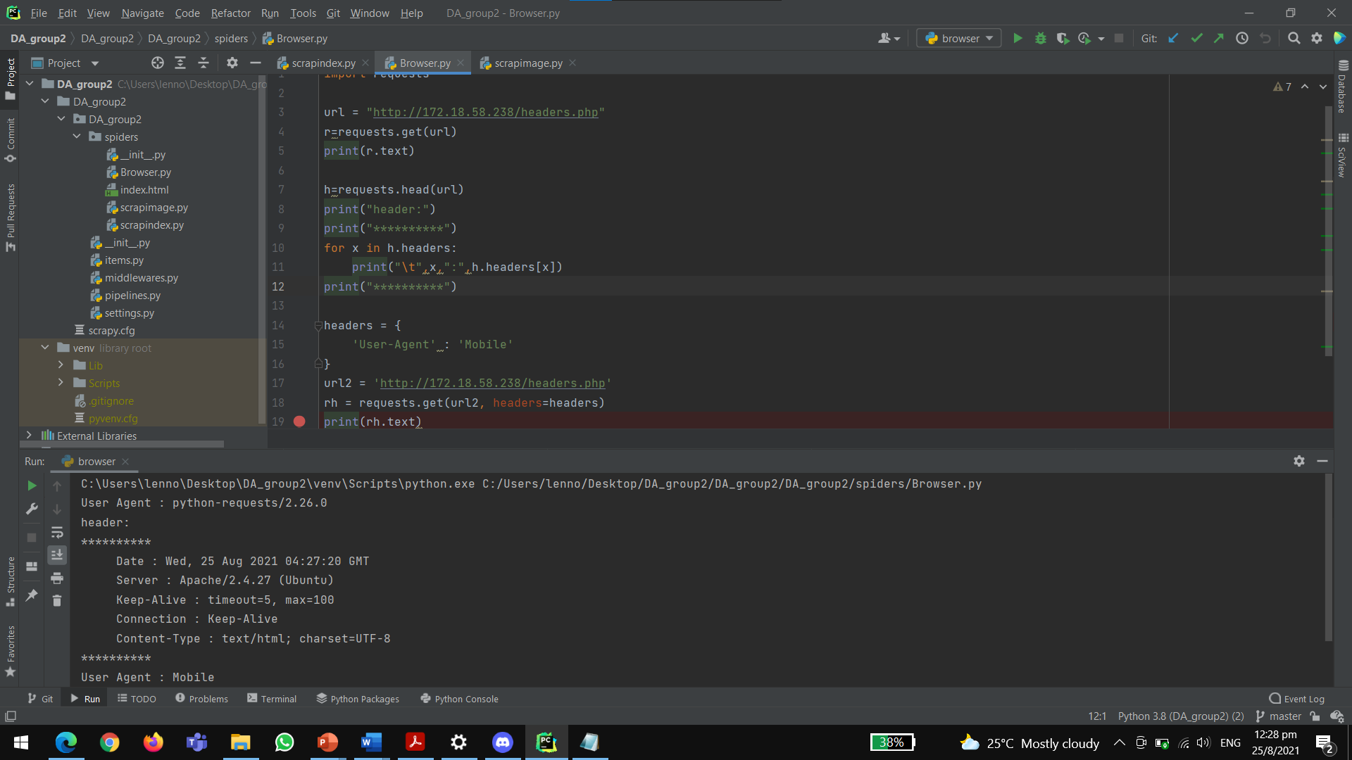
Reconnaissance and header change
As shown here, we have written for a request to be sent to our test server (172.18.58.238) We also changed request that the header be changed

Slide 9
Webcrawling
With Scrapy

Slide 10
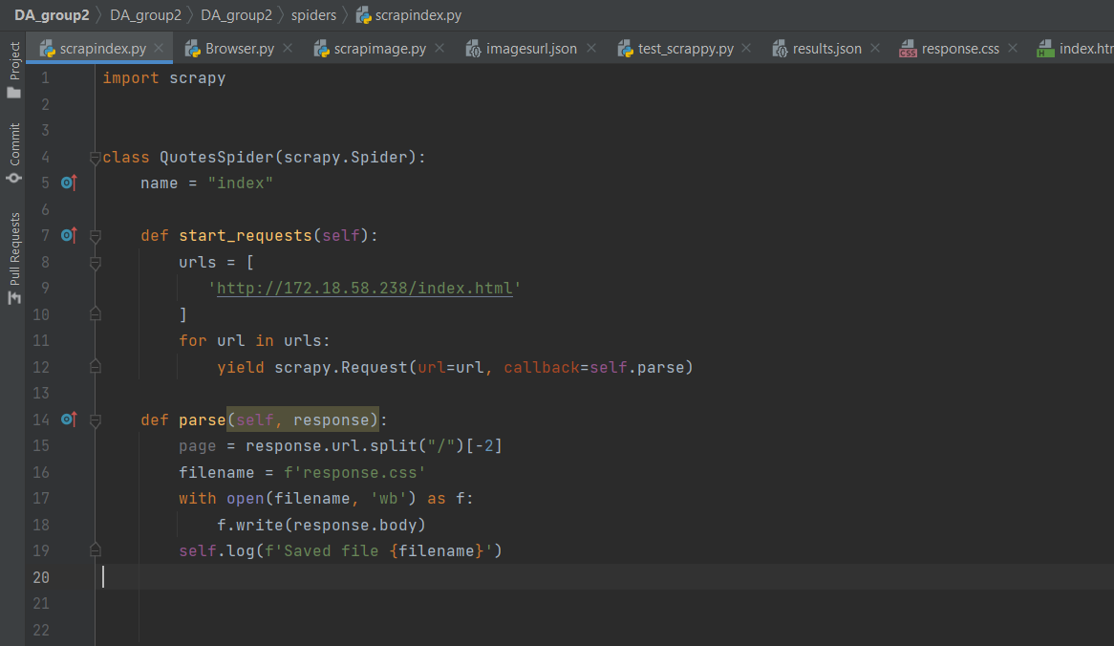
Webcrawling
As shown below we have created a WebCrawler and requested that it take an index page from our server (172.18.58.238) and output the file as response.css

Slide 11
Extraction of photo directory
With Scrapy

Slide 12
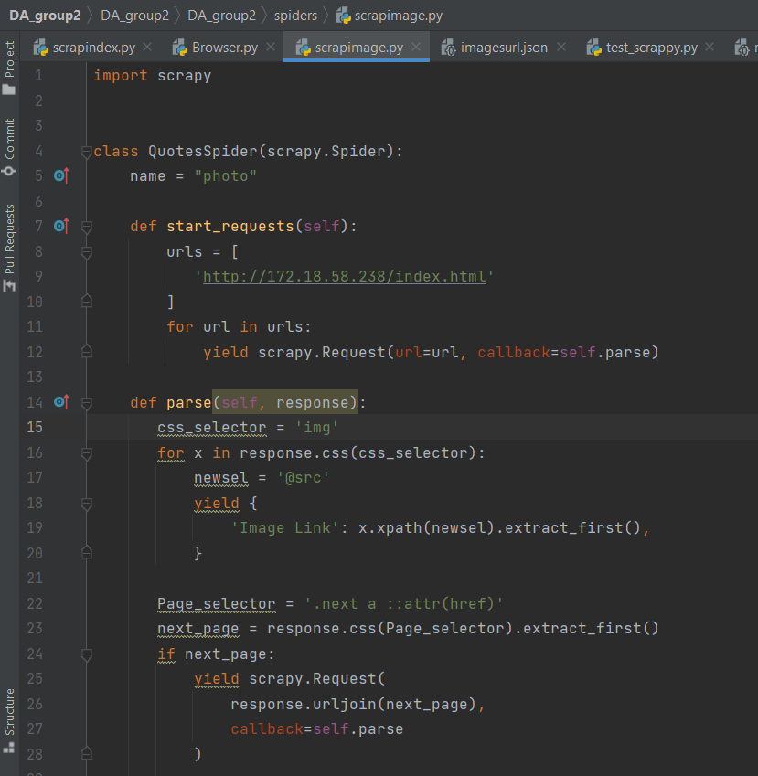
Extraction of photo directory
Scrapimage is programmed to crawl to every page and create a list of image links

Slide 13
Feature testing
With Unit test

Slide 14
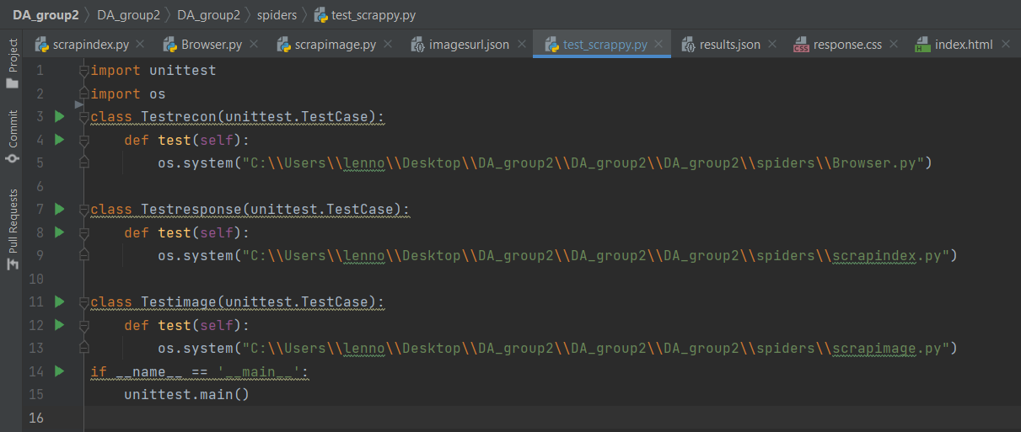
Feature testing
Here we imported the and unit test module and told unit test to test each files individually

Slide 15
Webcrawling results
With scrapy and requests

Slide 16
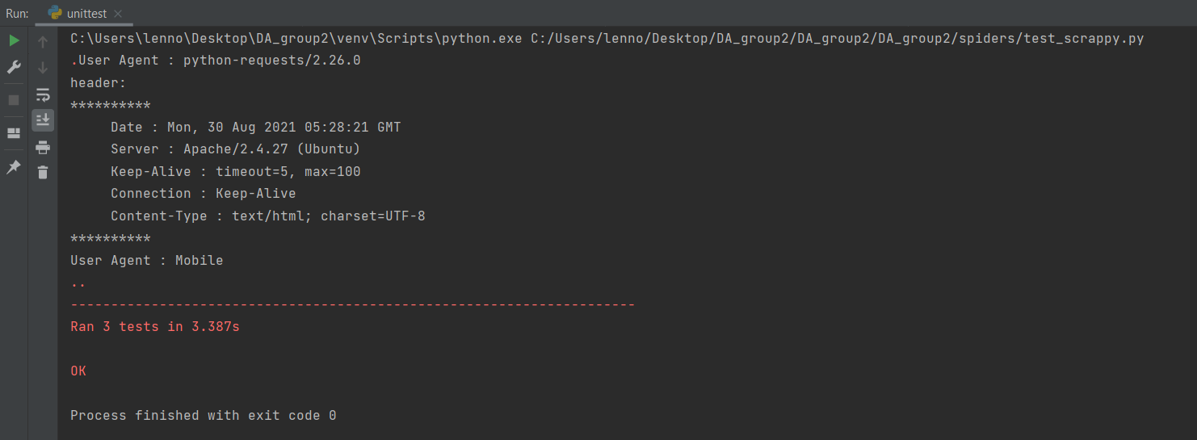
Webcrawling results
This is the result of the unit test

Slide 17
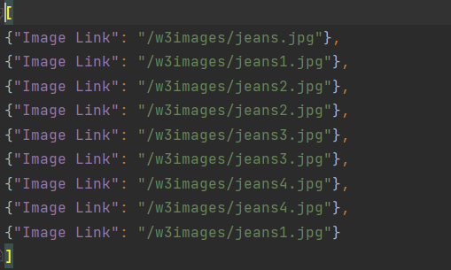
Webcrawling results
This is the result of the scrapphoto

Slide 18
Thank You

