Slide 1
Advanced Algorithms Week 11
Gorkem Kar
Notes:
Backtracking II

Slide 2
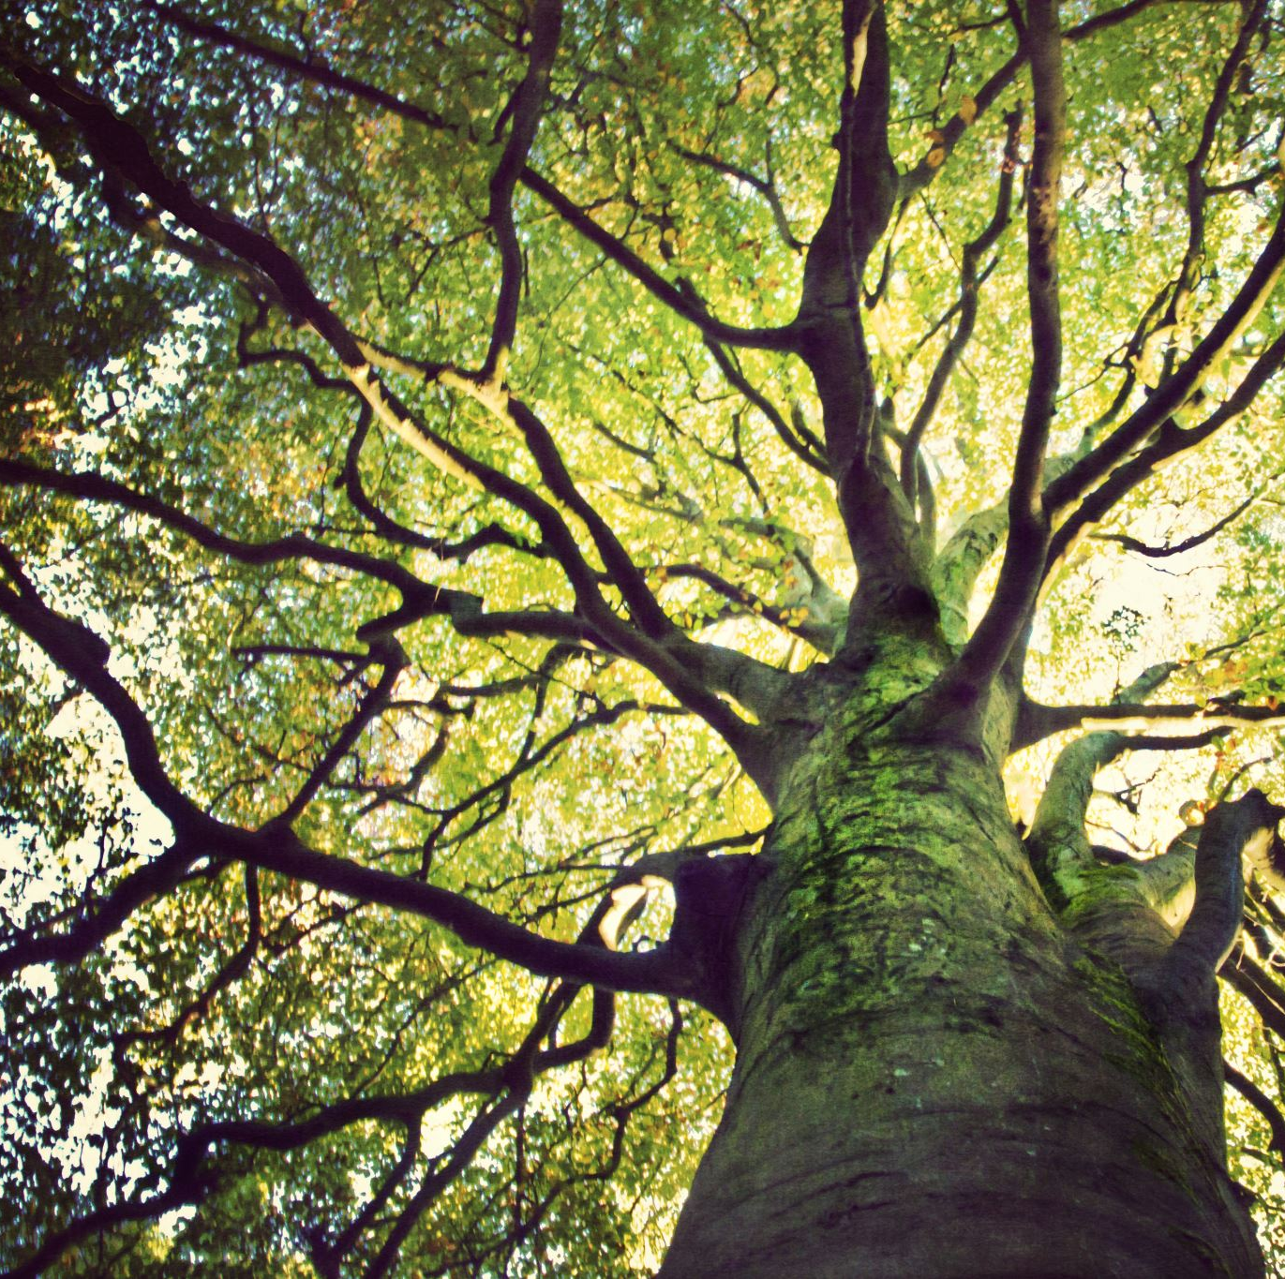
Contents
Review Graph Coloring
DFS and BFS discussion
The Hamiltonian Circuits
The Eulerian Circuits
BONUS discussion

Slide 3

Graph Coloring Problem
Assignment of colors to the vertices of a graph such that no two adjacent vertices share the same color
Given a graph, what is the minimum number of colors needed to color the graph.

Slide 4
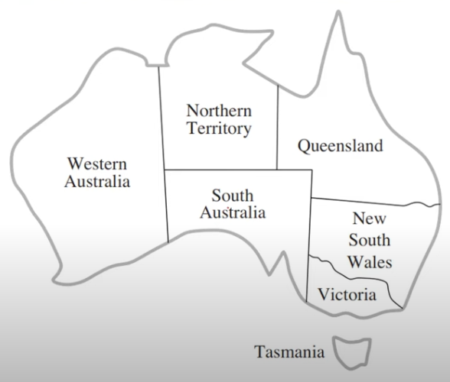
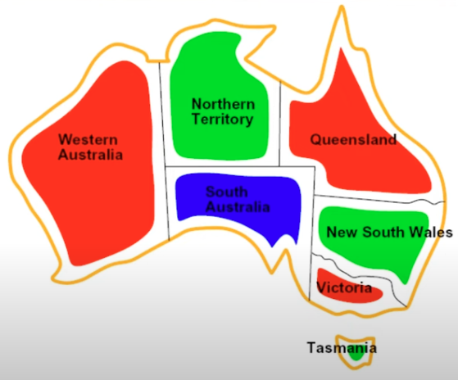
Example

Slide 5
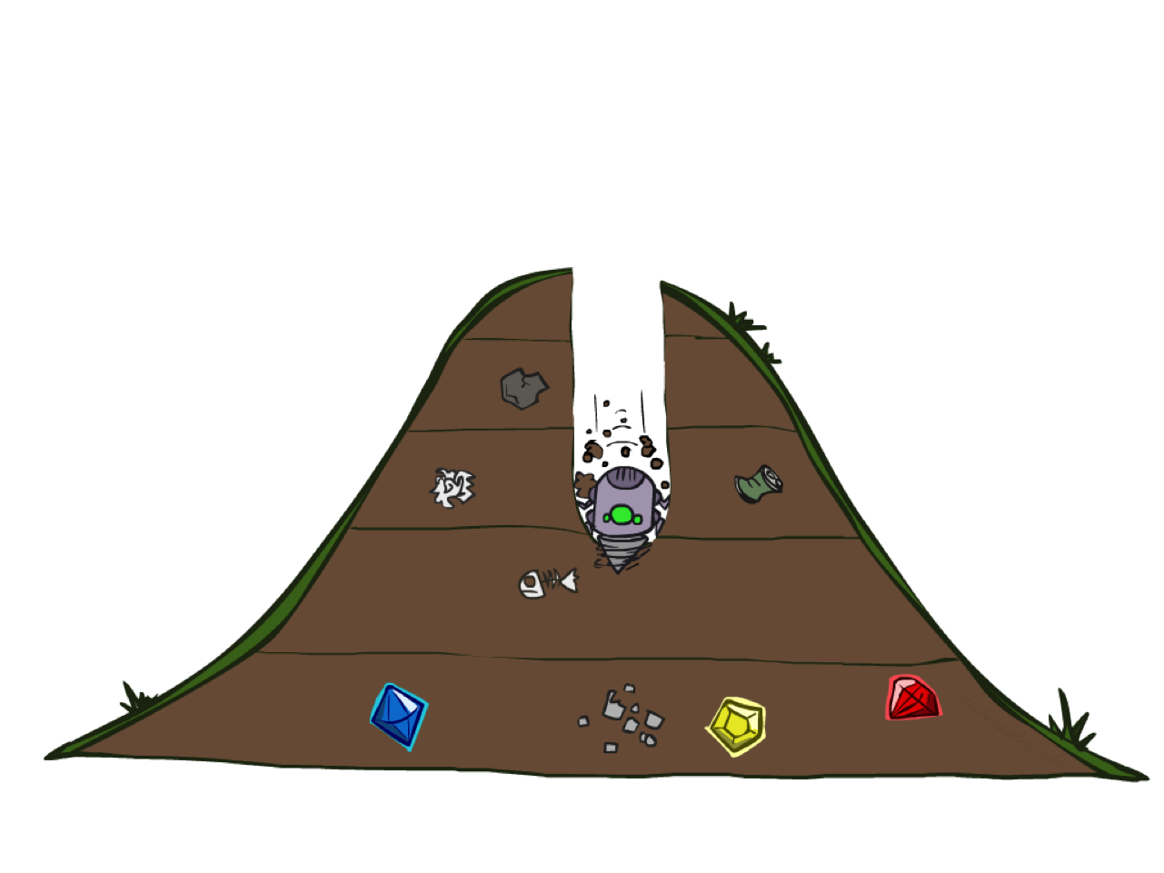
Depth-First (Tree) Search
Notes:
That was generic. Now specific strategy – dfs
Go deep!
Exponentially large at the bottom.

Slide 6
Depth-First Search
Strategy: expand a deepest node first
Implementation: Fringe is a LIFO stack
a
G
a
c
b
c
b
e
d
e
d
f
f
S
h
h
p
p
r
q
r
q
S
d
e
p
b
c
e
h
r
q
a
a
h
r
p
q
f
p
q
f
q
c
G
q
c
G
a
a
Notes:
S D B A C A E H P Q
Ties alphabetically in this case.

Slide 7
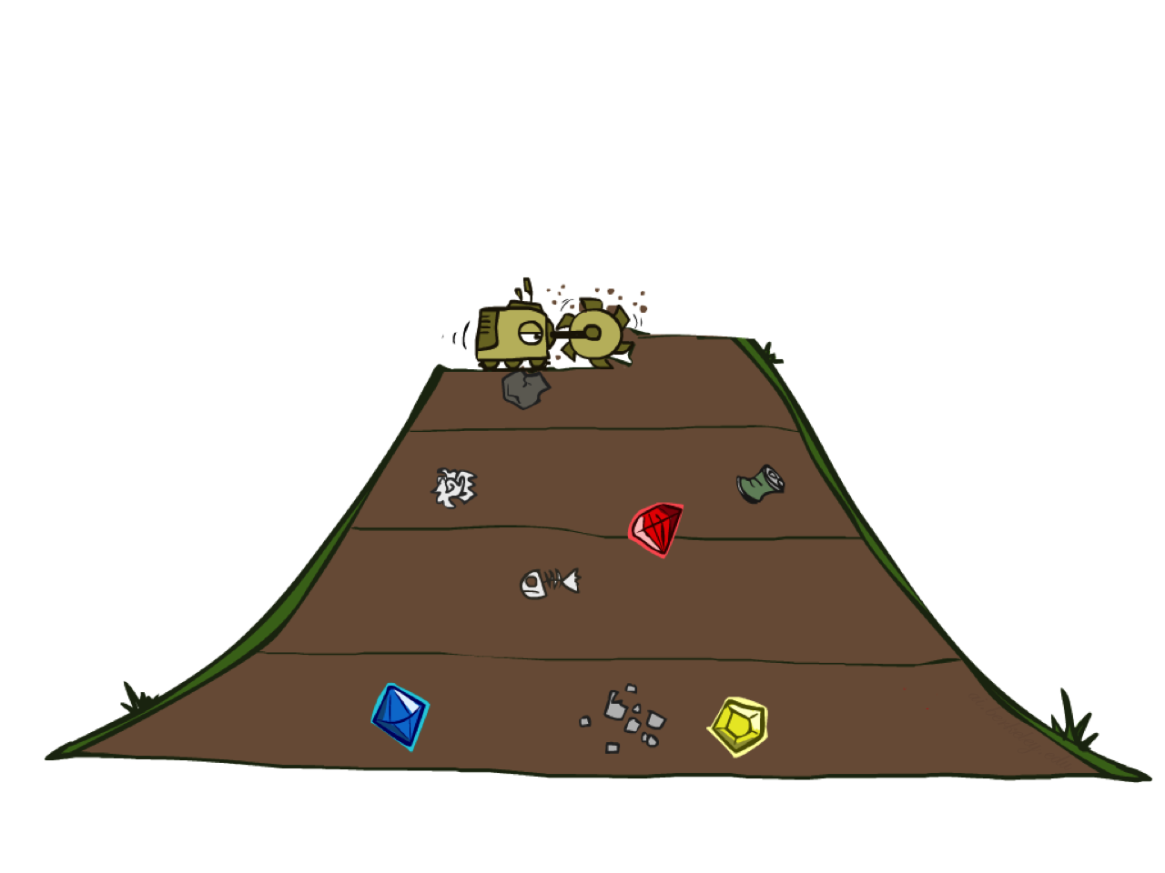
Breadth-First (Tree) Search
Notes:
Another strategy. Layer by layer.
Strip-mining
BFS

Slide 8
Breadth-First Search
Strategy: expand a shallowest node first
Implementation: Fringe is a FIFO queue
a
G
b
c
d
e
f
S
h
p
q
r
S
d
e
p
Search
Tiers
b
c
e
h
r
q
a
a
h
r
p
q
f
p
q
f
q
c
G
q
c
G
a
a
Notes:
Same general algorithm. Shallowest node.
S D E P B C E H R Q

Slide 9
Why they are not helping us?
Because we never check the constraints as we go.
Greedy solution makes assignments such that no current assignment of the visited nodes contradicts with the rule.
Problem with the Greedy solution, it’s irrevocable.
Then, we introduce the Backtracking approach.

Slide 10
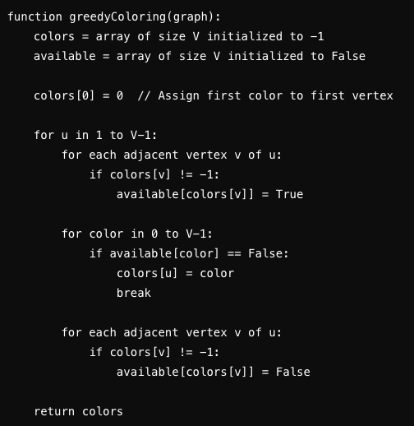
Greedy Coloring Algorithm
Notes:
What is wrong with this code?
Each coloring is committed!

Slide 11
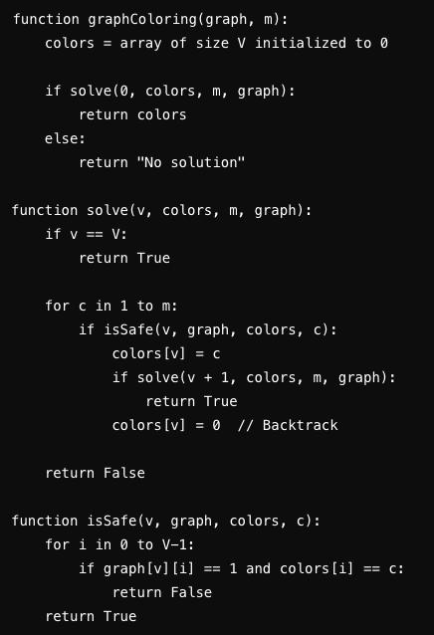
Backtracking Approach
Notes:
Helpful video: https://www.youtube.com/watch?v=miCYGGrTwFU

Slide 12

Hamiltonian Circuits
A Hamiltonian circuit (cycle)
Visit every vertex exactly once and returns to the starting vertex
A Hamiltonian path
Visit every vertex exactly once but does not necessarily return to the starting vertex

Slide 13
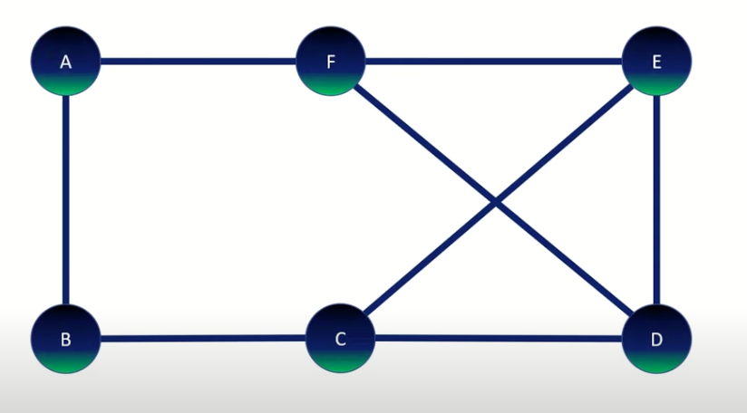
Example
Notes:
A-B-C-E-D-F-A
https://www.youtube.com/watch?v=pTUVll8lcEQ

Slide 14
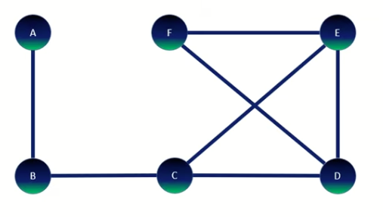
Exercise
Notes:
Hamiltonian path,
Not a Hamiltonian cycle

Slide 15
What if we are interested in Edges, not Vertices?
An Eulerian circuit
Includes every vertex and every edge of a graph
It may pass through a vertex more than once
It traverses each edge exactly once
Starting and ending vertex have to be the same
An Eulerian path
Includes every vertex and every edge of a graph
It traverses each edge exactly one
Starting and ending vertex are different

Slide 16
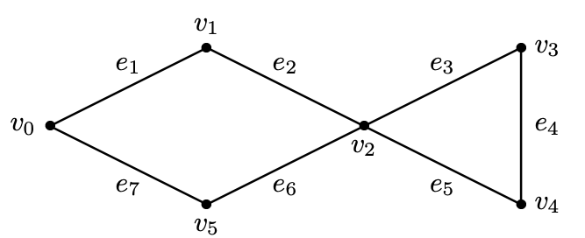
What do you see here?

Slide 17
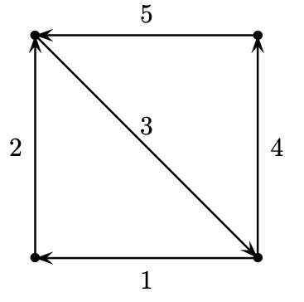
What do you see here?

Slide 18
Question
Do you think we can have a Euler path for every graph?
If you think yes, check the next slide.

Slide 19
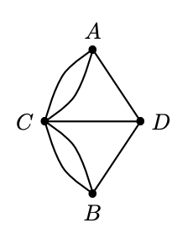
Sample Graph

Slide 20

Famous Problem

Slide 21
Sample Graph
All 4 vertices have odd degree,
Deg(A) = 3
Deg(B) = 3
Deg(C) = 5
Deg(D) = 3
Therefore, there is no Eulerian circuit or path

Slide 22
Observations
For each edge that enters v there must be another edge which leaves v. Since each edge is traversed once, there must be an even number of edges incident on v.
If we consider paths rather than circuits, then exactly two vertices, the starting and ending vertices, will have odd degree.

Slide 23

Eulerian Decision Making
If every vertex of a connected graph G has even degree
G has an Eulerian circuit
If all but two vertices of a connected graph G have even degree
G has an Eulerian path

Slide 24
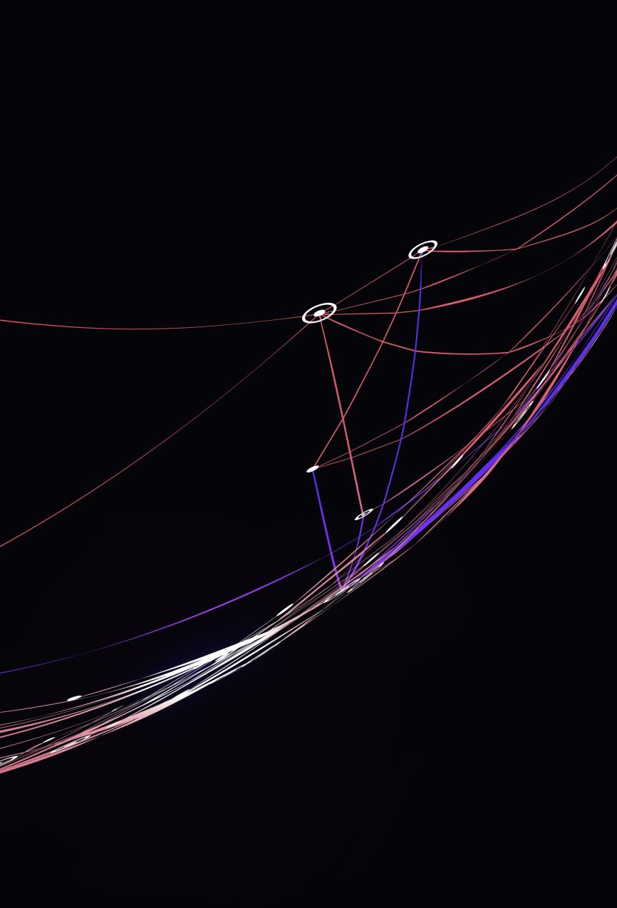
Fleury’s Algorithm
Choose one of the two vertices of odd degree as the starting point
Travel over any edge whose removal will not break the graph into disconnected components
Color the edge just traversed, and then travel over any edge whose removal will not break the remaining sub-graph into disconnected components
Repeat until all edges are colored (Traversed).

Slide 25
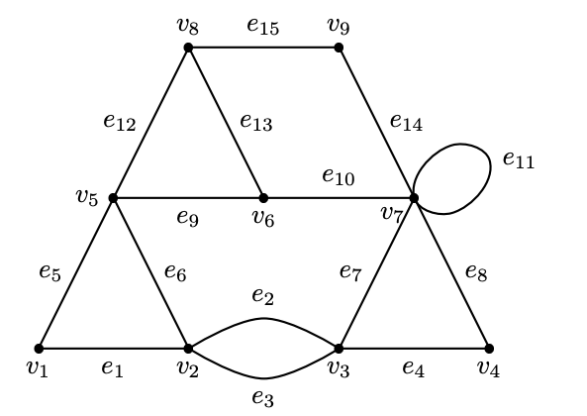
Sample Topology
Notes:
There are two vertices od odd degree: v6 and v8
Let’s choose the v8 as the starting vertex.
We can move along e12, e13, or e15.
Let’s choose e15.

Slide 26
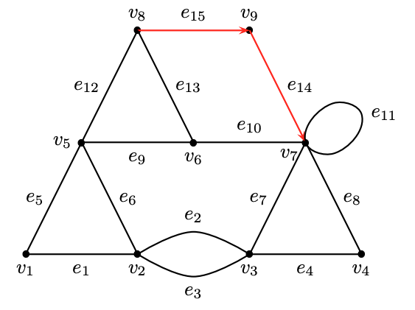
What to do?

Slide 27
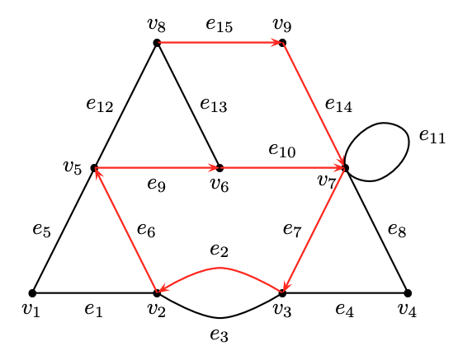
Next Step
Notes:
We have two choices: e11 or e8. If we choose e8, it would disconnect the loop e11 from the rest of the graph.
So we choose e11 first.

Slide 28
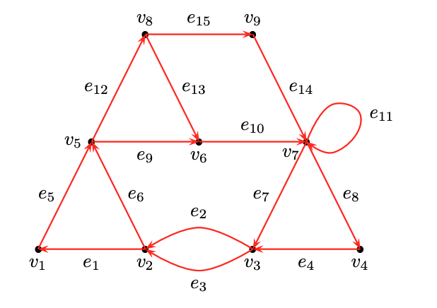
Final Step

