Slide 1
Advanced Algorithms Session 2
Gorkem Kar

Slide 2
Contents
Review of Last Lecture
Search Methods

Slide 3
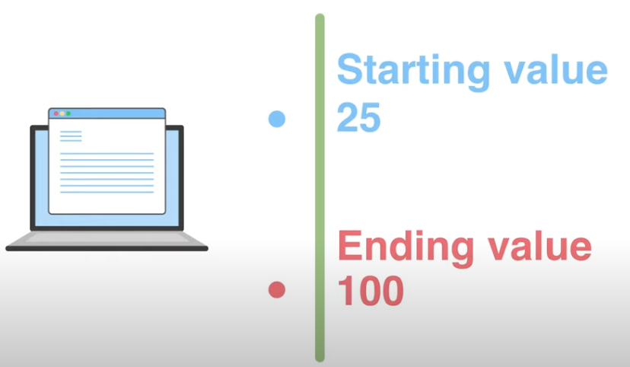
Growth Rate

Slide 4
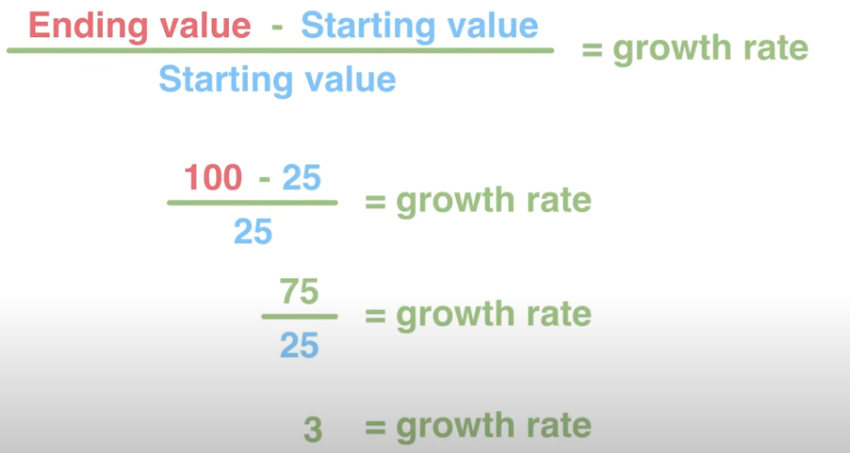
Growth Rate
Notes:
3 x 100% = 300%

Slide 5
Efficiency
Worst Case Efficiency
Average Case Efficiency
Best Case Efficiency

Slide 6
Big-O Notation
Simplified analysis of an algorithm’s efficiency
Complexity in terms of input size, N
Machine-independent
Basic computer steps
Time & space

Slide 7
Big-O Notation General Rules
Ignore constants
5n -> O(n)
Certain terms “dominate” others
O(1) < O(log(n)) < O(n) < O(nlog(n)) < O(n²) < O(2^{n}) < O(n!) We ignore low-order terms

Slide 8
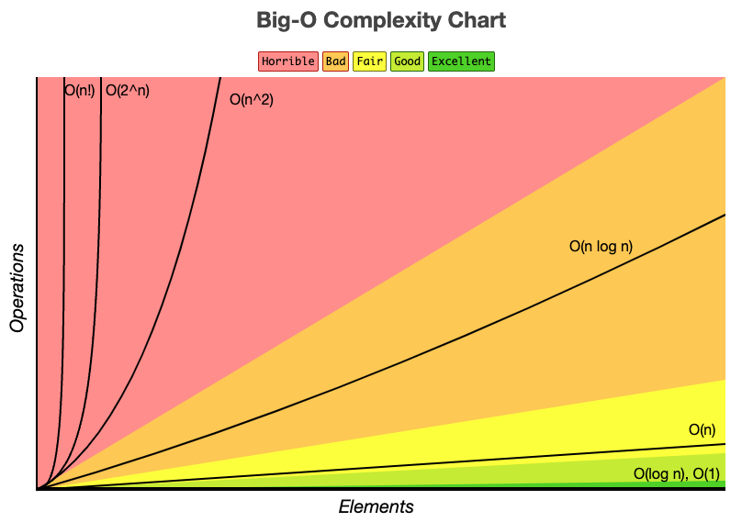
Big-O Complexity Chart

Slide 9
Big-O Constant Time
X = 5 + (15 * 20)
Independent of input size, N
O(1): “Big Oh of one”
X = 5 + (15 * 20);
Y = 15 – 5;
Print x + y;
Total time = O(1) + O(1) + O(1) = 3 * O(1) = O(1)

Slide 10
Big-O Linear Time
For x in range (0, n): print x; // O(1)
N * O(1)
O(N)
X = 5 + (15 * 20); O(1)
For x in range (0, n): print x; O(N)
Total time = O(1) + O(N)
Total time = O(N)

Slide 11
Big-O Quadratic Time
X = 5 + (15 * 20); O(1)
For x in range (0, n): print x; O(N)
For x in range (0, n): for y in range (0, n): print x * y; O(N²)

Slide 12
Exercise
If x > 0: // O(1) else if x < 0: // O(logn) else: // O(n²)
O(?)

Slide 13
Exercise
If x > 0: // O(1) else if x < 0: // O(logn) else: // O(n²)
O(n²)

Slide 14
Comparison
Big O notation (Worst-case)
Big Omega Ω notation (Best-case)
Big Theta Θ notation (Average-case)

Slide 15
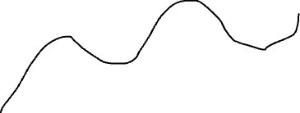


Comparison
Upper bound
F(n)
Lower bound

Slide 16
Comparison
F(n) = O(g(n)) iff f(n) <= c * g(n)
F(n) = Ω(g(n)) iff f(n) >= c * g(n)
F(n) = Θ(g(n)) iff c1 * g(n) <= f(n) <= c2 * g(n)

Slide 17

Search Algorithm
Notes:
https://www.youtube.com/watch?v=0aaQasyqxSQ

Slide 18
Linear Search
Target = 14
0
1
2
3
4
5
6
7
5
12
17
23
38
14
27
9

Slide 19
Linear Search
0
1
2
3
4
5
6
7
5
12
17
23
38
14
27
9
=
14

Slide 20
Linear Search
0
1
2
3
4
5
6
7
5
12
17
23
38
14
27
9
=
14

Slide 21
Linear Search
0
1
2
3
4
5
6
7
5
12
17
23
38
14
27
9
=
14

Slide 22
Linear Search
0
1
2
3
4
5
6
7
5
12
17
23
38
14
27
9
=
14

Slide 23
Linear Search
0
1
2
3
4
5
6
7
5
12
17
23
38
14
27
9
=
14

Slide 24
Linear Search
0
1
2
3
4
5
6
7
5
12
17
23
38
14
27
9
=
14

Slide 25
Linear Search
Works for sorted & unsorted arrays
Might work well for small data sets
Extremely slow for large data sets
O(?)
O(n)

Slide 26
Linear Search
Can you guys provide the pseudocode for Linear Search?

Slide 27
Binary Search
Works for SORTED arrays
With each iteration, half the values are eliminated
O(?)

Slide 28
Binary Search
[1, 4, 5, 7, 9, 12, 15, 18, 19, 22, 25, 29, 40, 50]
Target = 12
Average of (0, 13) = 6
left
mid
right

Slide 29
Binary Search
[1, 4, 5, 7, 9, 12, 15, 18, 19, 22, 25, 29, 40, 50]
Target = 12
Average of (0, 5) = 2
left
mid
right

Slide 30
Binary Search
[1, 4, 5, 7, 9, 12, 15, 18, 19, 22, 25, 29, 40, 50]
Target = 12
Average of (3, 5) = 4
left
right
mid

Slide 31
Binary Search
[1, 4, 5, 7, 9, 12, 15, 18, 19, 22, 25, 29, 40, 50]
Target = 12
Average of (5, 5) = 5
Left,
right
, mid
Return 5, the index of 12

Slide 32
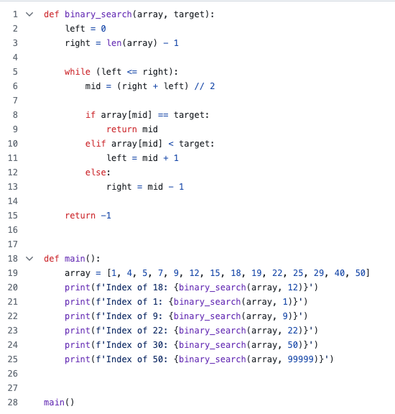
Binary Search Code

Slide 33
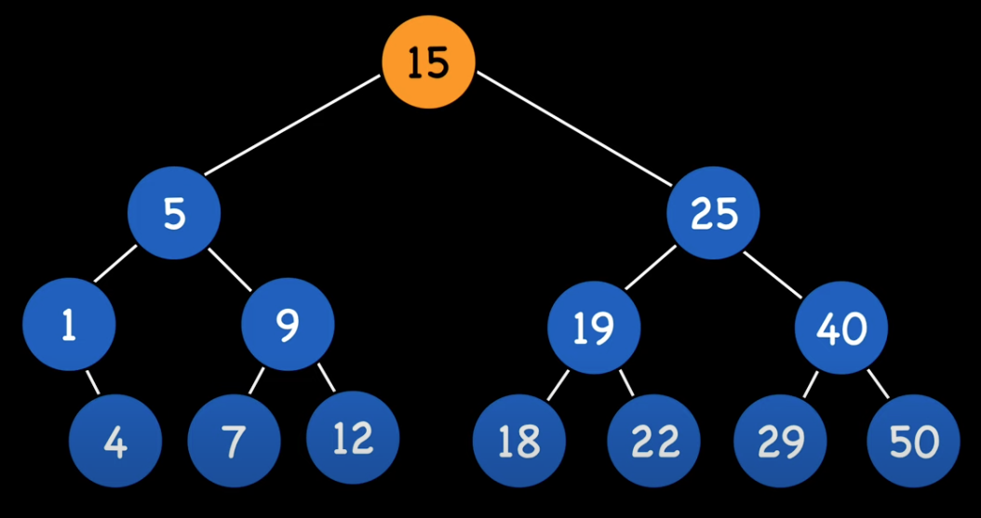
Binary Search Complexity
[1, 4, 5, 7, 9, 12, 15, 18, 19, 22, 25, 29, 40, 50]

Slide 34
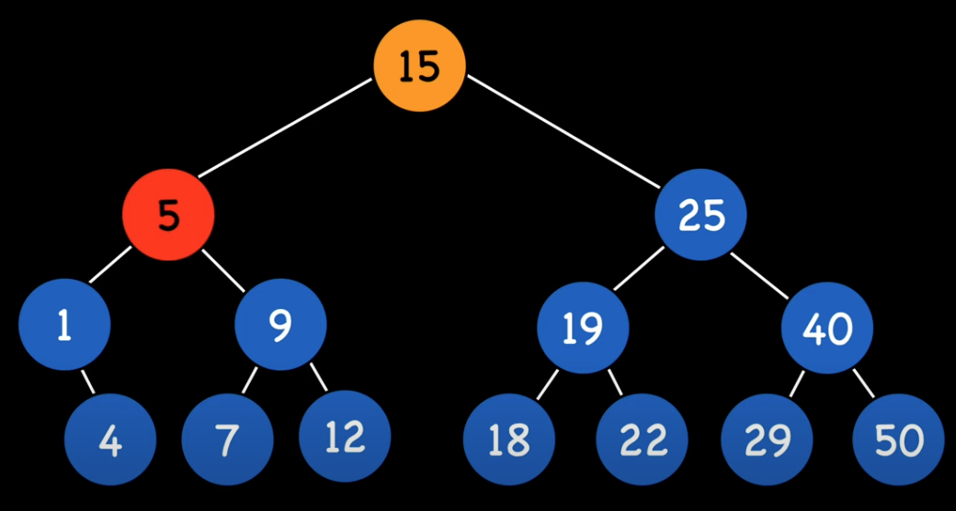
Binary Search Complexity
[1, 4, 5, 7, 9, 12, 15, 18, 19, 22, 25, 29, 40, 50]

Slide 35
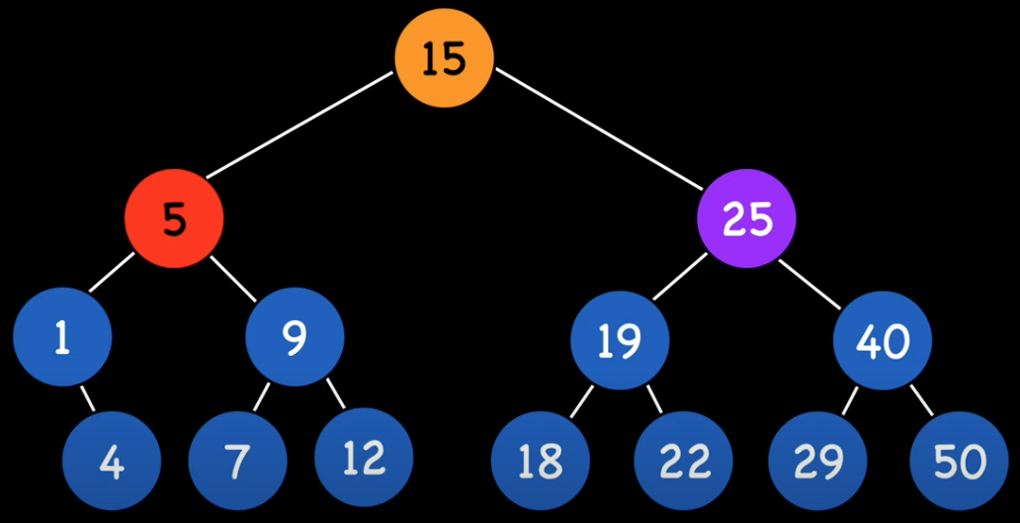
Binary Search Complexity
[1, 4, 5, 7, 9, 12, 15, 18, 19, 22, 25, 29, 40, 50]
Log₂(n) + 1
O(log(n))

Slide 36
Binary Search Divide & Conquer
[1, 4, 5, 7, 9, 12, 15, 18, 19, 22, 25, 29, 40, 50]
Log₂(n) + 1
O(log(n))

Slide 37
Find the maximum
0
1
2
3
4
5
6
7
5
12
17
23
38
14
27
9

Slide 38
Find the maximum pseudocode
Start
Define the current_max as a really low value
Define the index as 0
Compare each element Arr[index] with current_max
Update current_max if the element is greater than the current_max
Increase the index by 1
If the index is equal to the Array length – 1, then stop
Print out Array[index]
End

Slide 39
Find the maximum
Current max = -1000
0
1
2
3
4
5
6
7
5
12
17
23
38
14
27
9

Slide 40
Find the maximum
0
1
2
3
4
5
6
7
5
12
17
23
38
14
27
9
Current max = 5

Slide 41
Find the maximum
0
1
2
3
4
5
6
7
5
12
17
23
38
14
27
9
Current max = 12

Slide 42
Find the maximum
0
1
2
3
4
5
6
7
5
12
17
23
38
14
27
9
Current max = 17

Slide 43
Find the maximum
0
1
2
3
4
5
6
7
5
12
17
23
38
14
27
9
Current max = 23

Slide 44
Find the maximum
0
1
2
3
4
5
6
7
5
12
17
23
38
14
27
9
Current max = 38

Slide 45
Find the maximum
0
1
2
3
4
5
6
7
5
12
17
23
38
14
27
9
Current max = 38

Slide 46
Find the maximum
0
1
2
3
4
5
6
7
5
12
17
23
38
14
27
9
Current max = 38

Slide 47
Find the maximum
0
1
2
3
4
5
6
7
5
12
17
23
38
14
27
9
Current max = 38

Slide 48
Find the maximum complexity
O(?)
0
1
2
3
4
5
6
7
5
12
17
23
38
14
27
9

Slide 49
Find the maximum complexity
O(n)
0
1
2
3
4
5
6
7
5
12
17
23
38
14
27
9
Can we be smarter?

Slide 50

Divide and Conquer
Notes:
Start with 1:10

Slide 51
Next week
More divide and conquer algorithms

Slide 52
Ungraded HWs
Please write the pseudocode of the algorithms that we learnt today without looking at slides or online sources.
Pick your favorite programming language and implement them.
Modify the last example such that your code would find the minimum element in an array.

