Slide 1
Advanced Algorithms Session 3
Gorkem Kar

Slide 2
Contents
Review of Last Exercise
Merge Sort
Quick Sort
Examples and Exercises

Slide 3
Find the maximum
0
1
2
3
4
5
6
7
5
12
17
23
38
14
27
9

Slide 4
Find the maximum pseudocode
Start
Define the current_max as a really low value
Define the index as 0
Compare each element Arr[index] with current_max
Update current_max if the element is greater than the current_max
Increase the index by 1
If the index is equal to the Array length – 1, then stop
Print out current_max
End

Slide 5
Find the maximum
Current max = -1000
0
1
2
3
4
5
6
7
5
12
17
23
38
14
27
9

Slide 6
Find the maximum
0
1
2
3
4
5
6
7
5
12
17
23
38
14
27
9
Current max = 5

Slide 7
Find the maximum
0
1
2
3
4
5
6
7
5
12
17
23
38
14
27
9
Current max = 12

Slide 8
Find the maximum
0
1
2
3
4
5
6
7
5
12
17
23
38
14
27
9
Current max = 17

Slide 9
Find the maximum
0
1
2
3
4
5
6
7
5
12
17
23
38
14
27
9
Current max = 23

Slide 10
Find the maximum
0
1
2
3
4
5
6
7
5
12
17
23
38
14
27
9
Current max = 38

Slide 11
Find the maximum
0
1
2
3
4
5
6
7
5
12
17
23
38
14
27
9
Current max = 38

Slide 12
Find the maximum
0
1
2
3
4
5
6
7
5
12
17
23
38
14
27
9
Current max = 38

Slide 13
Find the maximum
0
1
2
3
4
5
6
7
5
12
17
23
38
14
27
9
Current max = 38

Slide 14
Find the maximum complexity
O(?)
0
1
2
3
4
5
6
7
5
12
17
23
38
14
27
9

Slide 15
Find the maximum complexity
O(n)
0
1
2
3
4
5
6
7
5
12
17
23
38
14
27
9
Can we be smarter?

Slide 16
Find the maximum
0
1
2
3
4
5
6
7
5
12
17
23
38
14
27
9
0
1
2
3
4
5
6
7
5
12
17
23
38
14
27
9
0
1
2
3
4
5
6
7
5
12
17
23
38
14
27
9

Slide 17
Sorting
What is sorting?
Why do we want a sorted array?
What is the complexity of sorting?
Can we sort every array?

Slide 18
Sorting
Sorting is arranging a group of objects
Ascending or descending
If an array is sorted, we can find the target
By using binary search, in complexity of O(logn)

Slide 19
Sorting
Divide and Conquer Related Sorting Algorithms
In-place Sorting Algorithms

Slide 20
Merge Sort
Introduction
Steps
Visual Example
Pseudocode
Analysis
Pros and Cons
Applications
Exercise

Slide 21
Merge Sort Introduction
It’s a divide and conquer algorithm!
The origin goes back to Neumann in 1945
IDEA: Split bigger problem into pieces
Solve them independently
Combine the results
Notes:
It divides the input array into two halves, recursively sorts them, and then merges the sorted halves.

Slide 22
Merge Sort Steps
Divide: Split the array into two halves
Conquer: Recursively sort each half
Combine: Merge the two sorted halves to produce the sorted array
Base Case: An array of one element is considered sorted
Recursive Case: Split and merge until base case is reached.
Notes:
It divides the input array into two halves, recursively sorts them, and then merges the sorted halves.

Slide 23

Merge Sort Short Video
Notes:
https://www.youtube.com/watch?v=4VqmGXwpLqc

Slide 24
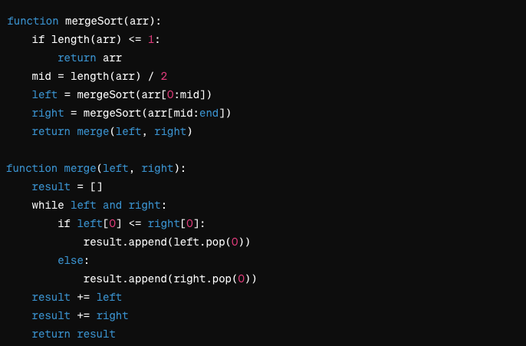
Merge Sort Pseudocode

Slide 25
Merge Sort Complexity
Time complexity?
O(nlogn), why?
Space complexity?
O(n)

Slide 26
Merge Sort Pros and Cons
Good for large datasets
Slower than in-place algorithms for small datasets

Slide 27
Merge Sort Applications
Sorting Linked Lists
External Sorting
Parallel Algorithms
Notes:
Sorting Linked Lists: Efficient due to no need for random access.
External Sorting: Useful when data is too large to fit into memory.
Parallel Algorithms: Easy to implement in parallel processing environments.

Slide 28
Merge Sort Exercise
Implement the Merge Sort algorithm in your preferred programming language to sort:
[4, 1, 3, 9, 7]
Challenge: Modify the problem to sort in decreasing order.

Slide 29
Quick Sort
Introduction
Steps
Visual Example
Pseudocode
Analysis
Pros and Cons
Applications
Exercise

Slide 30
Quick Sort Introduction
Another D&C algorithm!
The origin goes back to Hoare in 1959
IDEA: Partition the array to sort it in place

Slide 31
Quick Sort Steps
Choose a pivot
Rearrange elements such that ALL elements
Before the pivot are smaller than the pivot
After the pivot are greater than the pivot
Apply the same process to the sub-arrays
Base Case: sub-array of one or zero elements is already sorted

Slide 32

Quick Sort Short Video
Notes:
https://www.youtube.com/watch?v=Hoixgm4-P4M

Slide 33
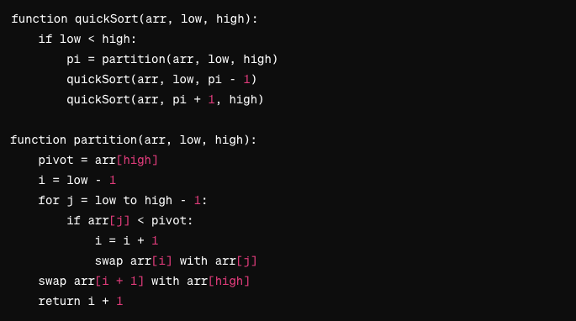
Quick Sort Pseudocode

Slide 34
Quick Sort Complexity
If we choose the smallest or largest element as the pivot, we might have O(n²)
Otherwise, the complexity is O(nlogn)
Space complexity: O(log(n))
It’s an in-place sort (Does not require additional storage to input size)

Slide 35
Quick Sort Pros and Cons
Efficient for large datasets
In-place sorting
Average case performance: O(nlogn)
Worst-case performance is O(n²)

Slide 36
Quick Sort Applications
Widely used in standard libraries including C++, Python
Real-time systems
Computer graphics

Slide 37
Quick Sort Exercise
Implement the Quick Sort algorithm in your preferred programming language to sort:
[34, 7, 23, 26, 87, 5, 62]
Challenge: Modify the problem to sort in decreasing order.

Slide 38
Practice Time
Leetcode is one of the famous websites for tech companies
https://leetcode.com/problem-list/sorting/ Shows the problems related to sorting.
Let’s investigate some of them, together.

