Slide 1
Advanced Algorithms Session 4
Gorkem Kar
Notes:
4272135

Slide 2
Contents
Review
Arithmetic with Large Integers
When Not to Use Divide and Conquer
Examples and Exercises
Fibonacci Numbers

Slide 3

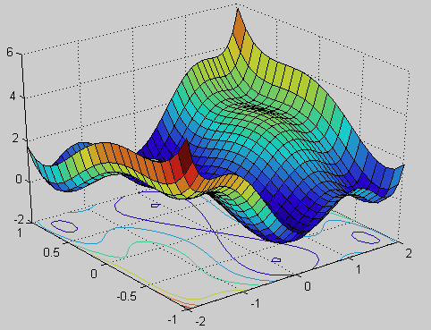
Large Integer Arithmetic
Cryptography
Scientific Computing

Slide 4
Cryptography
We may use big numbers to hide a certain message
Each character can be multiplied with that number and transmitted
In the receiver side, we try to calculate the original message

Slide 5
Cryptography Example
[A, B, C, D, E, F]: Represents the first six letters denoted by indexes of 1 to 6
Let’s assume the multiplication factor is 7
If the received message is: 4272135, can you decode the original message?
How about now? 10000010011000000000111

Slide 6
Cryptography Example
Now, imagine this multiplication factor is really big. Is it that easy to retrieve the original message? 11922198759619935
Probably, not.
This is an excellent example of working with big numbers.

Slide 7
Multiplication Algorithms
Schoolbook Multiplication
Complexity: O(n²)
Karatsuba Multiplication
Complexity: O(n^{1.585})
FFT Multiplication
Complexity: O(nlogn)
Notes:
Karatsuba Algorithm: https://www.youtube.com/watch?v=yWI2K4jOjFQ
FFT Algorithm: https://www.youtube.com/watch?v=YDhsLhTK3Bs

Slide 8
D&C Review
When do you think D&C helps us?
Can we think a scenario that D&C is actually hurting the complexity?

Slide 9
When Not to Use D&C?
Overhead of Recursion
Repeated function calls, leading to higher execution time and increased use of the call stack
Non-optimal for Small Datasets
Memory Consumption (e.g., Merge Sort)
Additional memory space for merging steps

Slide 10
Alternatives
In-place sorting algorithms
Bubble Sort
Selection Sort
Insertion Sort

Slide 11
Bubble Sort
Introduction & Steps
Visual Example
Pseudocode
Analysis
Exercise

Slide 12
Bubble Sort Introduction Steps
One of the simplest sorting algorithms ever
Compare consecutive items
At the end of 1st pass, the biggest element will be put to the last position.
At the end of the next pass, the next biggest element will be put to the correct place
Lots of repetition is needed

Slide 13

Bubble Sort Short Video

Slide 14
Bubble Sort Exercise
Implement the Bubble Sort algorithm in your preferred programming language to sort:
[34, 7, 23, 26, 87, 5, 62]
Challenge: Modify the problem to sort in decreasing order.

Slide 15
Selection Sort Introduction Steps
Another really simple sorting algorithm
Find the current minimum using a pass and place it to the first position
In the 2nd pass, find the second minimum and place it to the correct slot
You need to do that for every single element

Slide 16

Selection Sort

Slide 17
Insertion Sort Introduction Steps
Work left to right
Examine each item and compare it to items on the left
Insert them to the correct place

Slide 18

Insertion Sort

Slide 19
Fibonacci Numbers
One of the most popular sequence
By using some of the previous numbers, we can calculate the next number
0, 1, 1, 2, 3, 5, 8 , 13, 21, 34, 55, 89, …

Slide 20
Fibonacci Numbers Non-recursive (Iteration)
Since we need two variables to hold for the starting values, lest call them fib0 and fib1
Initialize the correct values
Use a loop to calculate the next number

Slide 21
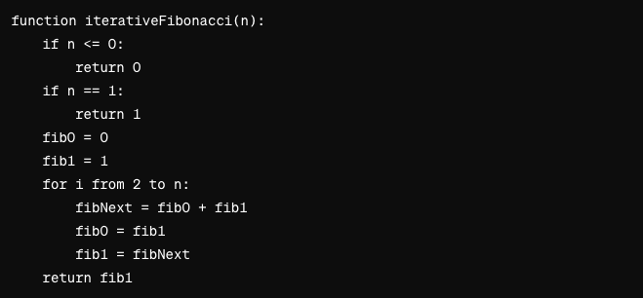
Fibonacci Numbers Iteration Code
Notes:
Time complexity is O(n)

Slide 22
Fibonacci Numbers Iteration Explanation
Base Cases:
If n <= 0, return 0 (assuming the Fibonacci sequence starts with F(0) = 0).
If n == 1, return 1 (assuming F(1) = 1).
Initialize:
fib0 to 0 (this will hold F(i-2)).
fib1 to 1 (this will hold F(i-1)).
Iterate:
Use a for loop from 2 to n.
Calculate the next Fibonacci number fibNext as the sum of fib0 and fib1.
Update fib0 to the current fib1 (move one step forward in the sequence).
Update fib1 to fibNext (move one step forward in the sequence).
Return:
After the loop completes, fib1 will contain the nth Fibonacci number. Return fib1.

Slide 23
Fibonacci Numbers Recursive
We will start similarly, but need lots of return statements
If n==0, return the first value,
If n==1, return the second value,
If n>1, we need to call and return the recursive function

Slide 24
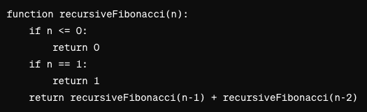
Fibonacci Numbers Recursive Code
Notes:
The complexity is O(2^n)

Slide 25
New Leetcode Exercises
https://leetcode.com/problem-list/recursion/
https://leetcode.com/problemset/
Notes:
The complexity is O(2^n)

