Slide 1
Advanced Algorithms Session 5
Gorkem Kar

Slide 2

Contents
Review
Intro to Dynamic Programming
The Binomial Coefficient
Dijkstra’s Algorithm
Examples and Exercises

Slide 3
Dynamic Programming
Method
Complex problems
Breaking down into simpler subproblems
Top-down (Memoization)
Bottom-up (Tabulation)
Notes:
Dynamic Programming (DP) is a method for solving complex problems by breaking them down into simpler subproblems.
It is applicable when the problem can be divided into overlapping subproblems which are solved just once and their solutions stored for future use.

Slide 4
Vs Divide & Conquer
D&C
Non-overlapping subproblems
Each subproblem is solved independently, then solutions are combined
Example: Merge Sort, Quick Sort
DP
Overlapping subproblems
Stores the solutions of subproblems to avoid redundant work
Fibonacci Sequence, Shortest Path Algorithms

Slide 5
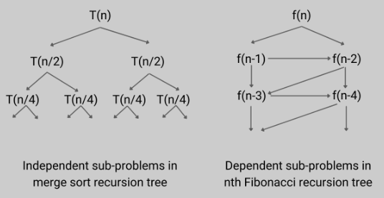
Comparison

Slide 6

Key Concepts
Subproblems reused multiple times
Don’t solve the same subproblem repeatedly,
Solve it once and store the result
Notes:
Many subproblems reused multiple times
Instead of solving the same subproblem repeatedly, solve it once and store the result

Slide 7
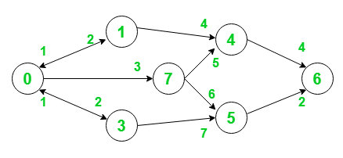
Key Concepts 2
Optimal substructure
Focus on subproblems
Example: Shortest path in a graph

Slide 8
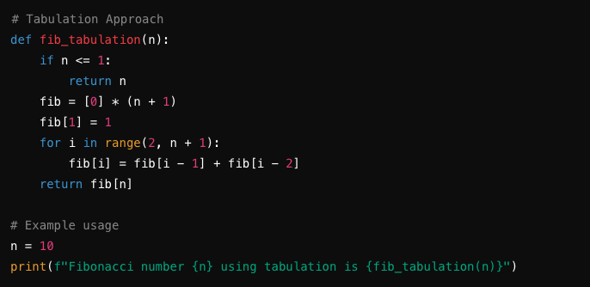
Tabulation (Bottom-Up)
Iteratively solves subproblems, and store their solutions in a table
All subproblem solutions are available when needed

Slide 9
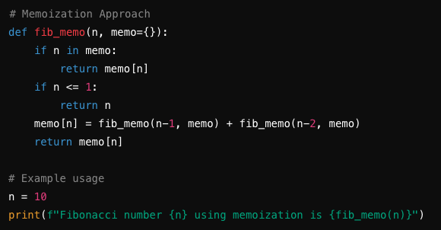
Memoization (Top-Down)
Recursively solves subproblems, and store their solutions in a table
Check if the solution to a problem is already computed and returns the stored result

Slide 10
Pros & Cons
Tabulation
Advantages
Efficient in terms of memory usage, avoids the overhead of recursive calls
Generally faster due to iterative computation
Disadvantages
Require the initialization of the table (array) to store the immediate results
Memoization
Advantages
Easier to implement for problems where recursion comes naturally
Often require less code, making it easier to understand
Disadvantages
Requires additional memory for the recursive call stack

Slide 11
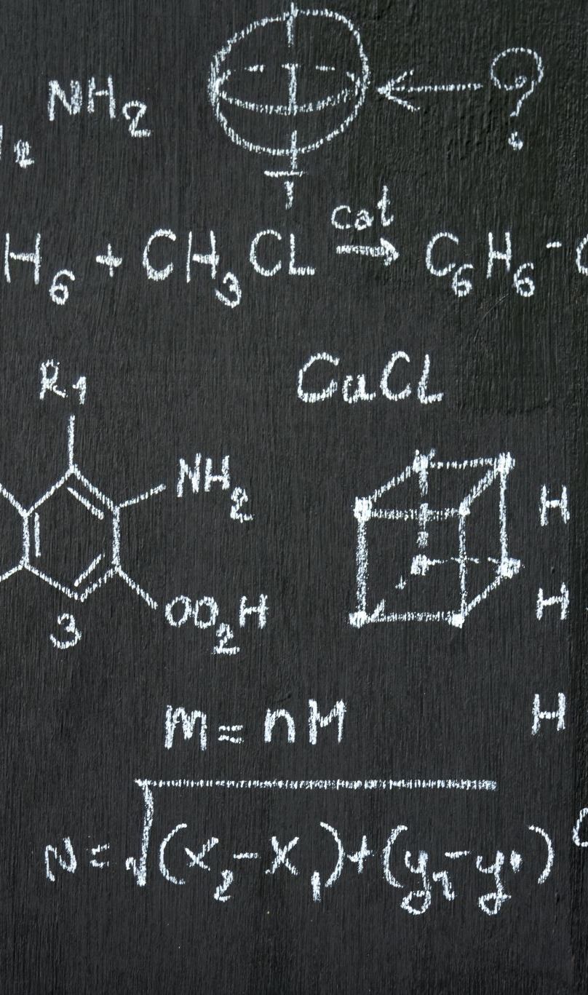
Modified Fibonacci
F(n) = 0 if n=0
1 if n=1
F(n-1) + 2F(n-2) if n>1
The task is compute F(n) efficiently

Slide 12
Recursive Approach
Formula is directly applied
Exponential time complexity
O(2^{n}) due to repeated calculations

Slide 13
Dynamic Programming Approach
Use either memorization or tabulation
Linear time complexity O(n) by storing intermediate results

Slide 14

Combinatorial Problems
Involve finding an optimal object from a finite set of objects
Selecting a subset or arrangement of items to optimize a given criterion
DP can solve them more efficiently by breaking them down into subproblems and storing intermediate results
Let’s start with the Binomial Coefficient

Slide 15
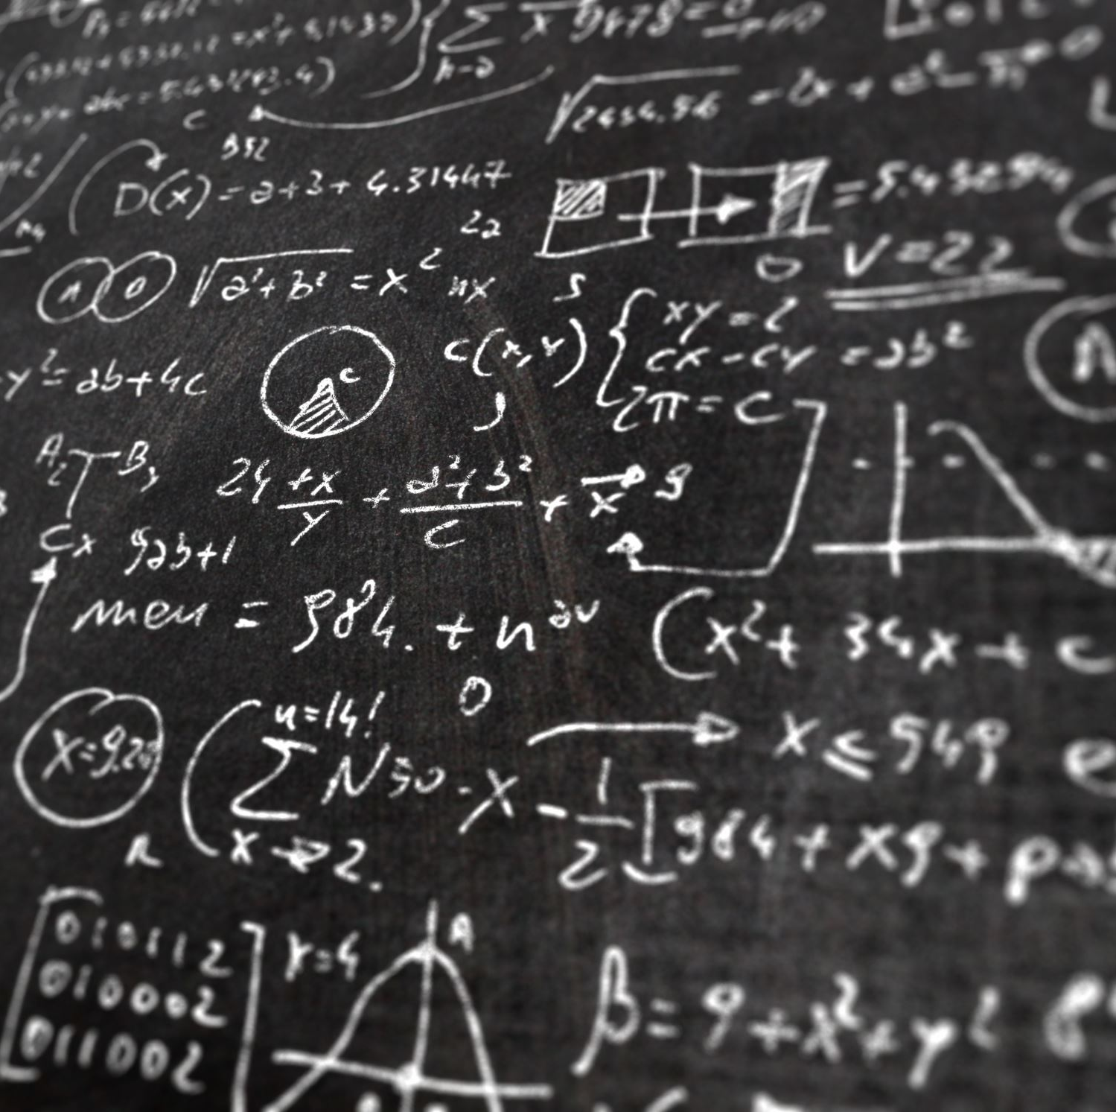

The Binomial Coefficient
C(n, k): # of ways to choose k elements from a set of n elements
$C\left(n, k\right)=\frac{n!}{k!\left(n−k\right)!}$
Ex: C(5, 2) = ?
$C\left(5, 2\right)=\frac{5!}{2!\left(5−2\right)!}=\frac{5x4x3x2x1}{2x1x3x2x1}=10$
Notes:
Order does not matter

Slide 16


Recursive Approach
$C\left(n, k\right)=1 if k=0 or k=n$
$C\left(n,k\right)=C\left(n−1,k−1\right)+C\left(n−1,k\right) otherwise$
Base Cases: If k = 0, k = n, there is exactly one way to choose k elements
Recursive Case: The recursion breaks the problem into smaller subproblems

Slide 17
Problems with Recursive Approach
What is time complexity?
O(2^{n})
The same computations are repeated, making it inefficient for larger values of n and k

Slide 18
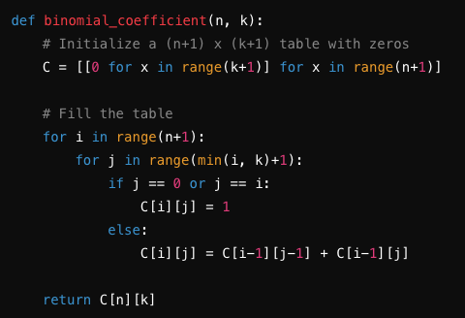

Dynamic Programming Solution
Let’s use a table to store intermediate results: C(i, j)
Initialize:
$C(i,0)=1 for all i$
$C\left(i,i\right)=1 for all i$
Fill the table using
$C\left(i,j\right)=C\left(i−1,j−1\right)+C(i−1,j)$

Slide 19
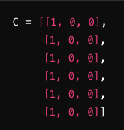
Binomial Coefficient Example
Let’s calculate C(5,2):
Initialize a table with size: 6x3 (n=5, k=2)
Fill the table using the recursive relation

Slide 20

Binomial Coefficient Example
For i=1:
C[1][0] = 1, C[1][1] = 1
For i=2:
C[2][0] = 1, C[2][1] = 2, C[2][2] = 1
For i=3:
C[3][0] = 1, C[3][1] = 3, C[3][2] = 3
For i=4:
C[4][0] = 1, C[4][1] = 4, C[4][2] = 6
For i=5:
C[5][0] = 1, C[5][1] = 5, C[5][2] = 10
C(5,2) = 10

Slide 21
DP Complexity Analysis
We fill an n+1 by k+1 table:
Time complexity: O(n . k)
Space complexity: O(n . k)

Slide 22
Graph Optimization Problems
Both DP and Dijkstra’s algorithm are used to solve optimization problems
DP is used for problems with a clear recursive structure and overlapping subproblems
Dijkstra is designed for finding the shortest path.

Slide 23
Dijkstra’s Algorithm
Introduced by E. W. Dijkstra in 1956
Designed for finding the shortest path in a road network
Application scenarios:
Network routing
Geographical Navigation
Robotics
Game Development

Slide 24
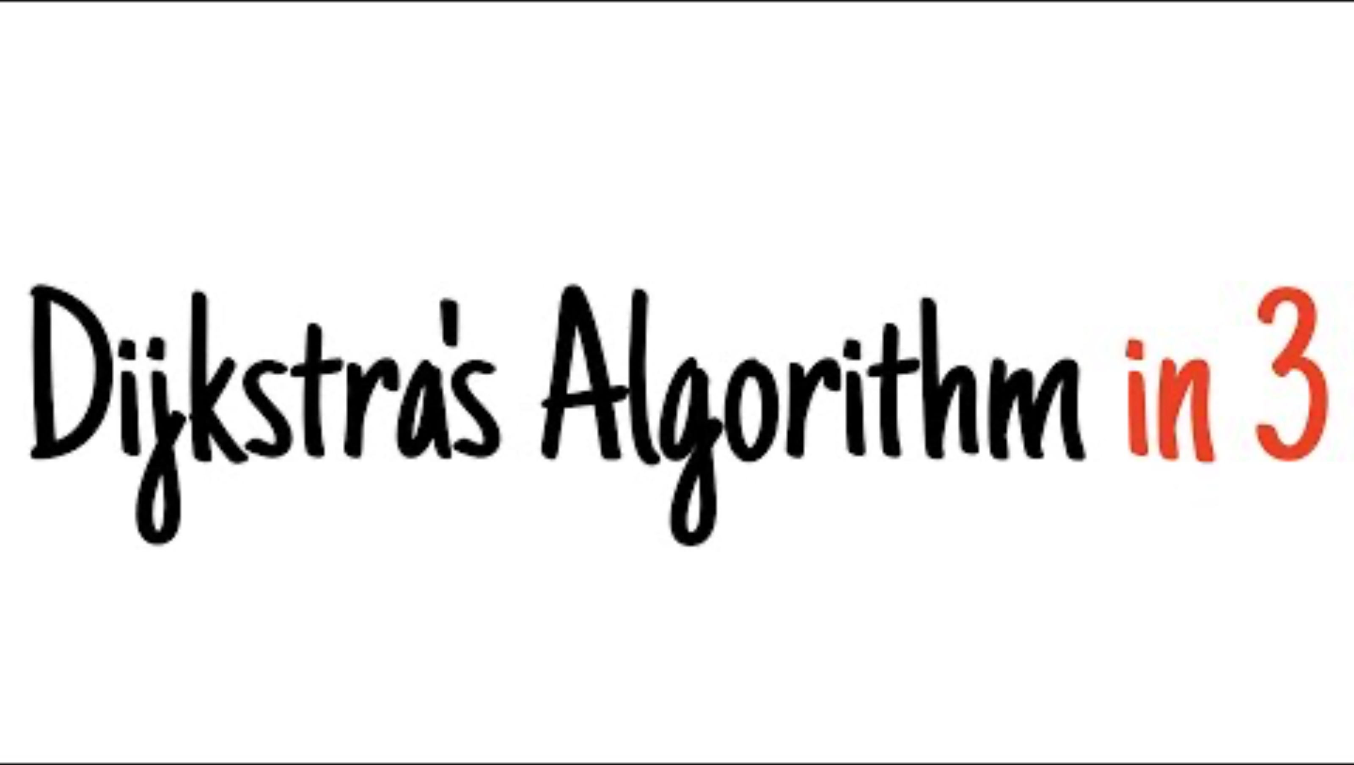
Dijkstra’s Algorithm

Slide 25
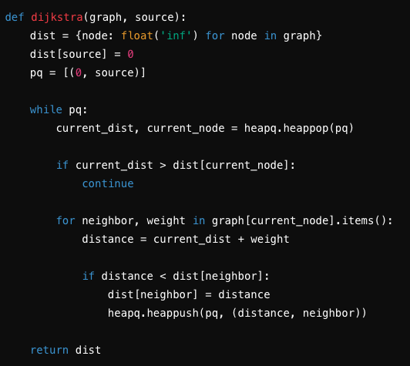
Dijkstra’s Algorithm Pseudocode

Slide 26
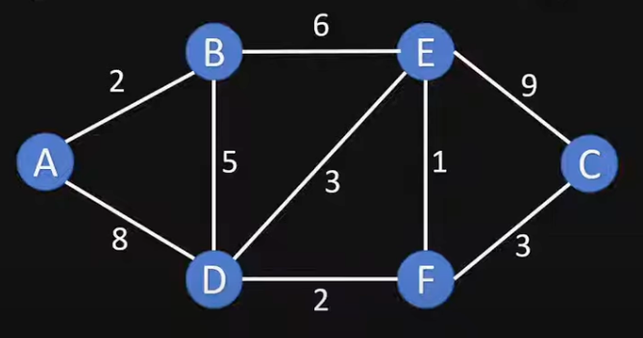
Dijkstra’s Algorithm Exercise
Notes:
Start with unvisited nodes: [A, B, C, D, E, F]
Visited nodes: []
Have a table of Nodes, shortest distance and previous node

Slide 27
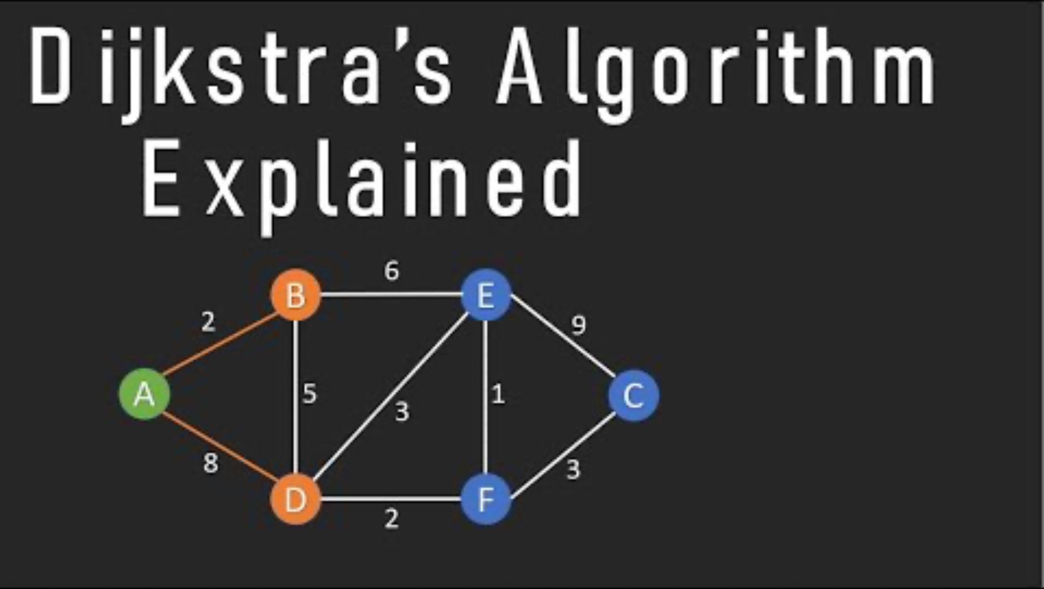
Dijkstra’s Algorithm Solution
Notes:
Start with unvisited nodes: [A, B, C, D, E, F]
Visited nodes: []
Have a table of Nodes, shortest distance and previous node

