Slide 1
Advanced Algorithms Session 6
Gorkem Kar

Slide 2

Contents
Review
Bellman-Ford Algorithm for Shortest Paths
Floyd’s Algorithm for Shortest Paths
Dynamic Programming in Optimization Problems
Examples and Exercises

Slide 3
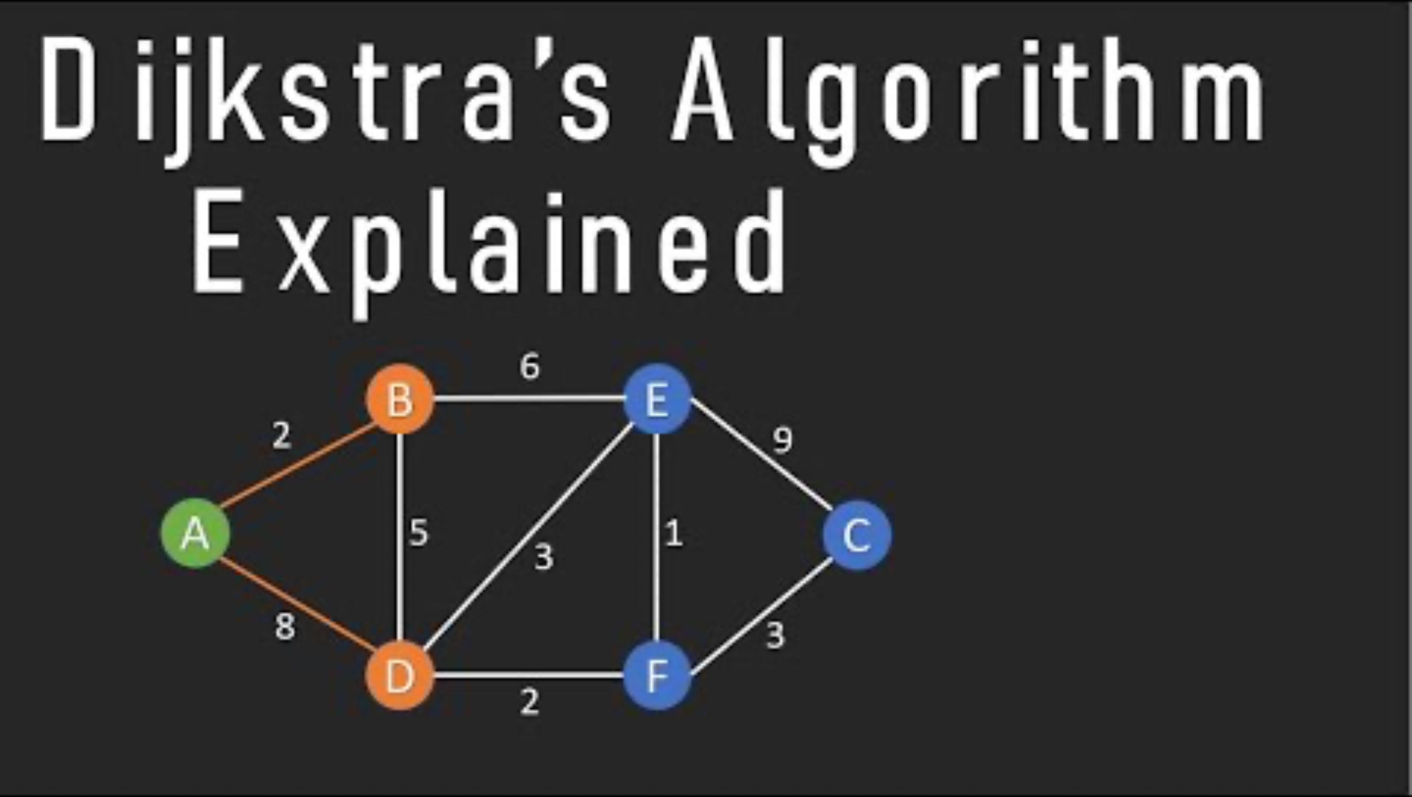
Dijkstra’s Algorithm Solution
Notes:
Start with unvisited nodes: [A, B, C, D, E, F]
Visited nodes: []
Have a table of Nodes, shortest distance and previous node

Slide 4

Dijkstra’s Algorithm
Time complexity:
O(V²)
Space complexity:
O(V)
It assumes each cost is non-negative
When it found a shortest path, it cannot be improved
Notes:
V is the number of vertices
Priority queue with a binary heap can reduce the time complexity to O( (V+E)logV )

Slide 5

Bellman-Ford Algorithm
Introduced by Richard Bellman and Lester Ford in 1958.
Handles graphs with negative weight edges.

Slide 6

Bellman-Ford Algorithm Steps
Initialization
Set the distance to the source node to 0 and all other nodes to infinity.
Relaxation
Repeat for (V-1) times: For each edge (u, v), update the distance if dist[u] + weight(u, v) < dist[v]
Negative Cycle Detection
Run the relaxation process one more time to check for changes; if any distance is updated, a negative cycle exists.

Slide 7

Bellman-Ford Example

Slide 8

Bellman-Ford Algorithm
Time complexity
O(V * E)
Space complexity
O(V)
If weights are all positive
Less efficient than Dijkstra

Slide 9

Comparison of Algorithms
Dijkstra:
Shortest path from one node to all nodes
Bellman-Ford:
Shortest path from one node to all nodes, negative edges are allowed
Floyd-Warshall:
Shortest path between all pair of vertices, negative edges are allowed

Slide 10

Floyd-Warshall Algorithm
Notes:
https://www.youtube.com/watch?v=4OQeCuLYj-4

Slide 11
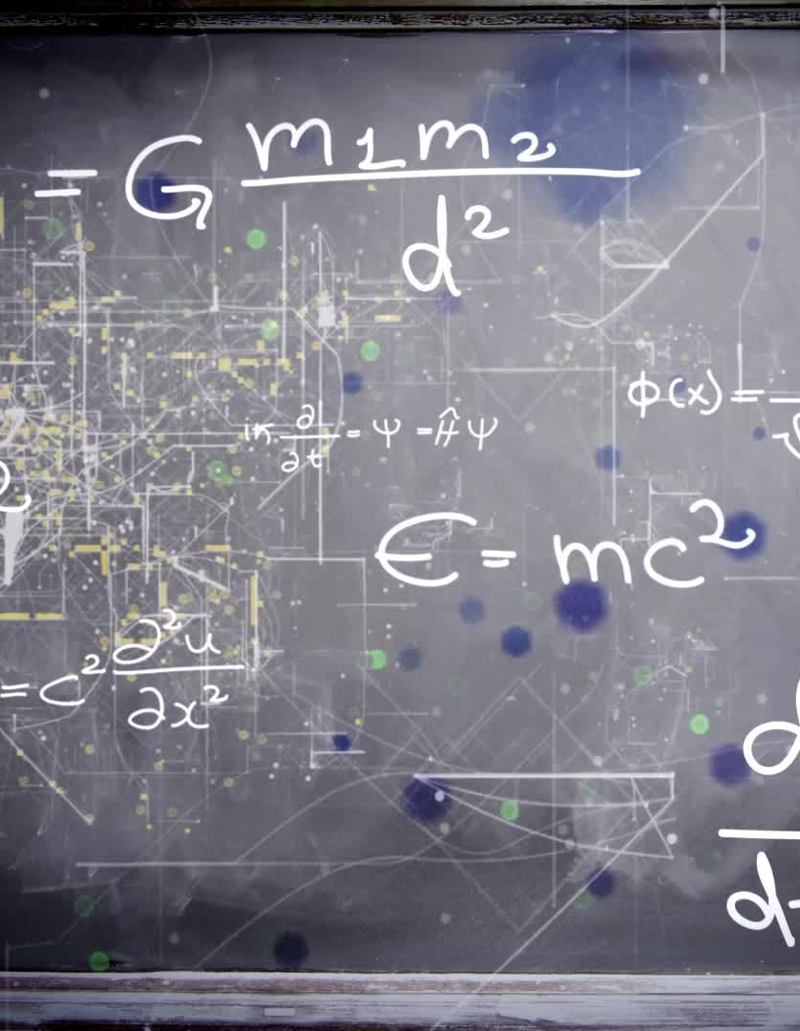
Floyd-Warshall Algorithm
Time complexity:
O(V³)
Space complexity:
O(V²)

Slide 12
Dynamic Programming in Optimization
Knapsack problem
Traveling salesman problem
Magical cow problem

Slide 13

Knapsack Problem
Notes:
https://www.youtube.com/watch?v=33k8EPNriTM

Slide 14
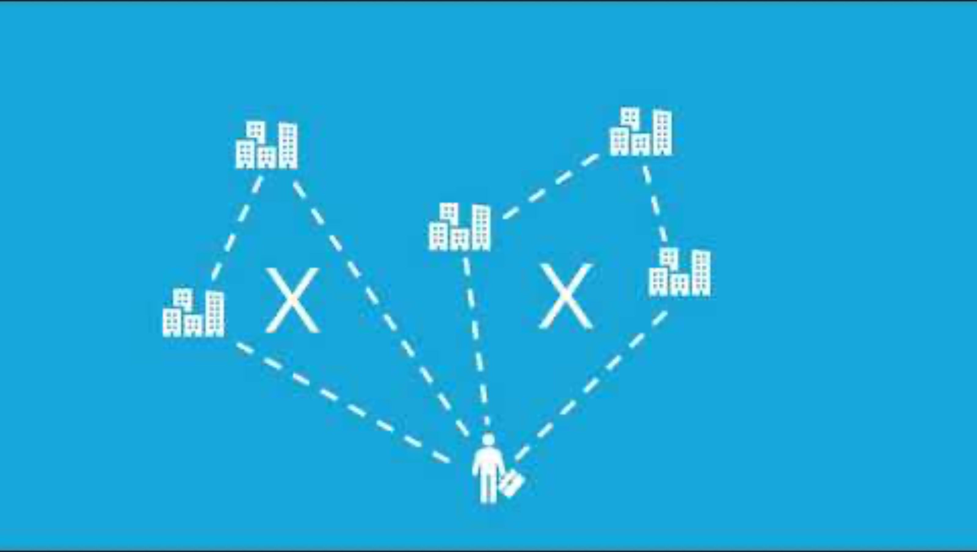
Traveling Salesman Problem

Slide 15

Magical Cow Problem
Notes:
https://www.youtube.com/watch?v=_tur2nPkIKo

