Slide 1
Advanced Algorithms Week 10
Gorkem Kar
Notes:
Backtracking II

Slide 2
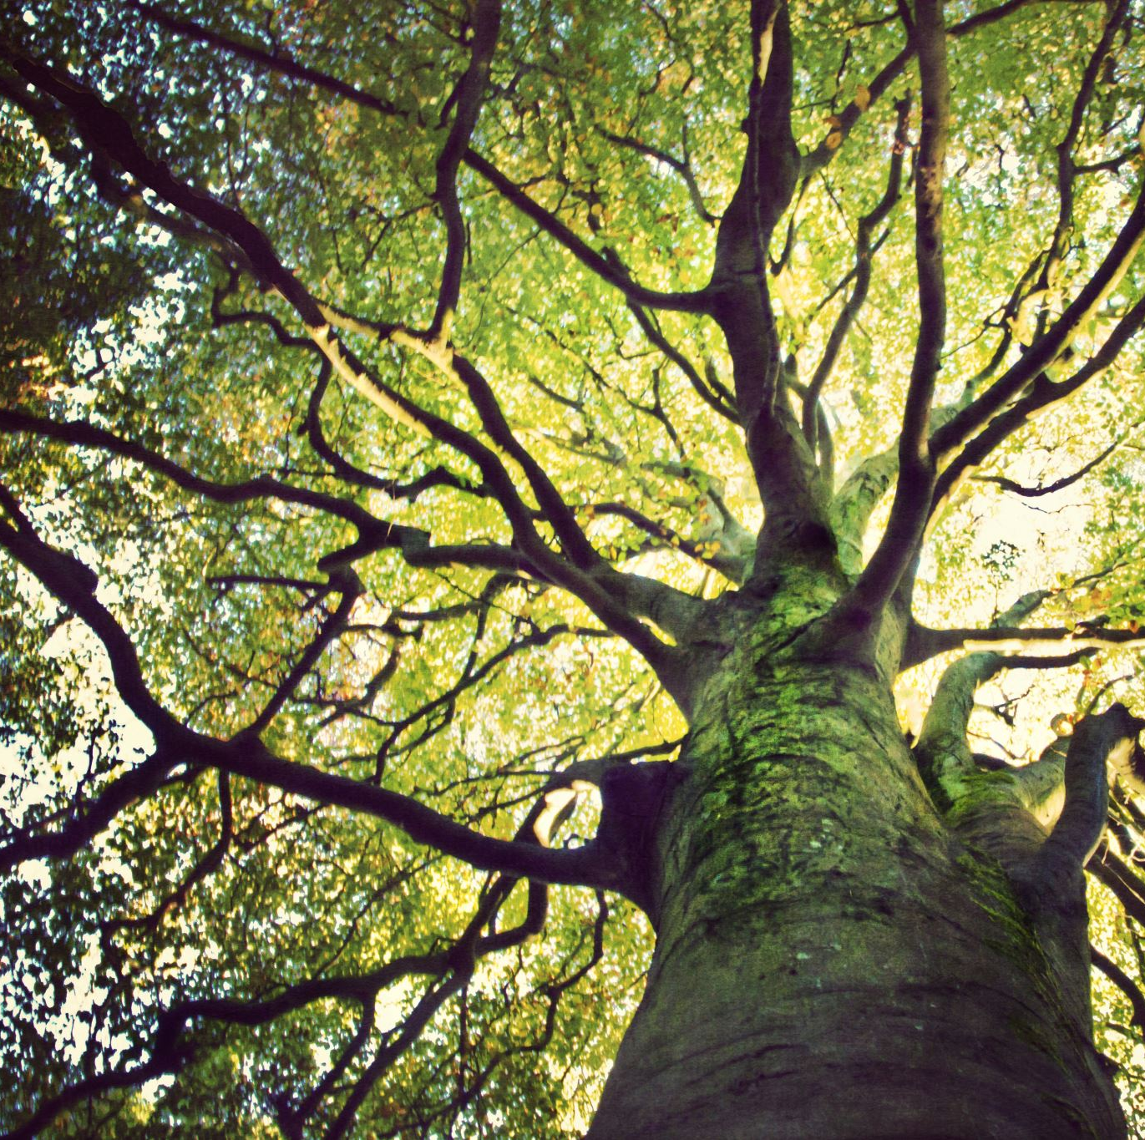
Contents
Review
Graph Coloring
The Hamiltonian Circuits
The 0-1 Knapsack Problem

Slide 3
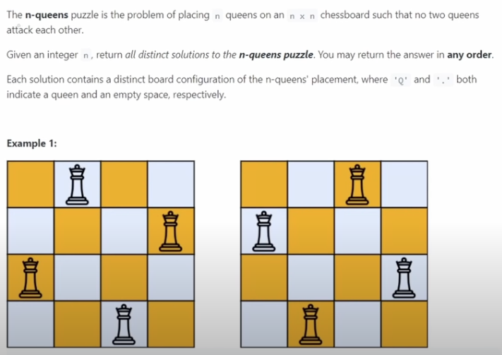
N-Queens Problem
You might remember the leetcode site
Interview question
Notes:
Excellent video for discussion of N Queens problem: https://www.youtube.com/watch?v=wGbuCyNpxIg

Slide 4

The Solution
Remember
There has to be one Queen in every row
There has to be one Queen in every column
Positive diagonals
Negative Diagonals

Slide 5

Graph Coloring Problem
Assignment of colors to the vertices of a graph such that no two adjacent vertices share the same color
Given a graph, what is the minimum number of colors needed to color the graph.

Slide 6
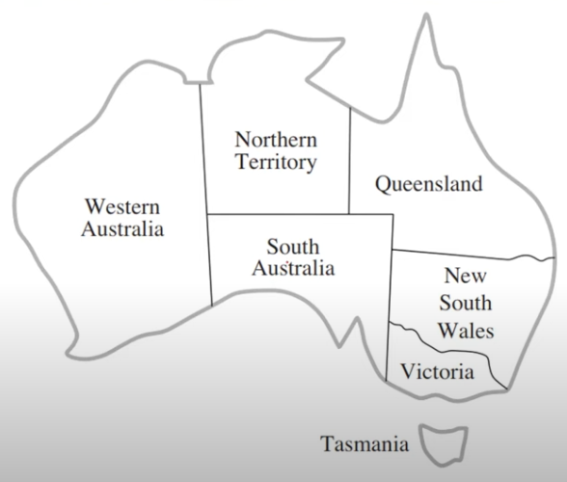
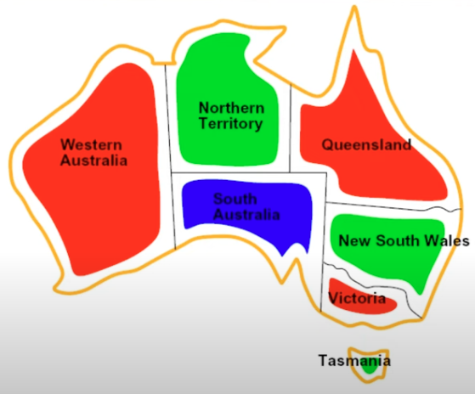
Example

Slide 7

Application Scenarios
Map Coloring
Scheduling Problems
Assigning time slots to tasks without conflicts
Register Allocation
Assigning variables to a limited number of CPU registers

Slide 8
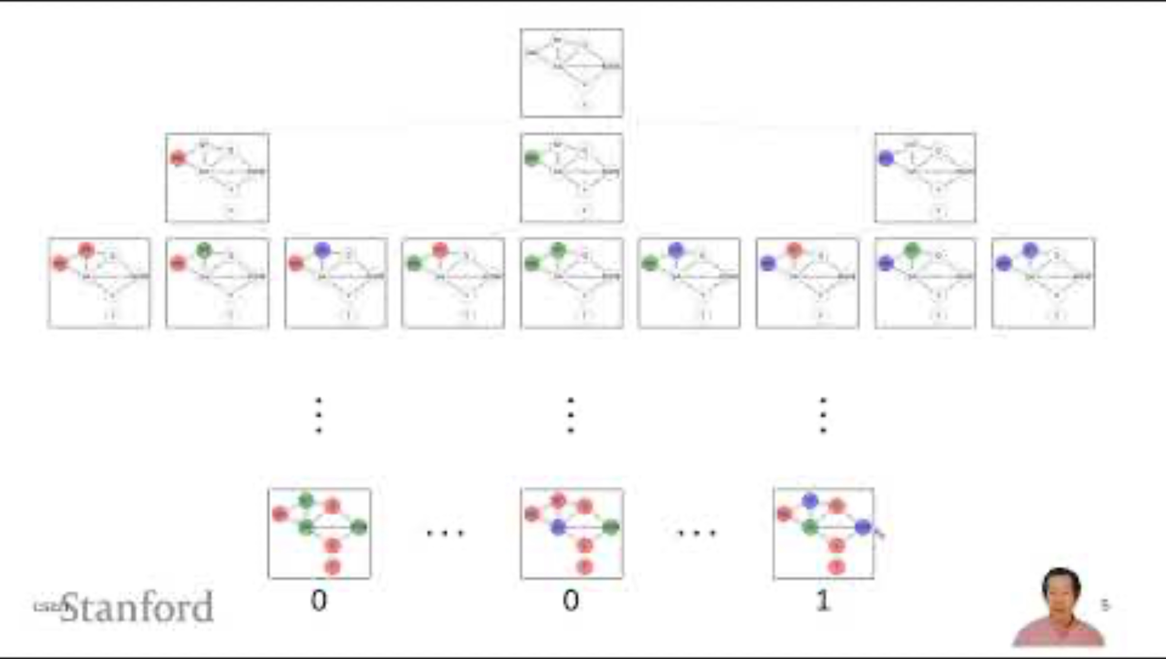
Video
Notes:
Start with 2:24 to 7:02

Slide 9
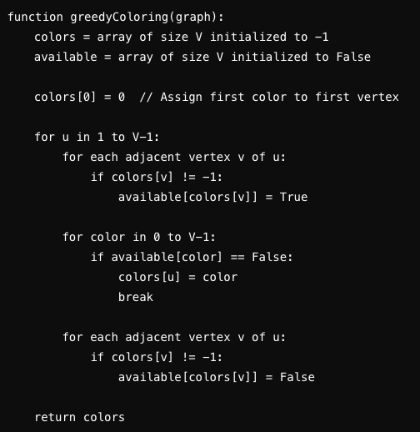
Greedy Coloring Algorithm
Notes:
What is wrong with this code?
Each coloring is committed!

Slide 10
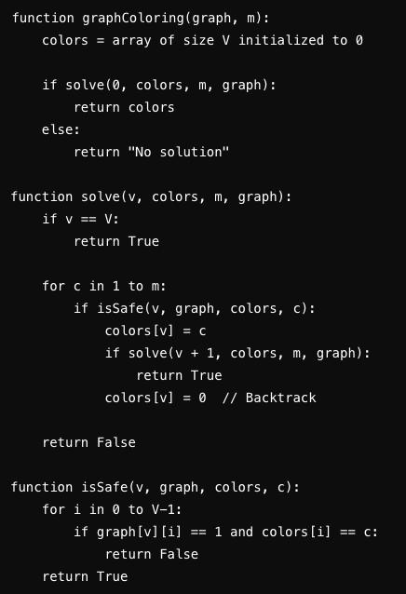
Backtracking Approach
Notes:
Helpful video: https://www.youtube.com/watch?v=miCYGGrTwFU

Slide 11

Hamiltonian Circuits
A Hamiltonian circuit (cycle)
Visit every vertex exactly once and returns to the starting vertex
A Hamiltonian path
Visit every vertex exactly once but does not necessarily return to the starting vertex

Slide 12
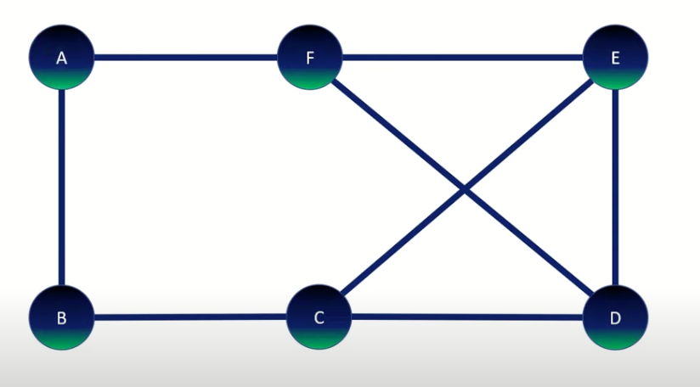
Example
Notes:
A-B-C-E-D-F-A
https://www.youtube.com/watch?v=pTUVll8lcEQ

Slide 13
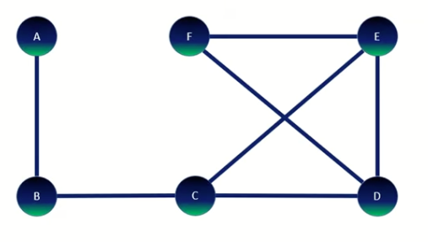
Exercise
Notes:
Hamiltonian path,
Not a Hamiltonian cycle

Slide 14

Application Scenarios
Routing
Optimal paths in routing problems
Scheduling
Task need to be completed in a specific order
DNA Sequencing
Ordering of sequences in computational biology

Slide 15

Useful Video

Slide 16

0-1 Knapsack Problem
So far we know that
The constraint:
The weight
Goal:
Maximize the total value of the items
How to solve it algorithmically?

Slide 17

Example
The total capacity: 20 kg
Items
20$, 6 kg
30$, 13 kg
15$, 5 kg
25$, 10 kg
10$, 3 kg
Notes:
You can get only one of each item.
What is the value that you calculate?

Slide 18
Solution
For each item,
Either you take it or not
We have 5 items in total
We create a tree with total of 5 levels,
Therefore 2⁵ = 32 values

Slide 19
The Generated Tree
Knap(0)
X₀ = 1
X₀ = 0
Knap(1)
Knap(1)
.
.
.
.
.
.
.
.
19

Slide 20
Final Tree
Subset | Items in it | Total Value | Total Weight | Fits in Knapsack
0 | {0,1,2,3,4}
1 | {0,1,2,3}
2 | {0,1,2,4}
3 | {0,1,2}
4 | {0,1,3,4}
5 | {0,1,3}
6 | {0,1,4}
7 | {0,1}
8 | {0,2,3,4}
9 | {0,2,3}
10 | {0,2,4}
11 | {0,2}
12 | {0,3,4}
13 | {0,3}
14 | {0,4}
15 | {0}
Subset | Items in it | Total Value | Total Weight | Fits in Knapsack
16 | {1,2,3,4}
17 | {1,2,3}
18 | {1,2,4}
19 | {1,2}
20 | {1,3,4}
21 | {1,3}
22 | {1,4}
23 | {1}
24 | {2,3,4}
25 | {2,3}
26 | {2,4}
27 | {2}
28 | {3,4}
29 | {3}
30 | {4}
31 | {}

Slide 21
Final Tree Completed
Subset | Items in it | Total Value | Total Weight | Fits in Knapsack
0 | {0,1,2,3,4} | 100 | 37 | False
1 | {0,1,2,3} | 90 | 34 | False
2 | {0,1,2,4} | 75 | 27 | False
3 | {0,1,2} | 65 | 24 | False
4 | {0,1,3,4} | 85 | 32 | False
5 | {0,1,3} | 75 | 29 | False
6 | {0,1,4} | 60 | 22 | False
7 | {0,1} | 50 | 19 | True
8 | {0,2,3,4} | 70 | 24 | False
9 | {0,2,3} | 60 | 21 | False
10 | {0,2,4} | 45 | 14 | True
11 | {0,2} | 35 | 11 | True
12 | {0,3,4} | 55 | 19 | True
13 | {0,3} | 45 | 16 | True
14 | {0,4} | 30 | 9 | True
15 | {0} | 20 | 6 | True
Subset | Items in it | Total Value | Total Weight | Fits in Knapsack
16 | {1,2,3,4} | 80 | 31 | False
17 | {1,2,3} | 70 | 28 | False
18 | {1,2,4} | 55 | 21 | False
19 | {1,2} | 45 | 18 | True
20 | {1,3,4} | 65 | 26 | False
21 | {1,3} | 55 | 23 | False
22 | {1,4} | 40 | 16 | True
23 | {1} | 30 | 13 | True
24 | {2,3,4} | 50 | 18 | True
25 | {2,3} | 40 | 15 | True
26 | {2,4} | 25 | 8 | True
27 | {2} | 15 | 5 | True
28 | {3,4} | 35 | 13 | True
29 | {3} | 25 | 10 | True
30 | {4} | 10 | 3 | True
31 | {} | 0 | 0 | True

Slide 22

Solution Video
Notes:
https://www.youtube.com/watch?v=Q2vDTam9qMQ
Start from 3:43

