Slide 1
Generics
Chapter 20 of Visual C# How to Program, 6/e

Slide 2
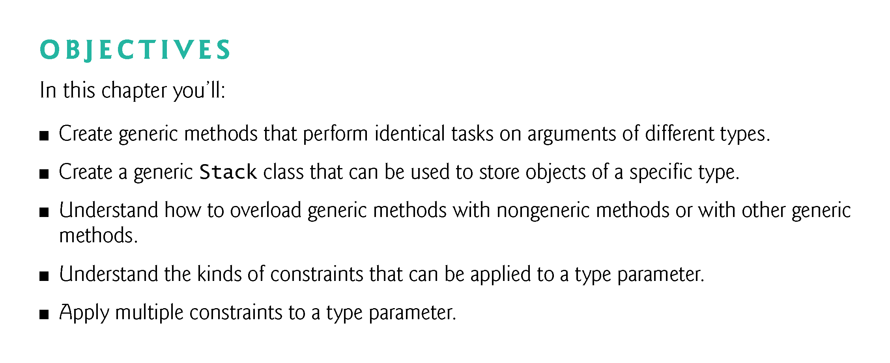
Diff generic method & generic class!!!

Slide 3
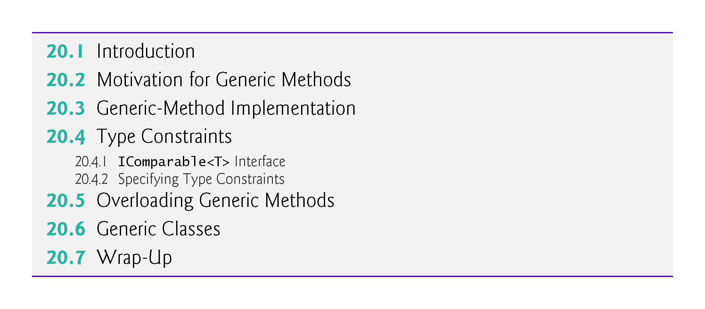

Slide 4
20.2 Motivation for Generic Methods（p）
Overloaded methods are often used to perform similar operations on different types of data.
To understand the motivation for generic methods, let’s begin with an example (Fig. 20.1) that contains three overloaded DisplayArray methods.
These methods display the elements of an int array, a double array and a char array, respectively.
Soon, we’ll reimplement this program more concisely and elegantly using a single generic method
!!!

Slide 5
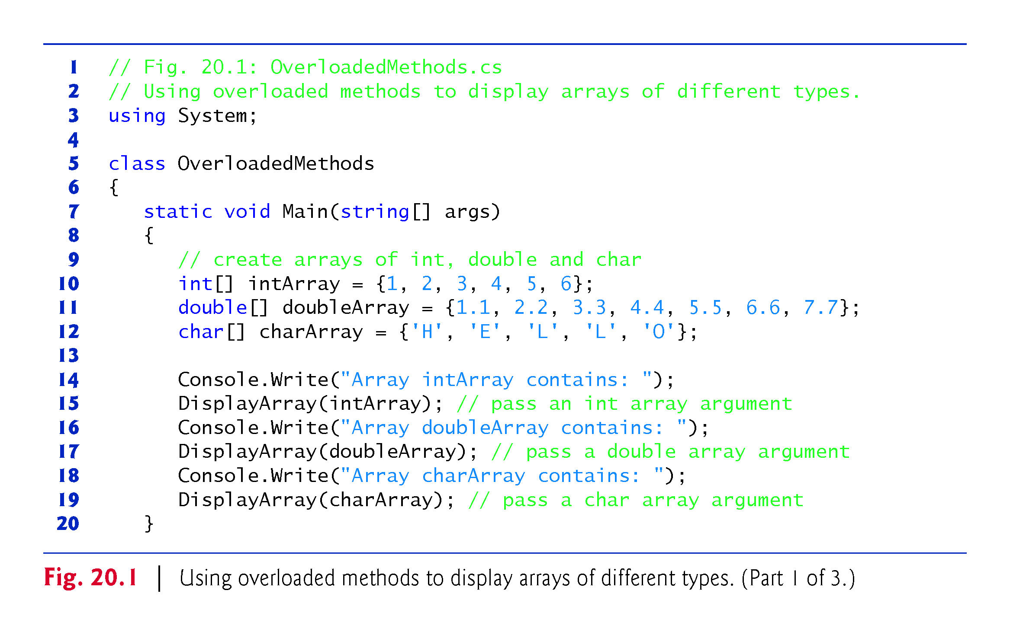

Slide 6
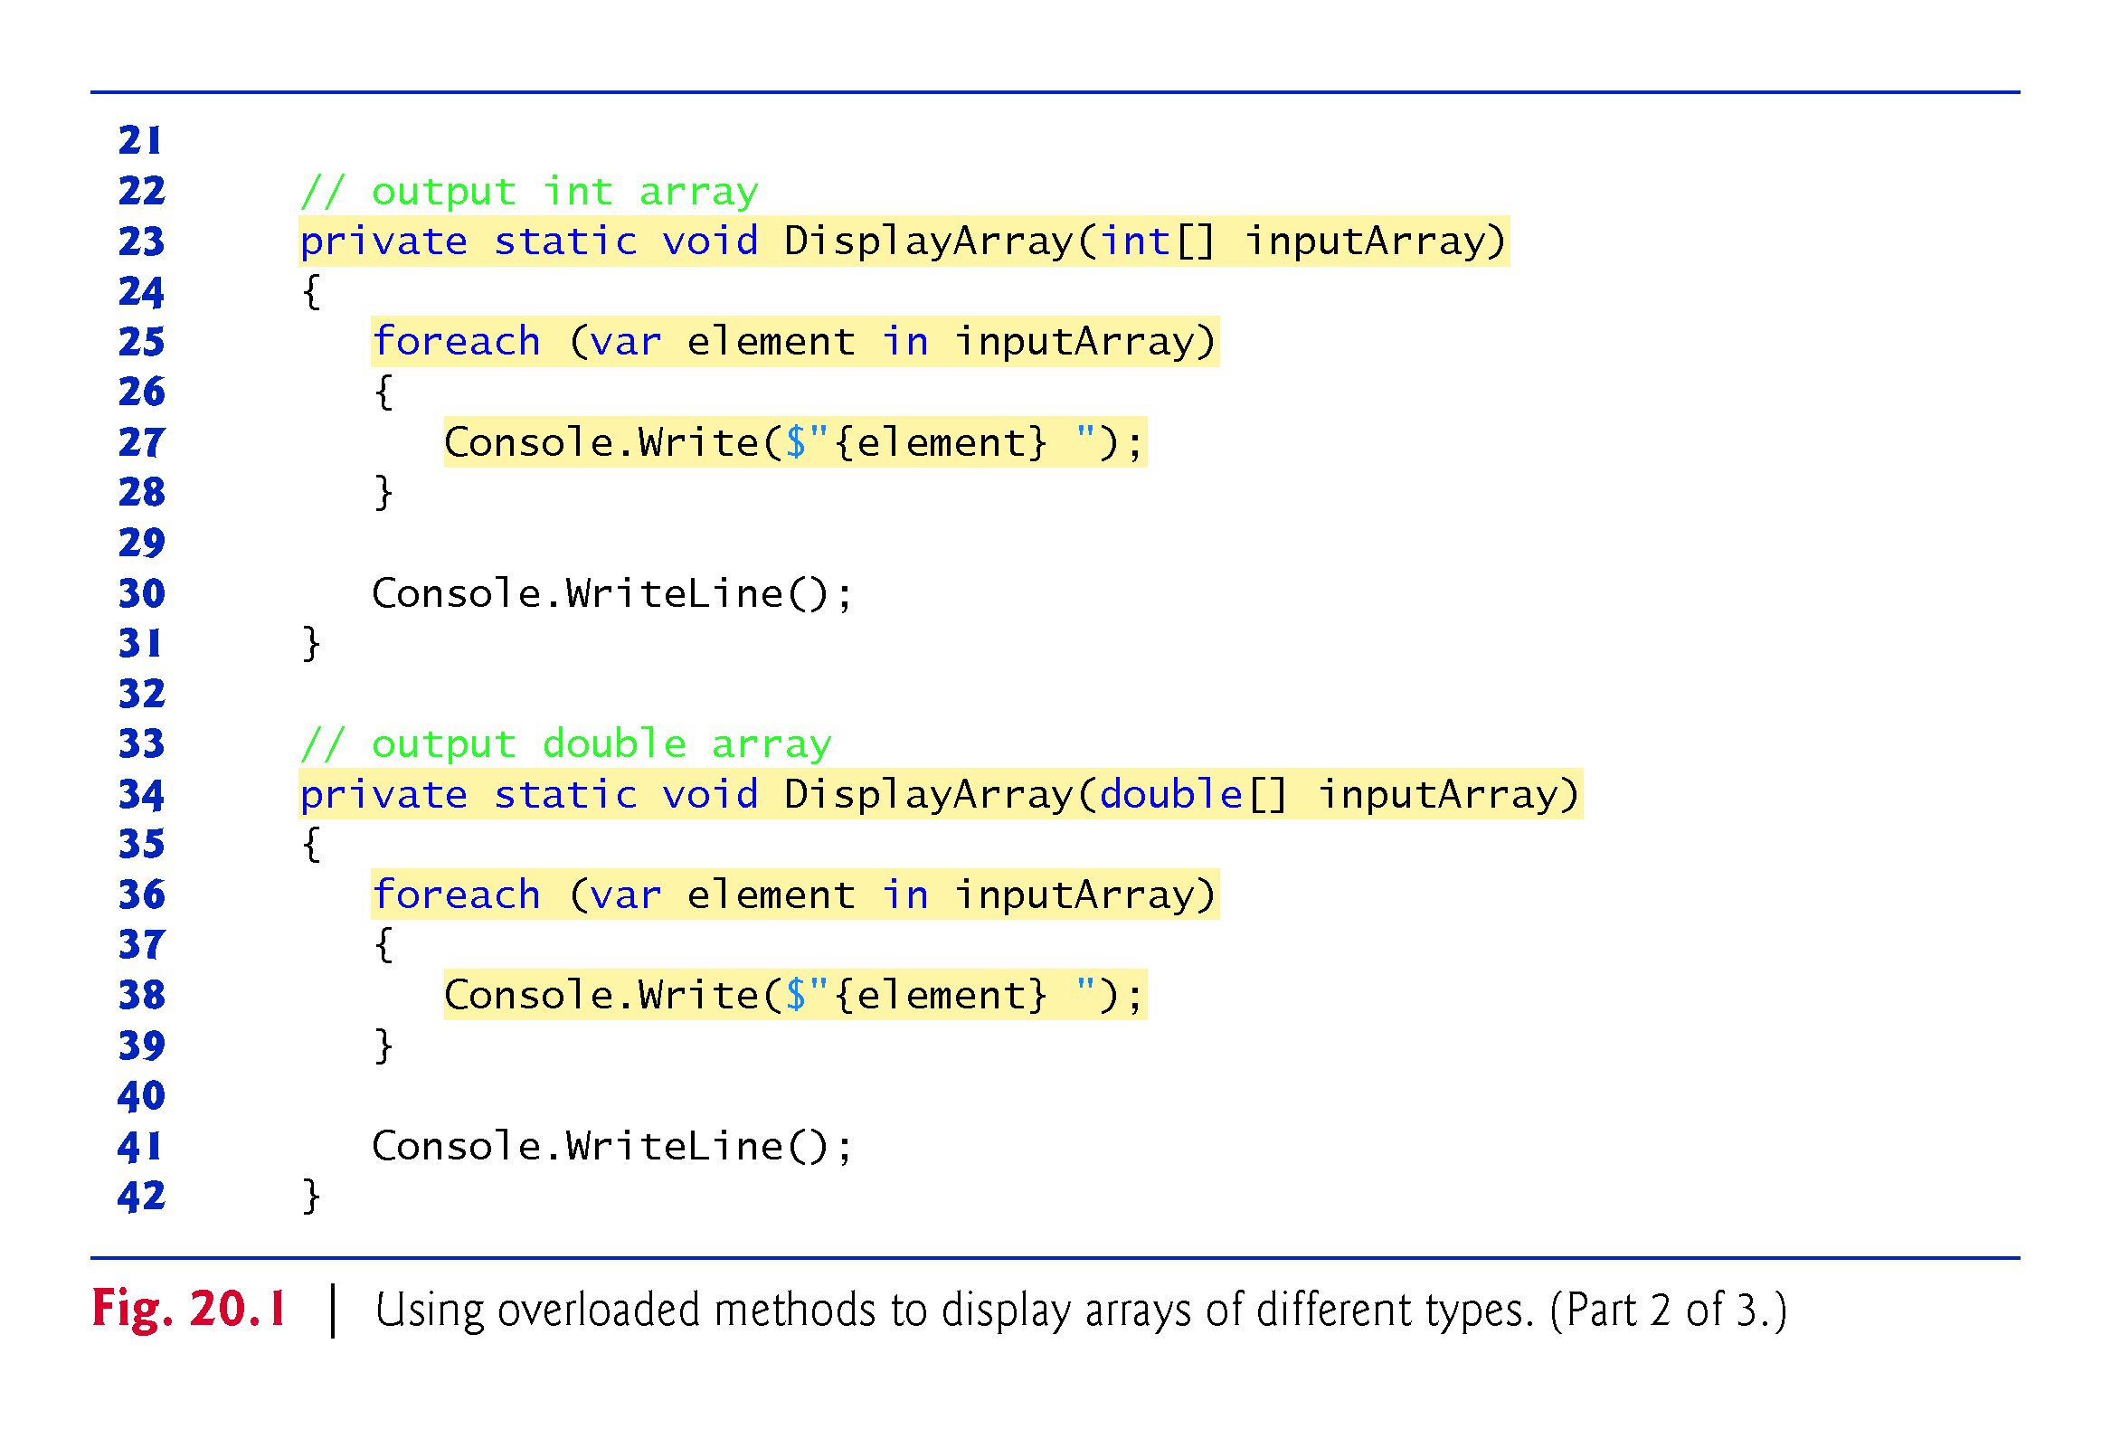
P->generic
!!!
!!!

Slide 7
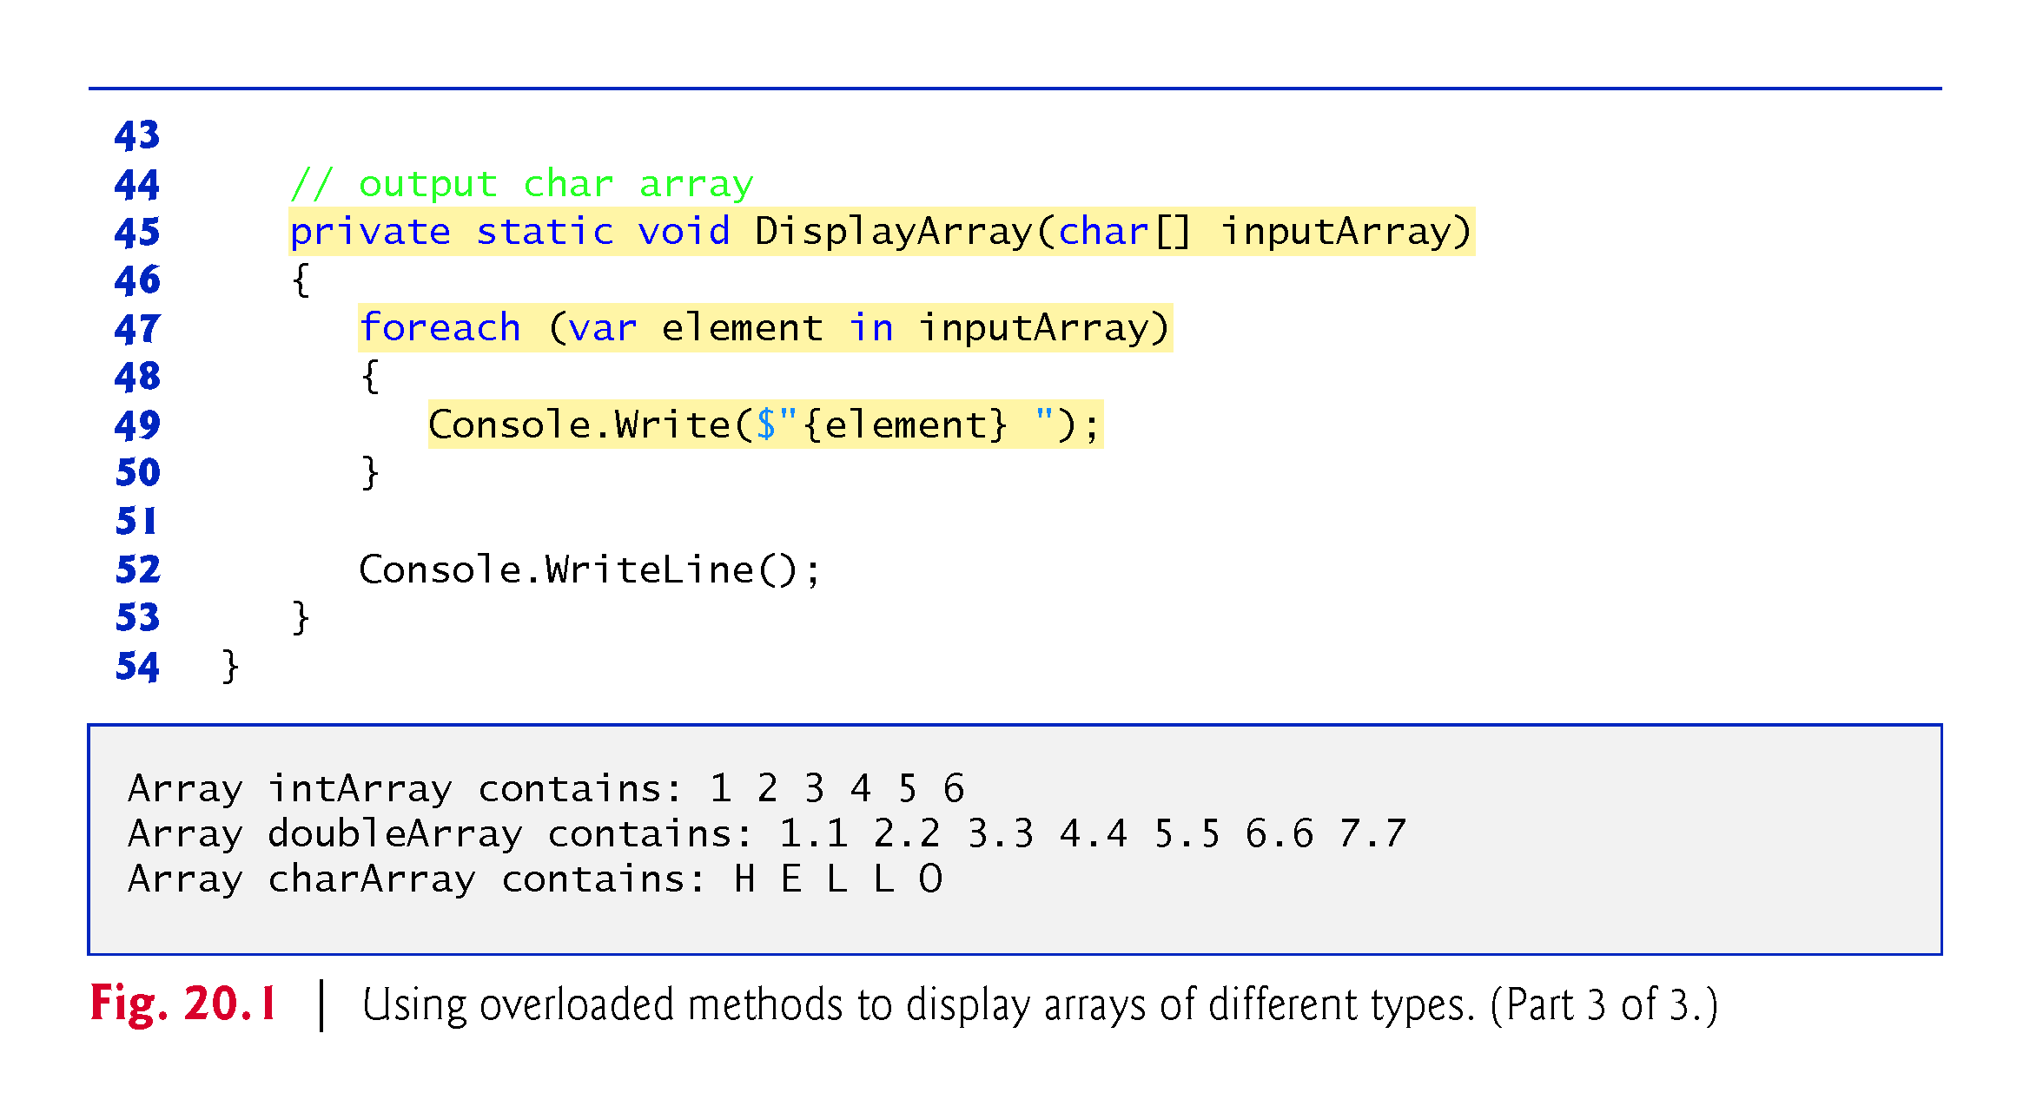

Slide 8
20.3 Generic-Method Implementation
Figure 20.3 reimplements the app of Fig. 20.1 using a generic DisplayArray method
Note that the DisplayArray method calls in lines 15, 17 and 19 are identical to those of Fig. 20.1, the outputs of the two apps are identical and the code in Fig. 20.3 is 22 lines shorter than that in Fig. 20.1.
As illustrated in Fig. 20.3, generics enable us to create and test our code once, then reuse it for many different types of data.
This effectively demonstrates the expressive power of generics.

Slide 9
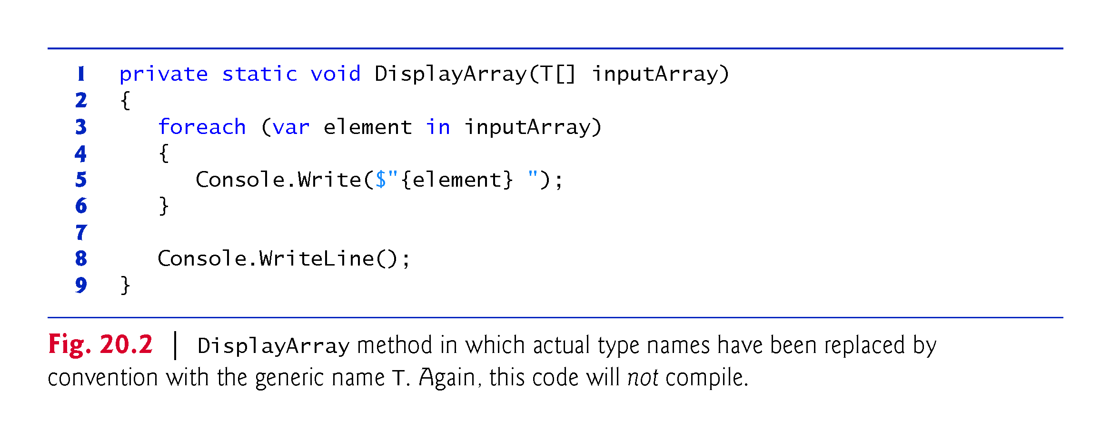
?

Slide 10
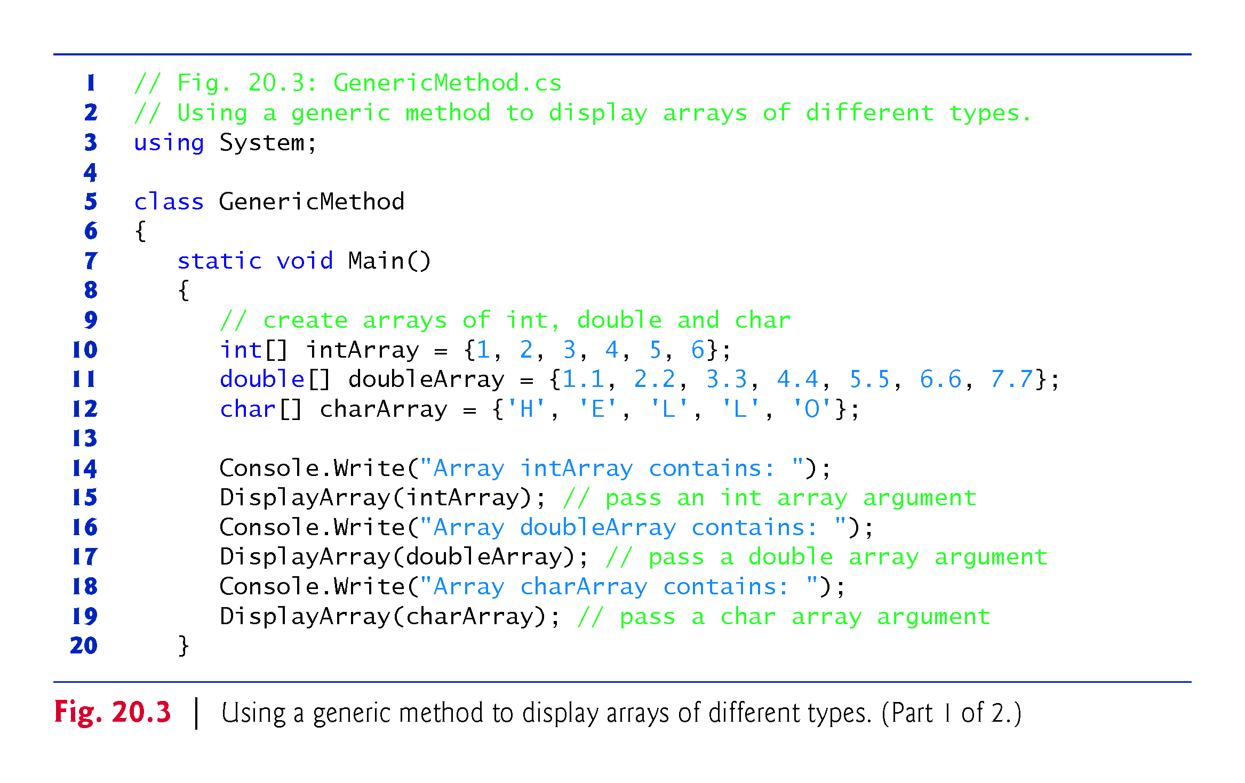

Slide 11
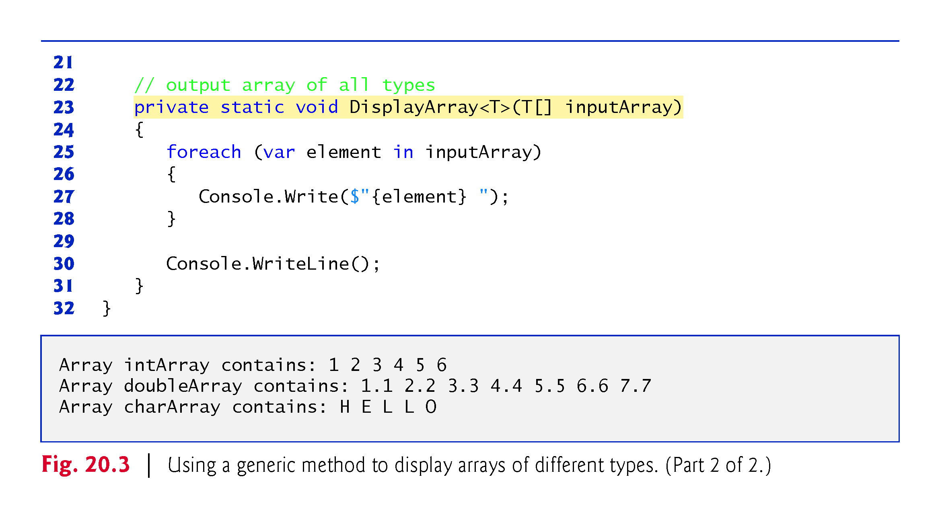
!!!
generic method
Takes generic data type
& generic class
Rewrite
Two methods

Slide 12
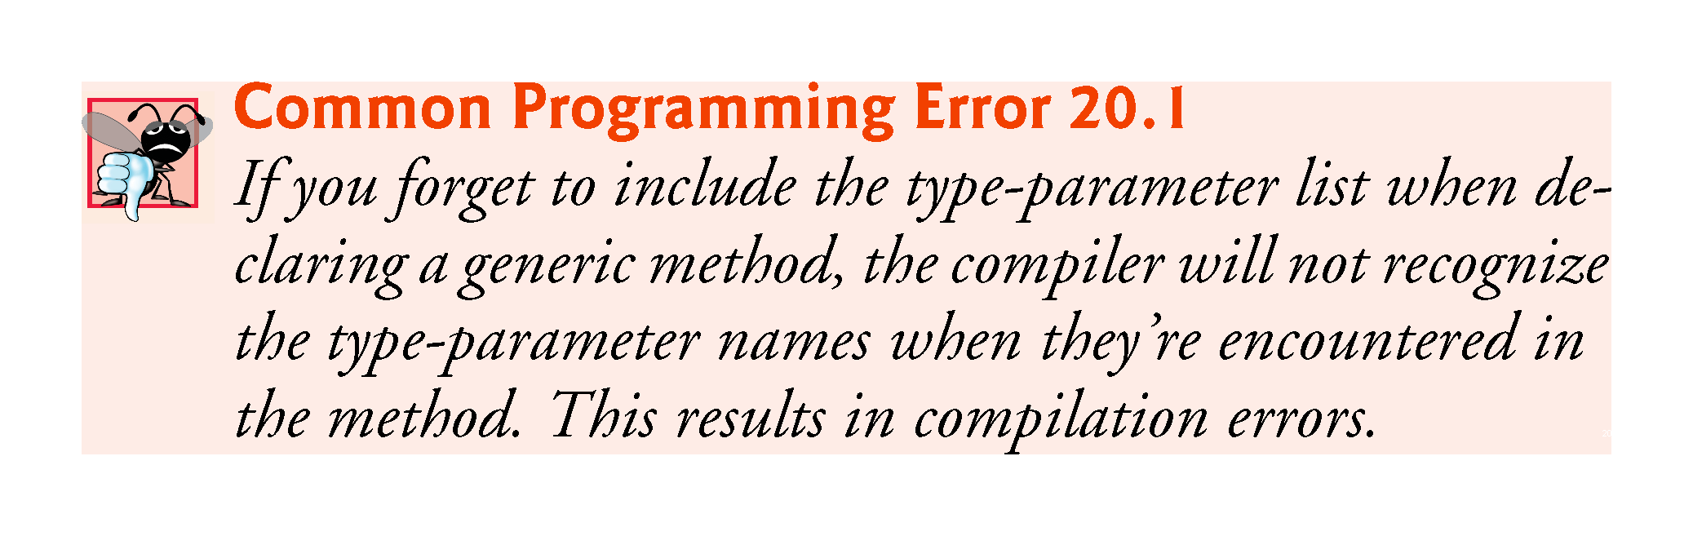

Slide 13
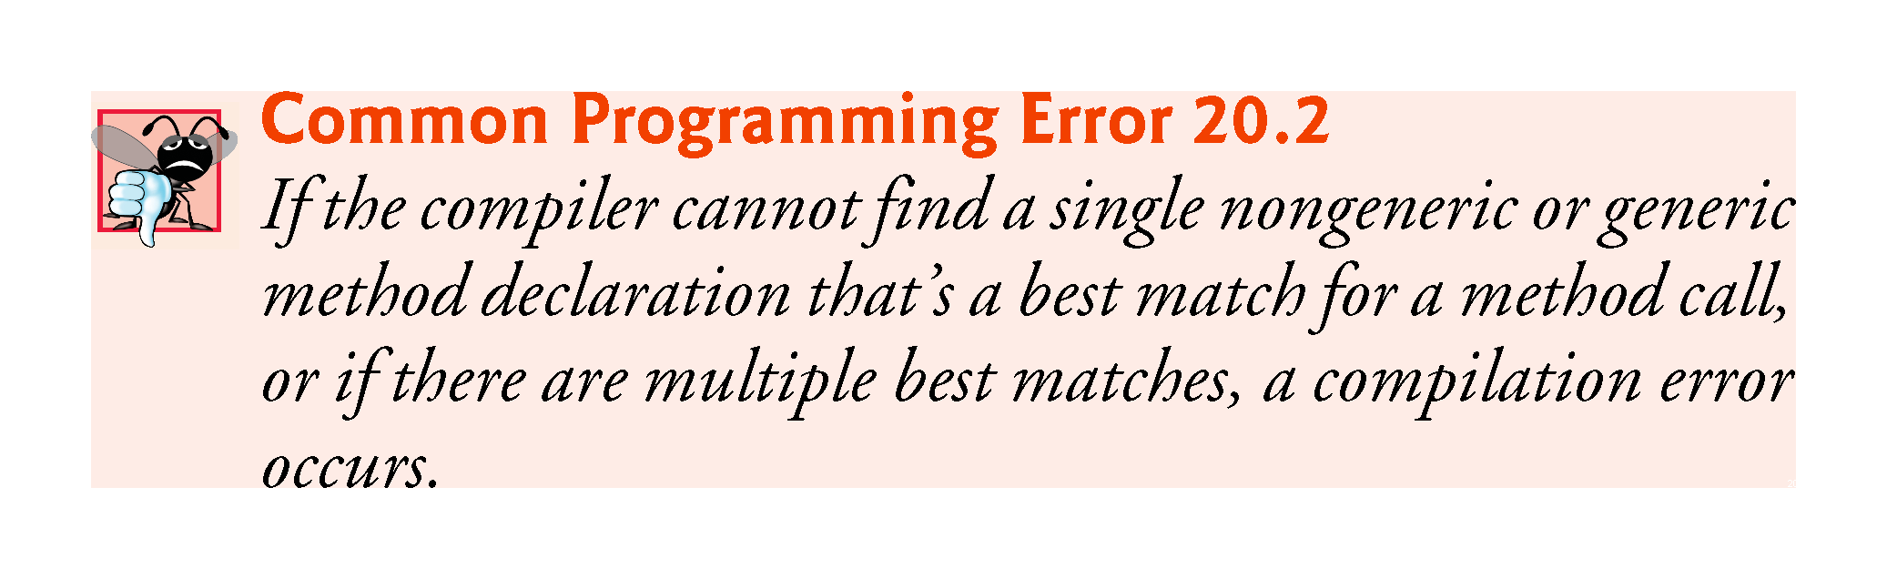

Slide 14
20.3 Generic-Method Implementation?
Value Types vs. Reference Types in Generics
The compiler handles value and reference types differently in generic method calls.
When a value-type argument is used for a given type parameter, the compiler generates a version of the method that’s specific to the value type—if one has been generated previously, the compiler reuses that one.
If DisplayArray were called with a reference type, the compiler would also generate a single version of the method that’s used by all reference types.

Slide 15
20.3 Generic-Method Implementation?
Explicit Type Arguments
You also can use explicit type arguments to indicate the exact type that should be used to call a generic function. For example, line 15 could be written as
DisplayArray<int>(intArray); // pass an int array argument
The preceding method call explicitly provides the type argument (int) that should be used to replace type parameter T in line 23.
Though not required here, an explicit type argument would be required if the compiler cannot infer the type from the method’s argument(s).

Slide 16
20.4 Type Constraints
IComparable<T> Interface
It’s possible to compare two objects of the same type if that type implements the generic interface IComparable<T> (of namespace System).
A benefit of implementing interface IComparable<T> is that IComparable<T> objects can be used with the sorting and searching methods of classes in the System.Collections.Generic namespace—we discuss those methods in Chapter 21.
The structures in the Framework Class Library that correspond to the simple types all implement this interface.
!!!
!!!

Slide 17
20.4 Type Constraints (cont.) ?
Specifying Type Constraints
Even though IComparable objects can be compared, they cannot be used with generic code by default, because not all types implement interface IComparable<T>.
However, we can restrict the types that can be used with a generic method or class to ensure that they meet certain requirements.
This feature—known as a type constraint—restricts the type of the argument supplied to a particular type parameter.

Slide 18
20.4 Type Constraints (cont.)
Figure 20.4 declares method Maximum (lines 18–35) with a type constraint that requires each of the method’s arguments to be of type IComparable<T>.
This restriction is important, because not all objects can be compared.
However, all IComparable<T> objects are guaranteed to have a CompareTo method that can be used in method Maximum to determine the largest of its three arguments.
!!!

Slide 19
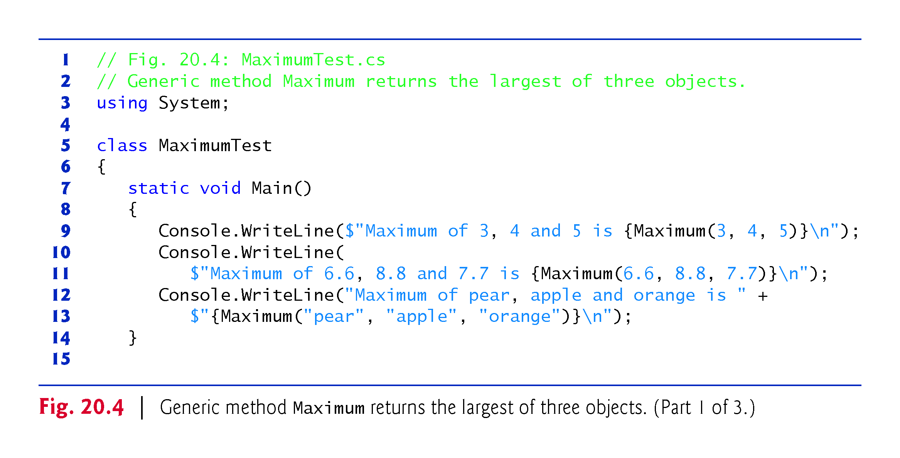

Slide 20
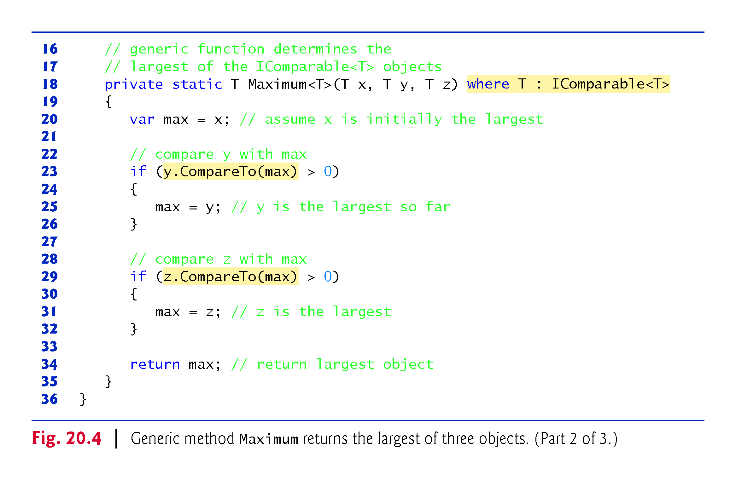
P
type constraint
!!!

Slide 21
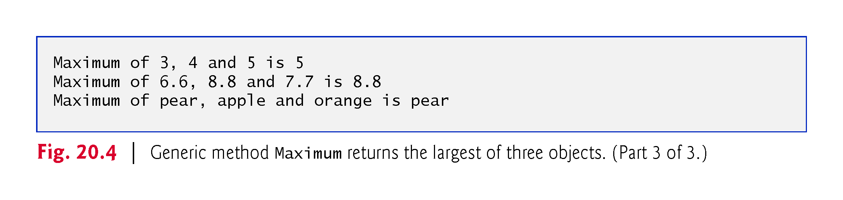

Slide 22
20.4 Type Constraints (cont.)
C# provides several kinds of type constraints.
A class constraint indicates that the type argument must be an object of a specific base class or one of its subclasses.
An interface constraint indicates that the type argument’s class must implement a specific interface.
The type constraint in line 18 is an interface constraint, because IComparable<T> is an interface.
!!!
!!!
!!!

Slide 23
20.4 Type Constraints (cont.)
You can specify that the type argument must be a reference type or a value type by using the reference-type constraint (class) or the value-type constraint (struct), respectively.
Finally, you can specify a constructor constraint—new()—to indicate that the generic code can use operator new to create new objects of the type represented by the type parameter.

Slide 24
20.4 Type Constraints (cont.)
If a type parameter is specified with a constructor constraint, the type argument’s class must provide a public parameterless or default constructor to ensure that objects of the class can be created without passing constructor arguments; otherwise, a compilation error occurs.
It’s possible to apply multiple constraints to a type parameter.

Slide 25
20.4 Type Constraints (cont.)
To do so, simply provide a comma-separated list of constraints in the where clause.
If you have a class constraint, reference-type constraint or value-type constraint, it must be listed first—only one of these types of constraints can be used for each type parameter.
Interface constraints (if any) are listed next.
The constructor constraint is listed last (if there is one).

Slide 26
20.5 Overloading Generic Methods
A generic method may be overloaded.
Each overloaded method must have a unique signature (as discussed in Chapter 7).
A class can provide two or more generic methods with the same name but different method parameters.
A generic method can be overloaded by nongeneric methods with the same method name.
When the compiler encounters a method call, it searches for the method declaration that best matches the method name and the argument types specified in the call.
!!!

Slide 27
20.6 Generic Classes
With a generic class, you can use a simple, concise notation to indicate the actual type(s) that should be used in place of the class’s type parameter(s).
At compilation time, the compiler ensures your code’s type safety, and the runtime system replaces type parameters with type arguments to enable your client code to interact with the generic class.

Slide 28
20.6 Generic Classes (cont.)
One generic Stack class, for example, could be the basis for creating many Stack classes (e.g., “Stack of double,” “Stack of int,” “Stack of char,” “Stack of Employee”).
Figure 20.5 presents a generic Stack class declaration.
This class should not be confused with the class Stack from namespace System.Collections.Generics.

Slide 29
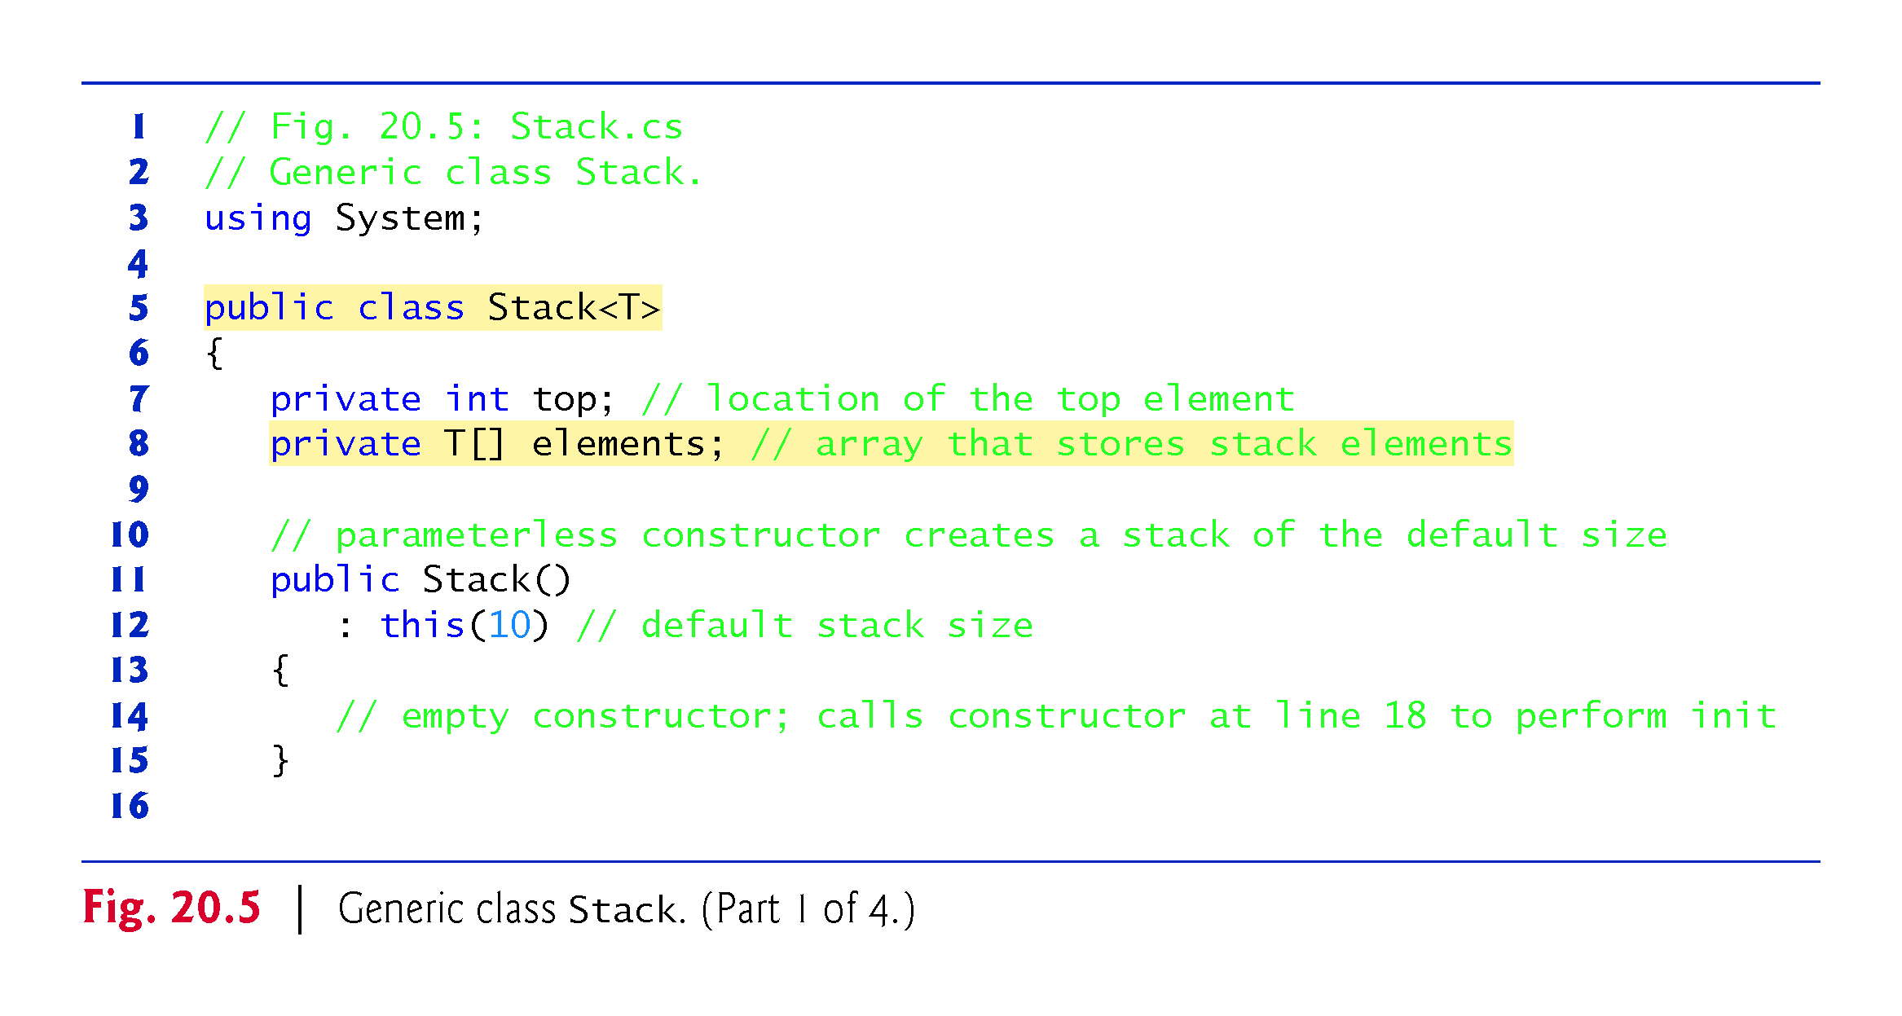
p
!!!
!!!
If new(), what is the stack size!!!

Slide 30
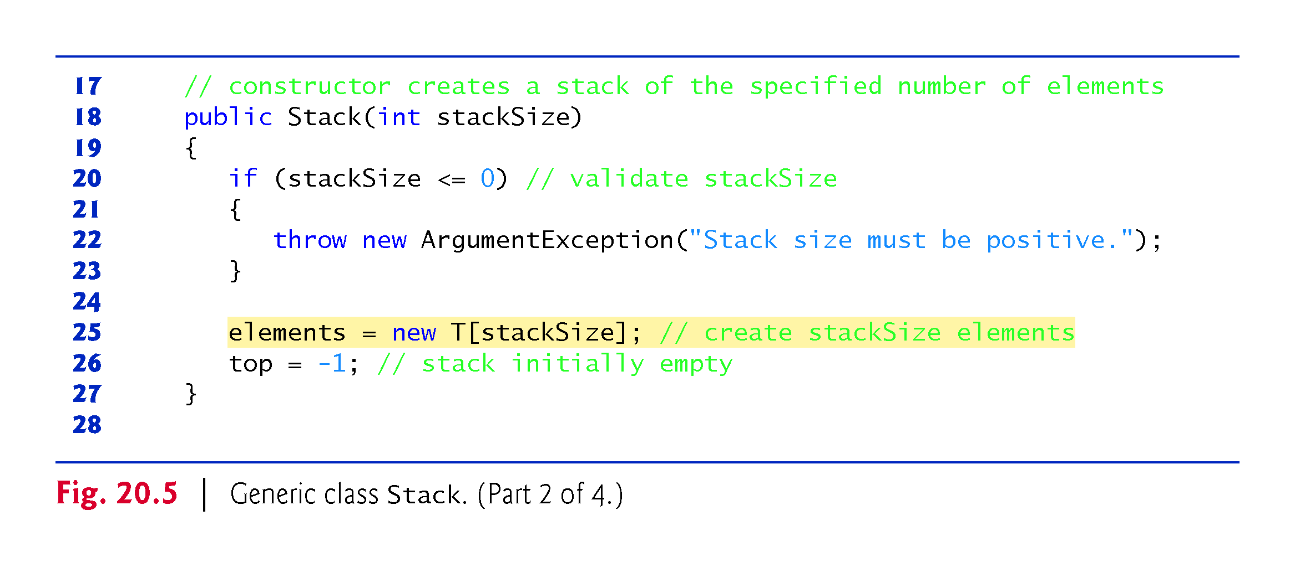

Slide 31
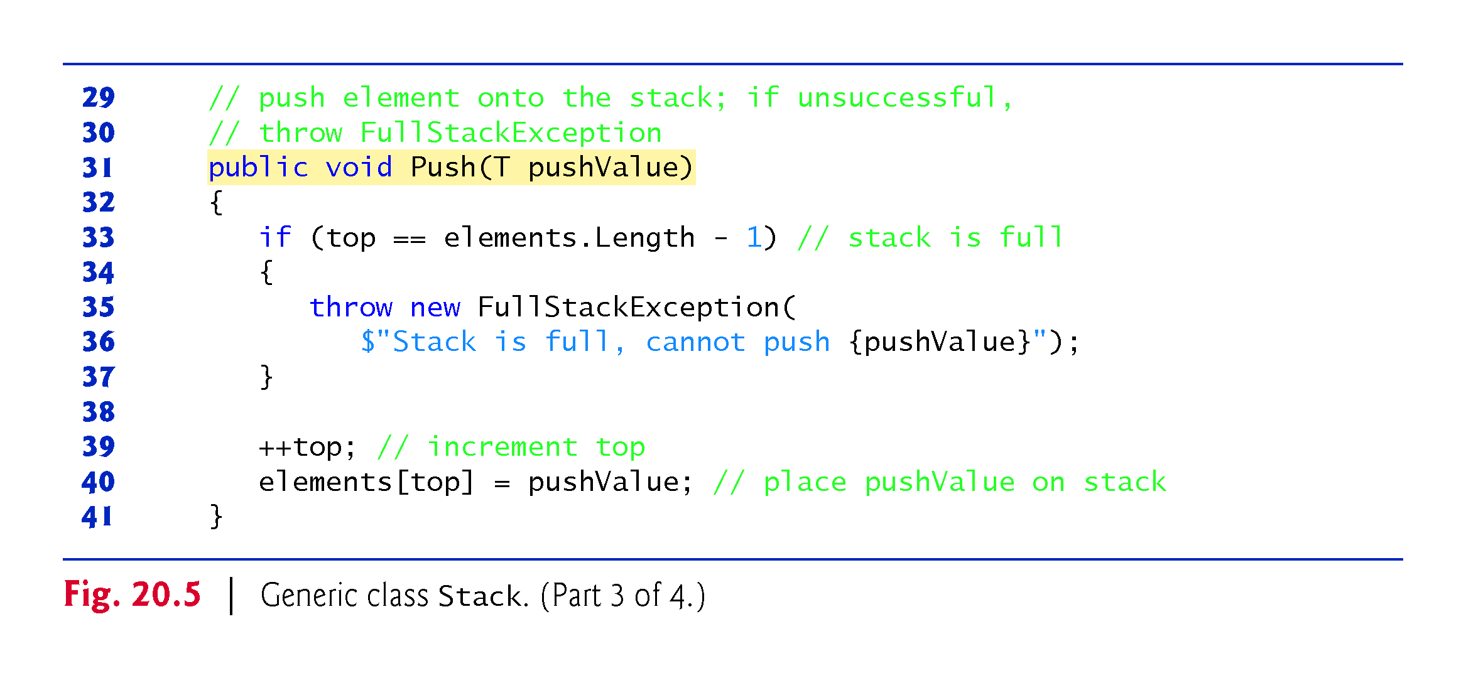
Length is the size when
The stack is full, size is 10 when creation
!!!

Slide 32
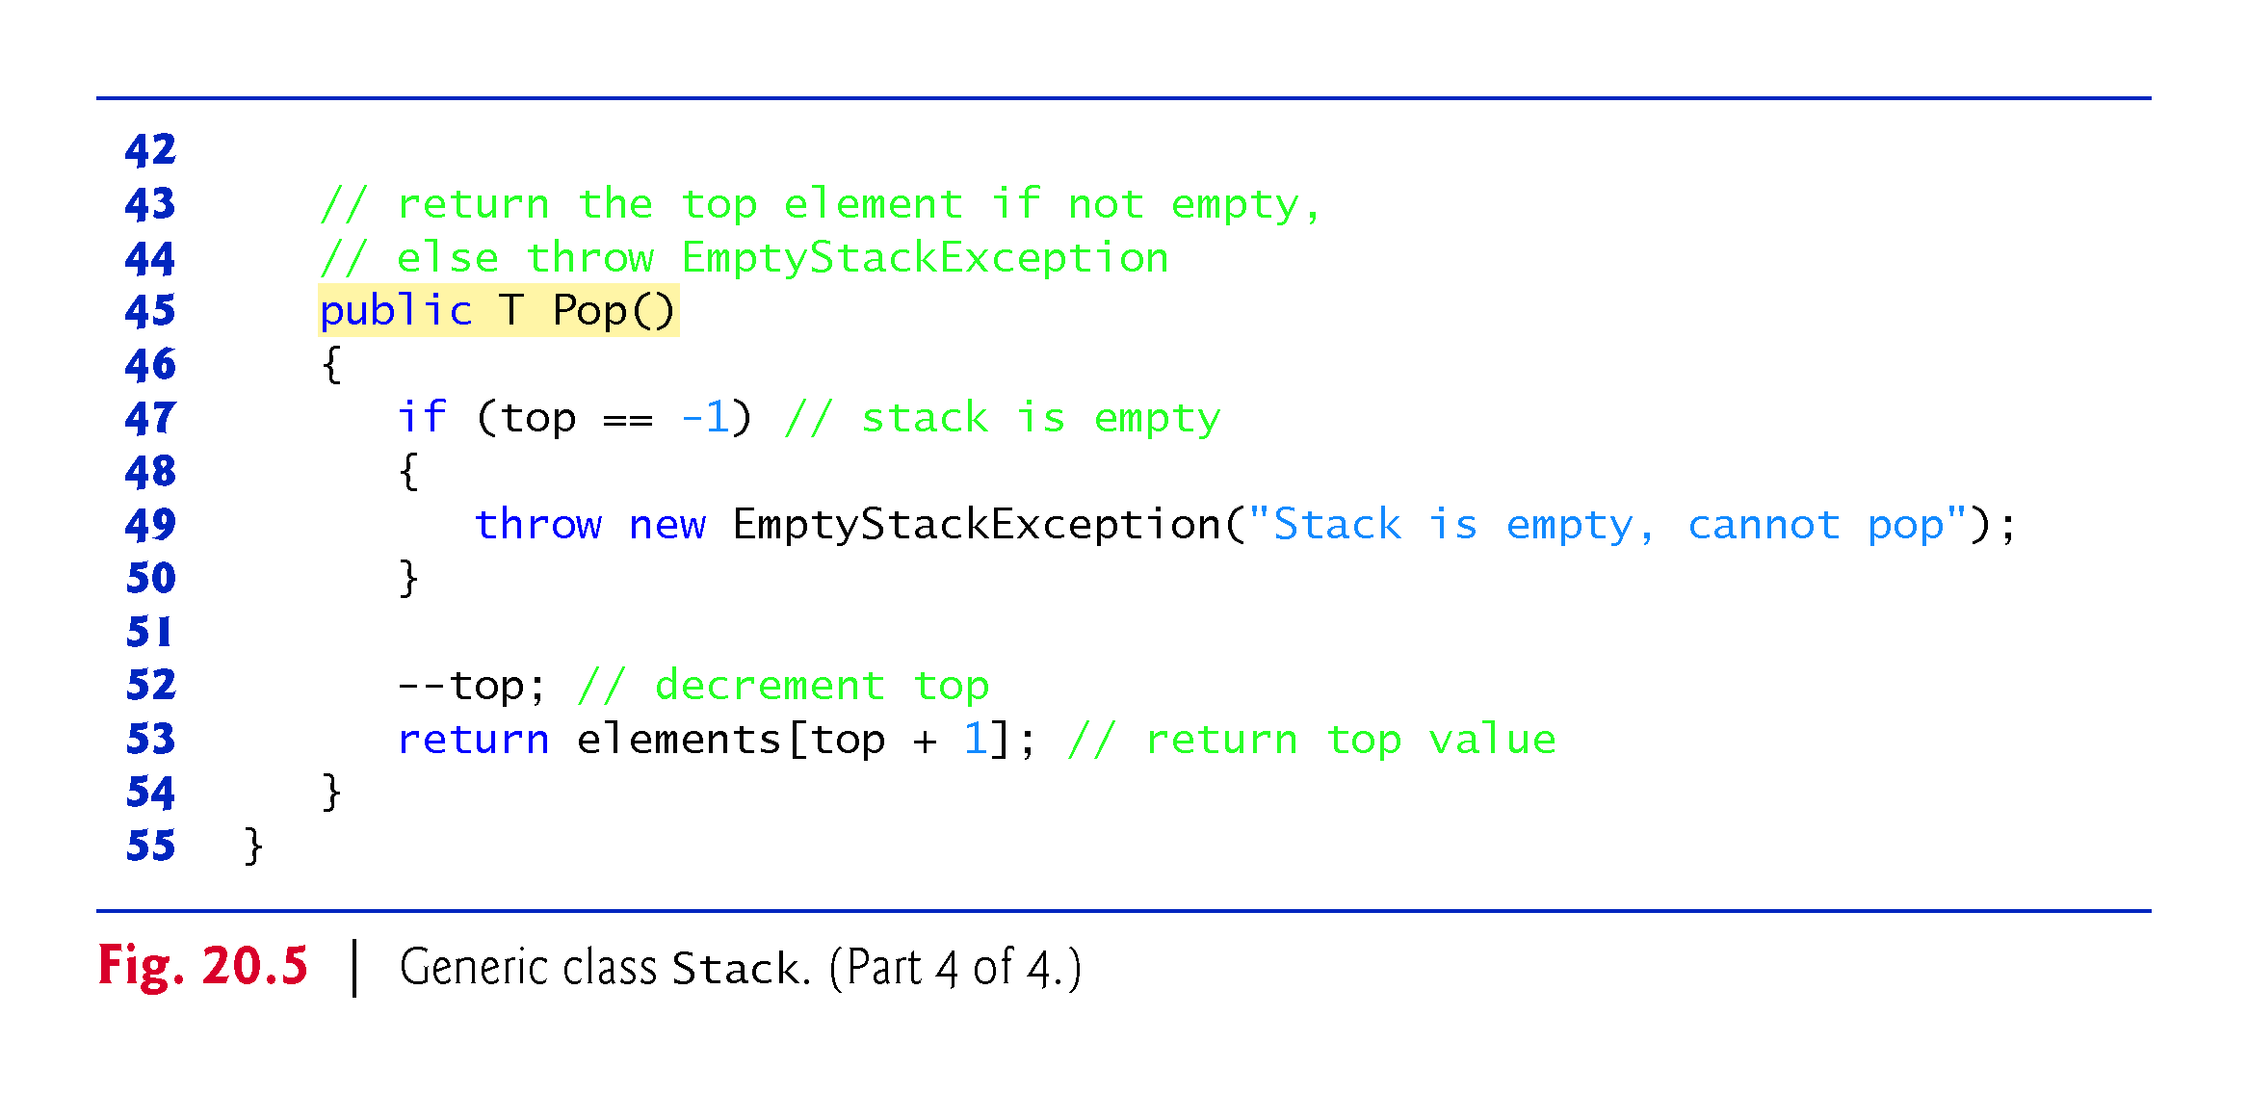
!!!
Rw push()/pop

Slide 33
20.6 Generic Classes (cont.)
Classes FullStackException (Fig. 20.6) and EmptyStackException (Fig. 20.7) each provide a parameterless constructor, a one-argument constructor of exception classes (as discussed in Section 13.8) and a two-argument constructor for creating a new exception using an existing one.
The parameterless constructor sets the default error message while the other two constructors set custom error messages.

Slide 34
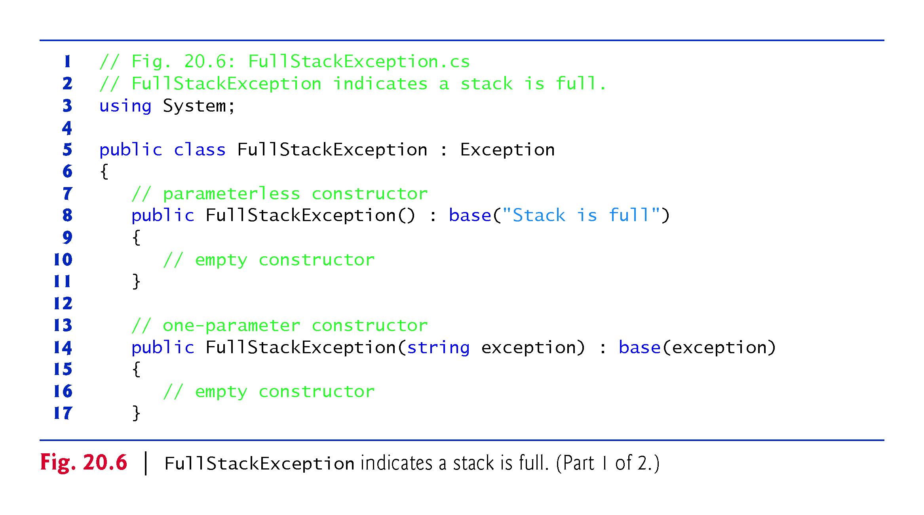

Slide 35
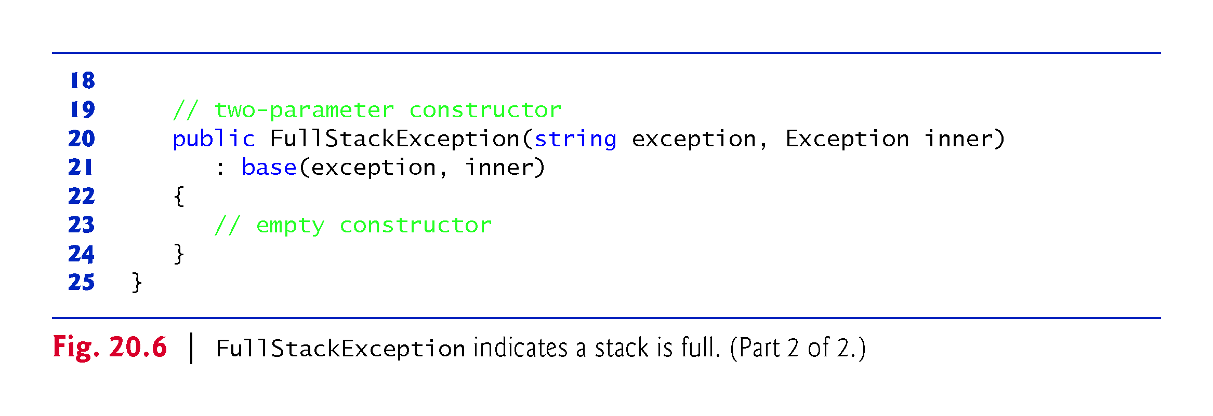

Slide 36
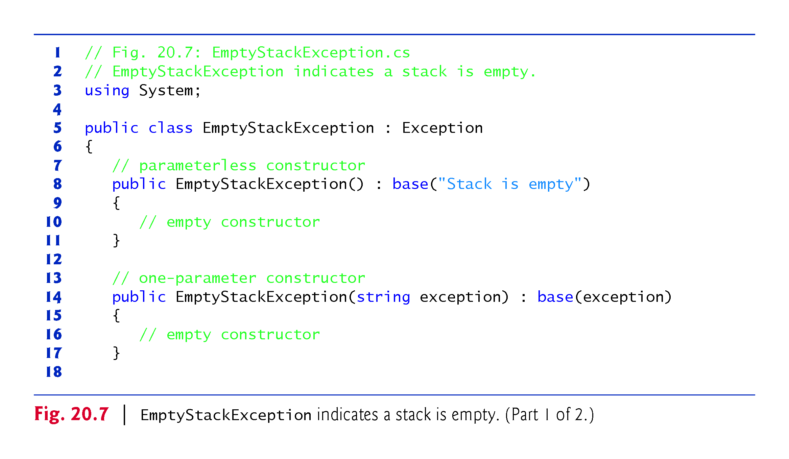

Slide 37
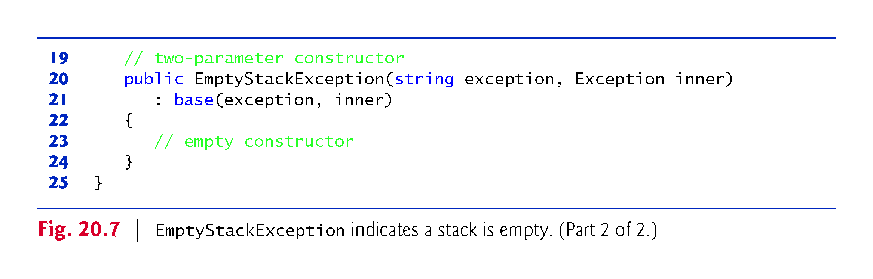

Slide 38
20.6 Generic Classes (cont.)
Now, let’s consider an app (Fig. 20.8) that uses the Stack generic class.
This Stack generic class can be used with any data type.
But no generic Stack push & pop method.

Slide 39
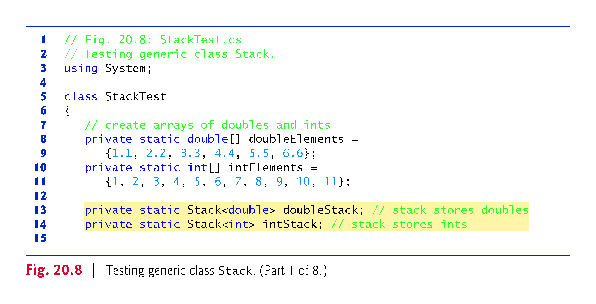

Slide 40
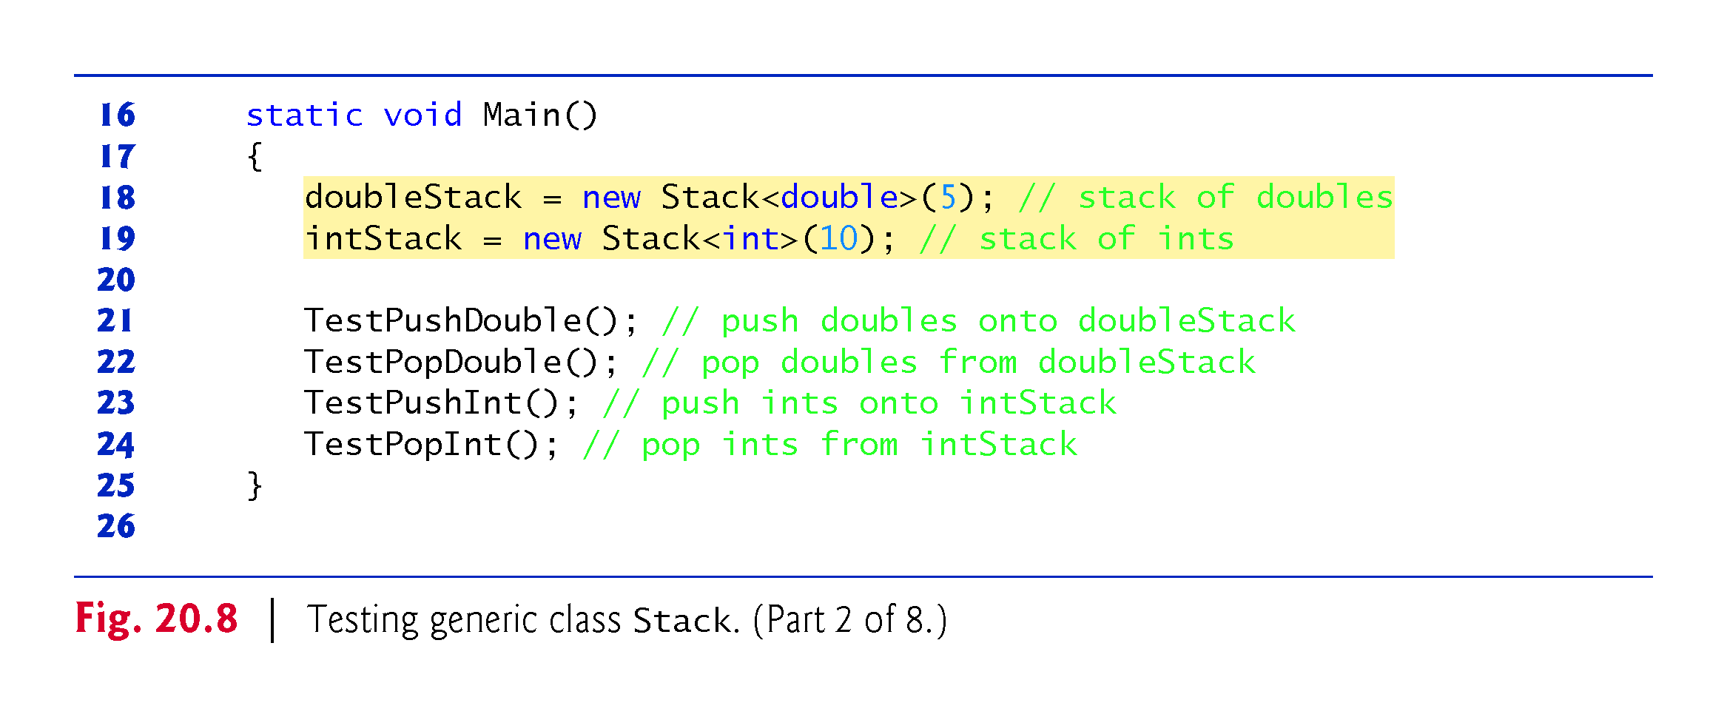
0-5,0-10 is the size?

Slide 41
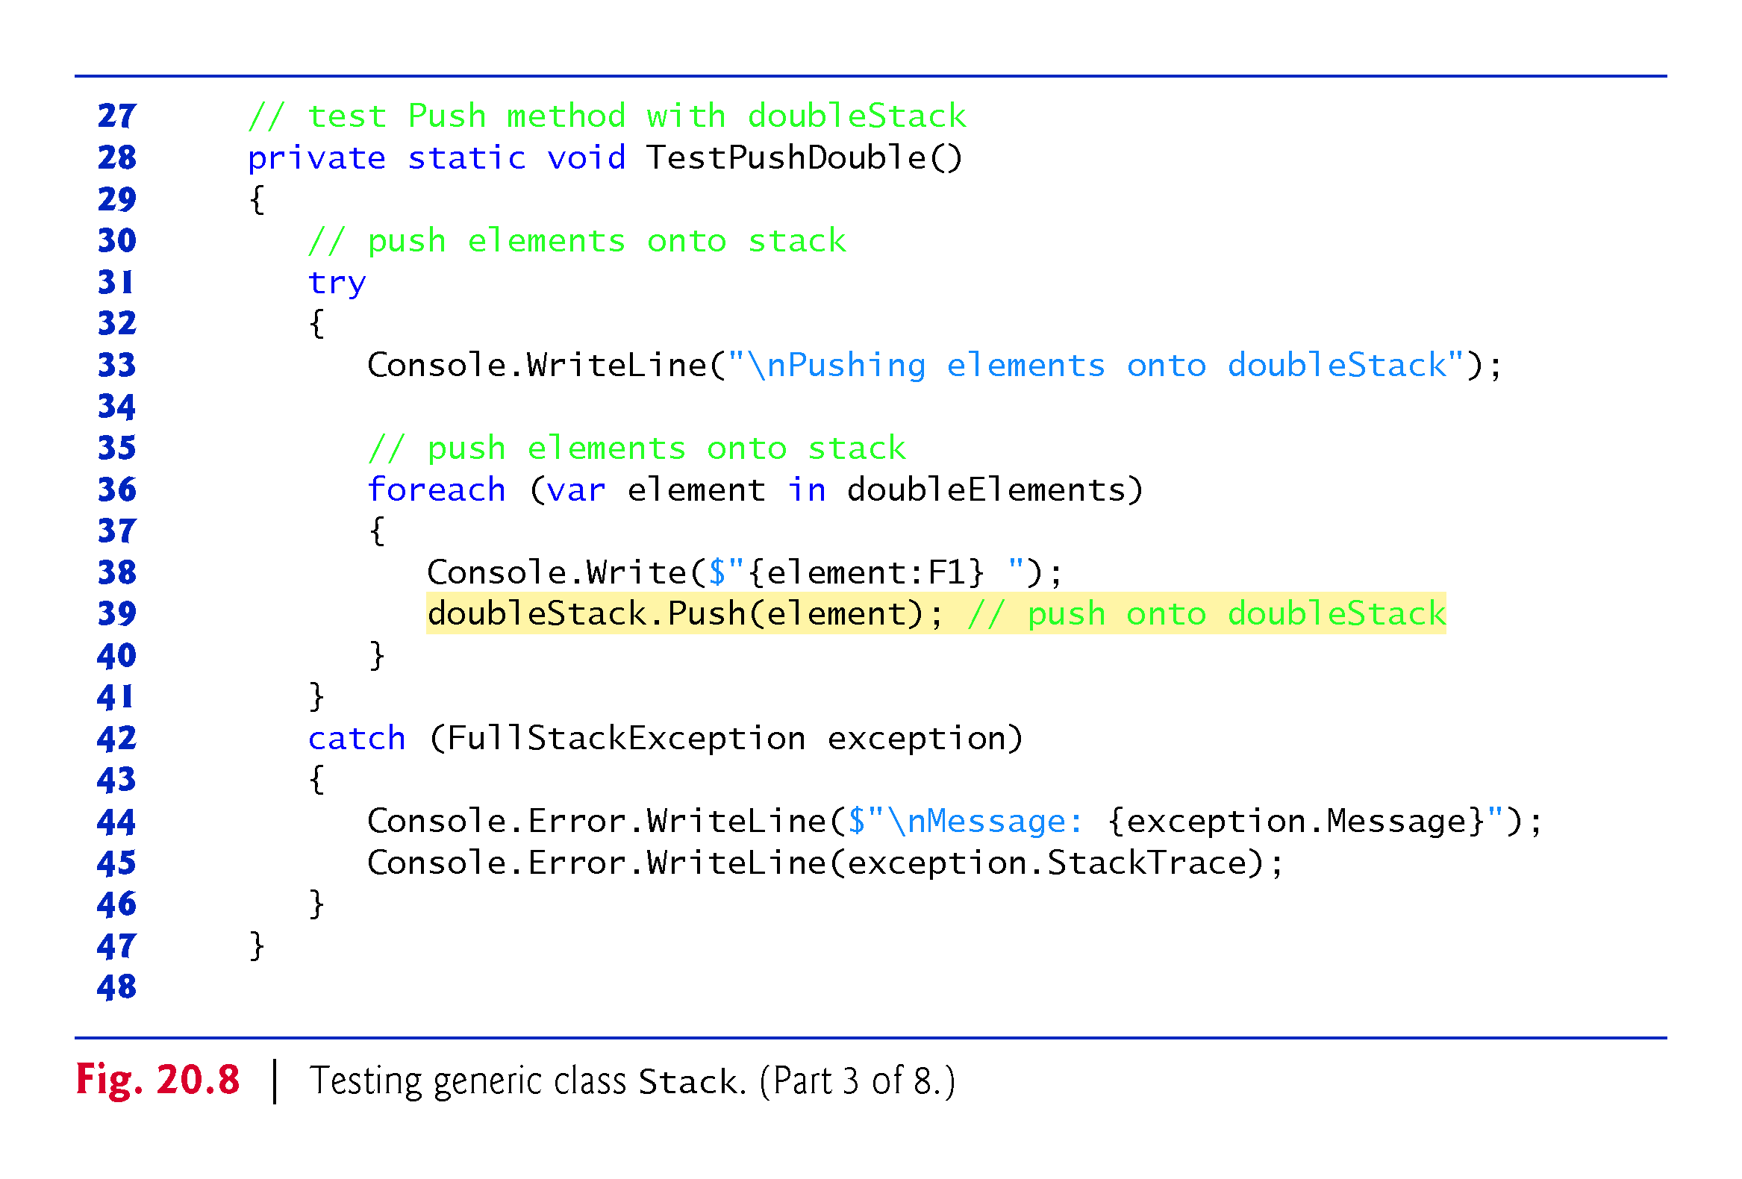
!!! rewrite

Slide 42
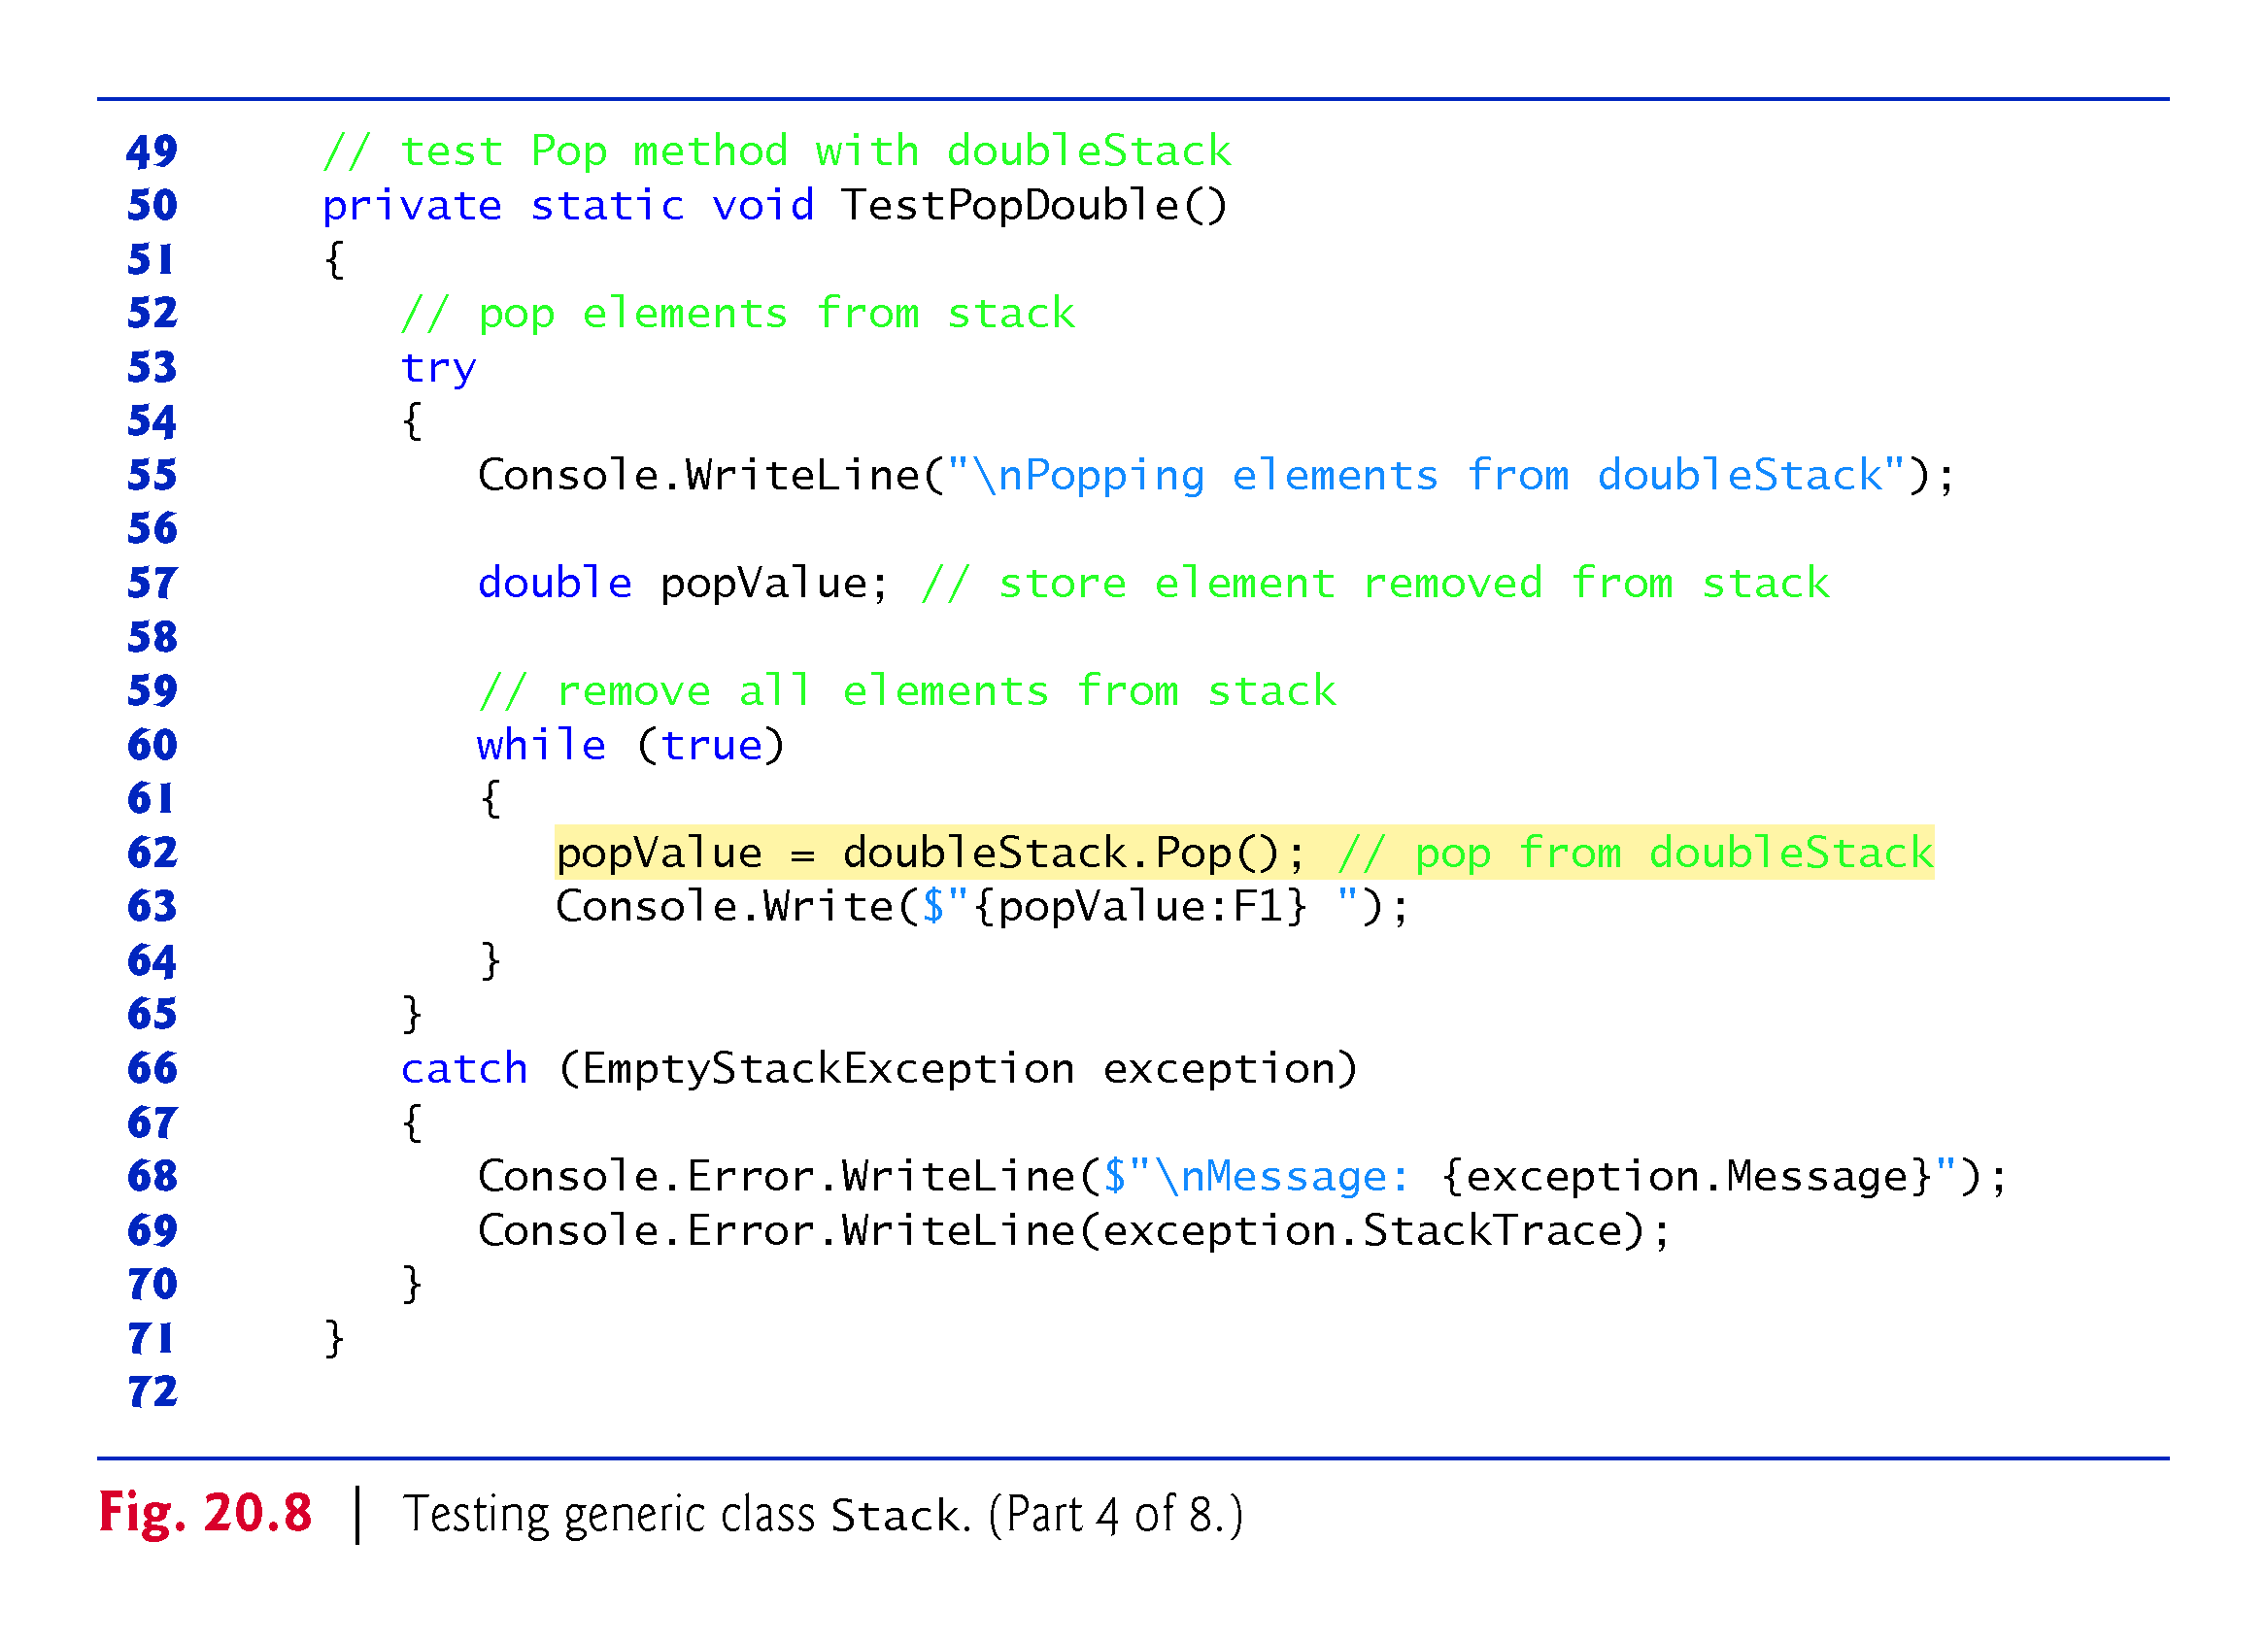

Slide 43
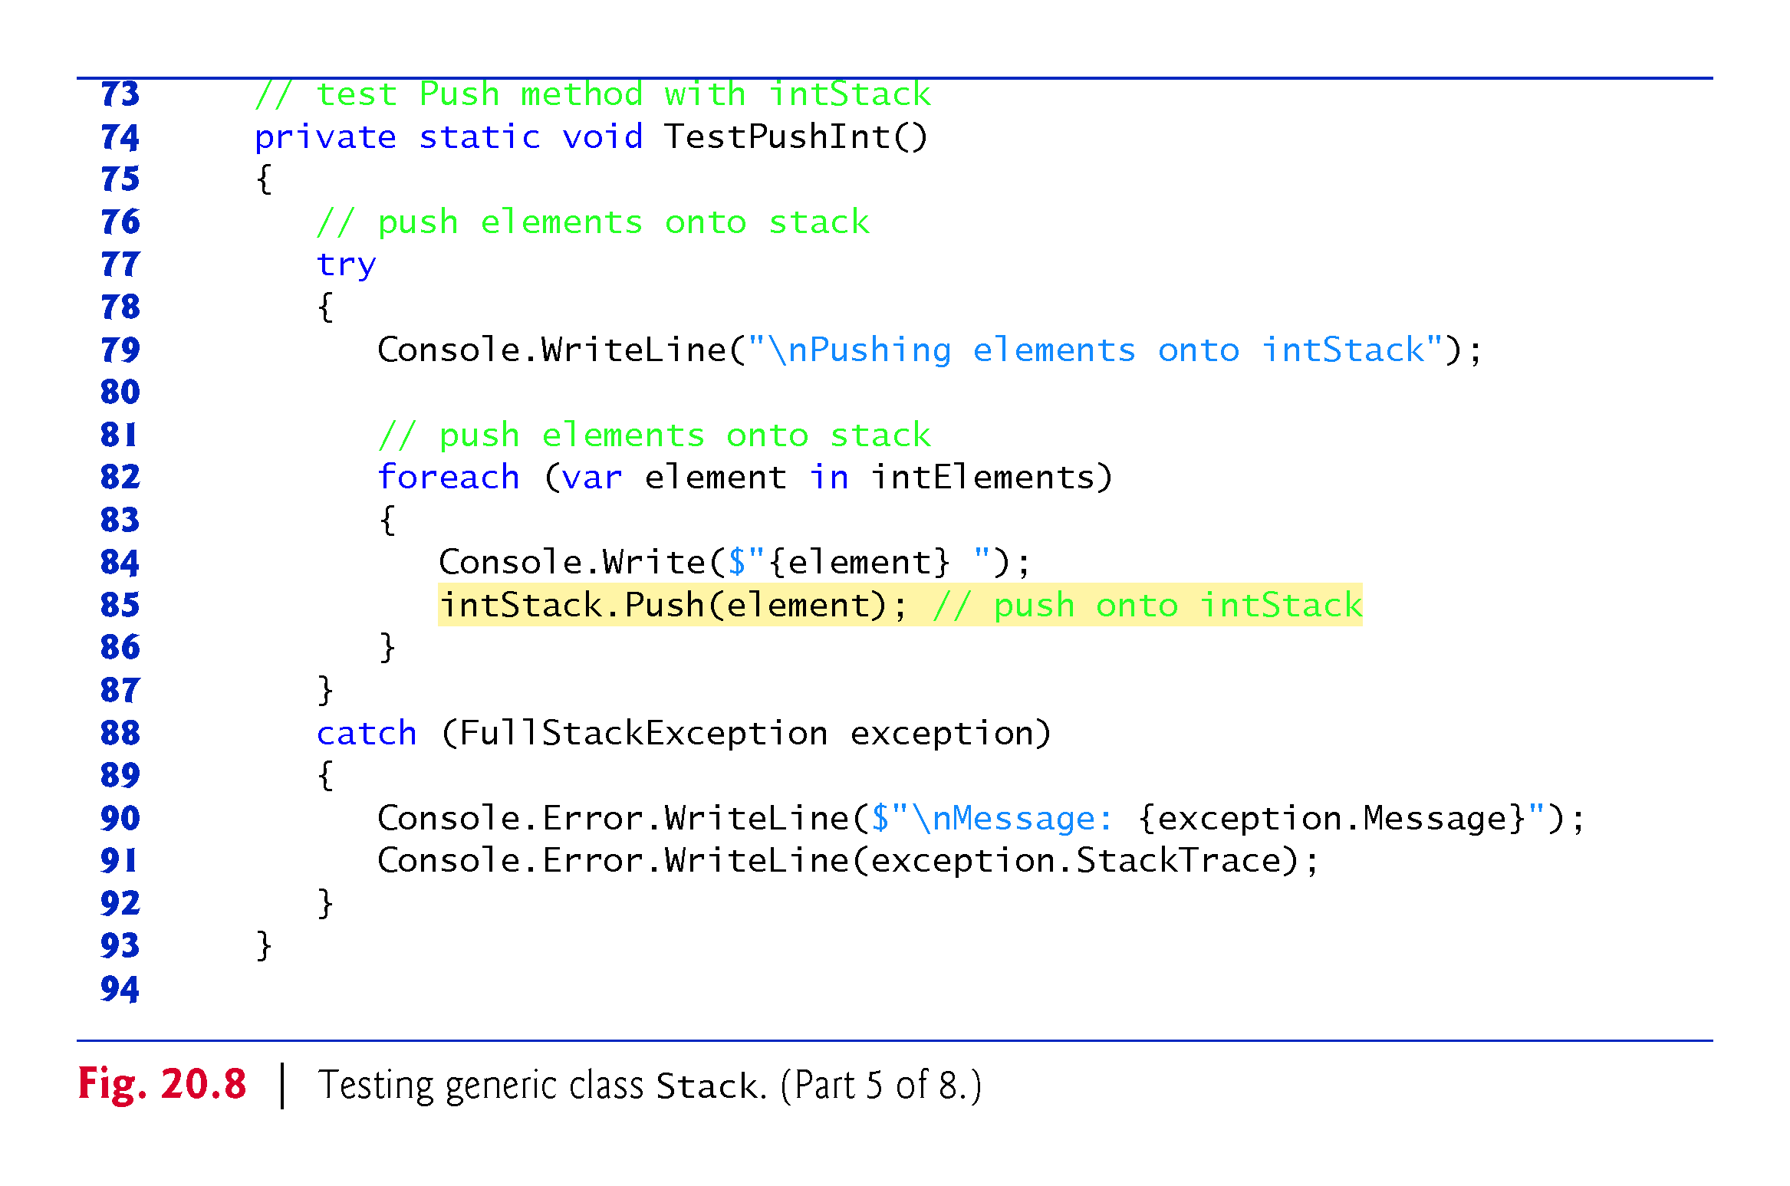

Slide 44
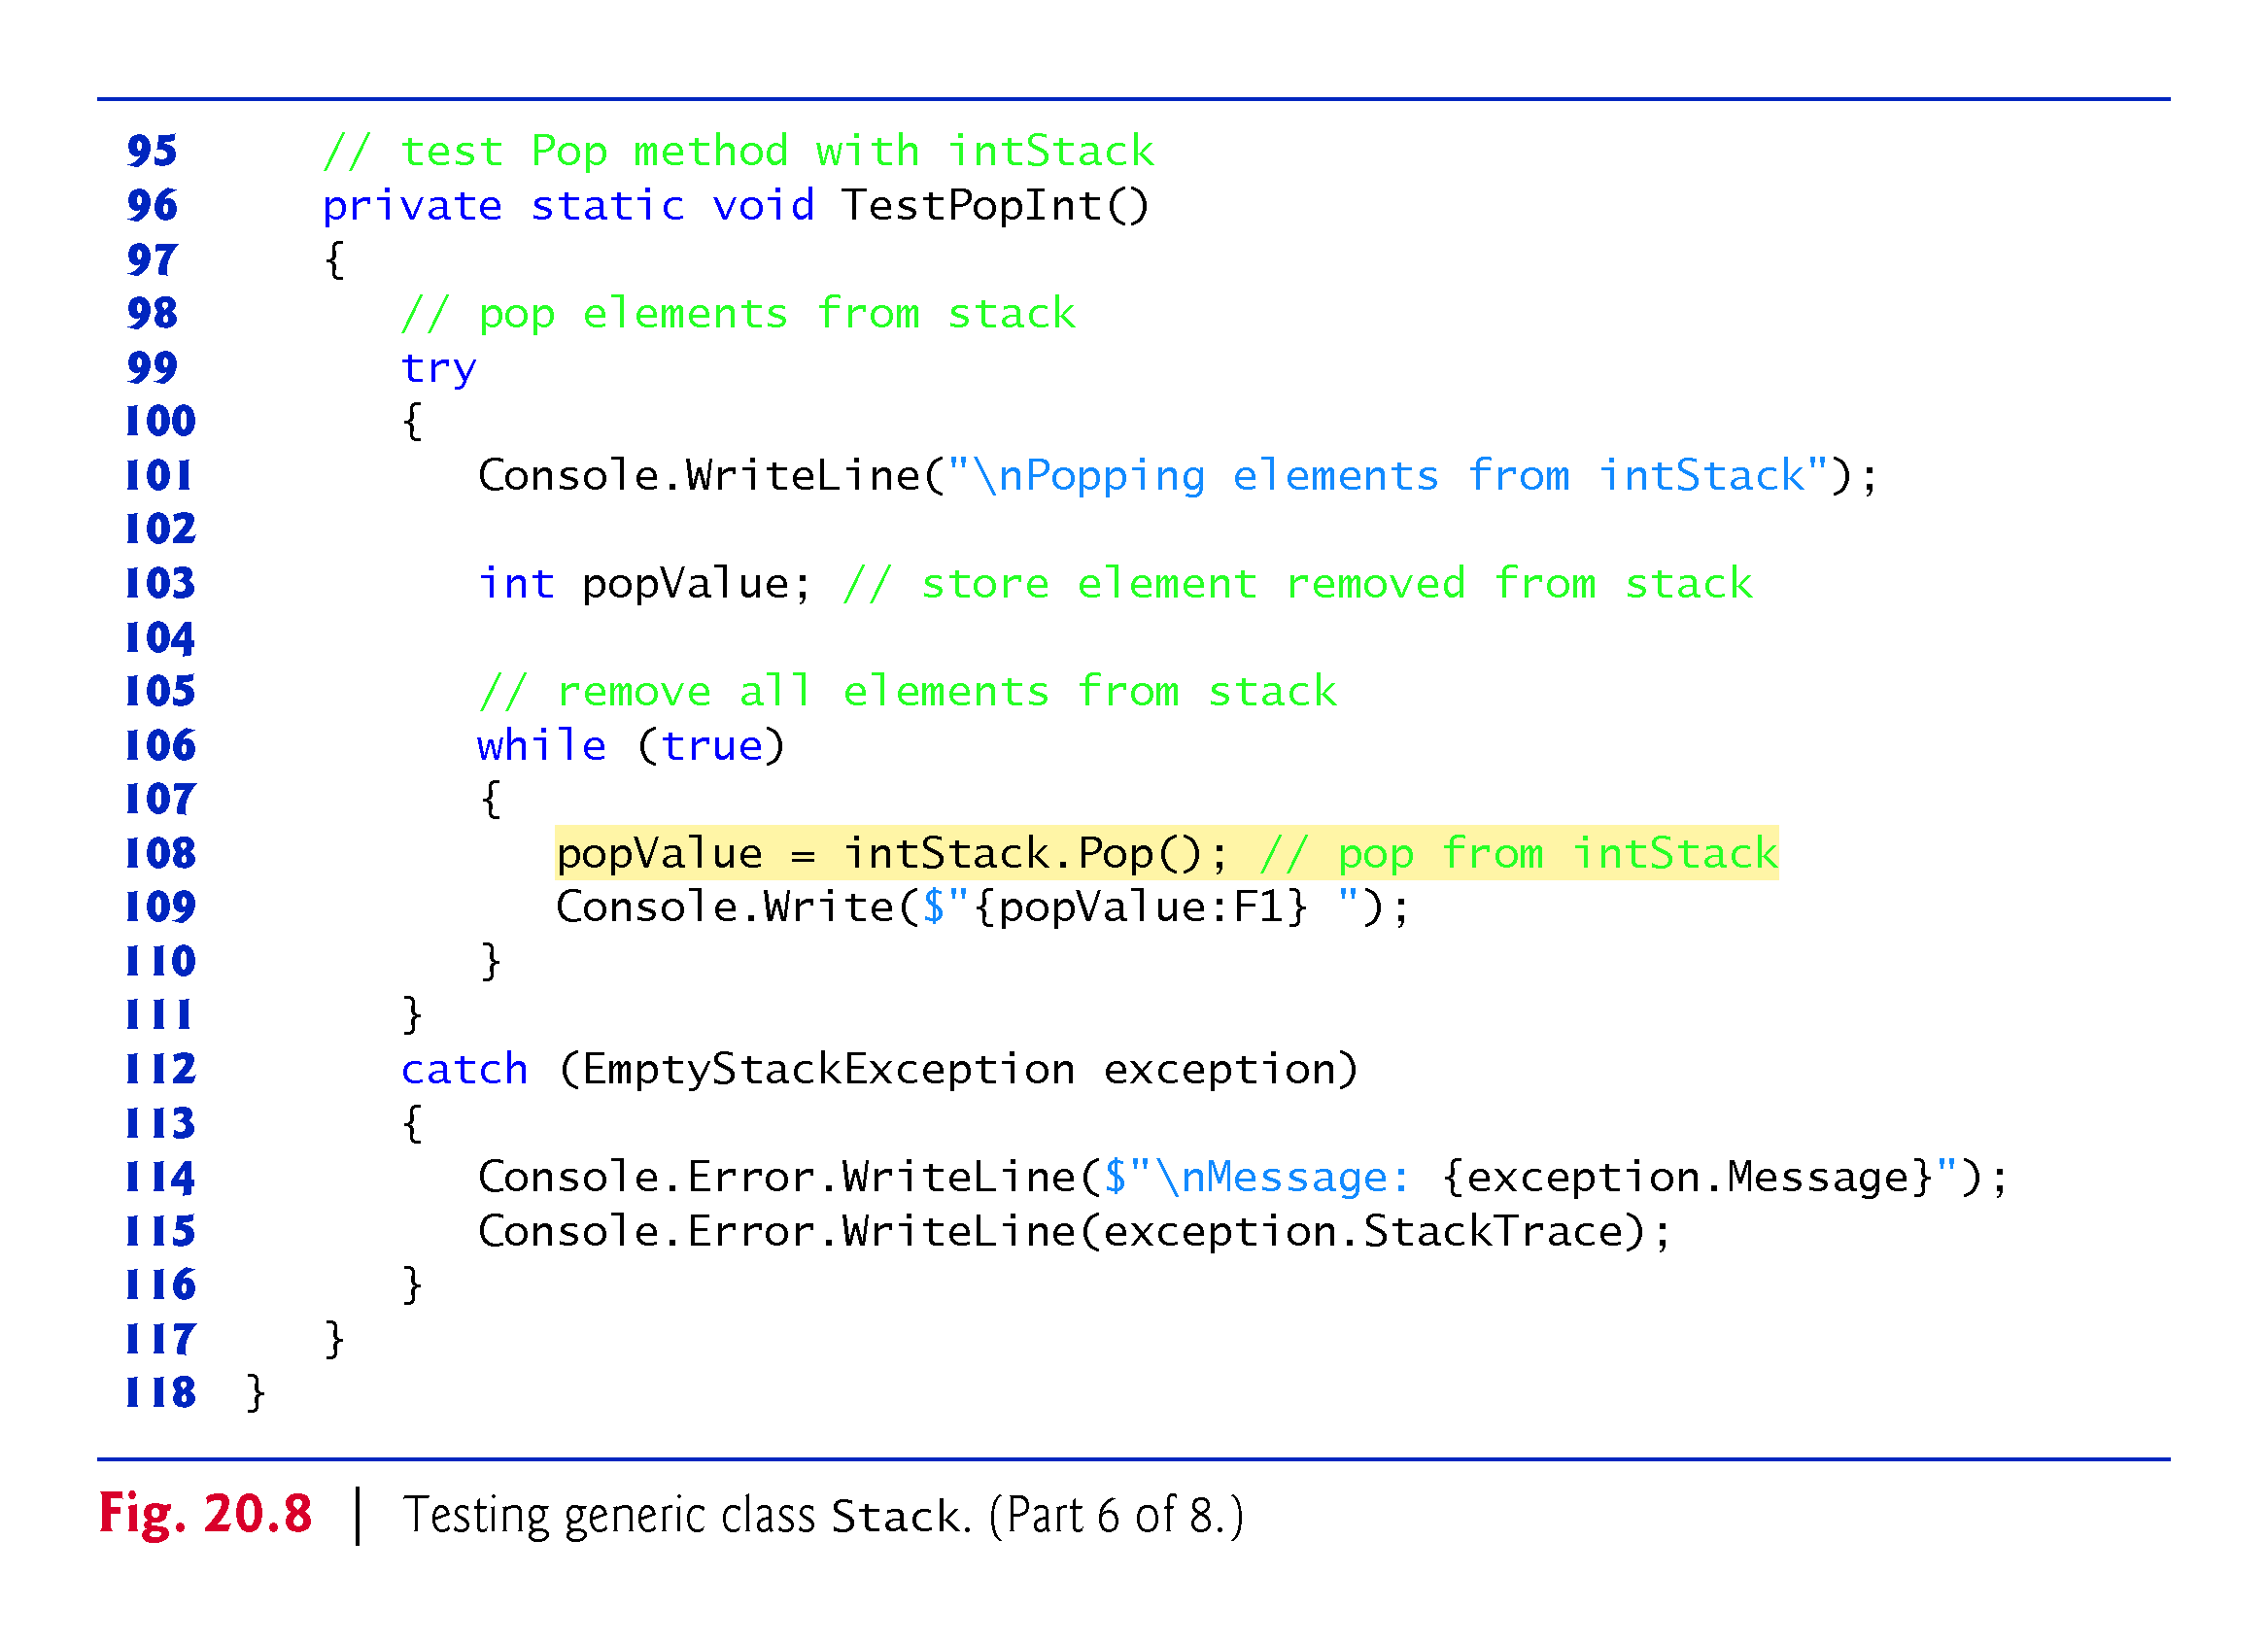

Slide 45
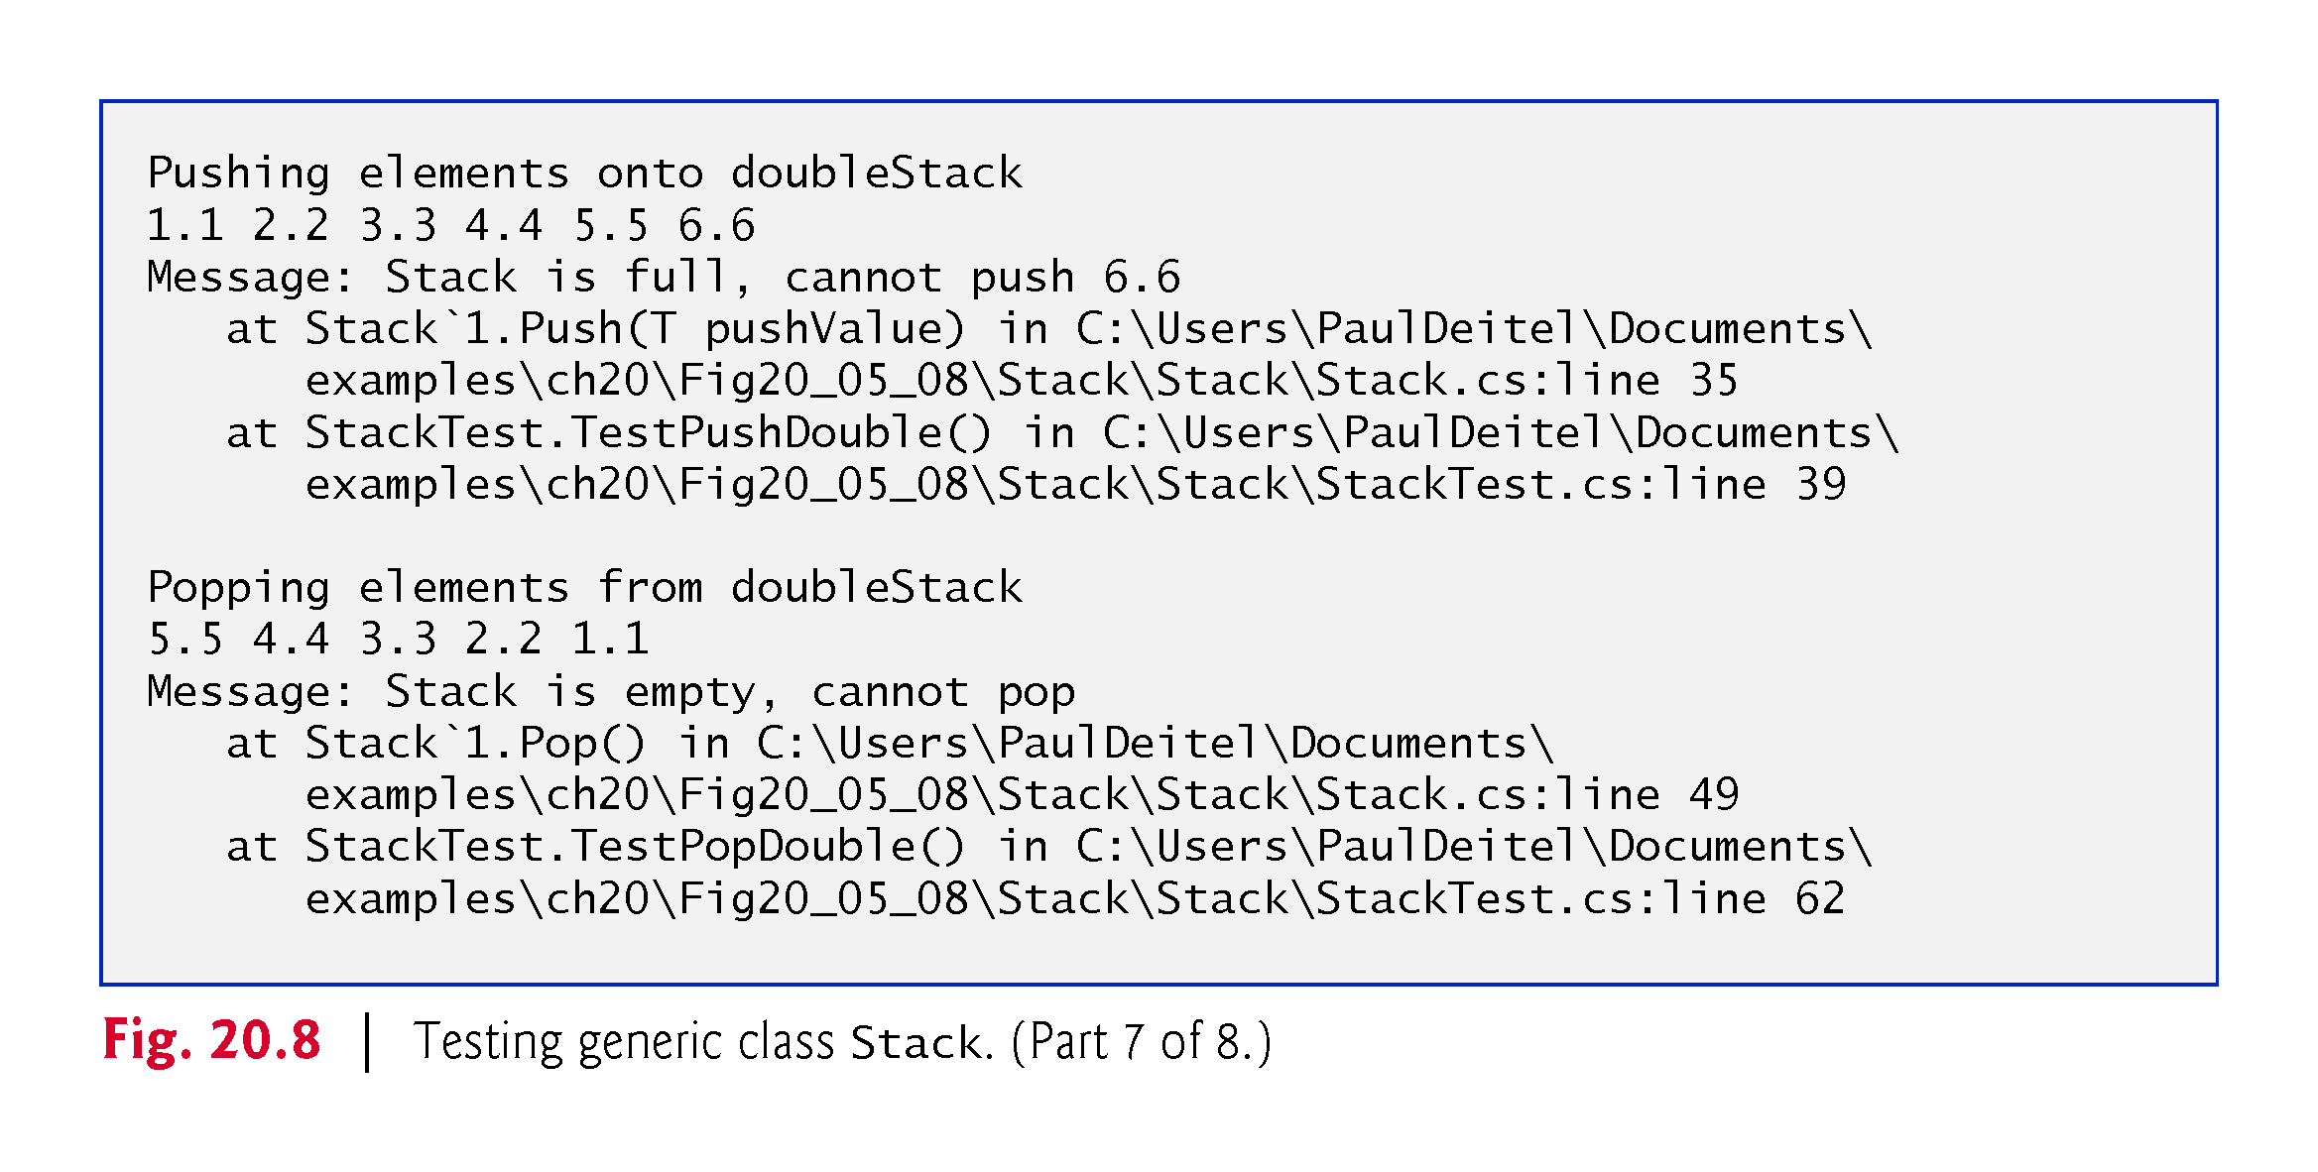

Slide 46
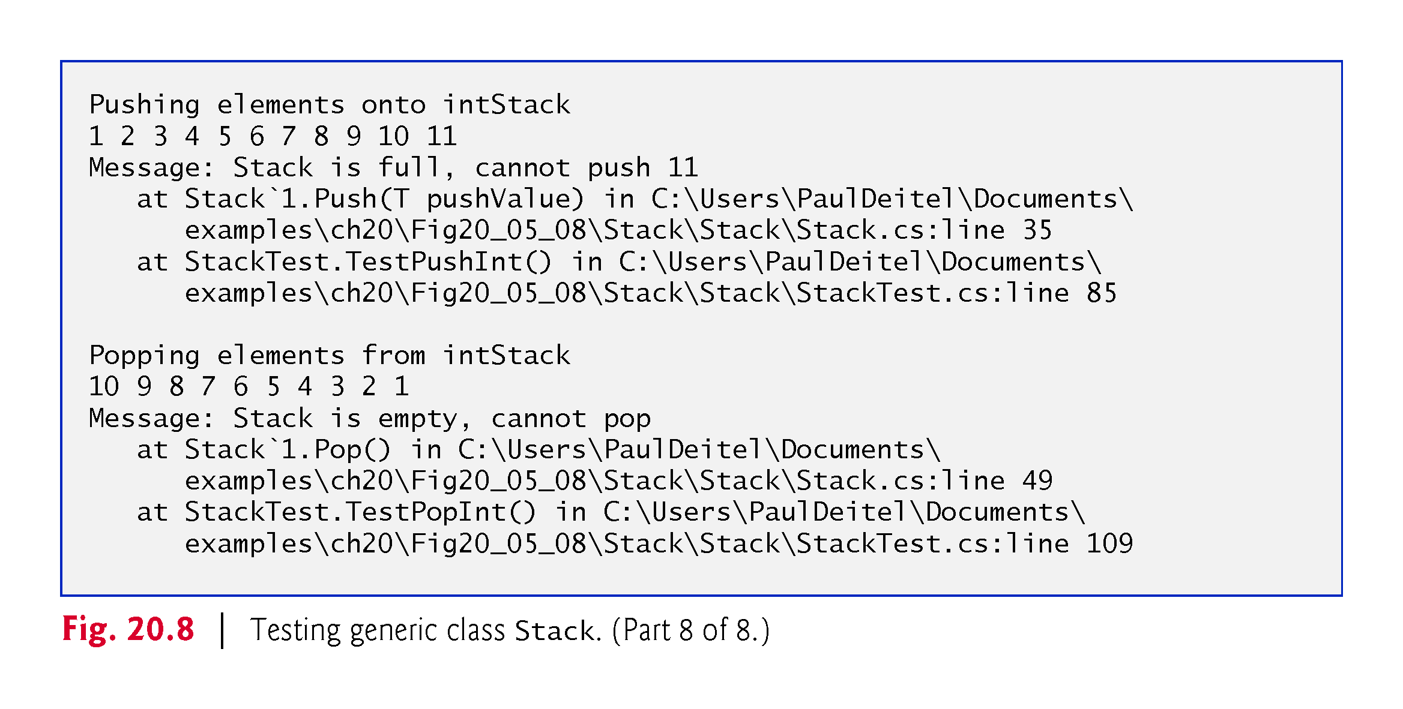

Slide 47
20.6 Generic Classes (cont.)
Figure 20.9 declares generic method TestPush (lines 33–53) to perform the same tasks as TestPushDouble and TestPushInt in Fig. 20.8—that is, Push values onto a Stack<T>.
Similarly, generic method TestPop (lines 56–77) performs the same tasks as TestPopDouble and TestPopInt in Fig. 20.8—that is, Pop values off a Stack<T>.
But with generic Stack push & pop method.
20.8 & 20.9 try to reuse the Stack<T> to generate new app with stack!!!
!!!
!!!

Slide 48
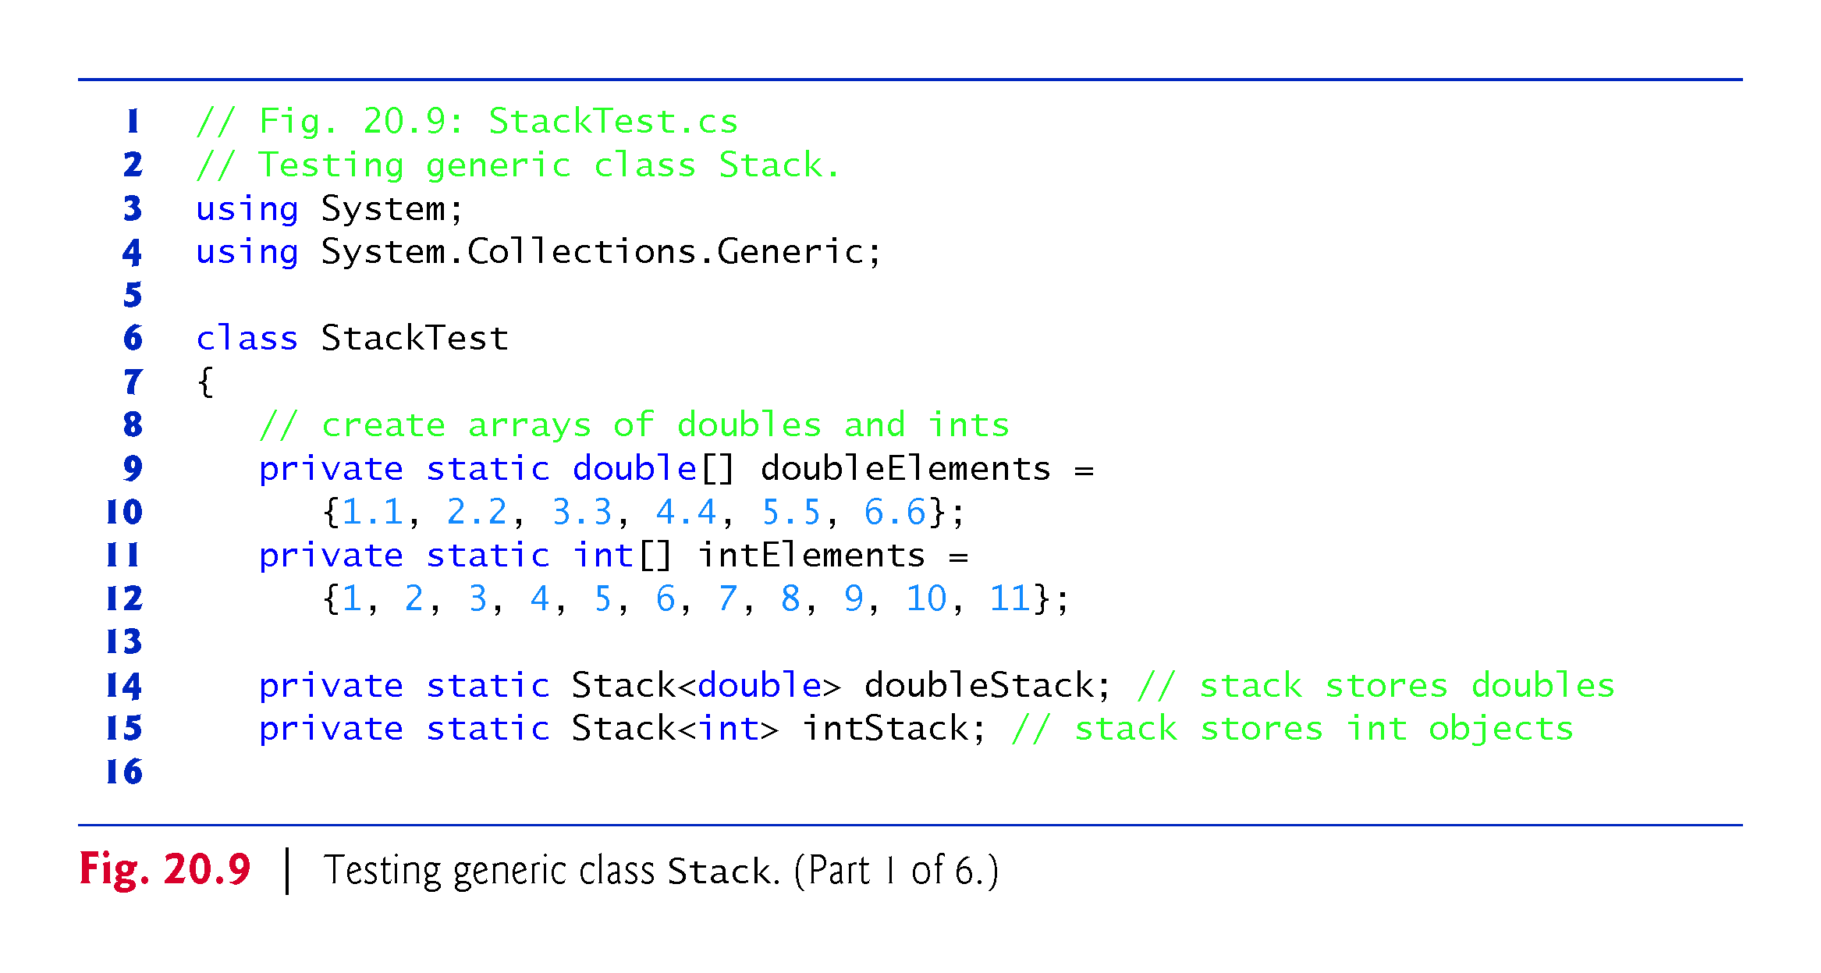

Slide 49
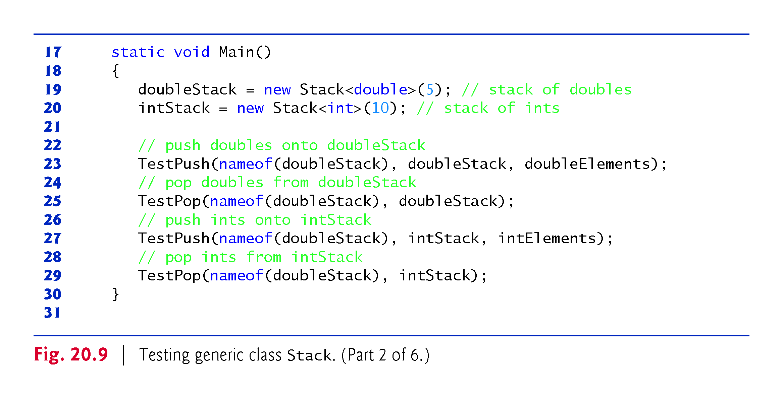
doubleStack
inStack all stack

Slide 50
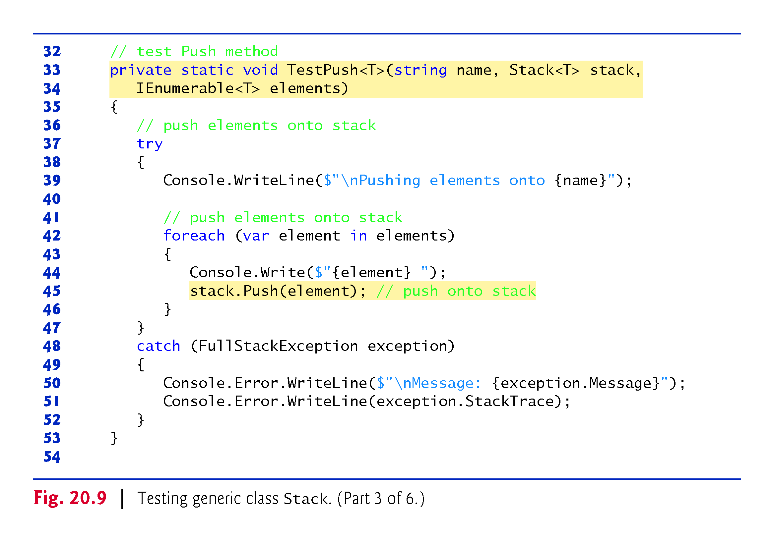
!!!
Array is IEnumerable

Slide 51
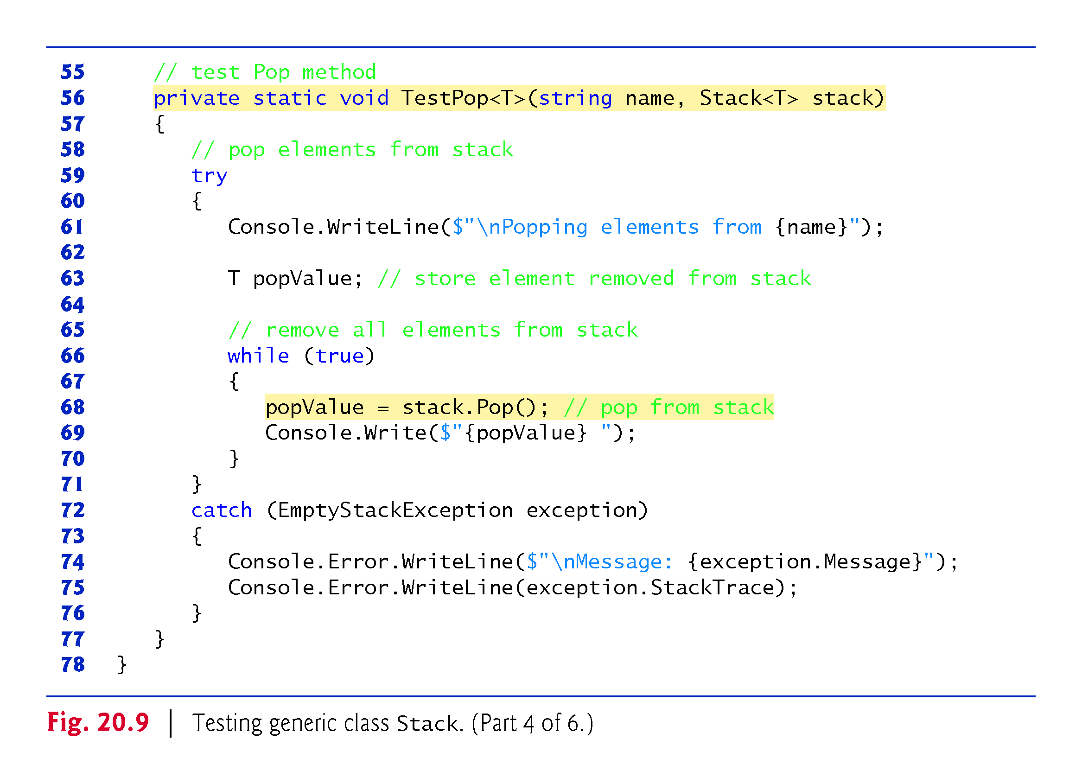
?

Slide 52
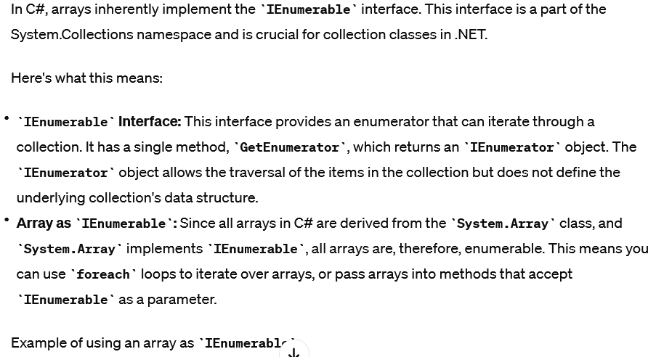
Array and IEnumerable

Slide 53
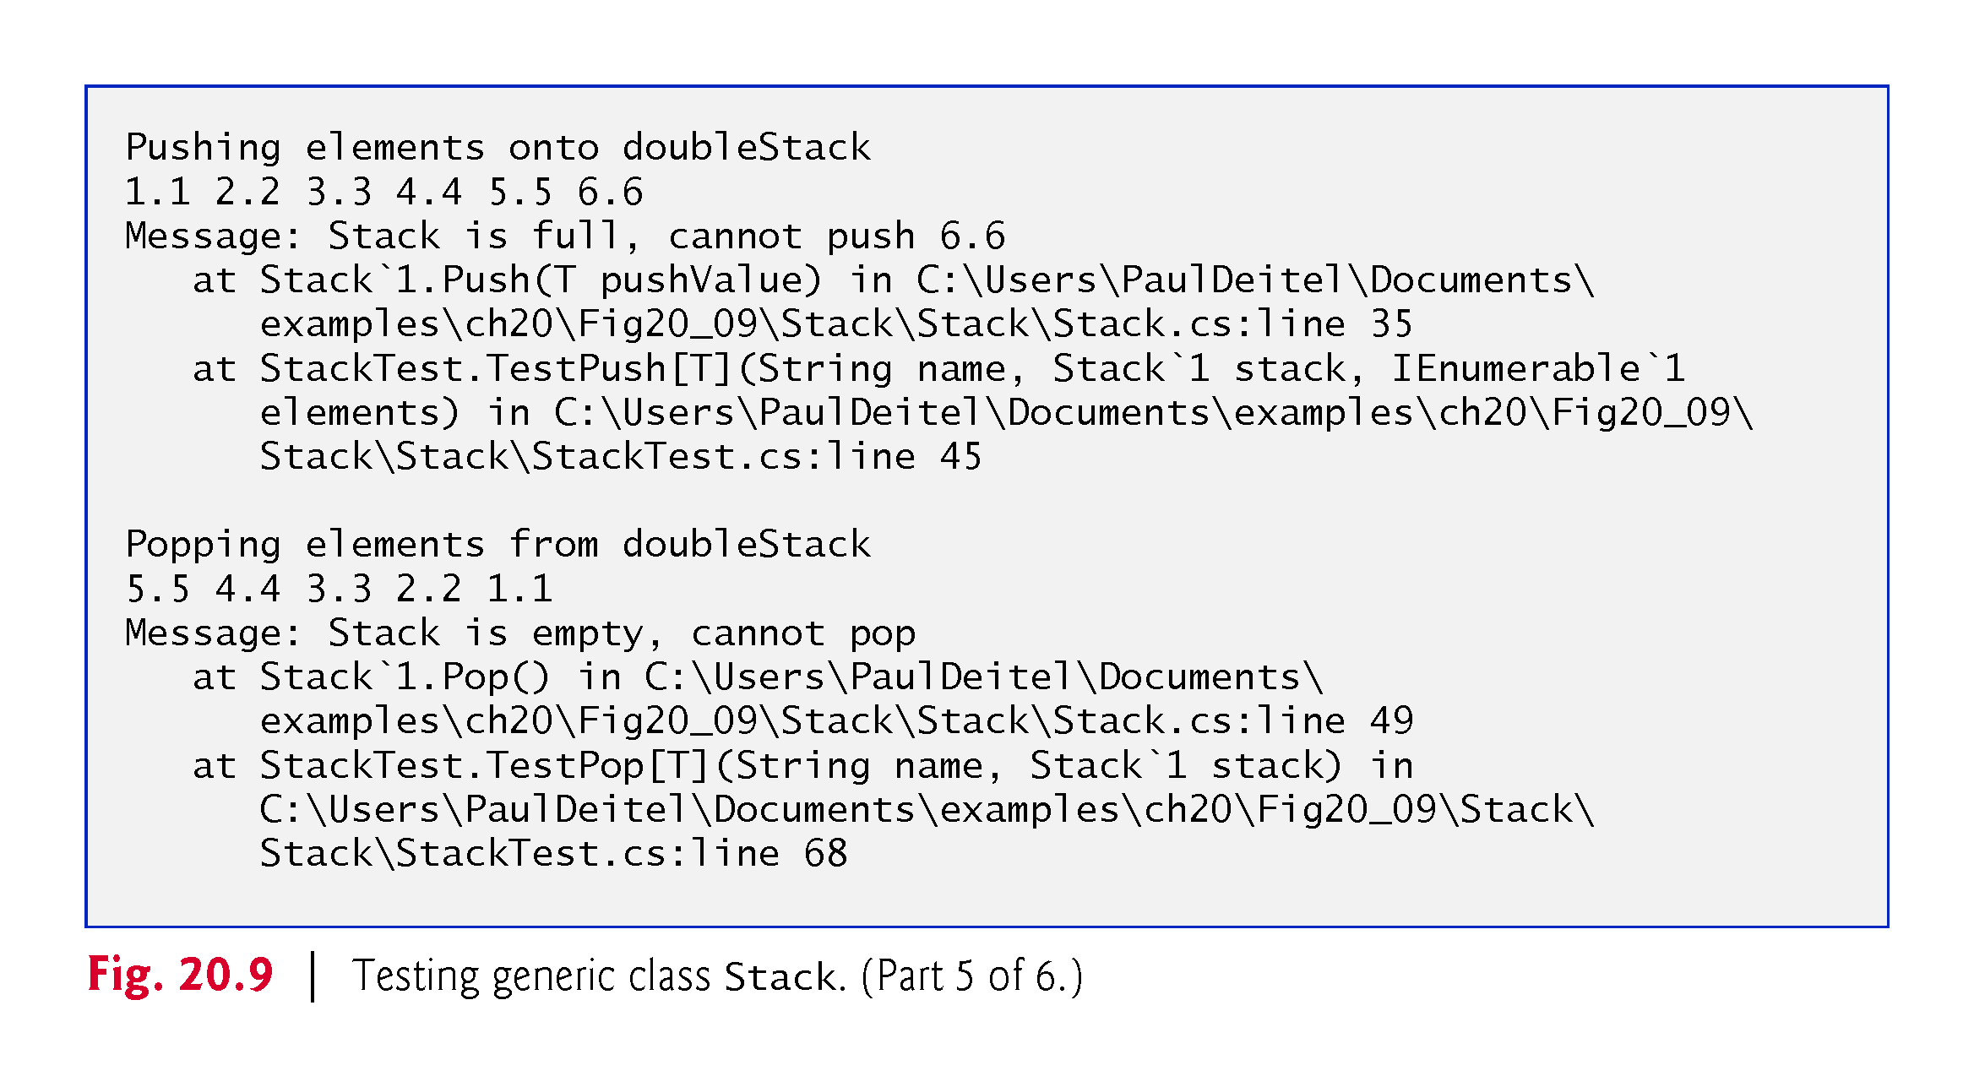

Slide 54
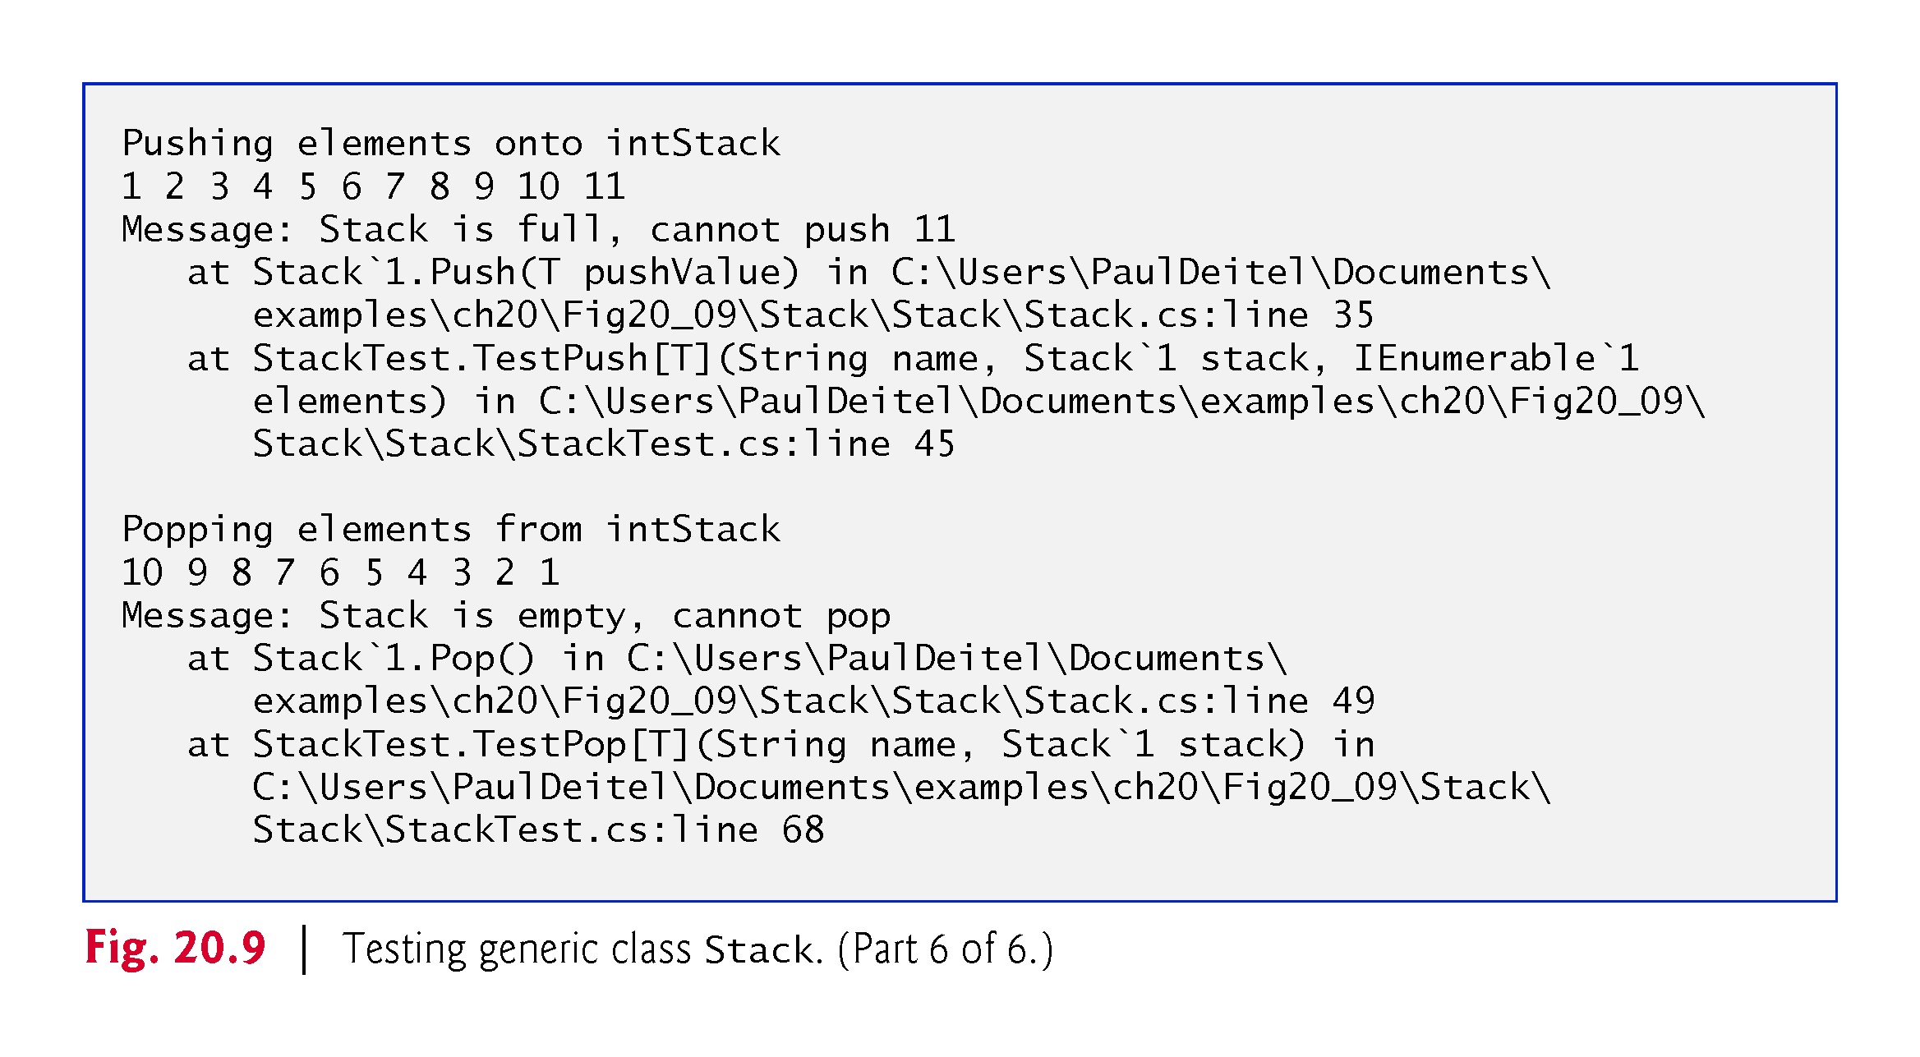

Slide 55
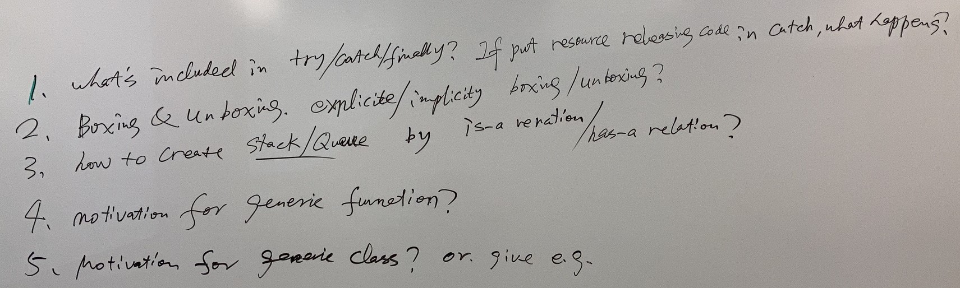
Q&A

Slide 56
Q&A
What's included in try/catch/finally? If put resource releasing code in catch, what happens?
Boxing & Unboxing. Explicit/Implicit boxing/unboxing?
How to create Stack/Queue by is-a relation/has-a relation?
Motivation for generic function?
Motivation for generic class? or give e.g.

