Slide 1
Final Report
E-commerce website

Slide 2
Team members
SI. NO. | Student Name | Roll no.
1 | Manav | 200010026
2 | Manvi | 200020025
3 | Niteesh | 200010035
4 | Tarun | 200010051

Slide 3
Problem statement
Write a C program to simulate an e-commerce website. The program should have
modules:
(a) User login.( Is user seller or consumer.)
(b) If seller, seller Id and username to be entered. Add items to the category.
(c) Display category and items with seller ID and price.
(d) Consumers can search an item, or select an item from the list displayed.
(e) Enter item and quantity with seller ID.
(f) Display total amount and complete information about the purchase details.
Write a C program to simulate an e-commerce website. The program should have
modules:

Slide 4
Whole program has usage of GUI.
Also there is readme in submission which has instructions.

Slide 5
What is GUI ?
Graphical user interface (GUI), a computer program that enables a person to communicate with a computer through the use of symbols, visual metaphors, and pointing devices.
Simply, it helps the user to easily use our page by using symbols

Slide 6
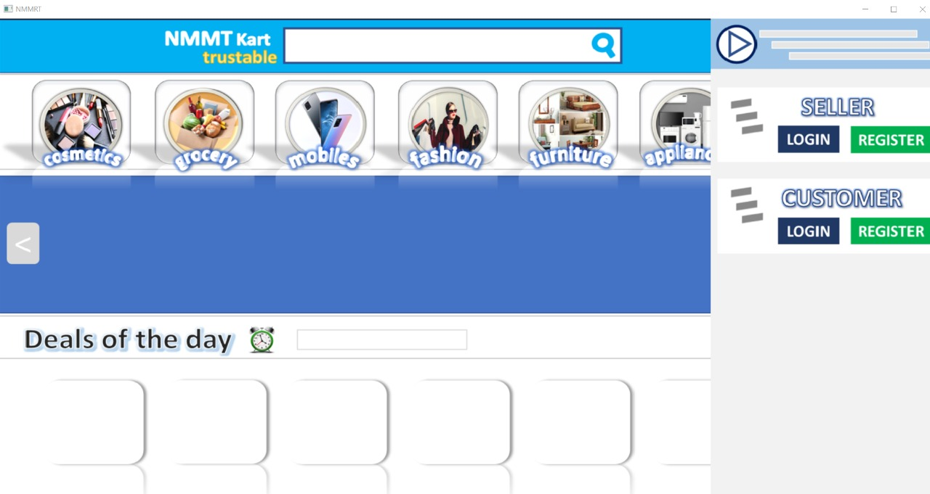
Home page

Slide 7
So as seen our home page has options for login of both seller and customer.
We can also directly search for items.
How searching works is explained later.

Slide 8
User registration
We simply take user ID as input.
Then take password and confirm password
If both match then registration is successful
Else we output that they do not match and redo the entire process.

Slide 9
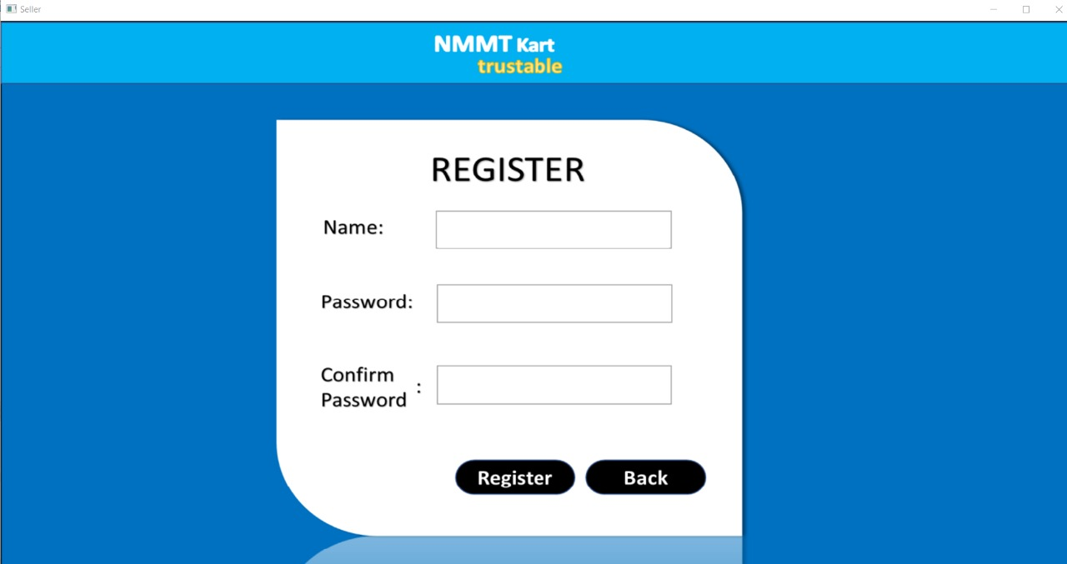

Slide 10
User login
There are separate login for customer and seller.
Both work similarly.
Both have a separate function in which we have a verify function
In verify function which uses customer ID and password.
Now , verify function if password and ID do not match it makes the overall function return name did not match password.
If user ID does not exist then it returns no account exist.

Slide 11
Verify function works by using a integer return type.
If password is wrong then it returns a integer which in parent program denotes wrong password.
If ID does not exist then t returns a integer which in parent program denotes wrong ID.

Slide 12
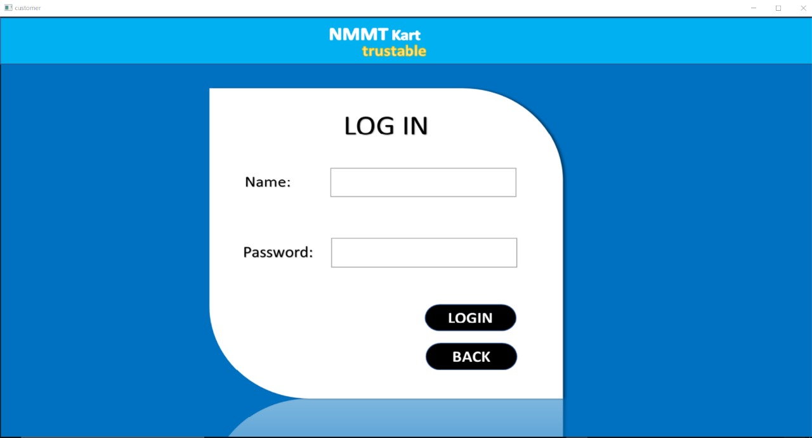

Slide 13
After seller login
We land on a page with seven categories in which we can add item in selected category.
Adding items will be explained later.
It also shows the item added using current seller ID.
Also a logout icon is there.

Slide 14
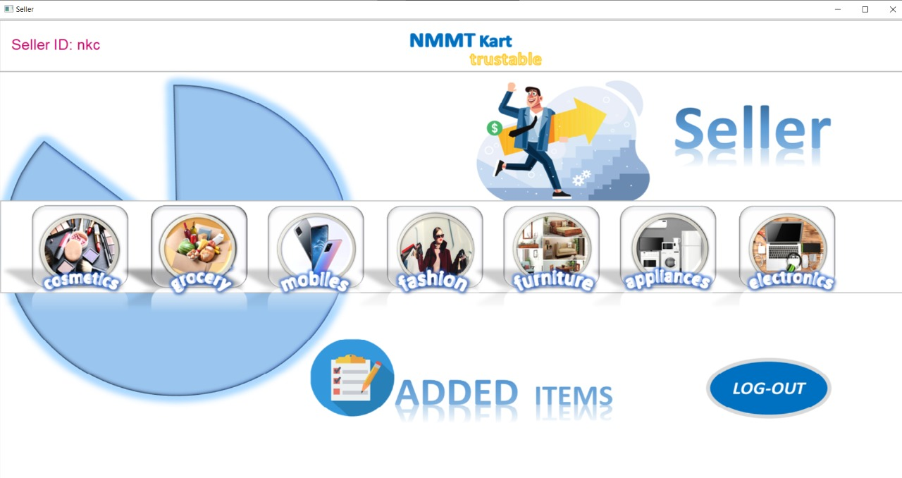

Slide 15
Adding items
Just a simple function.
This stores various information like,
Title,Price,Description.
Which category it belongs to.
Also images are added using GUI

Slide 16
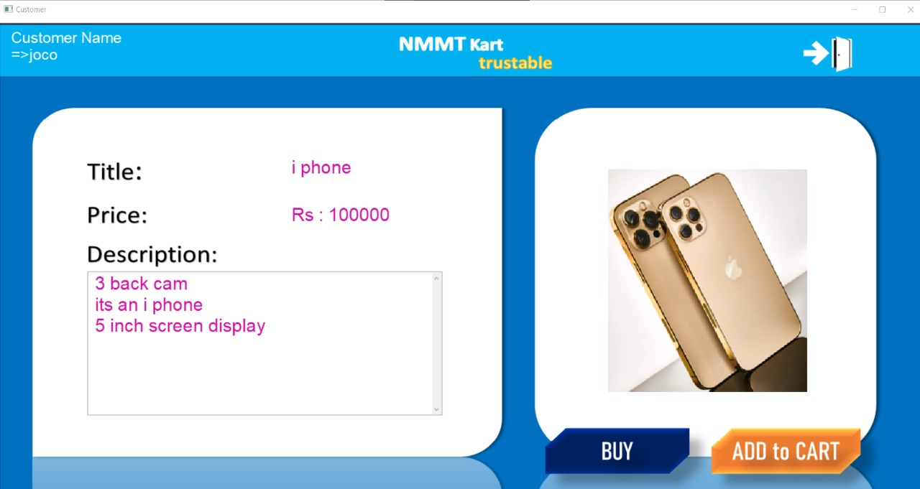

Slide 17
Searching for item
We have a function which takes the name of the item as input then searches in added items.
After this it returns the item which matches the name of the entered item the most.
After finding product user can add the quantity.
Then also viewing cart option is also present

Slide 18
Viewing cart
How this works is that we store the items that the user has added in the cart.
Then whenever that user is done buying the user can simply view the items that are selected

Slide 19
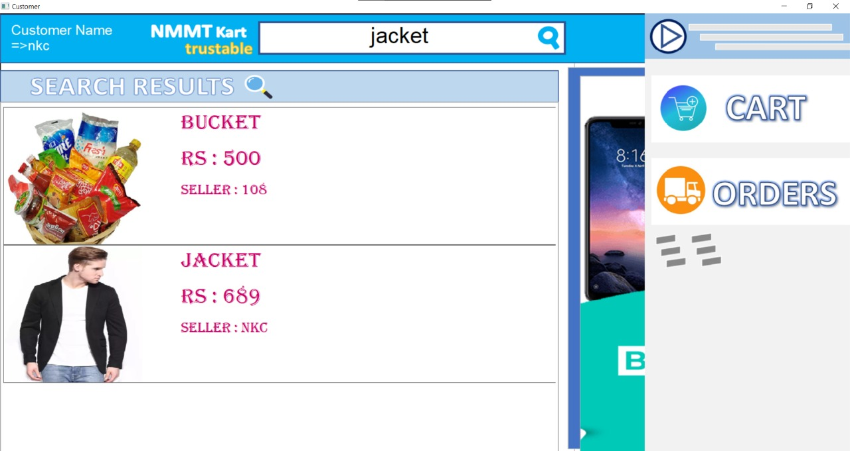

Slide 20
Order details
We can view the items that are been ordered currently .
Also some basic details of order will be visible.

Slide 21
Role of members
SI. NO. | Name | Role
1 | Manav | Report writing and implementing GUI
2 | Manvi | Function to register n login , also to instruct design and appearance of program
3 | Niteesh | Implementing gui & function reading all product & data of all product data files
4 | Tarun | Function to check duplicate entries

