Slide 1

Directory Size Calculator Application
Niteesh Chowdary Medipudi

Slide 2
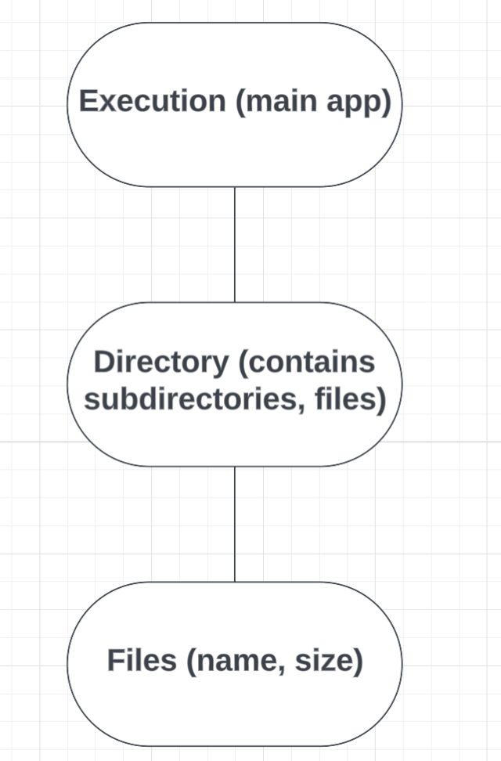
Approach & Design
Used three classes Execution, Directory & Files to create a virtual system using OOPs concepts in Python
Execution: Contains the CLI logic, command handling & test data
Directory: Manages subfolders and files and support logic for cd, ls & size.
Files: Stores the file name and size
Used Recursion to calculate the size of files present in the directory

Slide 3
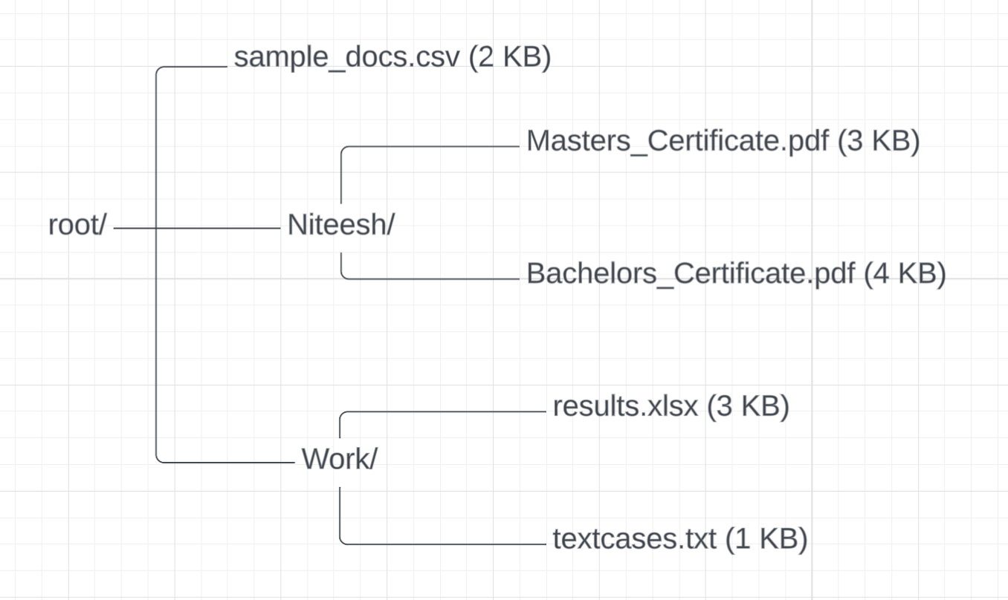
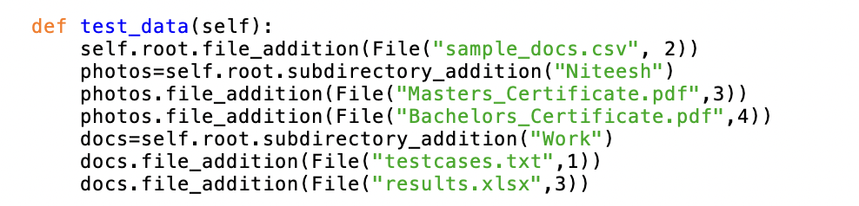
Test data
Predefined the input- without the need for user input
Included mix of input types:
Root-level files
Nested subdirectories
Multiple file types with estimated sizes

Slide 4
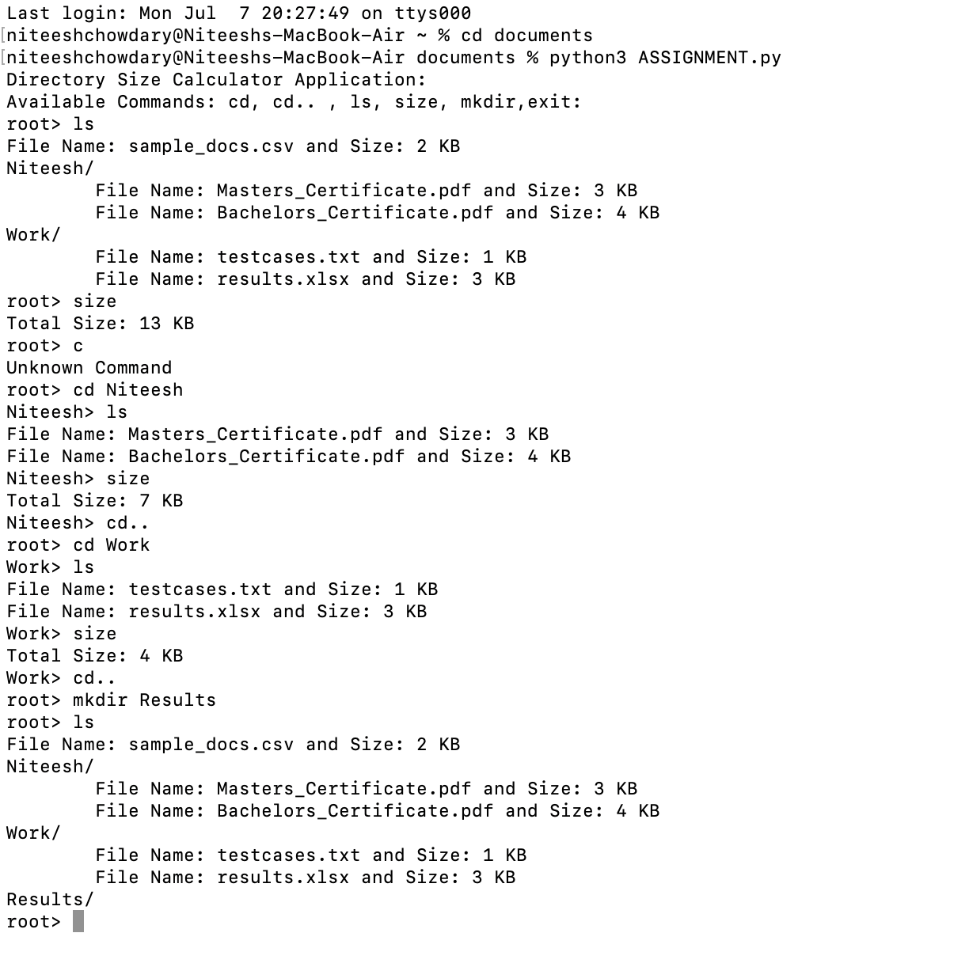
How to Run & Test
Launch a terminal or command prompt
Navigate to the directory containing the Python script
Run the script using the command:
python3 filename.py
The terminal snapshot illustrates various test cases to demonstrate and validate functionality

Slide 5
Thank You

