Slide 1
Wind Energy Project Report (Data Mining and Feature Engineering)
Prepared By:
Adaiyibo Kio and Nitesh Kumar

Slide 2
Data preprocessing
Filtering of data for Turbine State, Power Limitation and Valid Data
Turbine State – 5
Power Limitation – 0
Data Valid – 1
The above filtering reduced the data set from 3.3M to 2.1M observations.

Slide 3
Timeline
Initial exploratory data analysis suggested that id19 – id25, id36, id37, id71 – id78, id84 – id87, and id111 might be important. These were later shown to be temperature measurements correlated to each other and/or ambient temperature.
Further exploratory data analysis suggested that id12 – id14, id26 – 28, id30, id31, id47, id61, id94 – id96, and id141 might be important. These were shown to be various measurements intrinsic to the generator and related to generator speed, power and temperature.
Removal of features that are correlated and similarly distributed with other features included in the model and keep only one of then.
While id5 and id17 were flagged as possibly important by further analysis after the process mentioned above, they are understood to be measurements intrinsic to the internal workings of the turbine, and are excluded from the current analysis.

Slide 4
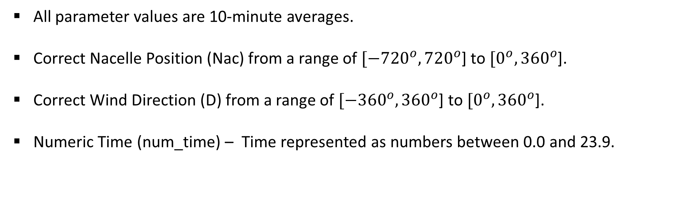
Feature Engineering – Modifying Features
All parameter values are 10-minute averages.
Correct Nacelle Position (Nac) from a range of $[−{720}^{o}, {720}^{o}$] to $[0^{o}, {360}^{o}$].
Correct Wind Direction (D) from a range of $[−{360}^{o}, {360}^{o}$] to $[0^{o}, {360}^{o}$].
Numeric Time (num_time) – Time represented as numbers between 0.0 and 23.9.

Slide 5
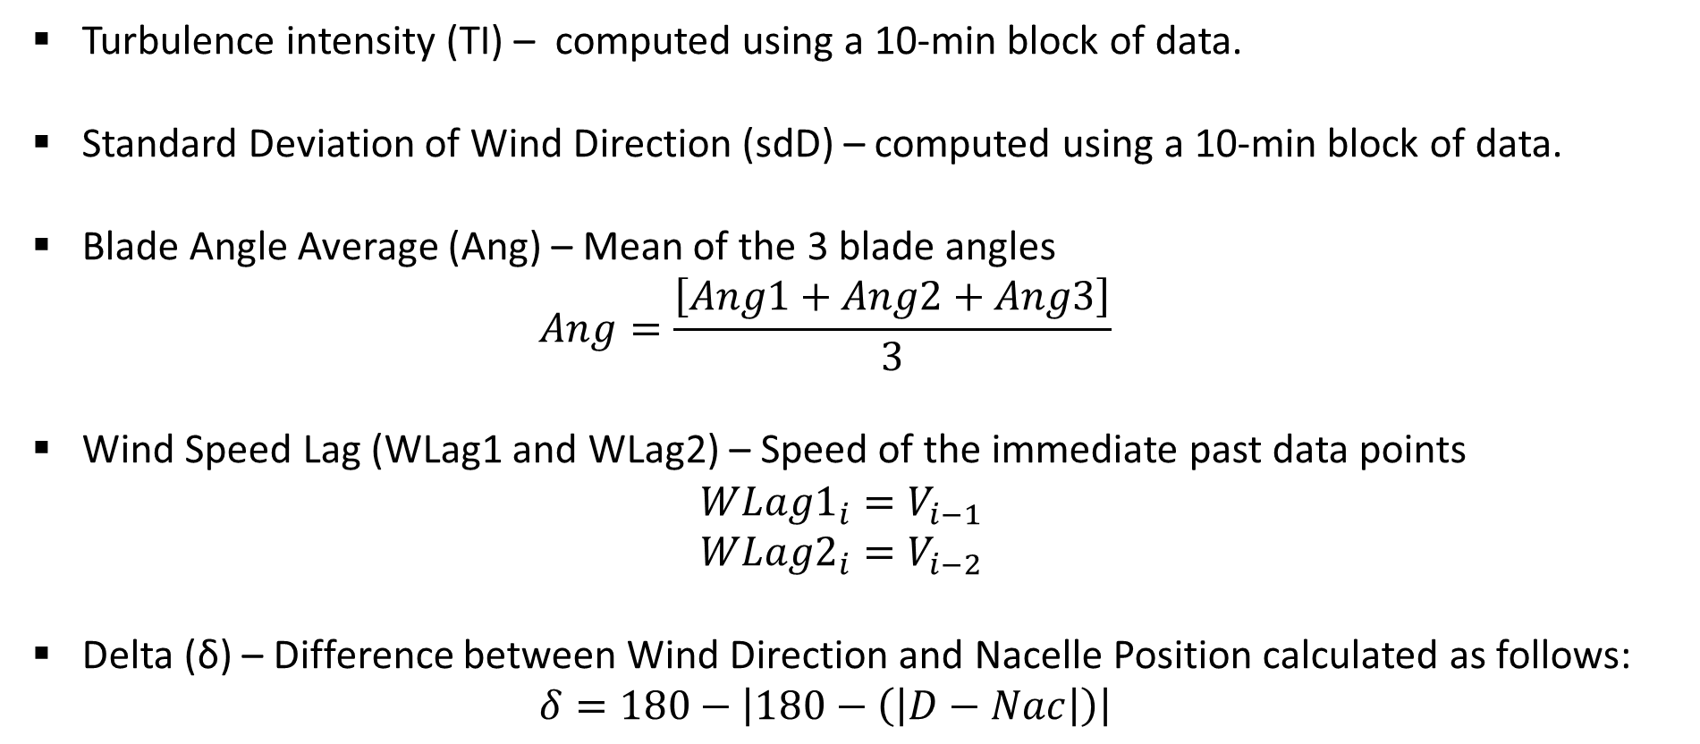
Feature Engineering – New Features
Turbulence intensity (TI) – computed using a 10-min block of data.
Standard Deviation of Wind Direction (sdD) – computed using a 10-min block of data.
Blade Angle Average (Ang) – Mean of the 3 blade angles
$$Ang=\frac{\left[Ang1+Ang2+Ang3\right]}{3}$$
Wind Speed Lag (WLag1 and WLag2) – Speed of the immediate past data points
$$WLag1_{i}=V_{i−1}$$
$$WLag2_{i}=V_{i−2}$$
Delta (δ) – Difference between Wind Direction and Nacelle Position calculated as follows:
$$δ=180−\left|180−\left(\left|D−Nac\right|\right)\right|$$

Slide 6
KNN – All Variables
This data set includes 12 features and Power.
Using Forward Stepwise Selection the results below are obtained.
The Model with 5 predictors is the best model.
Number of Predictors | RMSE (%) | Predictors
1 | 3.974 | W
2 | 2.552 | W | G
3 | 2.097 | W | G | T
4 | 2.070 | W | G | T | Ang
5 | 2.045 | W | G | T | Ang | I
6 | 2.289 | W | G | T | Ang | I | WLag1
7 | 2.514 | W | G | T | Ang | I | WLag1 | WLag2
8 | 2.907 | W | G | T | Ang | I | WLag1 | WLag2 | num_time
9 | 3.335 | W | G | T | Ang | I | WLag1 | WLag2 | num_time | sdD
10 | 3.778 | W | G | T | Ang | I | WLag1 | WLag2 | num_time | sdD | Nac
11 | 4.299 | W | G | T | Ang | I | WLag1 | WLag2 | num_time | sdD | Nac | D
12 | 4.721 | W | G | T | Ang | I | WLag1 | WLag2 | num_time | sdD | Nac | D | delta

Slide 7
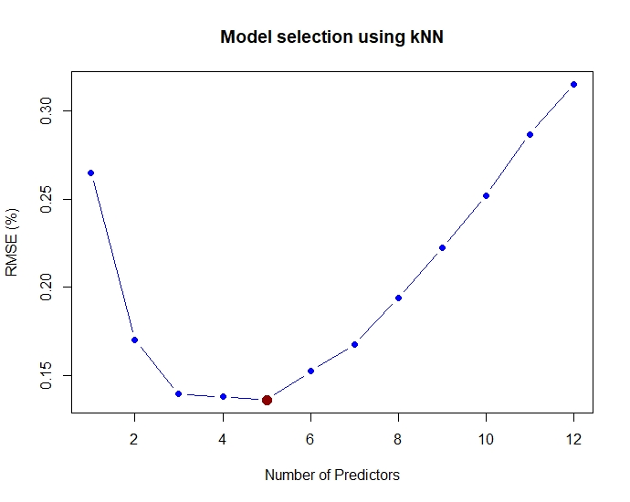
KNN – All Variables
Best model features
W + G + T + Ang + I
Best model RMSE
2.045%

Slide 8
KNN – without Nac
This data set includes 11 features and Power.
Using Forward Stepwise Selection the results below are obtained.
The Model with 5 predictors is the best model.
Number of Predictors | RMSE (%) | Predictors
1 | 3.974 | W
2 | 2.552 | W | G
3 | 2.097 | W | G | T
4 | 2.070 | W | G | T | Ang
5 | 2.045 | W | G | T | Ang | I
6 | 2.289 | W | G | T | Ang | I | WLag1
7 | 2.514 | W | G | T | Ang | I | WLag1 | WLag2
8 | 2.907 | W | G | T | Ang | I | WLag1 | WLag2 | num_time
9 | 3.335 | W | G | T | Ang | I | WLag1 | WLag2 | num_time | sdD
10 | 3.887 | W | G | T | Ang | I | WLag1 | WLag2 | num_time | sdD | delta
11 | 4.346 | W | G | T | Ang | I | WLag1 | WLag2 | num_time | sdD | delta | D

Slide 9
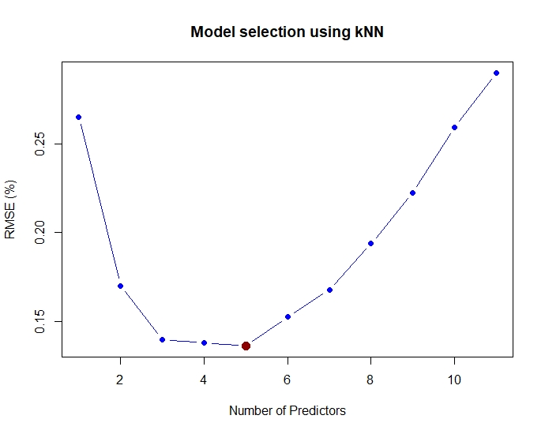
KNN – without Nac
Best model features
W + G + T + Ang + I
Best model RMSE
2.045%

Slide 10
KNN – without G and Ang
This data set includes 10 features and Power.
Using Forward Stepwise Selection the results below are obtained.
The Model with 3 predictors is the best model.
Number of Predictors | RMSE (%) | Predictors
1 | 3.982 | W
2 | 3.271 | W | T
3 | 3.095 | W | T | num_time
4 | 3.353 | W | T | num_time | I
5 | 3.869 | W | T | num_time | I | WLag1
6 | 4.333 | W | T | num_time | I | WLag1 | WLag2
7 | 4.873 | W | T | num_time | I | WLag1 | WLag2 | Nac
8 | 5.494 | W | T | num_time | I | WLag1 | WLag2 | Nac | sdD
9 | 6.167 | W | T | num_time | I | WLag1 | WLag2 | Nac | sdD | delta
10 | 6.623 | W | T | num_time | I | WLag1 | WLag2 | Nac | sdD | delta | D

Slide 11
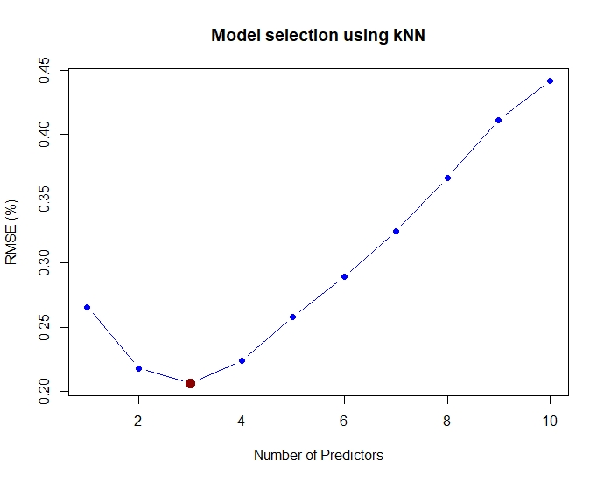
KNN – without G and Ang
Best model features
W + T + num_time
Best model RMSE
3.095%

Slide 12
KNN – without G, Ang, and Nac
This data set includes 9 features and Power.
Using Forward Stepwise Selection the results below are obtained.
The Model with 3 predictors is the best model.
Number of Predictors | RMSE (%) | Predictors
1 | 3.982 | W
2 | 3.271 | W | T
3 | 3.095 | W | T | num_time
4 | 3.353 | W | T | num_time | I
5 | 3.869 | W | T | num_time | I | WLag1
6 | 4.333 | W | T | num_time | I | WLag1 | WLag2
7 | 5.003 | W | T | num_time | I | WLag1 | WLag2 | sdD
8 | 5.748 | W | T | num_time | I | WLag1 | WLag2 | sdD | delta
9 | 6.285 | W | T | num_time | I | WLag1 | WLag2 | sdD | delta | D

Slide 13

KNN – without G, Ang, and Nac
Best model features
W + T + num_time
Best model RMSE
3.095%

Slide 14
Summary of Models
Results presented with the RMSE values of the best model in each class.
The best models containing G and Ang contain 5 variables.
The best models excluding G and Ang contain 3 variables.
 | With G and Ang | Without G and Ang
With Nac | W + G + T + Ang + I RMSE = 2.045% | W + T+ num_time RMSE = 3.095%
Without Nac | W + G + T + Ang + I RMSE = 2.045% | W + T+ num_time RMSE = 3.095%

Slide 15
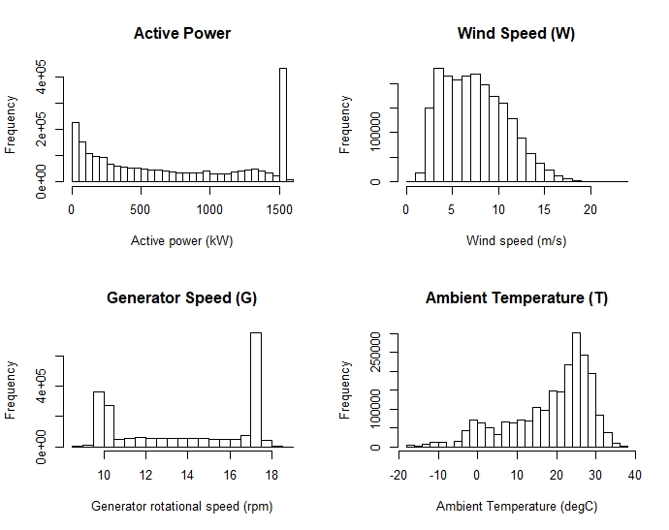
Variable Distributions

Slide 16
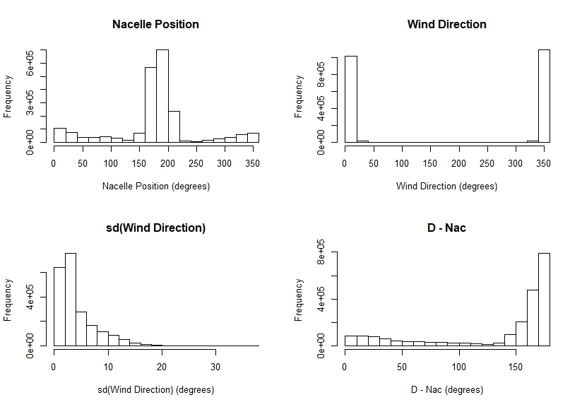
Variable Distributions

Slide 17
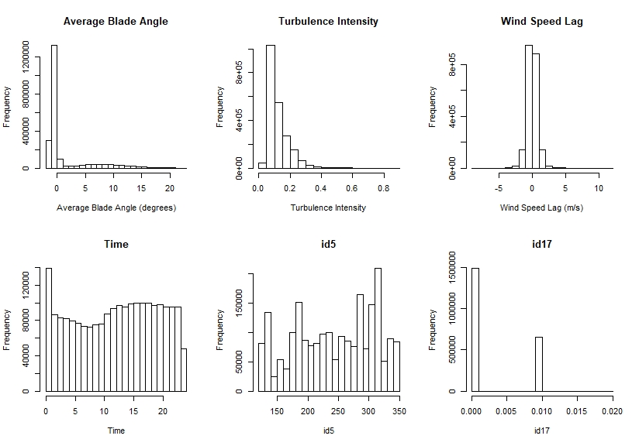
Variable Distributions

